Slide 1
Text Classification for Hate Speech Detection
Mohammad Ayham Nashar
03.07.2025

Slide 2
Introduction
Problem
Detection of hate speech and offensive language in tweets
Task
Multiclass text classification

Slide 3
Literature Review
Hate Speech and Offensive Language Dataset: (Davidson et al., 2017)
~25,000 tweets
3 classes (hate speech, offensive language and neither)
C-LSTM for text classification: Zhou et al. (2015)
BERT for NLP: Devlin et al. (2018)

Slide 4
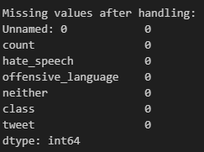
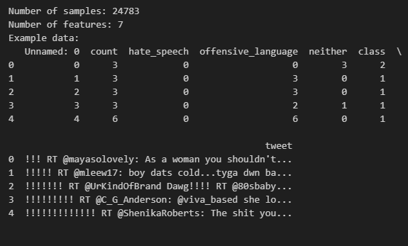
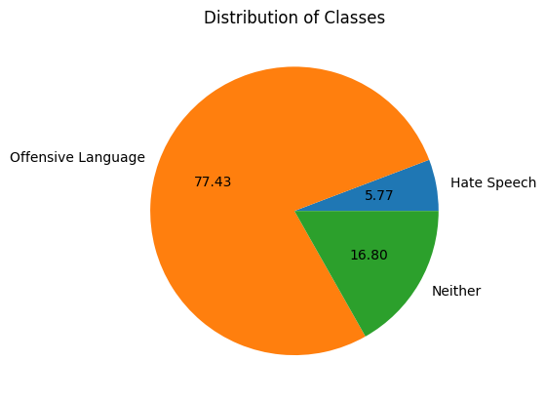
Dataset Characteristics

Slide 5
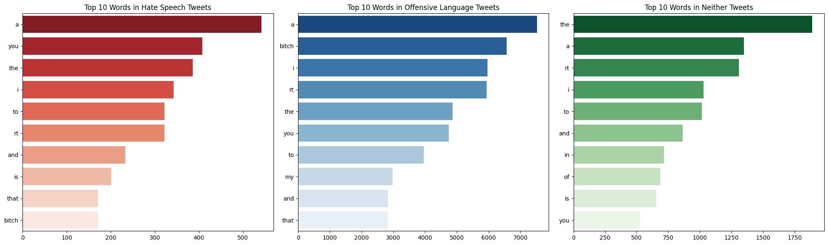
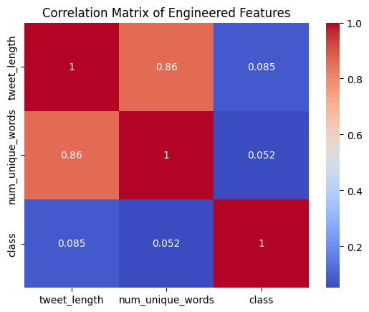

Slide 6
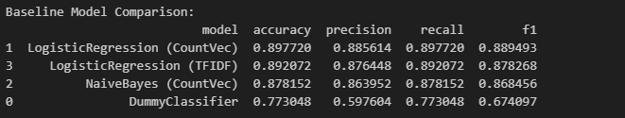
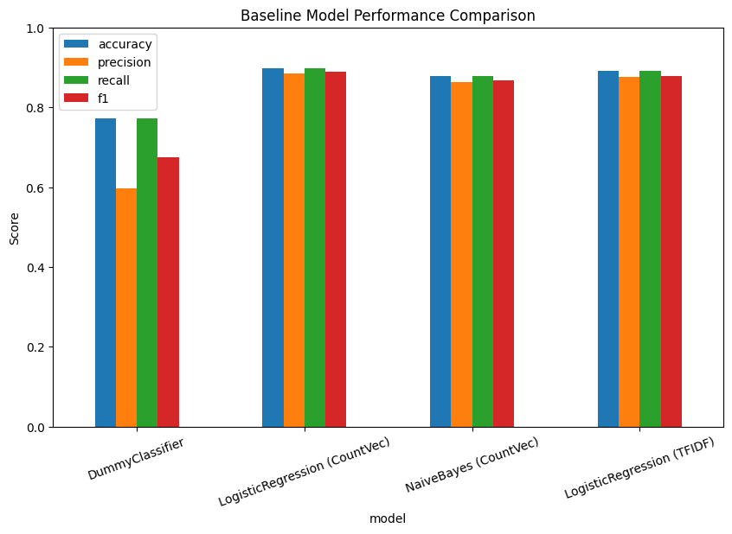
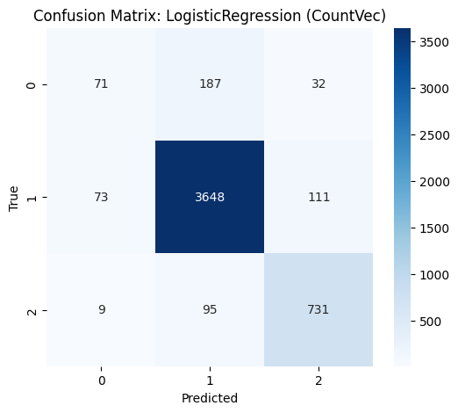
Baseline Model

Slide 7
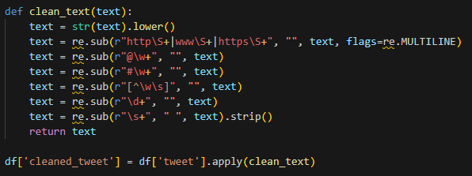
Model Selection & Feature Engineering

Slide 8
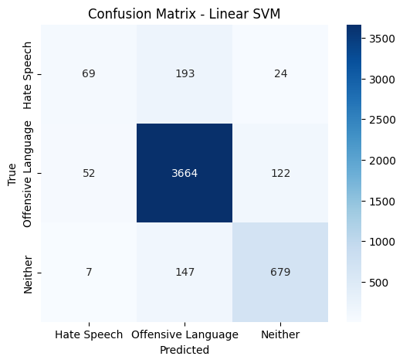
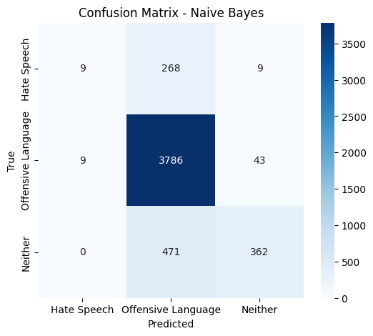

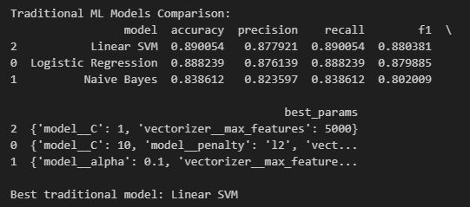
Traditional ML Models

Slide 9
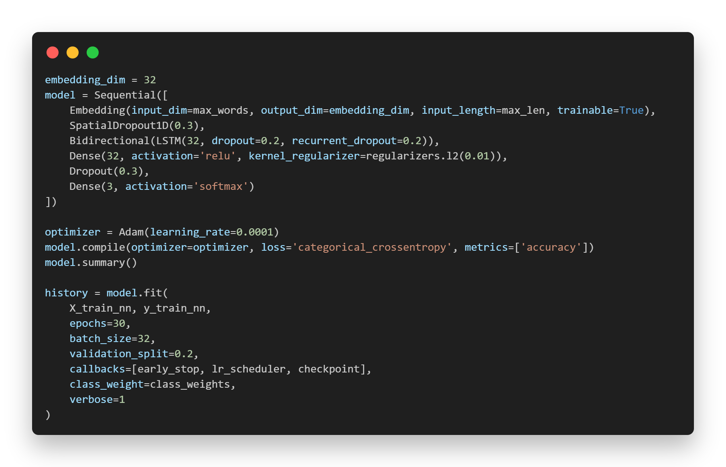
Neural Network Model & Training

Slide 10
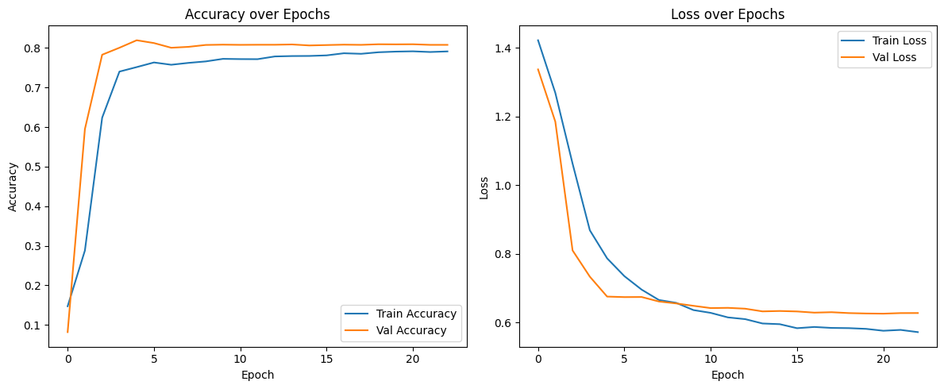
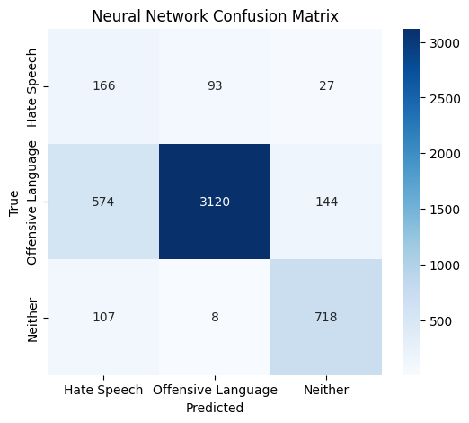
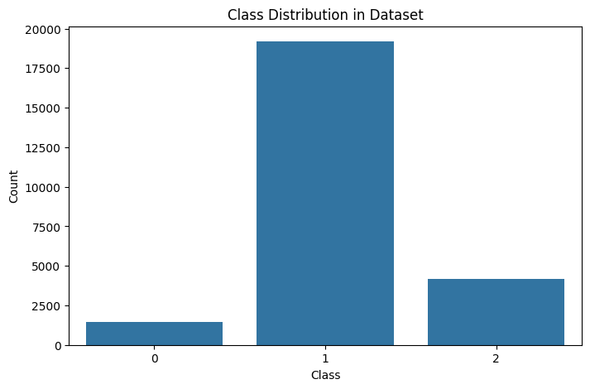
Neural Network Results

Slide 11
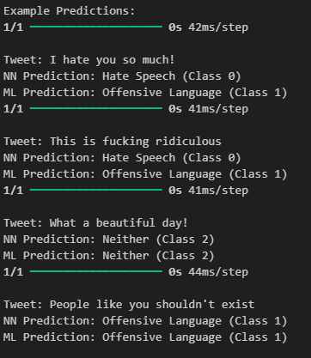
Testing

Slide 12

Challenges and Errors
Overfitting
Class Imbalance
Misclassifications
Neural Network Underperformance

Slide 13
Discussion
NN underperform?
Data imbalance
Simpler models (SVM) may be better for small/medium datasets
Feature engineering differences
Comparative analysis?
ML models are strong baselines for text classification
NN may need more data, tuning, or pre-trained embeddings

Slide 14
Conclusion and Future Work
Summary
Baseline models are strong for small, structured datasets.
Deep learning can be competitive with more data or advanced architectures.
Next Steps
Experiment with BERT or other transformer models.
Explore ensemble methods and further feature engineering.

Slide 15
Präsentation Team 4
Questions?
Thank you for your attention ☺

