Slide 1
AIN-3009 MLOps Term Project
Predictive Maintenance
End-to-End ML Lifecycle on Azure ML + MLflow
Course
AIN-3009 Delivering AI Applications with MLOps
Instructor
Dr. Gökşin Bakır
Student
Ayhan Gurbangeldiyev · 2020053
A complete MLOps lifecycle project: from dataset and experiments to registry, deployment, and monitoring.
Dataset
Training
Tuning
Registry
Endpoint
Monitoring
3.4%
0.974
v1
Succeeded
failure rate
best CV ROC-AUC
registered model
endpoint state
5-minute technical project presentation
1/8

Slide 2
AIN-3009 MLOps Term Project
Project Objective
What the assignment asks us to demonstrate
1
Experiment tracking
4
Performance monitoring
Log parameters, metrics, artifacts, and outputs with MLflow.
Track model behavior over time with drifted batches.
2
Model training and tuning
5
Model registry
Train baselines and tune hyperparameters with traceable runs.
Version the model and manage Staging → Production lifecycle.
3
Model deployment
Package the model and serve predictions through an endpoint.
Project framing
The rest of the deck maps each requirement to a concrete project artifact: code, metrics, MLflow logs, Azure registry, endpoint evidence, and monitoring charts.
Tracking
Training/Tuning
Registry
Deployment
Monitoring
2/8

Slide 3
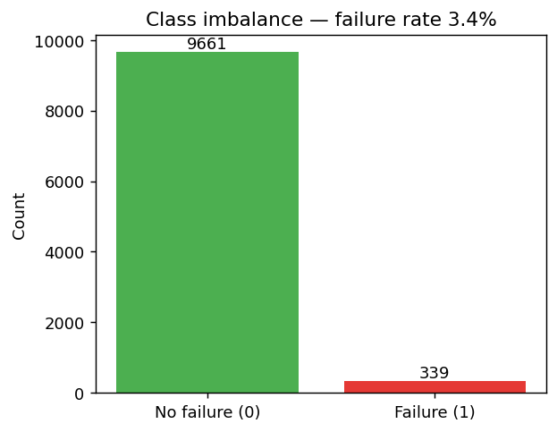
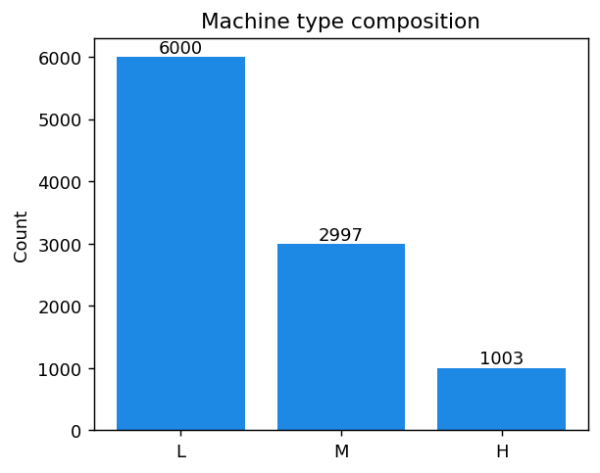
AIN-3009 MLOps Term Project
Dataset & Problem Framing
AI4I 2020 predictive-maintenance data: imbalanced binary classification
What data did we use?
Source: AI4I 2020 Predictive Maintenance dataset
10,000 machine telemetry records
Target: Machine failure (0/1)
Failure rate is only 3.4%, so accuracy is misleading
Leakage columns removed: TWF, HDF, PWF, OSF, RNF
Evaluation focus: ROC-AUC, PR-AUC, recall, and F1 instead of raw accuracy.
Tracking
Training/Tuning
Registry
Deployment
Monitoring
3/8

Slide 4
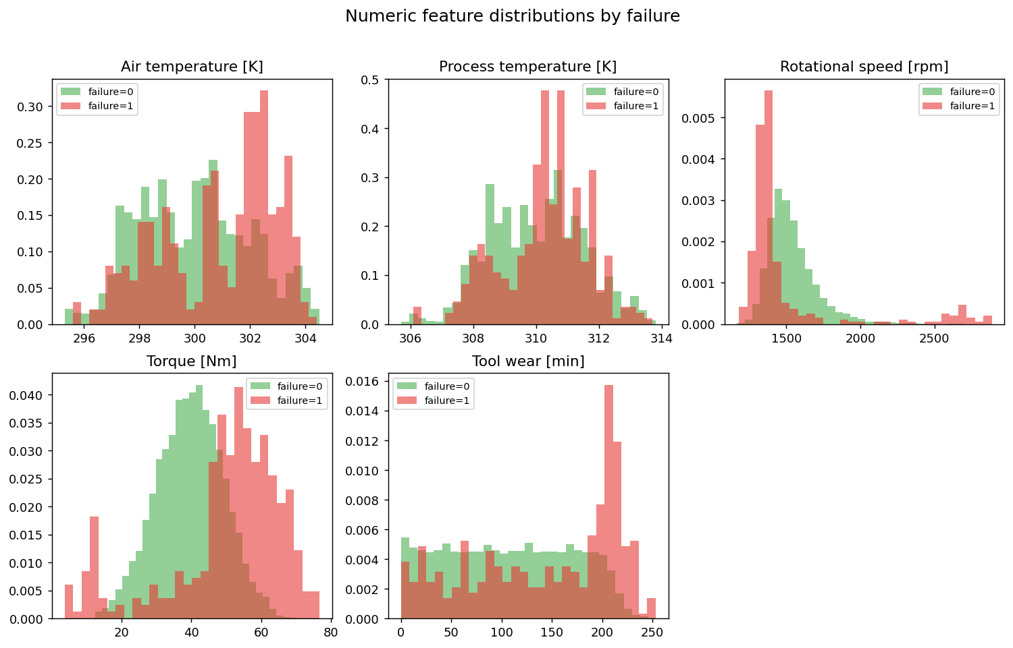
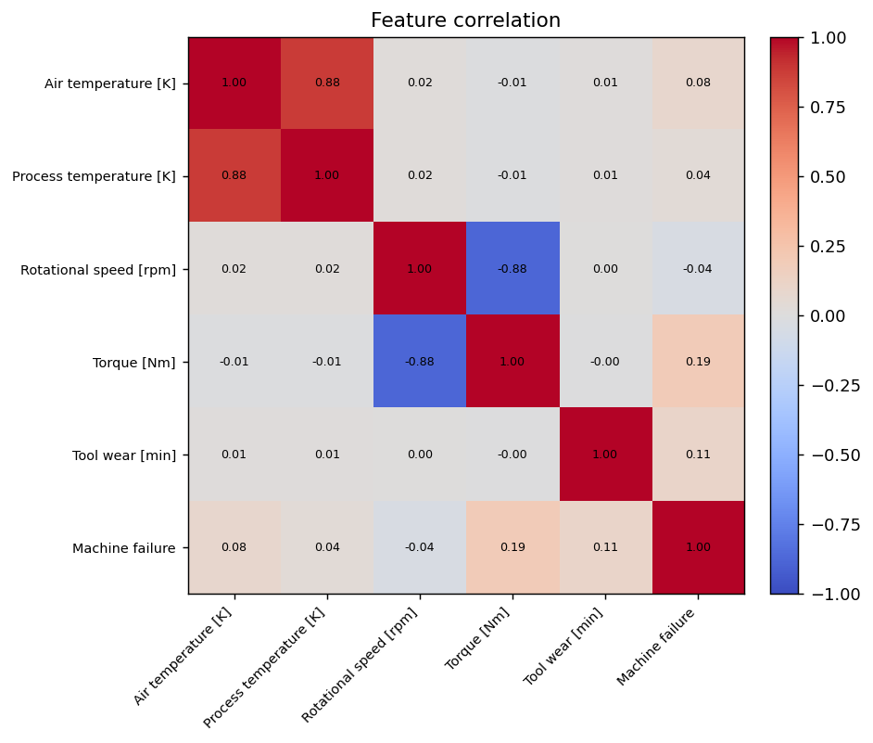
AIN-3009 MLOps Term Project
Data Preparation & EDA
Preprocessing is part of the model artifact, not a manual side step
Preprocessing pipeline
Numeric features → StandardScaler
The scikit-learn Pipeline serializes preprocessing with the estimator, so training and serving use the same transformations.
Machine Type → OneHotEncoder
Tracking
Training/Tuning
Registry
Deployment
Monitoring
4/8

Slide 5
AIN-3009 MLOps Term Project
Architecture: Local Training, Cloud Lifecycle
Azure credit is used for shared MLOps infrastructure, not expensive training compute
Azure ML
Workspace
Model Registry
Staging → Production
Local machine
train + tune
MLflow
Tracking URI
Monitoring
metrics → MLflow
Managed Online
Endpoint /score
Stores: experiments, parameters, metrics, artifacts, registered models, and endpoint state.
Tracking
Training/Tuning
Registry
Deployment
Monitoring
5/8

Slide 6
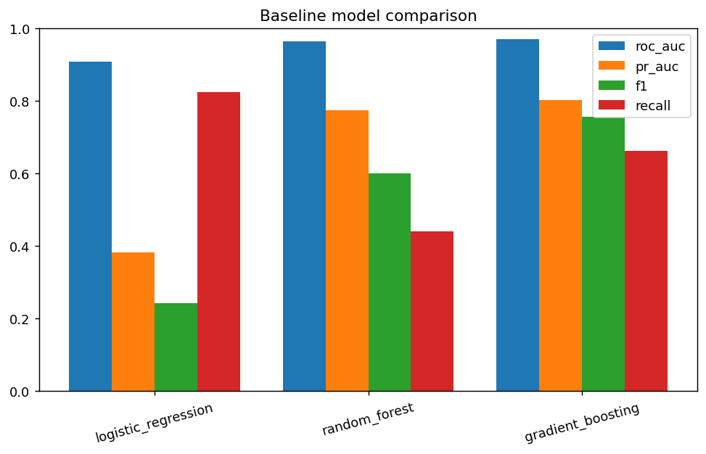
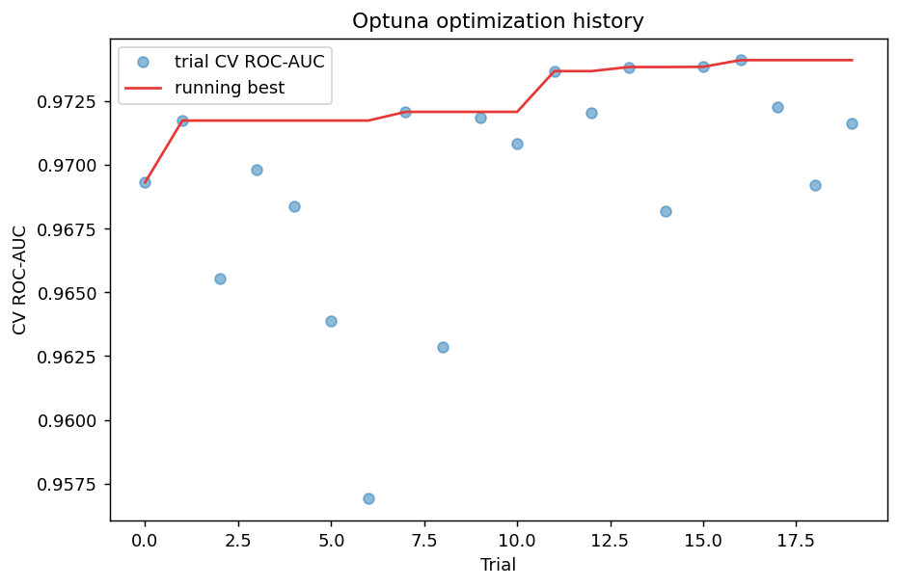
AIN-3009 MLOps Term Project
Training, Tracking & Tuning
Every model run and Optuna trial is traceable in MLflow
20
0.974
0.44 → 0.77
MLflow logs
Optuna trials
Best CV ROC-AUC
Recall lift
parameters, metrics, classification report, confusion matrix, serialized model artifact
Tracking
Training/Tuning
Registry
Deployment
Monitoring
6/8

Slide 7
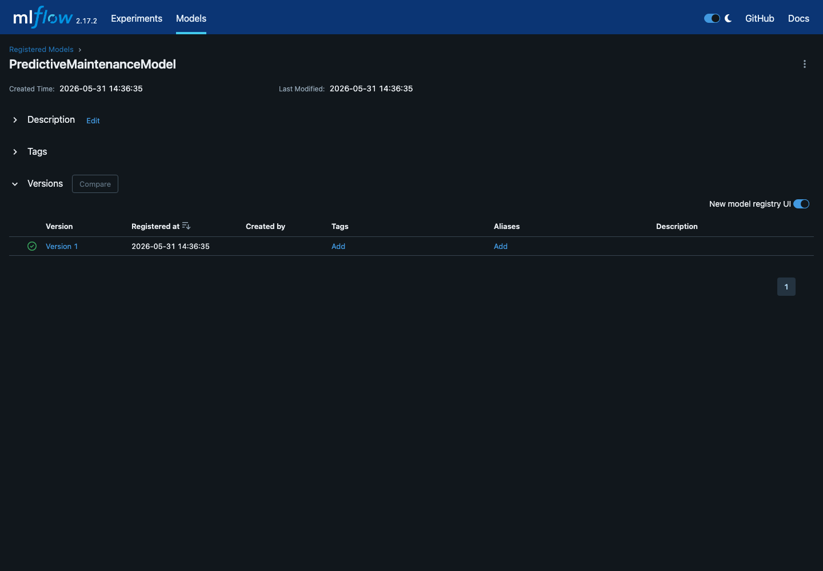
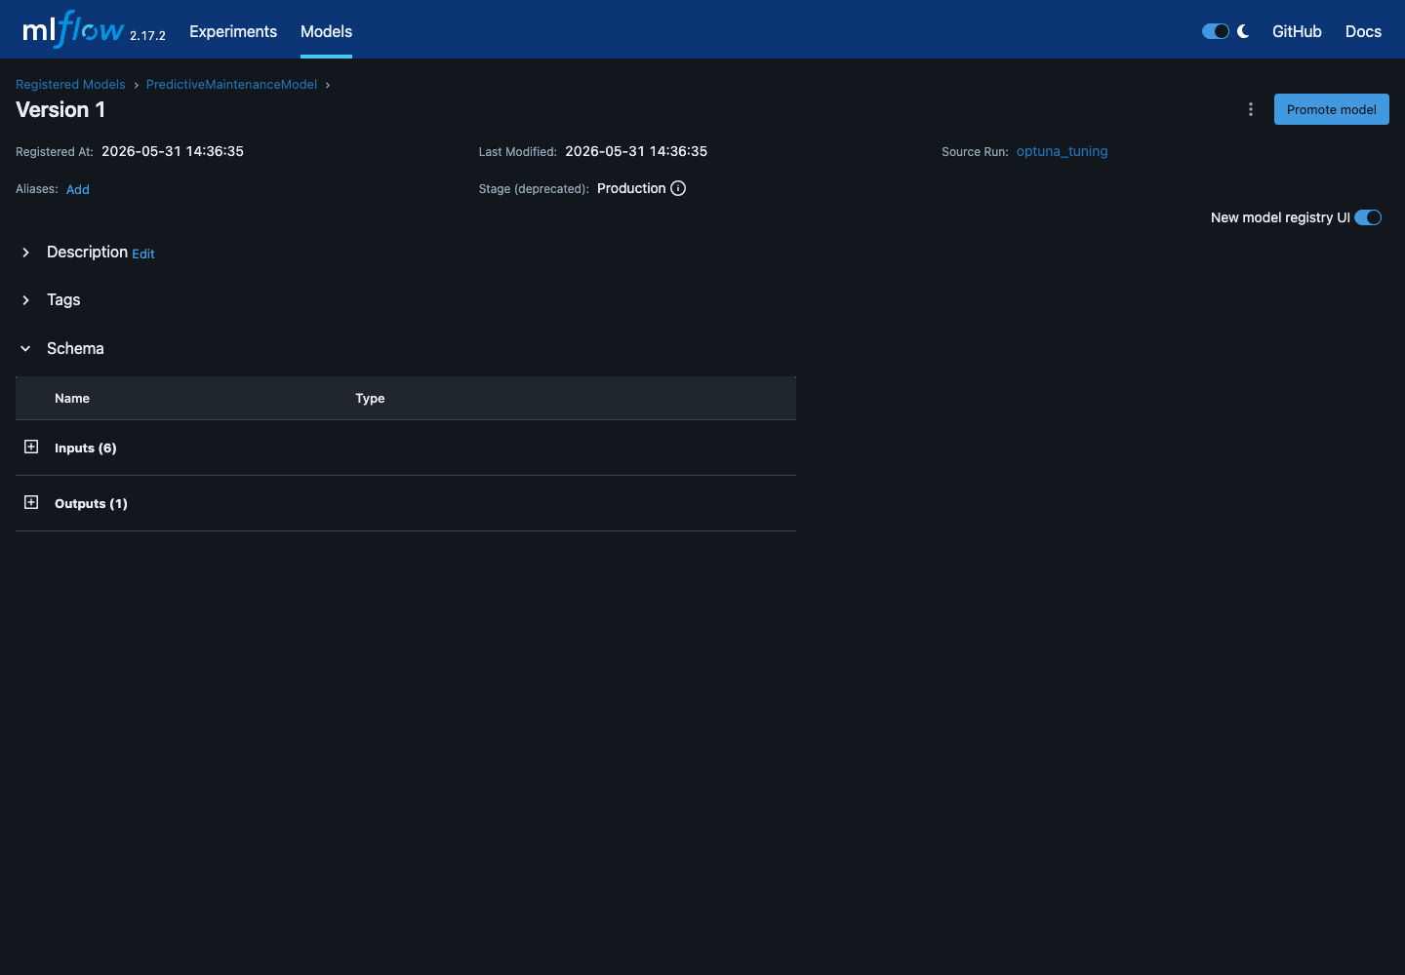
AIN-3009 MLOps Term Project
Registry, Deployment & Pipeline Automation
The model becomes a versioned, deployable asset
PredictiveMaintenanceModel
Registered model
1
Staging → Production
Version
Lifecycle
Succeeded
Endpoint state
Airflow DAG orchestration
validate
train
tune
register
monitor
Tracking
Training/Tuning
Registry
Deployment
Monitoring
7/8

Slide 8
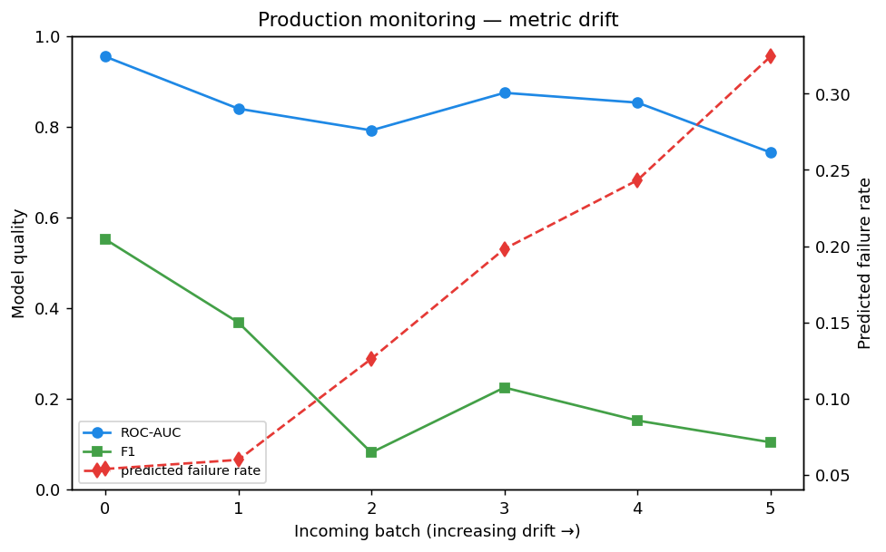
AIN-3009 MLOps Term Project
Monitoring Closes the MLOps Loop
Metric drift shows when retraining should be considered
0.914
0.766
Batch 0 ROC-AUC
Batch 5 ROC-AUC
4% → 37%
Predicted failure rate
Course objectives covered
✓
Experiment tracking
✓
Training and tuning
✓
Registry and deployment
✓
Monitoring and drift tracking
Final takeaway: this is not a notebook-only model; it is an end-to-end MLflow + Azure ML lifecycle demonstration.
Tracking
Training/Tuning
Registry
Deployment
Monitoring
8/8

