Slide 1
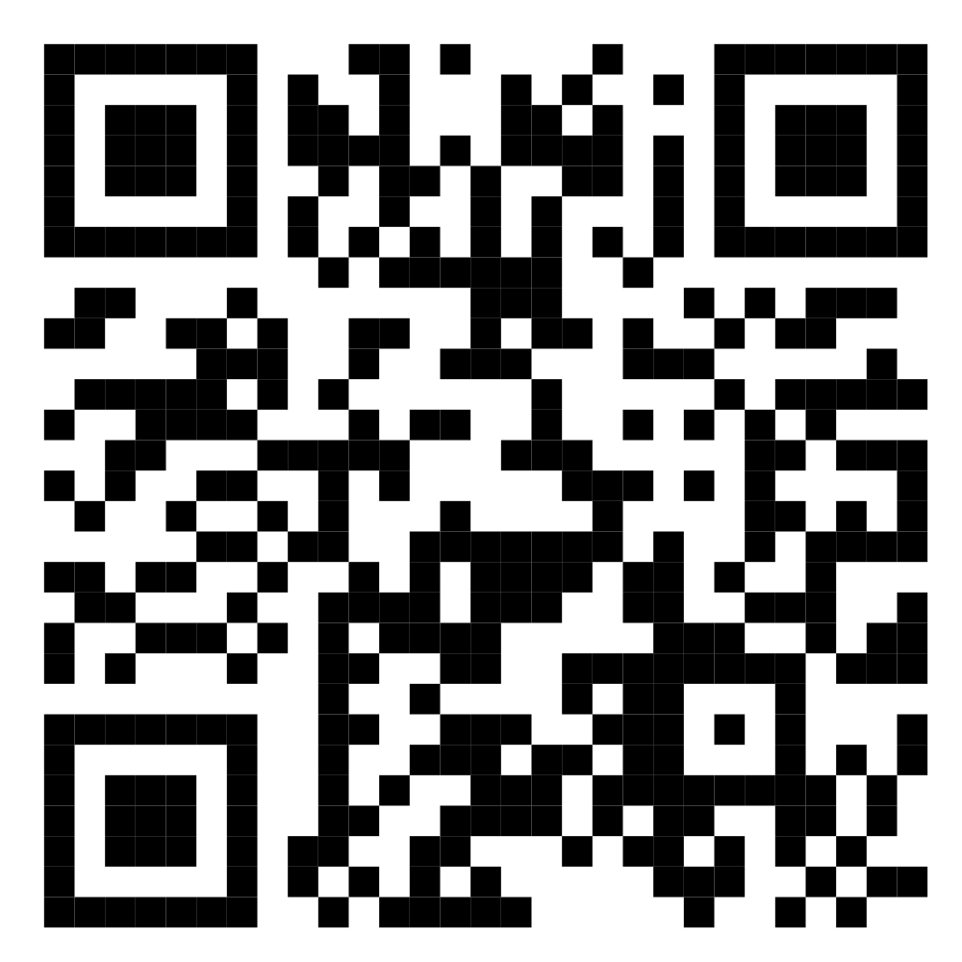
ADLASB GRAND FINALE
DLAS
Digital Legal Aid System
Five Doors, One Record · ADLASB Grand Finale
TRY THE PROTOTYPE
legal-tech-rosy.vercel.app
Scan to open the prototype
Fictional data only · 16699 is a web simulation
Notes:
TIME 0:00–0:15 (15 s).
Say: "Can one digital legal-aid system serve five very different citizens, seven provider roles and eleven technical challenges without splitting the case record or replacing human judgment? This is DLAS: five doors, one record."
Point at the QR code: the jury can open the live prototype now. All data is fictional; 16699 is a web simulation, not a live call.
Before the pitch: open the site about 5 minutes early so the API is awake, and test-scan this slide from the room with two phones.

Slide 2





One system, not 23 islands
5 + 7 + 11 = 23
citizens + provider roles + technical challenges = 23 mandatory items
5 DOORS IN
7 PROVIDER ROLES
16699 voice (simulated)
DLAO officer
ONE AUTHORITATIVE RECORD
Application ID
created at submission
Mediator
Low-data · light mode
16699 helpline agent
Web / mobile PWA
UDC entrepreneur
Case ID
only after a human DLAO officer accepts
Panel lawyer
UDC assisted access
Facts, provenance, consent, safe contact, documents, tasks and audit stay on this record.
Receiving DLAO
DLAO walk-in / referral
Case-support staff
LAYER 1
Citizen Access
LAYER 2
Service Delivery
LAYER 3
Technical Capability
LAYER 4
Governance & Trust
Notes:
TIME 0:15–1:00 (45 s).
Left: five doors — the 16699 voice route (simulated on the web), a low-data light mode, web/mobile PWA, assisted access at a UDC, and DLAO walk-in or referral. Every door writes to the same record.
Centre: the Application ID is created at submission. The Case ID exists only after a human DLAO officer accepts. Facts, provenance, consent, safe contact, documents, tasks and audit stay on that one record — nobody re-enters the story.
Right: the seven provider roles all work on that record, each seeing only what their role allows.
Bottom: the four layers the challenge asks for. 5 citizens + 7 roles + 11 technical challenges = 23 mandatory items, shown through six connected flows instead of 23 separate demos.

Slide 3

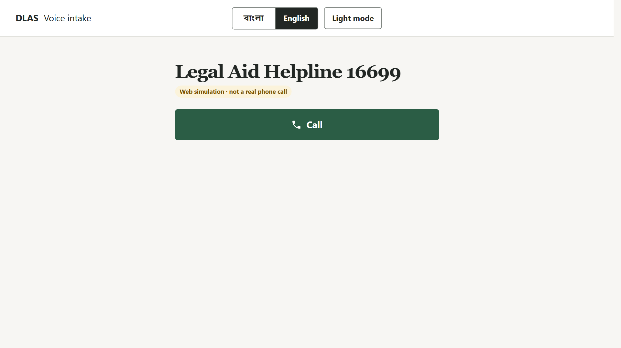

FLOW 1 OF 6
ONE RECORD
Application ID at submission · no Case ID yet
Safe voice intake
CITIZENS
A1 Moyuri
A2 Ripon (representative)
PROVIDERS
B3 16699 helpline
B1 DLAO officer
MODULES
T5 Bangla intake agent
1
Ripon calls for his sister Moyuri
38 recorded Bangla prompts guide the call; he answers by voice or keypad. Every fact stays marked representative-reported.
2
Read-back before submit
The caller corrects any field. The call ends with an Application ID and a 6-digit status PIN.
3
The wrong person answers
The officer's neutral script reveals nothing; the attempt is logged and a safer follow-up task appears.
Screen: /voice
Human decides: the DLAO officer verifies safety, identity and eligibility. The AI never sets priority or eligibility.
Notes:
TIME 1:00–2:00 (1 min). Covers A1 Moyuri, A2 Ripon, B3 helpline, B1 DLAO officer, T5.
Click path: open /voice → Call. Press 1 (complaint), then 2 (calling as a representative). Give fictional Ripon as caller and brother, fictional Moyuri as the victim, and the district. Press 2 for "NID not known", give the fictional account, press 2 for no current safety risk. Choose a safe contact route.
At read-back, correct one field, then press 1 to submit: the call reads out the Application ID and the 6-digit status PIN. There is no Case ID yet.
Sign in as the DLAO officer, search the exact Application ID: representation, applicant confirmation pending, representative-reported facts, the review task.
Click "Simulate call: unknown person answers": the neutral words reveal nothing; the attempt is logged with a safer follow-up task.
Say honestly: the keyboard-only path is tested; validation with a blind user is still pending, and Moyuri's own confirmation screen is not built yet.

Slide 4
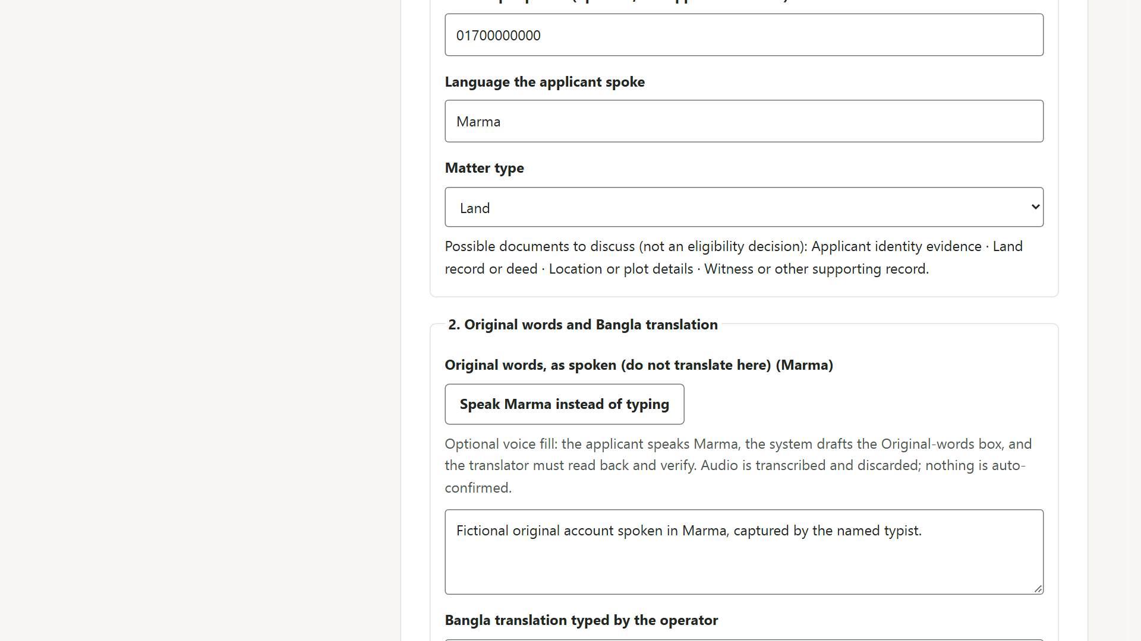
FLOW 2 OF 6
ONE RECORD
Same Application · original and translation kept
Assisted intake at a UDC
CITIZENS
A4 Nuching Marma
PROVIDERS
B4 UDC entrepreneur
B1 DLAO officer
MODULES
T6 Document agent
T10 Low-bandwidth PWA
1
Everyone's role is recorded
Applicant, helper, translator and typist stay separate. The helper's phone never becomes the applicant's contact.
2
Marma original, Bangla translation
Both versions are kept, with who said and who confirmed each.
3
Cited document briefing
AI summarises; every point quotes its source line. The unreadable deed is flagged, not guessed.
Screen: /assisted
Human decides: the owning DLAO officer checks each cited point and approves the briefing with a reason.
Notes:
TIME 2:00–3:00 (1 min). Covers A4 Nuching, B4 UDC entrepreneur, T6 document agent, T10 low-bandwidth PWA. (Offline sync, T9, is kept for the Bad Day slide.)
Click path: sign in as the UDC operator → Assisted intake and offline drafts. Read the free-service notice, enter a local passphrase, select "Load fictional Nuching example".
Show the separate applicant / helper / translator / typist roles, the Marma original next to the Bangla translation, consent and confirmation states, and the safe contact (the helper's phone is not the applicant's contact).
Sign in as the DLAO officer, open the Application, upload the six fictional text samples and generate the provisional document briefing. Click "Open source" on one quoted point. Show the missing witness item and the unreadable deed flagged as uncertain.
Toggle Light mode: the shell stays usable on a weak connection.

Slide 5
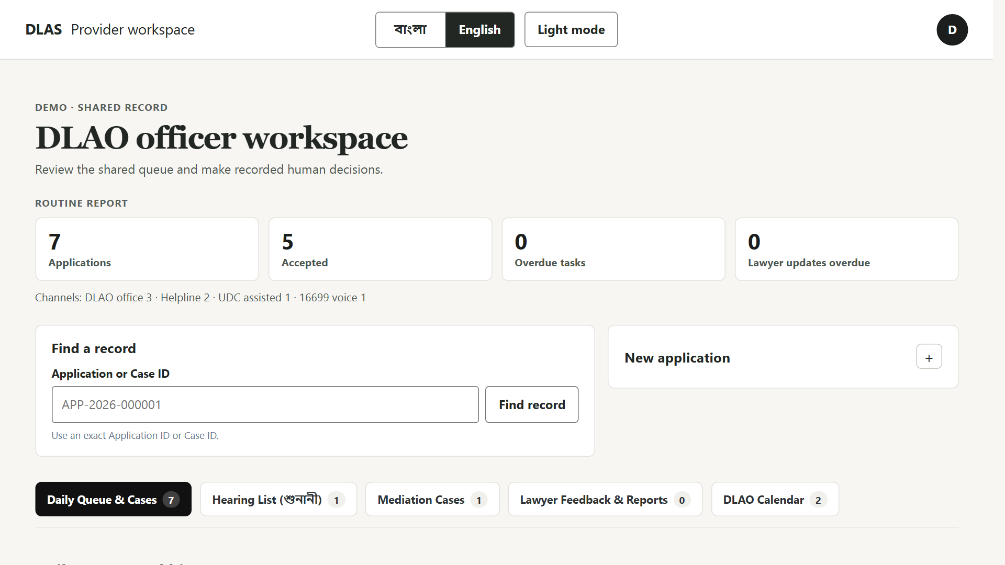
FLOW 3 OF 6
ONE RECORD
Related Cases linked by reference · never merged
A DLAO officer's day
PROVIDERS
B1 DLAO officer
B7 Case-support staff
MODULES
T3 Related incidents
T4 Duplicate review
T8 Multi-agent triage
1
One queue, a clear next action
Flag reasons, age, owner and next step for every Application.
2
Triage that disagrees out loud
Three components assess the case; a HIGH-vs-LOW conflict is shown to the officer, never settled silently.
3
Look-alikes stay separate
A similar-but-different pair gets a reasoned review; nothing is merged or rejected automatically.
Screen: DLAO queue ( / )
Human decides: the officer records the priority, the triage disposition and each duplicate decision, every one with a reason.
Notes:
TIME 3:00–4:00 (1 min). Covers B1 DLAO officer, B7 case support, T3 related incidents, T4 duplicate review, T8 multi-agent triage.
Click path: sign in as the DLAO officer. Show the shared queue: flag reasons, age/status, owner, next action.
Open the seeded triage-disagreement Application → Run triage. Compare the component recommendations and evidence, point at the separate routing/jurisdiction prompt, and record a reasoned disposition. The review does not change priority or route.
Open the "Fictional factory fire — separate claims" group: three separate Cases, one shared evidence reference, no copy or merge.
Search the seeded look-alike duplicate pair: inspect matching and differing attributes, record a reason, mark them different. Both Applications stay separate.
If time allows: sign in as case support and open the reconstruction with the audit integrity check.

Slide 6
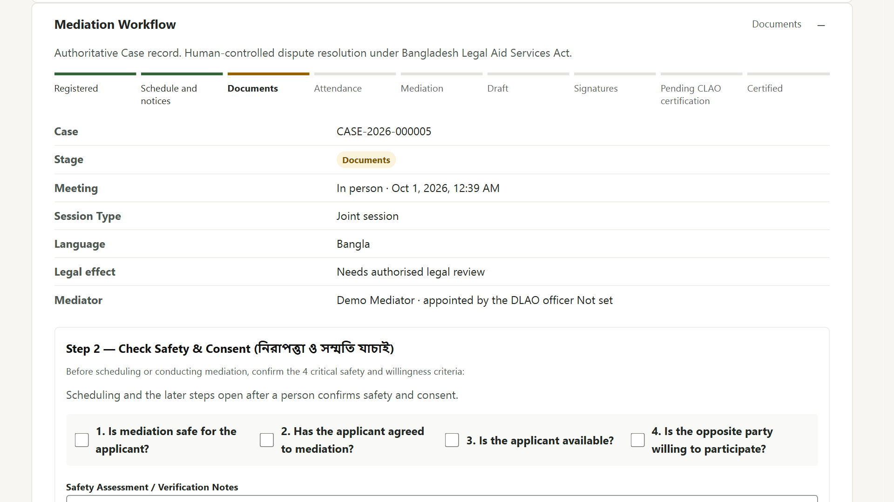
FLOW 4 OF 6
ONE RECORD
Mediation runs on the same Case
Mediation in 11 steps
1
2
3
4
5
6
7
8
9
10
11
Start
Safety & consent
Schedule
Session
Terms
Decision
Draft
Signatures
CLAO certify / return
Certified
Follow-up
PROVIDERS
B1 DLAO officer
B2 Mediator
CLAO certifies
MODULES
T7 Settlement draft
T11 Offline e-signature
1
Safety comes first
No step runs until a person confirms safety; "Not safe" stops it.
2
AI suggests, people decide
AI only suggests wording; the mediator reviews, both parties confirm.
3
Integrity-verifiable signatures
Each party signs, even offline; a changed copy fails verification.
Human decides: the parties agree the terms with the mediator; the CLAO certifies the settlement or returns it for correction.
Notes:
TIME 4:00–5:00 (1 min). Covers B2 mediator (with the CLAO certifying), T7 settlement draft, T11 offline e-signature.
Step 1 — the DLAO officer starts mediation and either runs it or appoints a mediator.
Step 2 — Safety & consent: safe for the applicant, the applicant agrees, is available, the other party is willing. No later step runs until a person confirms all four; a "Not safe" decision stops the mediation, and a party with a signing code is told nothing about why.
LIVE DEMO TIP: Rashida's seeded mediation (APP-2026-000008) was created before this check existed. Tick all four boxes, write a short note, and press Consent Confirmed before continuing.
If the CLAO returns the draft for correction, the signed version stays on record and everyone signs the new version with fresh codes.
Step 3 — schedule: mode (in person, remote or hybrid), joint or separate session, language. Step 4 — session notes for each side. Step 5 — issue-by-issue terms. Step 6 — the decision after mediation.
Step 7 — settlement draft: AI only suggests wording, the mediator reviews every field and warning, and both parties confirm they understand.
Step 8 — separate one-time codes: each party signs in their own session; one signs offline and then syncs. Step 9 — the CLAO checks the signatures, records the legal basis, and certifies or returns the draft for correction. Step 10 — certified record. Step 11 — follow-up and compliance.
Say: a signature or certificate is integrity-verifiable, but it is not proof of identity and not a court decree.

Slide 7
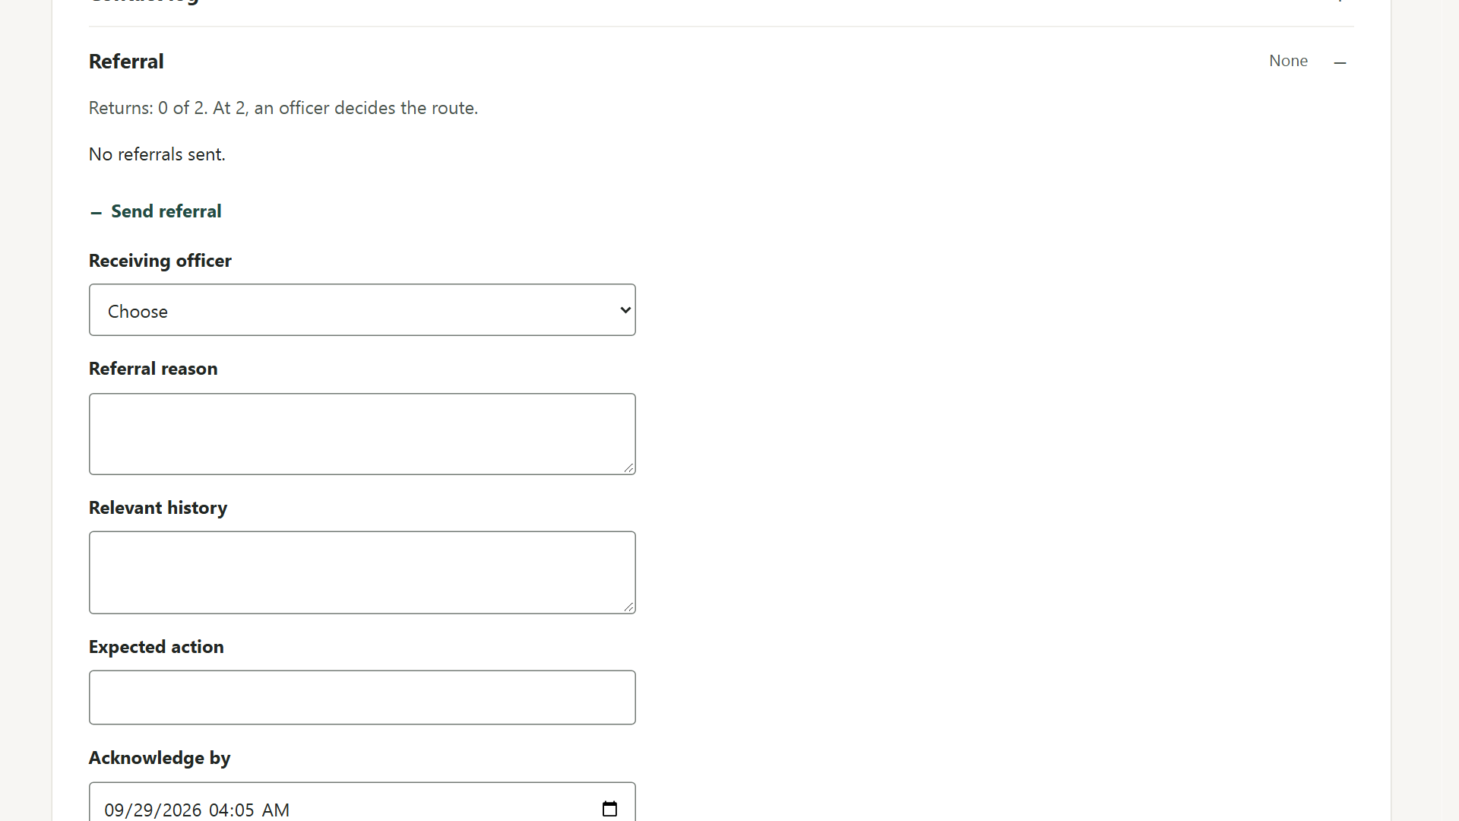
FLOW 5 OF 6
ONE RECORD
Referral travels with the record · no re-entry
Urgent referral
CITIZENS
A3 Nabila
PROVIDERS
B1 DLAO officer
B6 Receiving DLAO
MODULES
T2 Jurisdiction ping-pong
1
Urgency, with reasons
Rules show why the case looks urgent, with evidence references. The officer sets the priority.
2
Restricted evidence stays restricted
Office role alone cannot open it; every open or denial is logged.
3
Nobody can drop it
An unacknowledged referral creates a follow-up task; two returns block transfers until a human decides.
Screen: Referral handover · /applications/:id
Human decides: the owning DLAO officer records the routing decision. The timer never decides jurisdiction.
Notes:
TIME 5:00–6:00 (1 min). Covers A3 Nabila, B1 DLAO officer, B6 receiving DLAO, T2 jurisdiction ping-pong.
Click path: sign in as the DLAO officer and open the seeded fictional Nabila Application. Review the urgency reasons and record the human priority decision.
Inspect the restricted-evidence metadata. Create a referral with history, expected action, deadline and a named receiving DLAO; share restricted evidence only with a recorded necessity reason.
Sign in as the receiving DLAO: read the package and the safe-contact rules. A user who is not responsible cannot open the restricted item, and the denial is audited.
Return with a reason; after the second return the escalation blocks further transfers until the owning officer records a reasoned routing decision.
Leave a short-deadline referral unacknowledged: an overdue follow-up task and audit event appear.

Slide 8
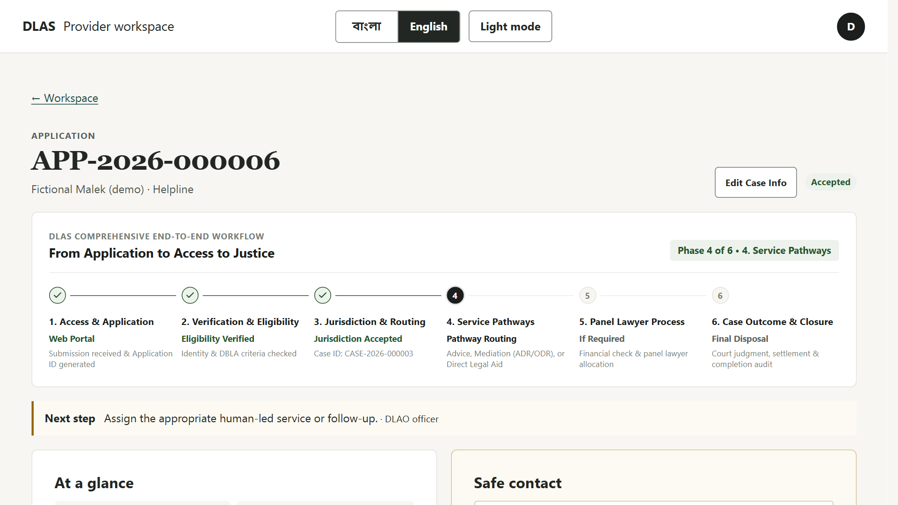
FLOW 6 OF 6
ONE RECORD
Same Application and Case, seven months on
A long-running case
CITIZENS
A5 Abdul Malek
PROVIDERS
B5 Panel lawyer
B3 16699 helpline
MODULES
T1 Lawyer accountability
1
Status without reading
Ask by Voice: Malek says his number and PIN and hears the stage, hearing date and next step. No name is spoken.
2
Two missed updates
An overdue alert and a temporary hold on new assignments, pending human review. No misconduct finding.
3
Every contact attempt on the record
A call answered by the shop owner discloses nothing; the retry and the next attempt are logged.
Screen: Malek record · /applications/:id
Human decides: the DLAO officer reviews the hold and any lawyer change. Payments are status records only.
Notes:
TIME 6:00–7:00 (1 min). Covers A5 Malek, B5 panel lawyer, B3 helpline, T1 lawyer accountability.
Click path: sign in as the DLAO officer and open the seeded fictional Malek record (APP-2026-000006). Show the hearing date, the applicant-safe next action and the contact log: the shop owner answered (nothing disclosed, next attempt planned), then a retry reached Malek.
Show the lawyer's two missed required updates: the overdue alert, the temporary new-assignment hold, and the officer's continue/lift decision. No misconduct finding, automatic reassignment or payment recovery.
Ask by Voice (home page, Track card): say the request, the number digit by digit, "yes" to the read-back, "yes" to listening privately, then the PIN. The PIN is in the private demo credentials — never show it on screen. If the local voice service is not running, type the number and PIN instead.
Mention: a citizen can request a lawyer change; the old lawyer stays assigned until the replacement accepts.

Slide 9




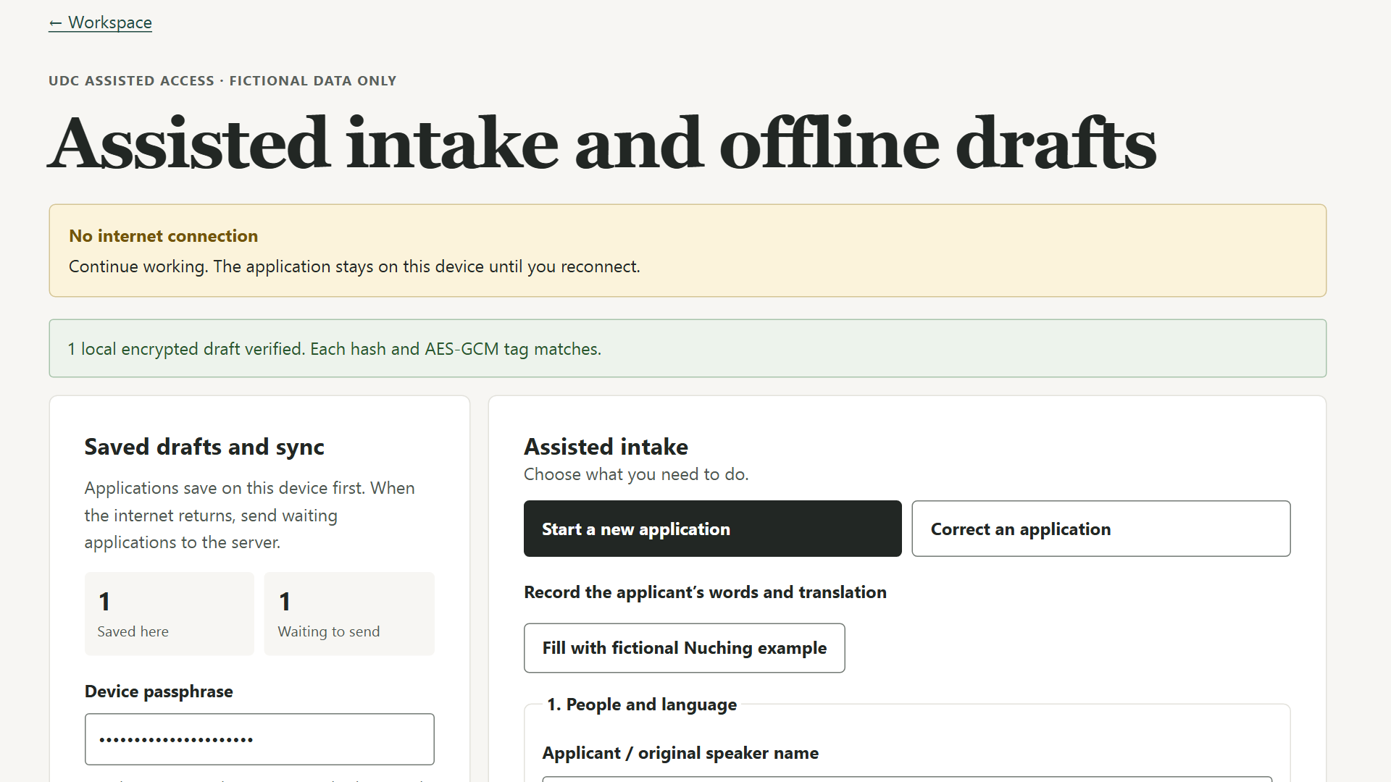
BAD DAY · PLANNED FAILURE
The network drops mid-submission
Nuching's assisted intake at a UDC (fictional): the operator is offline at the moment of submission.
Offline
Encrypted local queue
Reconnect
Exactly one Application
The connection drops while the UDC operator submits.
The draft is kept in encrypted browser storage with a mutation ID.
The queue syncs; a retry reuses the same ID.
No duplicate record, and the local queue clears.
Also automated: the other 11 bad-day checks
Wrong person answers: nothing disclosed
Keyboard-only voice intake (Ripon)
Referral not acknowledged: follow-up task
Lawyer misses two updates: hold + review
Look-alike duplicate stays separate
Triage components disagree: shown
Unreadable document is not guessed
Offline edit conflict: a human resolves
Changed signed copy fails verification
Voice AI down: keyboard keeps the draft
Wrong role denied restricted evidence
Notes:
TIME 7:00–8:00 (1 min). The one planned failure: T9 offline-first sync on Nuching's intake.
Click path: sign in as the UDC operator → Assisted intake and offline drafts, with the fictional Nuching example loaded. In the browser's network controls, go offline.
Change the fictional original statement and select "Queue encrypted application". Retry once: the retry keeps the same temporary and mutation IDs.
Reconnect: the queued Application syncs once and the encrypted local queue clears. A repeated retry does not create another Application.
Sign in as the DLAO officer and search: exactly one Application.
Close with: each of the other eleven bad-day checks on the right has its own automated test — the jury can ask to see any of them.

Slide 10









THE PAYOFF
Less re-work. More reach.
For providers
For citizens
The story is entered once
Every role works on the same Application / Case record.
Bangla voice, no reading needed
A web simulation of a 16699 call, with read-back.
The next action is visible
The queue shows owner, flag reasons, age and next step.
Help at a UDC
The original words and the translation are both kept.
Briefings cite their sources
Each summary point links to its document and line.
Safe contact
If the wrong person answers, nothing is disclosed.
Overdue work surfaces itself
Late referrals and lawyer updates create follow-up tasks.
Works on weak networks
Offline drafts and a light mode for low data.
Notes:
TIME 8:00–9:00 (1 min).
Providers: the story is entered once and follows the record, so nobody re-types it at a referral, a mediation or a lawyer assignment. The queue tells each officer the owner and the next action. Document briefings cite their source lines, so checking is faster. Overdue referrals and lawyer updates raise follow-up tasks on their own instead of relying on memory.
Citizens: Malek and Ripon can use voice without reading; Nuching gets help at a UDC with her own words kept next to the translation; Moyuri is protected because the wrong person hears nothing; weak networks do not lose work.
Do not quote time-saving numbers: none have been measured yet. The pilot metrics are on the next slide.

Slide 11




FEASIBILITY
Fits DLAS today. Ready to grow.
Fits the DLAS workflow
Built on a common stack
Mirrors the real process: Application → DLAO acceptance → Case
One record for every door and every provider role
Humans keep every final decision; AI only suggests or summarises
MERN in plain JavaScript: MongoDB, Express, React PWA, Node
Web frontend on Vercel
Optional AI, with manual and rule-based fallbacks
What scaling needs
How a pilot is measured
Real 16699 telephony integration
An always-on timer service for deadlines
Distributed rate limiting
Law-team approval of placeholder policies
Five success indicators — no values claimed yet
Safe-contact compliance
One-record continuity
Accessible completion
Tracked responsibility
Resilient recovery
Notes:
TIME 9:00–10:00 (1 min).
Fit: the workflow mirrors how legal aid already works — an Application, a human DLAO acceptance, then a Case. Humans keep eligibility, priority, jurisdiction, lawyer assignment, mediation outcome and closure.
Stack: plain-JavaScript MERN with an installable PWA; the web frontend is on Vercel. AI is optional and every AI step has a manual or rule-based fallback.
Scaling needs: a real 16699 telephony integration (today it is a web simulation), an always-on service for deadline timers, distributed rate limiting, and law-team approval of the placeholder policies (urgency criteria, thresholds, caller-verification wording).
Metrics for a pilot: safe-contact compliance, one-record continuity, accessible completion, tracked responsibility, resilient recovery. We are not claiming values yet.
Close: "One record, five doors, humans in charge." Then move to the closing slide for Q&A.

Slide 12
QUESTIONS
Try it yourself
legal-tech-rosy.vercel.app
Ask us about any of the 23 items.
Scan to open the prototype
Fictional data only · 16699 is a web simulation
Notes:
Q&A. Leave this slide up so the jury can scan the QR code. The two backup slides after this one map every one of the 23 items to its flow, page and automated test, and list the honest limits.

Slide 13
BACKUP · 23-ITEM MAP · 1 OF 2
Where each item lives: citizens and providers
Item | In the pitch | Page / route | Automated test | Status
A1 Moyuri | Flow 1 | /voice; officer record | tests/e2e/step4.spec.js | Pending
A2 Ripon | Flow 1 | /voice (keypad IVR) | tests/e2e/step4.spec.js | Pending
A3 Nabila | Flow 5 | /applications/:id; referrals | tests/e2e/step8.spec.js | Implemented
A4 Nuching | Flow 2, Bad Day | /assisted | tests/e2e/step7.spec.js | Implemented
A5 Malek | Flow 6 | /cases/:id; Track → Ask by Voice | step9.spec.js; voice-status.spec.js | Implemented
B1 DLAO officer | Flows 3–5 | /; /applications/:id | step3, 6, 8, 10, 11 .spec.js | Implemented
B2 Mediator | Flow 4 | /applications/:id (mediation) | tests/e2e/step12.spec.js | Implemented
B3 16699 helpline | Flows 1, 6 | /; /voice; status lookup | step3, 4, 6 .spec.js | Implemented
B4 UDC entrepreneur | Flow 2 | /assisted | tests/e2e/step7.spec.js | Implemented
B5 Panel lawyer | Flow 6 | /cases/:id; lawyer worklist | tests/e2e/step9.spec.js | Implemented
B6 Receiving DLAO | Flow 5 | /referrals/:id | tests/e2e/step8.spec.js | Implemented
B7 Case support | Flow 3 | /; search and reconstruction | tests/e2e/step6.spec.js | Implemented
Pending — A1: Moyuri's own confirm / correct screen is not built yet. A2: validation with a blind user has not been done; a keyboard-only test exists.
Notes:
Backup for Q&A. Citizen items A1–A5 and provider roles B1–B7, each with the flow that shows it, the page to open and its automated test. A1 and A2 are honestly marked pending.

Slide 14
BACKUP · 23-ITEM MAP · 2 OF 2
Where each item lives: technical challenges
Item | In the pitch | Page / route | Automated test | Status
T1 Lawyer accountability | Flow 6 | Lawyer change, hold review, payments | tests/e2e/step9.spec.js | Implemented
T2 Jurisdiction ping-pong | Flow 5 | Referral panel; routing decision | tests/e2e/step8.spec.js | Implemented
T3 Related incidents | Flow 3 | /incidents/:groupId | tests/e2e/step10.spec.js | Implemented
T4 Duplicate review | Flow 3 | Duplicate review panel | tests/e2e/step10.spec.js | Implemented
T5 Bangla intake agent | Flow 1 | /voice | tests/e2e/step5.spec.js | Implemented
T6 Document agent | Flow 2 | Briefing on /applications/:id | tests/e2e/step7.spec.js | Implemented
T7 Settlement draft | Flow 4 | Mediation panel | tests/e2e/step12.spec.js | Implemented
T8 Multi-agent triage | Flow 3 | Triage panel | tests/e2e/step11.spec.js | Implemented
T9 Offline sync | Bad Day | /assisted (offline) | tests/e2e/step7.spec.js | Implemented
T10 Low-bandwidth PWA | Flow 2 | Light mode; service worker | step7.spec.js; pwa/offline.spec.js | Implemented
T11 E-signature | Flow 4 | /mediation/sign; verifier | tests/e2e/step12.spec.js | Implemented
Notes:
Backup for Q&A. Technical challenges T1–T11, each with the flow that shows it, the page to open and its automated test.

Slide 15







BACKUP · WHAT WE DO NOT CLAIM
Honest limits
16699 is simulated
A web simulation of the call. No real calls, SMS, telecom link or government systems.
Fictional data only
No real beneficiaries, NID numbers, cases or payments are used.
Blind-user test pending
Ripon's call passes a keyboard-only test; a blind user has not yet validated it.
Applicant self-confirmation pending
Moyuri cannot yet confirm or correct Ripon's report herself; it stays marked unconfirmed.
Law-team approvals pending
Urgency criteria, thresholds, caller-verification wording and settlement template wording.
Signature is not enforceability
E-signatures are integrity-verifiable; alone they do not prove identity or legal effect.
Certification is not a decree
The CLAO certification is recorded; it is not presented as a court decree.
Text documents only
The document agent reads text files; no scanned PDFs or OCR.
Notes:
Backup for Q&A. Amber items are pending work or approvals; the others are deliberate boundaries of the prototype. Use this slide if the jury asks what is real and what is simulated.

