Slide 1
Final Project Presentation Heli-Tilt
By Ali Ismail

Slide 2
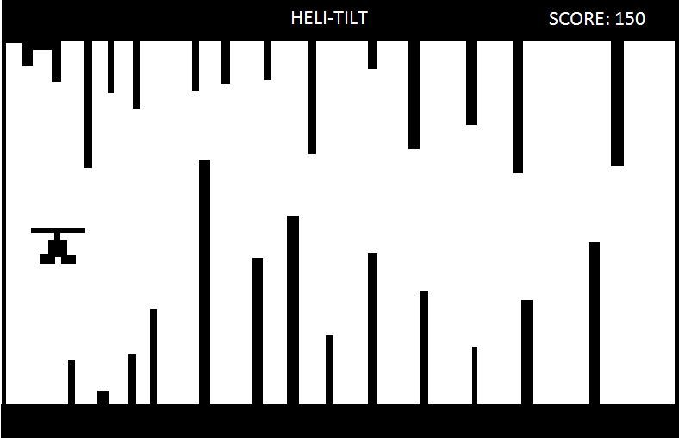
Game Concept

Slide 3
New Hardware
AT89C51RC2
Triple Axis Accelerometer Breakout - ADXL345
GDM12864HLCM

Slide 4
New Software
Game Menu
Keypad to navigate game menu
Level Design
Generate random bars on top and bottom of level
Update bars as level progresses forward
Distance Scoring
Based on pixel moved forward
Helicopter Accelerometer Positioning
y direction (maybe x direction)
Collisions

Slide 5
Milestones
Week 1 (October 27th)
Parts delivered
Begin LCD interfacing
Week 2 (November 3rd)
LCD Working
Accelerometer Interfacing
Week 3 (November 10th)
Accelerometer Working
Game Menu and Level Building
Week 4 (November 17th)
Game Menu and Level Building Working
Helicopter Movement

Slide 6
Milestones Cont.
Week 5 (November 24th)
Helicopter moving and detecting collisions
Game scoring Completed
Week 6 (December 1st )
Last minute debugging
Write Final Report

Slide 7
Deliverables
Accelerometer Helicopter Tilting Game
At a minimum
Game Menu
Tilting Helicopter moving through levels
Basic Scoring Scheme
More time
Save High Scores
Difficulty Setting
Introduce x axis (vary speed)

Slide 8
Back-Up Plan
Incremental Project
Get LCD working
Get Accelerometer working
Integrate both parts (Incremental)
Accelerometer Fails
If accelerometer fails, move helicopter with a keypad

Slide 9
Questions? Yes? No? Maybe So?

