Slide 1
Final Project Presentation Heli-Tilt
By Ali Ismail

Slide 2
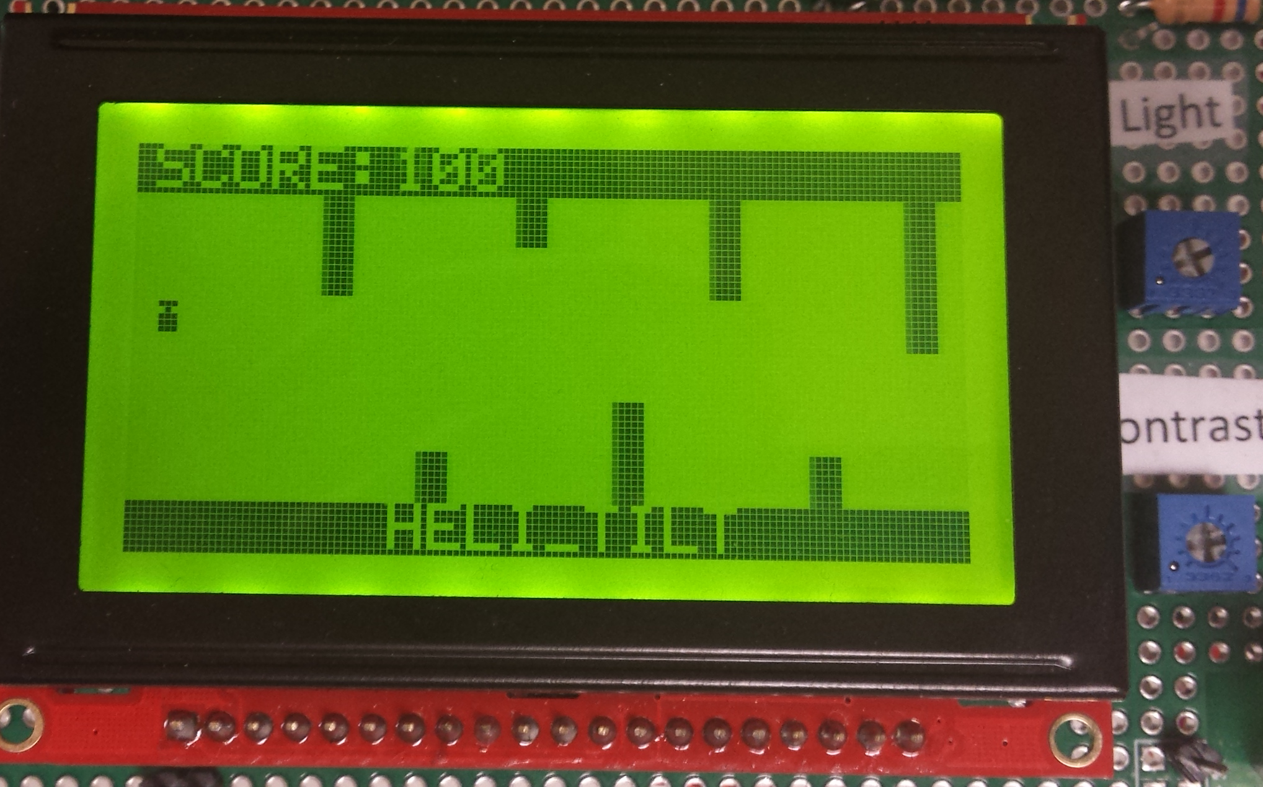

Slide 3
Hardware Block Diagram
5 V Supply
Haptic Motor
3.3 V Supply
8051
MOTOR_CTRL
Level Shifter
ADXL345
HV1
HV2
HV
HV3
HV4
LV1
LV2
LV
LV3
LV4
SDA
SCL
SDA
SCL
EPROM
SDA
SCL
RS
R/W
/RES
/CS1
/CS2
DB0
DB1
DB2
DB3
DB4
DB5
DB6
DB7
128 x 64 GLCD
RS
R/W
/RES
/CS1
/CS2
DB0
DB1
DB2
DB3
DB4
DB5
DB6
DB7

Slide 4
Aplay_game()
credits/still screen()
draw_level()
Aupdate_heli()
Adetect_collision()
Aupdate_score()
comp_score()
write_score()
Ahigh_scores()
disp_score()
Aset_difficulty()
difficulty_screen()
Wait_for_choice()
accel_screen()
disp_readings()
calibrate()

