Slide 1
Current Topics Presentation Motors and Motor Drivers
By Ali Ismail

Slide 2
3 Different Motors
Direct Current (DC)
Two wires (power and ground) and continuous motion
Applications include computer cooling fans and remote control car wheels
Servo
Three wires (power, ground, and control)
DC motor, gear set, control circuit and position-sensor
Applications include boat rudder or robotic arm
Stepper
Utilizes toothed electromagnets arranged around central gear
4 or 8 leads
Require external circuitry to control magnets
Source: https://www.modmypi.com/blog/whats-the-difference-between-dc-servo-stepper-motors

Slide 3
Motor Characteristics
Torque
SI: Newton-Meters
English: inch-pounds
Speed (Angular Velocity)
Revolutions per minute
Power
Torque maintained at a certain speed

Slide 4
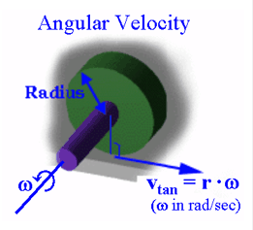
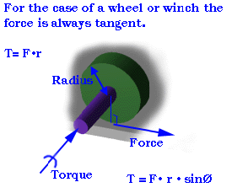
Torque and Speed Explained
Source: http://lancet.mit.edu/motors/motors3.html#torque
Notes:
Tendency of a force to rotate an object.
More torque, the more force. The more force, the greater payload you can handle

Slide 5
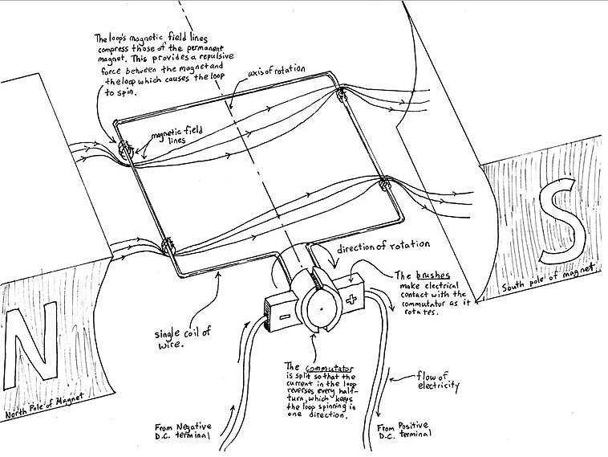
Basic DC Motors
Source: http://lancet.mit.edu/motors/matt1.jpg

Slide 6
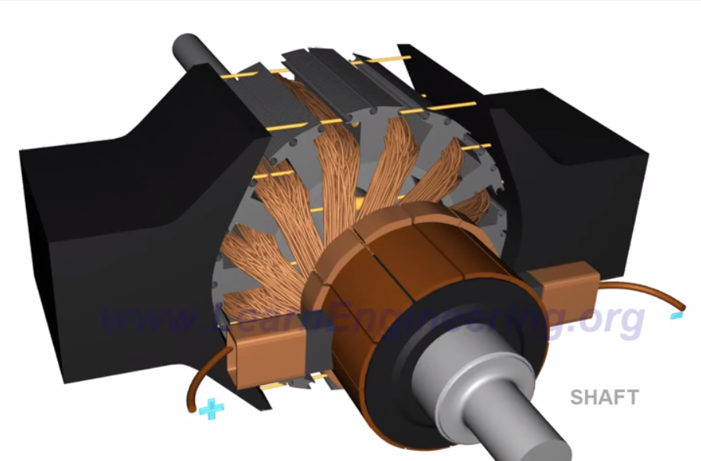
Enhanced DC Motors
Steel slots increase magnetic flux interaction
Increased # of armatures smoothens rotations
Source: https://www.youtube.com/watch?v=LAtPHANEfQo

Slide 7
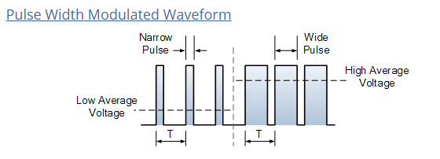
DC Motor Control
Source: http://www.electronics-tutorials.ws/blog/pulse-width-modulation.html

Slide 8
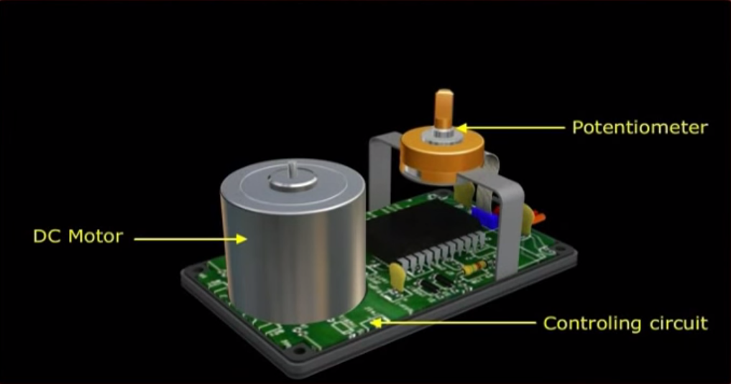
Basic Servo Motors
Source: https://www.youtube.com/watch?v=0hWe1oF5UBg

Slide 9
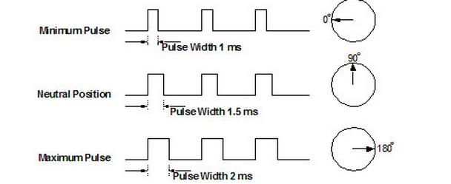
Servo PWM Control
Source: http://www.servocity.com/html/how_do_servos_work_.html#.VE65-vl4pGM

Slide 10
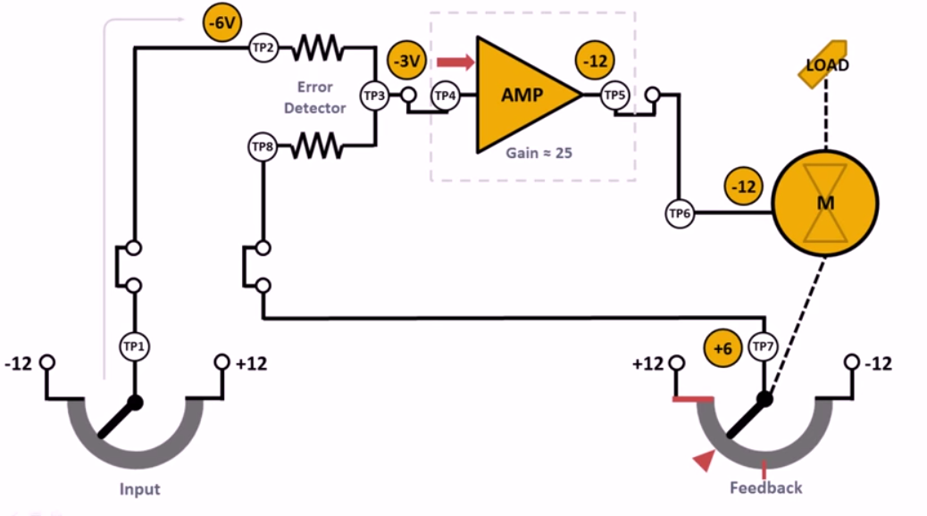
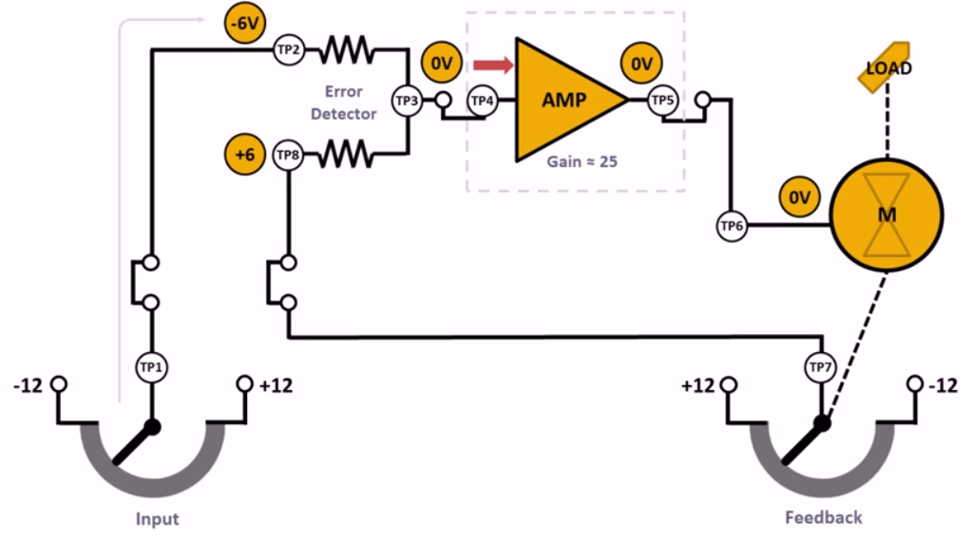
Servo Motor Control
Source: https://www.youtube.com/watch?v=tsrAP8EgcbQ

Slide 11
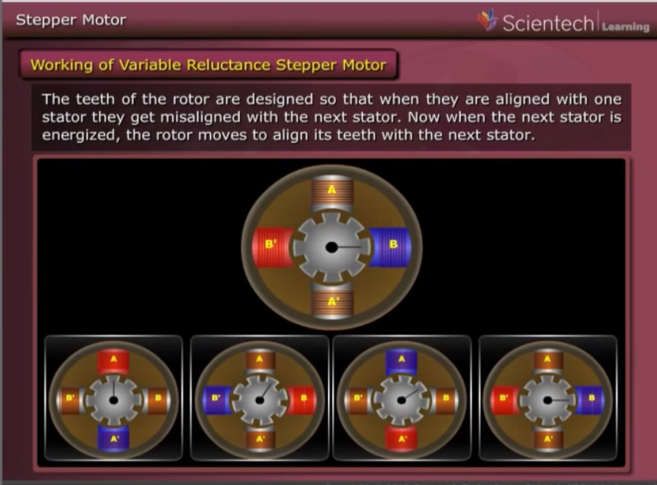
Stepper Motors
Source: https://www.youtube.com/watch?v=0hWe1oF5UBg
Notes:
Reduce airgap

Slide 12
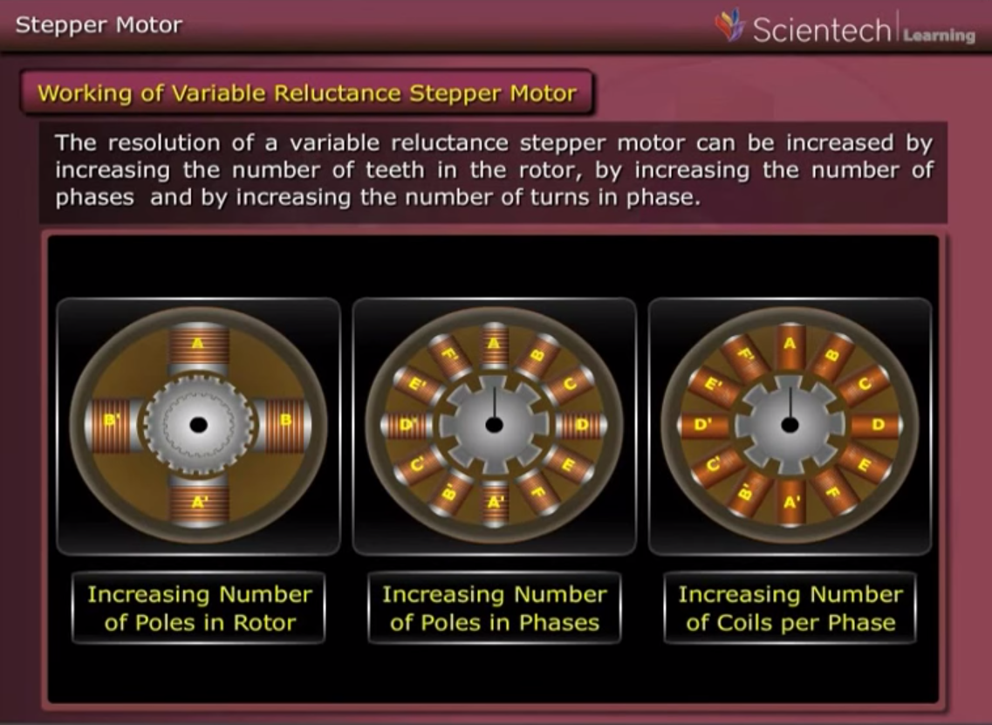
Enhanced Stepper Motors
Source: https://www.youtube.com/watch?v=0hWe1oF5UBg
Notes:
Reluctance

Slide 13
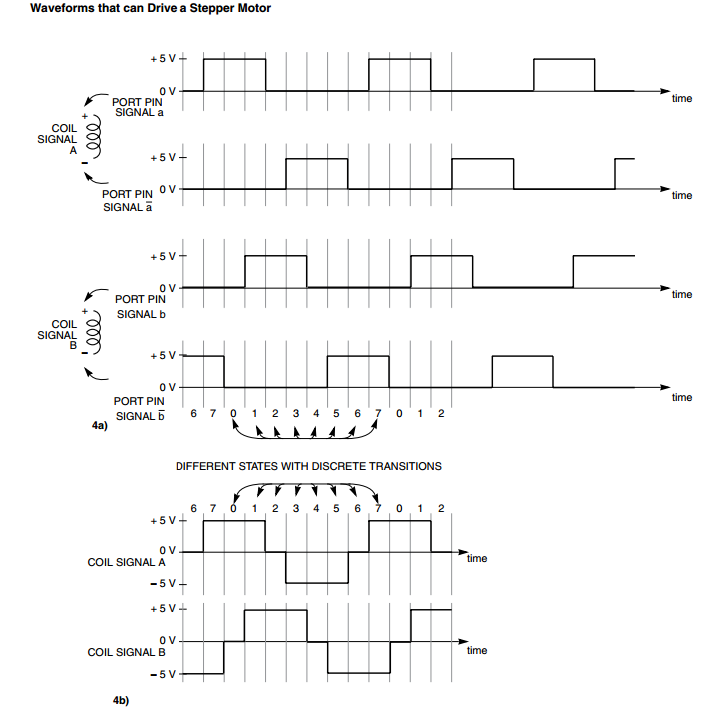
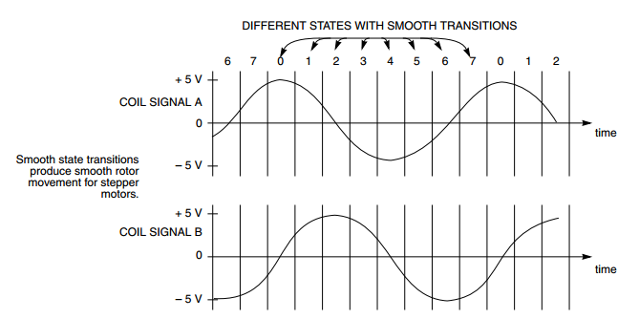
Stepper Motor Control
Source: http://www.freescale.com/files/microcontrollers/doc/app_note/AN2974.pdf

Slide 14
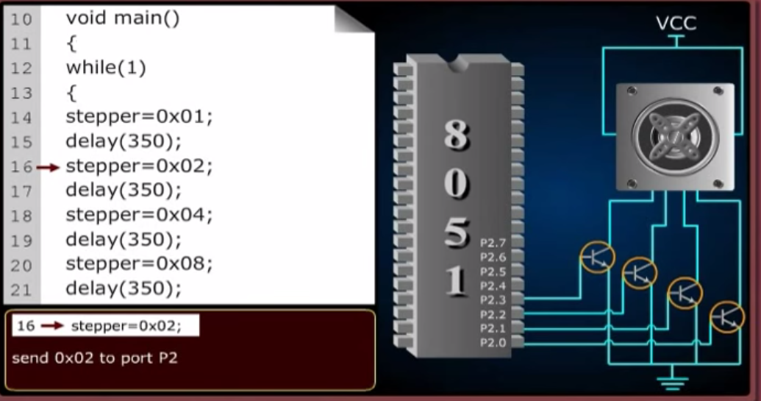
Stepper Motor Control
Source: https://www.youtube.com/watch?v=0hWe1oF5UBg

Slide 15
References
Source: https://www.modmypi.com/blog/whats-the-difference-between-dc-servo-stepper-motors
Source: http://lancet.mit.edu/motors
Source: https://www.youtube.com/watch?v=LAtPHANEfQo
Source: http://www.electronics-tutorials.ws/blog/pulse-width-modulation.html
Source: https://www.youtube.com/watch?v=0hWe1oF5UBg
Source: http://www.servocity.com/html/how_do_servos_work_.html#.VE65-vl4pGM
Source: http://www.servocity.com/html/how_do_servos_work_.html#.VE65-vl4pGM
Source: https://www.youtube.com/watch?v=tsrAP8EgcbQ
Source: http://www.freescale.com/files/microcontrollers/doc/app_note/AN2974.pdf
Source: http://www.engineersgarage.com/tutorials/how-use-pmdc-motor-electronic- circuits?page=1

Slide 16
Supplemental Slides/Questions?

Slide 17
Current Relationships
T = K_{T} * I
K_{T} = NOMINAL TORQUE / NOMINAL CURRENT
Source: http://www.engineersgarage.com/tutorials/how-use-pmdc-motor-electronic-circuits?page=1

Slide 18
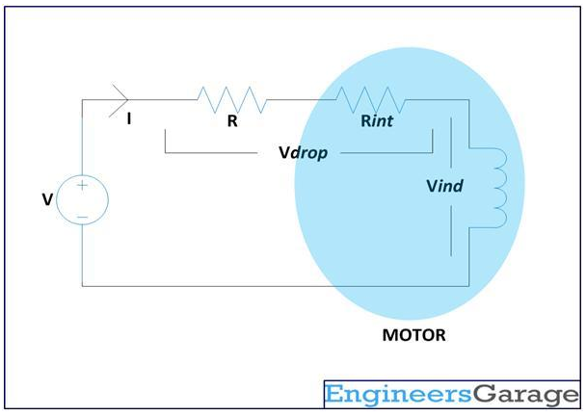
Voltage Relationships
)
Vind = V – Vdrop
Vind = K_{E} * S
RPM = ( ( V – I ( R + Rint ) ) / K_{E} ) * ( 60 / 2pi)
Source: http://www.engineersgarage.com/tutorials/how-use-pmdc-motor-electronic-circuits?page=1

Slide 19
Design Considerations
If connecting motor to circuit:
Provides required voltage
Sources more current than CURRENT AT MAXIMUM POWER
Providing enough current:
ULN200X stepper motor driver ICs
Darlington Pairs
H-bridges
ICs that enables voltage to be applied in different directions
Source: http://www.engineersgarage.com/tutorials/how-use-pmdc-motor-electronic-circuits?page=1

