Slide 1

CLINIC MANAGEMENT SYSTEM
AND SERVICES
(MAJOR PROJECT 2)
by:
Ariel D. Maniago
William N. Pinque
Notes:
Good morning sir jack, panel and judges, classmates, I am William together with my partner Ariel D. Maniago

Slide 2

Patient
Treatment
Organizing
Prescription
Patient
History
Diagnosis
Notes:
Clinic management system and services is design to provide solutions to your daily clinical task such as ORGANIZING numerous data about the patient information database, PATIENT HISTORY, PATIENT TREATMENT history, laboratory results, anatomy, DIAGNOSIS, PRESCRIPTION, medical certificates, daily sales, payment and others.
Basically, patient spend a substantial amount of time in clinics waiting for services to be delivered by the doctor or health professionals. And we all know that as the number of patients continually increase, managing a clinic can also become increasingly difficult, especially if everything is done manually.

Slide 3

Hard copy documents
Check-up schedules
Tracking patient’s history
Medical certificate issuance
Notes:
Statement of the Problem
1. The clinic services experienced a problem in keeping a hard copy and a printed DOCUMENT of their respective patient.
2. Walk-in patients waiting outside the clinic for their turn to be CHECKED-UP and to get their respective schedule for their personal checkup.
3. The doctor is dependent with their secretary in TRACKING THE PATIENT HISTORY of the client.
4. Immediate ISSUANCE OF THE MEDICAL CERTIFICATES of the patient takes longer to release because it needs the actual presence of the doctor for the details and signature.

Slide 4

Online data
Online booking (Set Appointment)
Online patient search
Online medical certificate issuance
Notes:
Solution of the Problem
1. The solution to these problems is to make a website that capable of keeping a DATA ONLINE instead of storing it in the filing cabinet.
2. A website that is able to accept patient ONLINE BOOKING schedules for personal check-up.
3. This website can SEARCH, sort and print data from the database without the help of the secretary or staff.
4. A website that is able to print and send medical certificates online without the actual presence of the doctor.

Slide 5

Easy to login
Paperless
Remote Access
Online booking
Patient search
Printing
Notes:
The proposed project is an effective replacement of the current manual procedures of the clinic services. This will give a better result and efficient performance with the following features given below:
Easy to login and only authorized personnel can access
Paperless
Remote access
Online booking which lead to faster consultation
You can check the patient history and others
You can print patient prescription, recommendation and others.

Slide 6

Doctor & Staff
Patient access
Billing statement printing
Official receipt printing
Data privacy
Notes:
Limitations of the Project
1. Records and files are stored online for accessibility and portability but only DOCTOR AND STAFF can access.
2. PATIENT CAN ACCESS online but limited only for set appointment schedule.
3. BILLING STATEMENTS, OFFICIAL RECEIPTS ISSUANCE are not included in the system due to limited time given and at the same time we
are dealing only in front end at the moment.
4. You may also encounter DATA PRIVACY since all information on the web is not 100% secure.

Slide 7

Green, white, blue, red
Google fonts
Customized clinic logo
Html, CSS, Javascript, JSON server
Own Rest API, Fetch API, Axios API
Tailwin UI, Tailwin CSS, React strap
React router-DOM, React hostify
Flowbite, Netlify, Github, Google drive
CorelDraw, AdobePhotoshop, MS-Office
Notes:
The themes, fonts, logo and technology we used in this website are very important to us. Because it acts as a key component of our web design. It gives the visual significance of our website layout and it also enhances our website message and usability. It defines the hierarchy of our website content and below are the list we used:
1. For the themes ?????
2. for the font: we used google fonts
3. We customized the logo ??????
4. For the technology:
We used, Html, CSS, Javascript, JSONserver, we made our own Rest API using JSON server, fetch API, Axios API,
Tailwin UI, Tailwin CSS, React strap for columns, rows and container, React JS router-DOM, React hostify for notification and
appointment ID, flowbite, netlify, github, google drive
CorelDraw, AdobePhotoshop, MS-Office

Slide 8

HOME
SERVICES
BLOGS
ABOUT US
FAQ
SET APPOINTMENT
HEMATOLOGY
HEALTHY HABITS
MISSION
CAN THE CLINIC DIAGNOSE ME
APPOINTMENT DATE
SEROLOGY
VISION
PRE-EMPLOYMENT
HEALTHY
TIPS TO EAT
OUR CORE VALUES
PERSONAL INFORMATION
DO I NEED TO BE SERIOUSLY ILL
BLOOD CHEM CLINICAL
WHAT OUR CLIENTS SAYS
MEDICAL CONCERN
MICROSCOPY
CAN I HAVE A CONSULTA-TION
ANNUAL PHYSICAL EXAM
SET APPOINTMENT
FOOTER
HELPFUL LINKS
FOLLOW US
HELP AND SUPPORT
Notes:
Navigational bar, composes of home, services, blogs

Slide 9

SET APPOINTMENT
FOOTER
HOME
SERVICES
TEXT
TEXT
TEXT
TEXT
TEXT
TEXT
LOGO
TEXT
TEXT
TEXT
TEXT
TEXT
TEXT
TEXT
TEXT
IMAGE
TEXT
TEXT
TEXT
TEXT
IMAGE
TEXT
TEXT
TEXT
TEXT
TEXT
TEXT
TEXT
TEXT
TEXT
TEXT
TEXT
TEXT
TEXT

Slide 10

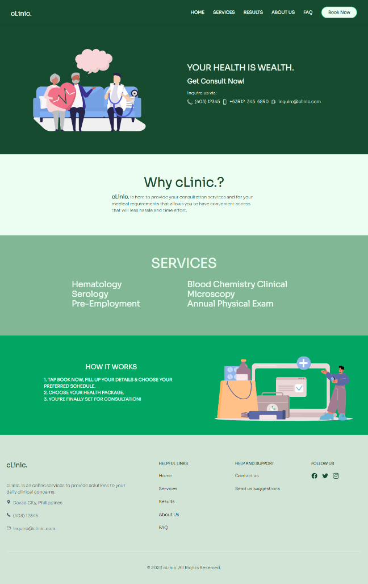
https://clinicmp2.netlify.app/

Slide 11


