Slide 1
Title: Exploring Health Insurance Charges
UMBC Data Science Master Degree Capstone
Dr. Chaojie (Jay) Wang
Author Name: Shreya Ayireddy
DA54897
GitHub Profile: https://github.com/ayireddyshreya
LinkedIn Profile: www.linkedin.com/in/shreya-ayireddy

Slide 2
Introduction
The "Predicting Health Insurance" aims to analyze various factors influencing medical costs and health insurance premium. Understanding these factors is crucial for developing accurate predictive models and gaining insights into the relationships among different variables.
Objective: Analyze factors affecting health insurance charges and build regression models to predict charges.

Slide 3
Dataset Overview
The dataset explores the relationship between individual characteristics (such as age, gender, BMI, smoking status) and external factors (region, occupation) with health insurance premiums. By studying this dataset, I aim to uncover patterns, correlations, and dependencies that can inform the development of machine learning models for predicting insurance charges.
Understanding the factors influencing health insurance premiums is essential for both insurance providers and individuals seeking coverage. Accurate predictions can lead to better-informed decision-making, personalized pricing, and improved risk assessment in the insurance industry.

Slide 4
About the data
Data Sources: Insurance dataset
Data Size:
The file size is 101.94 MB.
The dataset consists of 12 variables/columns and 1 million rows.

Slide 5
Data Dictionary
Column Name | Data Type | Definition | Potential Values
Age | Integer | The age of the insured individual. | Integer values
Gender | Object | The gender of the insured individual. | 'Male' or 'Female'
BMI (Body Mass Index) | Float | A measure of body fat based on height and weight. | Float values
Children | Integer | The number of children covered by the insurance plan. | Integer values
Smoking Status | Object | Indicates whether the individual is a smoker. | 'Smoker' or 'Non-Smoker'
Region | Object | The geographical region of the insured individual. | 'North', 'South', 'East', 'West'
Medical History | Object | Information about the individual's historical medical problems. | Categorical values
Family Medical History | Object | Information about the medical history of the family. | Categorical values
Exercise Frequency | Object | The frequency of the individual's exercise routine. | 'Never', 'Rarely', 'Occasionally', 'Frequently'
Occupation | Object | The occupation of the insured individual. | Categorical values
Coverage Level | Object | The type of insurance plan. | 'Basic', 'Standard', 'Premium'
Charges | Float | The health insurance charges for the individual. | Float values

Slide 6
Target variable
The target variable is the 'Charges' column. This variable represents the health insurance charges for the individual and would be the predicted value in the machine learning model.
Features/ Predictors
'Gender', 'smoker', 'region', 'medical_history', 'family_medical_history', 'exercise_frequency', 'occupation', and 'coverage_level' can be used as variables for predicting machine learning models. These variables represent categorical features, and depending on the nature of your predictive task, they can be valuable predictors for your model.

Slide 7
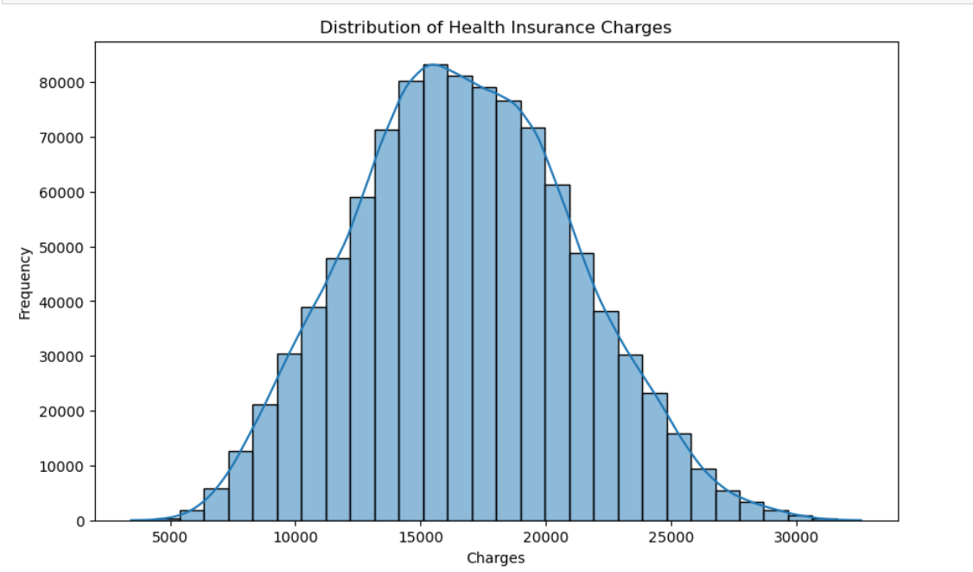
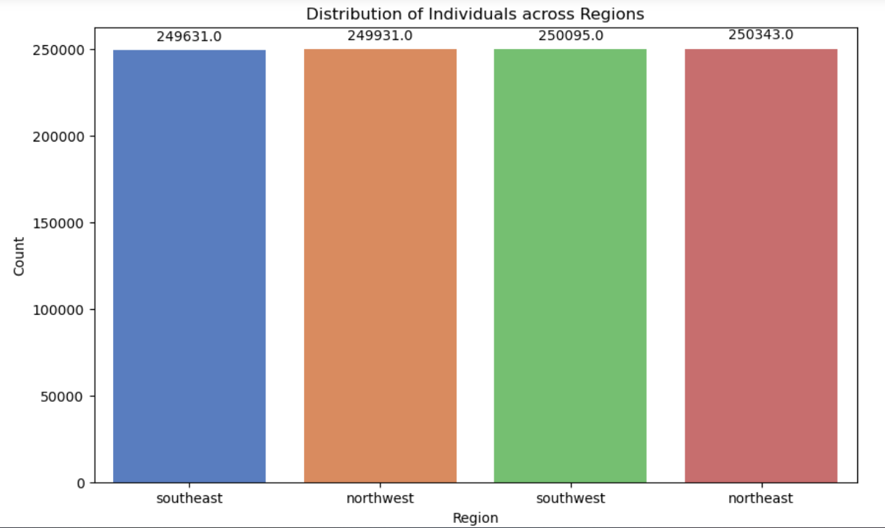
Exploratory Data Analysis

Slide 8
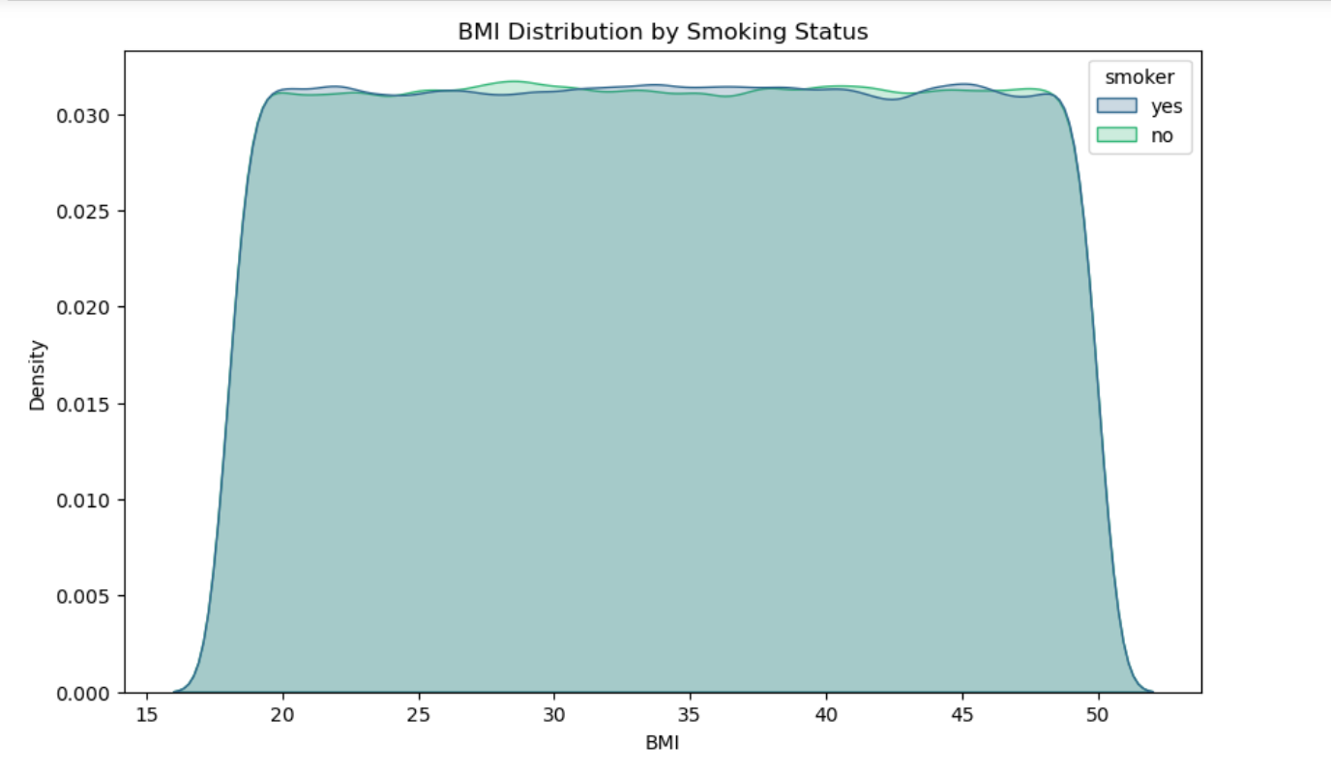
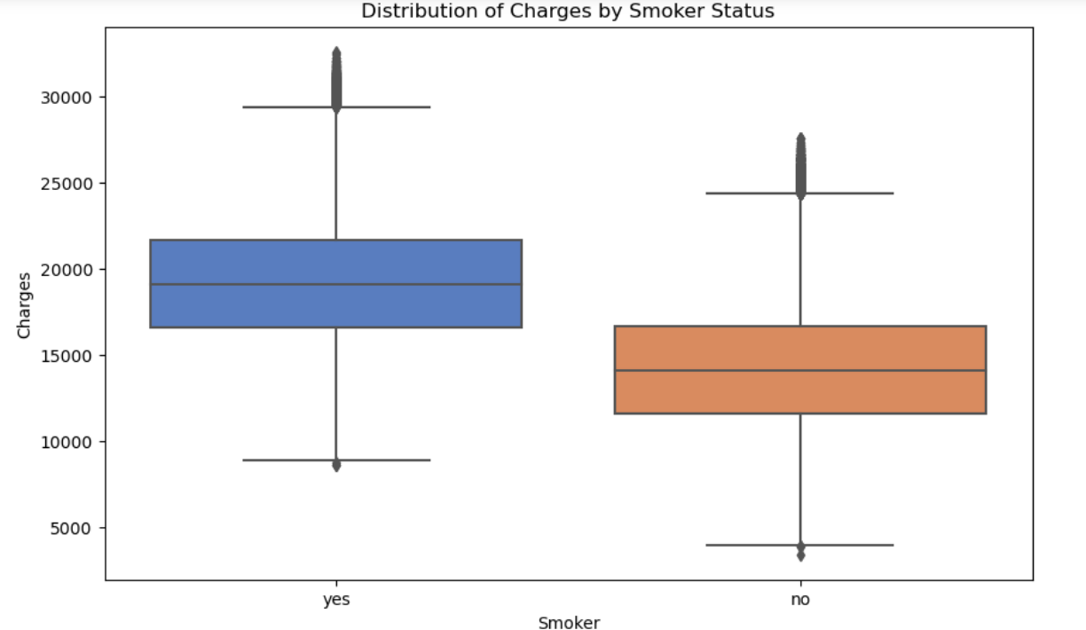

Slide 9
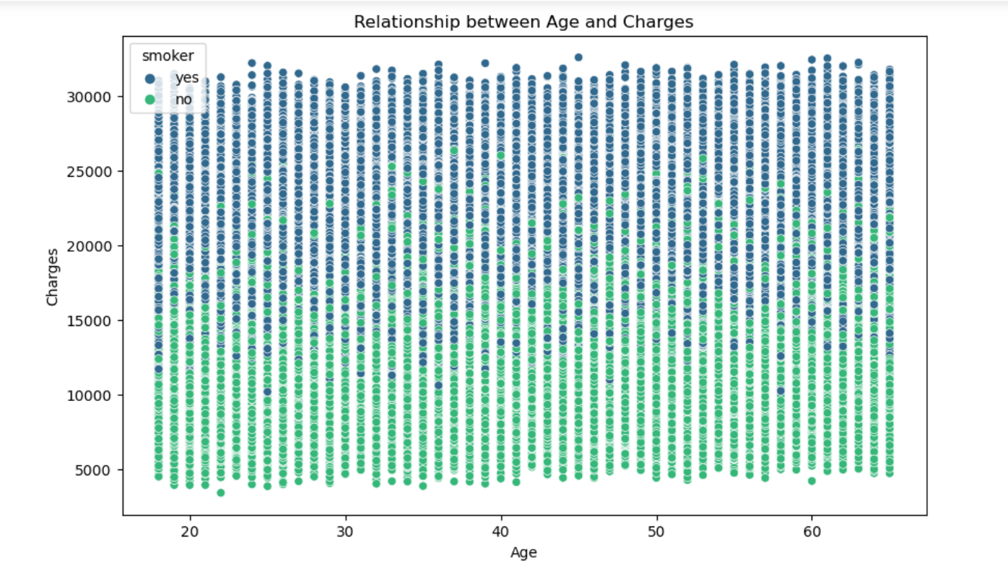
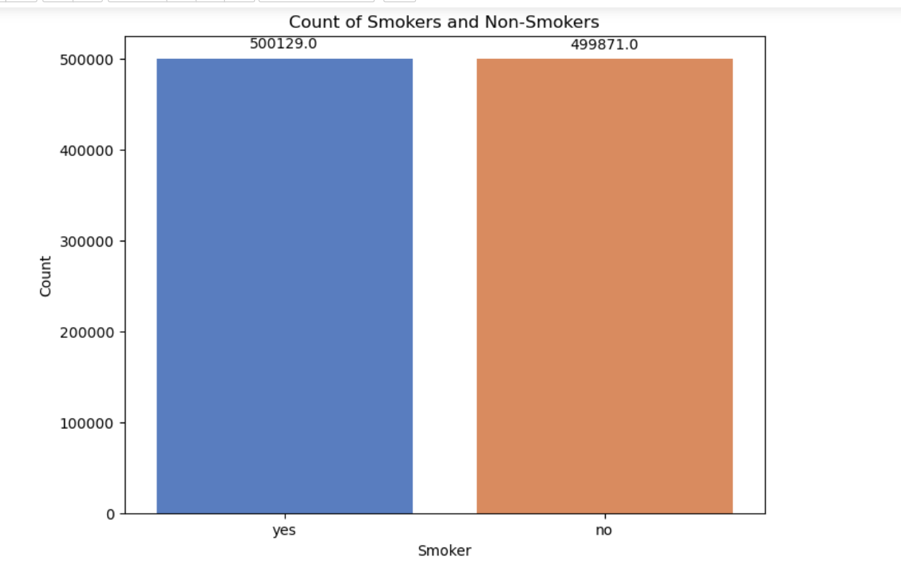

Slide 10
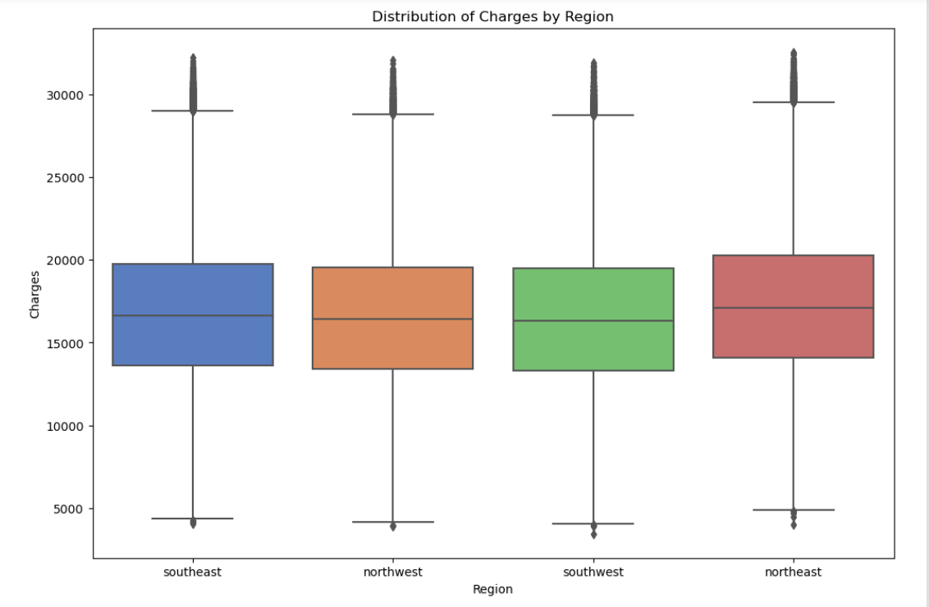
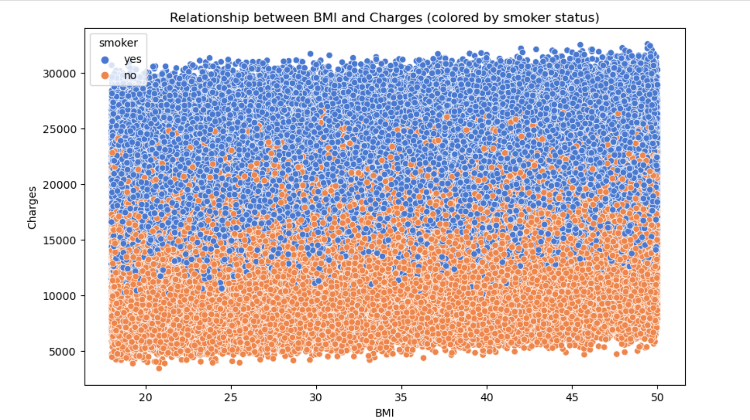

Slide 11
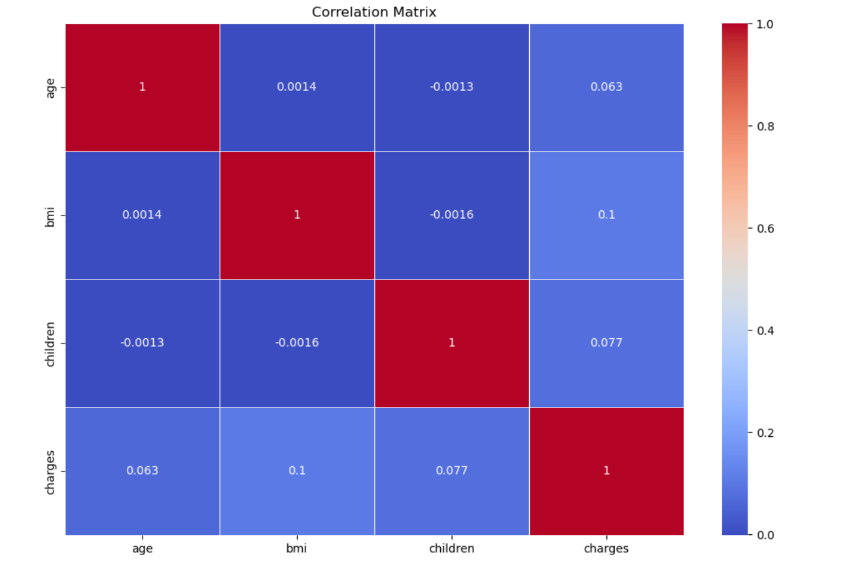
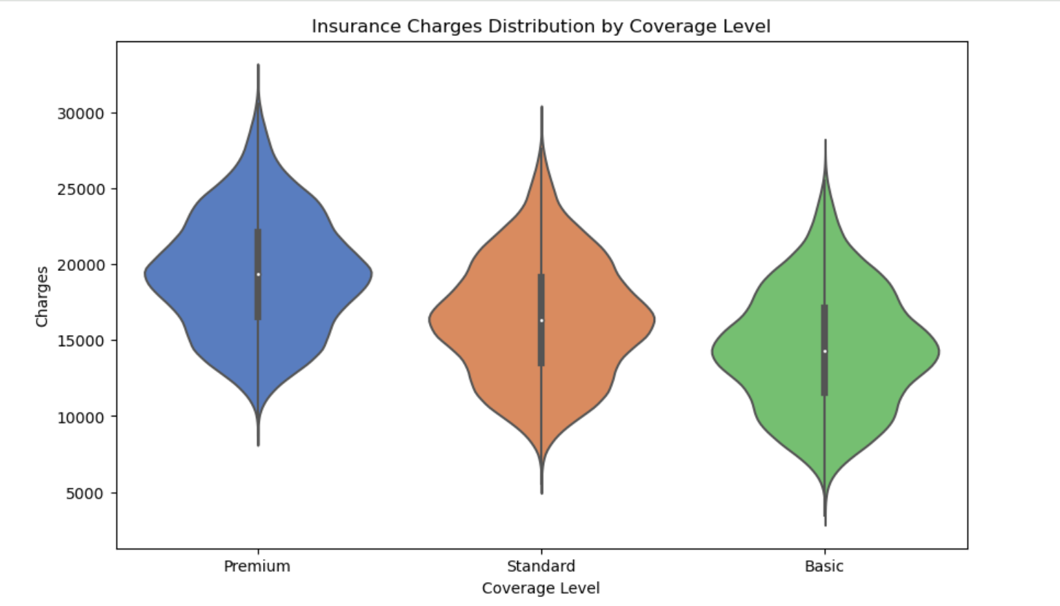

Slide 12
Machine learning predictions
In this project, machine learning techniques are applied to analyze and predict health insurance charges based on various factors.
By leveraging machine learning algorithms, we can build predictive models that estimate health insurance charges based on factors such as age, BMI, smoking status, and region.
These predictive models can help insurance companies better understand risk factors, set appropriate premiums, and make data-driven decisions to optimize business outcomes.

Slide 13
Regression models used in this project are:
Decision Tree Regression
Random Forest Regression
Linear Regression
Preprocessing
Data preprocessing is a critical step in machine learning workflows to ensure data compatibility with models.
Standardization and encoding techniques are applied to handle numerical and categorical features, respectively.
This step ensures that the data is in a suitable format for model training.

Slide 14
Model Building
The use of pipelines simplifies the workflow by combining preprocessing and modeling steps.
Utilization of the Pipeline class from Scikit-learn to combine preprocessing and modeling steps.
ColumnTransformer allows for applying different transformations to different types of features.
Utilization of the Pipeline class from Scikit-learn to combine preprocessing and modeling steps.
The model selected initially is Linear Regression, but other models can be easily substituted.
Notes:
##

Slide 15
Model Evaluation Results for linear regression
Model Evaluation
Splitting the dataset into training and testing sets using train_test_split.
Fitting the model on the training data using the fit method.
Making predictions on the testing data using the predict method.
Calculation of evaluation metrics:
Mean Absolute Error (MAE)
Mean Squared Error (MSE)
R-squared.
Mean Absolute Error: 250.34
Mean Squared Error: 83483.88
R-squared: 0.9957

Slide 16
Model building with Decision Tree Regressor
Decision Tree Regressor is utilized as an alternative model for predicting healthcare charges.
The same preprocessing steps are applied using the preprocessor pipeline.
Define a pipeline comprising the preprocessor and DecisionTreeRegressor.
Training data is split for model fitting, ensuring a robust evaluation of the model's performance.
Model Evaluation Results
MSE: 329418.30
MAE: 457.84
R-squared: 0.9831

Slide 17
Model building with Random Forest Regressor
Random Forest Regressor is employed as another model option for predicting healthcare charges.
Similar to previous models, preprocessing steps are integrated into the pipeline for data transformation.
Define a pipeline consisting of the preprocessor and RandomForestRegressor.
Training data is used to train the model, ensuring it learns patterns and relationships in the data.
Model Evaluation Results
MSE: 170077.18
MAE: 334.78
R-squared: 0.9913

Slide 18
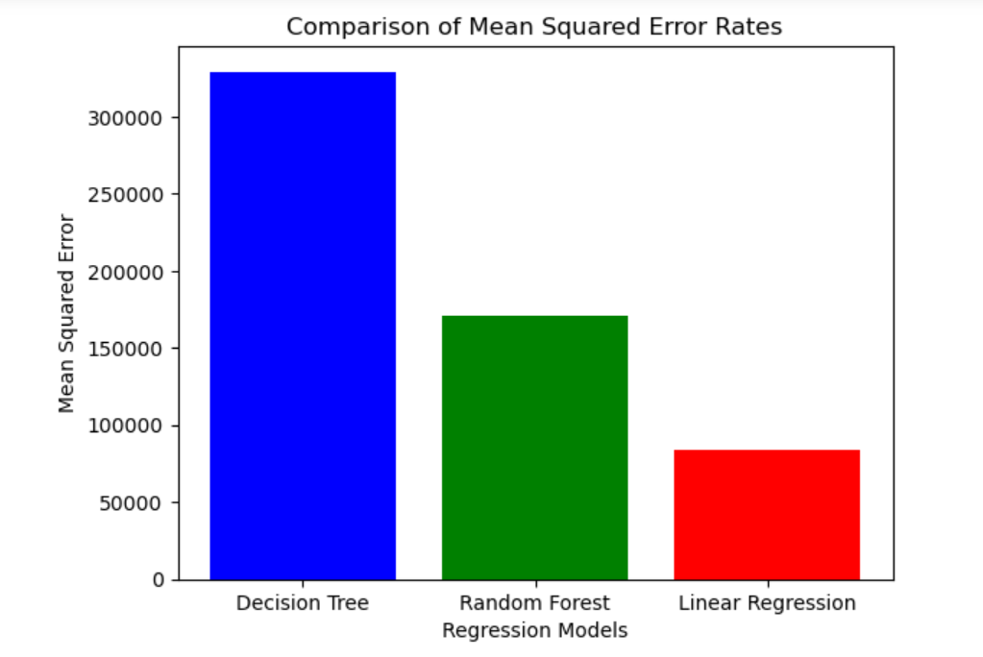
Comparison of all 3 models
Linear Regressor:
Mean Squared Error: 83483.88
Mean Absolute Error: 250.34
R-squared: 0.9957
Decision Tree Regressor:
MSE: 329418.30
MAE: 457.84
R-squared: 0.9831
Random Forest Regressor:
MSE: 170077.18
MAE: 334.78
R-squared: 0.9913

Slide 19
Linear Regression model emerges as the preferred choice for predicting healthcare charges due to its outstanding performance metrics
Linear Regression exhibits the lowest MSE and MAE, indicating superior predictive accuracy and precision.
With the highest R-squared value among the models, Linear Regression explains the most variance in the data.
The exceptional performance of Linear Regression makes it the recommended choice for predicting healthcare charges.

Slide 20
Web Application
Flask web application utilizes a pre-trained machine learning model to predict insurance charges based on user input.
Users input their demographic and health-related information, including age, gender, BMI, smoking status, and region, through a simple web form. This data is then transmitted to a pre-trained machine learning model, which utilizes historical insurance data to make predictions.
The model predicts insurance charges based on the provided information, returning the estimated costs to the user interface for display. By integrating machine learning with web technology, this application exemplifies a practical use case, enhancing accessibility to insurance pricing information for a wider audience.

Slide 21
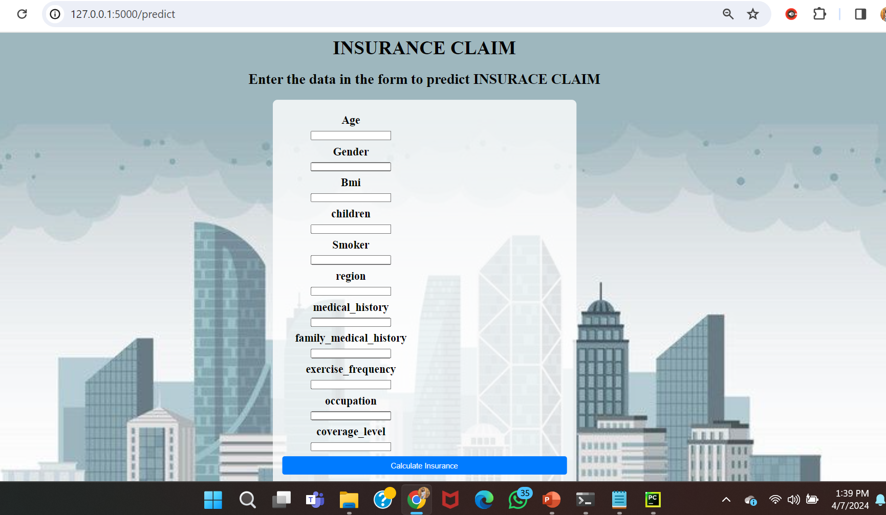
Web Application

Slide 22
Conclusion
My analysis involved robust data preprocessing and model building, utilizing Linear Regression, Decision Tree Regressor, and Random Forest Regressor.
The developed models demonstrated strong predictive performance in estimating healthcare charges, with the Linear Regression model exhibiting exceptional accuracy.
Implications: The accurate prediction of healthcare charges can facilitate informed decision-making and resource allocation in healthcare management, aiding in budgeting and financial planning.
The model's accuracy enables informed decision-making and resource allocation in healthcare management.
Applications extend to healthcare cost prediction, budgeting, and identifying cost drivers.

Slide 23
Limitations
Model Assumptions: Linear Regression models rely on assumptions such as linearity, independence of errors, which may not always hold true in real-world healthcare data. Violations of these assumptions can lead to biased estimates and inaccurate predictions.
Ethical and Legal Considerations: The use of predictive models in healthcare raises ethical and legal concerns related to patient privacy, fairness, and potential biases in decision-making. Ensuring transparency, accountability, and adherence to regulatory requirements is essential to mitigate these risks.
Future scope
Integration of Advanced Machine Learning Techniques: Explore the integration of advanced machine learning techniques such as deep learning and neural networks to capture intricate patterns and dependencies in healthcare data.
Integration with Value-Based Care Initiatives: Integrate predictive analytics models with value-based care initiatives to promote cost-effective and high-quality healthcare delivery.

Slide 24
References
Badawy, M., Ramadan, N. & Hefny, H.A. Healthcare predictive analytics using machine learning and deep learning techniques: a survey. Journal of Electrical Systems and Inf Technol 10, 40 (2023). https://doi.org/10.1186/s43067-023-00108-y
Krishnamoorthi R, Joshi S, Almarzouki H Z, Shukla P K, Rizwan A, Kalpana C, & Tiwari B (2022) A novel diabetes healthcare disease prediction framework using machine learning techniques. J Healthcare Eng. https://doi.org/10.1155/2022/1684017
Goyal P, Pandey S, Jain K, Goyal P, Pandey S, Jain K (2018) Introduction to natural language processing and deep learning. Deep Learn Nat Language Process: Creat Neural Netw Python 1–74. https://doi.org/10.1007/978-1-4842-3685-7

