Slide 1
Title: Exploring Health Insurance Charges Dataset
UMBC Data Science Master Degree Capstone
Dr. Chaojie (Jay) Wang
Author Name: Shreya Ayireddy
DA54897
GitHub Profile: https://github.com/ayireddyshreya
LinkedIn Profile: www.linkedin.com/in/shreya-ayireddy

Slide 2
Introduction
The "Predicting Health Insurance" aims to analyze various factors influencing medical costs and health insurance premium. Understanding these factors is crucial for developing accurate predictive models and gaining insights into the relationships among different variables.
Objective: Analyze factors affecting health insurance charges and build regression models to predict charges.

Slide 3
Dataset Overview
The dataset explores the relationship between individual characteristics (such as age, gender, BMI, smoking status) and external factors (region, occupation) with health insurance premiums. By studying this dataset, I aim to uncover patterns, correlations, and dependencies that can inform the development of machine learning models for predicting insurance charges.
Data Sources: Insurance dataset
Data Size: The file size is 101.94 MB. The dataset consists of 12 variables/columns and 1 million rows.

Slide 4
Data Dictionary
Column Name | Data Type | Definition | Potential Values
Age | Integer | The age of the insured individual. | Integer values
Gender | Object | The gender of the insured individual. | 'Male' or 'Female'
BMI (Body Mass Index) | Float | A measure of body fat based on height and weight. | Float values
Children | Integer | The number of children covered by the insurance plan. | Integer values
Smoking Status | Object | Indicates whether the individual is a smoker. | 'Smoker' or 'Non-Smoker'
Region | Object | The geographical region of the insured individual. | 'North', 'South', 'East', 'West'
Medical History | Object | Information about the individual's historical medical problems. | Categorical values
Family Medical History | Object | Information about the medical history of the family. | Categorical values
Exercise Frequency | Object | The frequency of the individual's exercise routine. | 'Never', 'Rarely', 'Occasionally', 'Frequently'
Occupation | Object | The occupation of the insured individual. | Categorical values
Coverage Level | Object | The type of insurance plan. | 'Basic', 'Standard', 'Premium'
Charges | Float | The health insurance charges for the individual. | Float values

Slide 5
Target variable
The target variable is the 'Charges' column. This variable represents the health insurance charges for the individual and would be the predicted value in the machine learning model.
Features/ Predictors
'Gender', 'smoker', 'region', 'medical_history', 'family_medical_history', 'exercise_frequency', 'occupation', and 'coverage_level' can be used as variables for predicting machine learning models. These variables represent categorical features, and depending on the nature of your predictive task, they can be valuable predictors for your model.

Slide 6
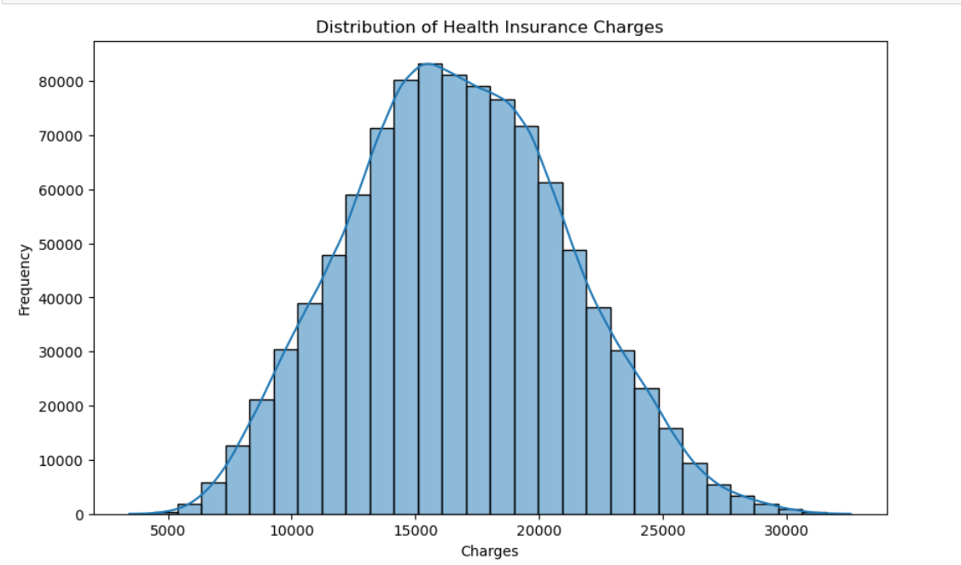
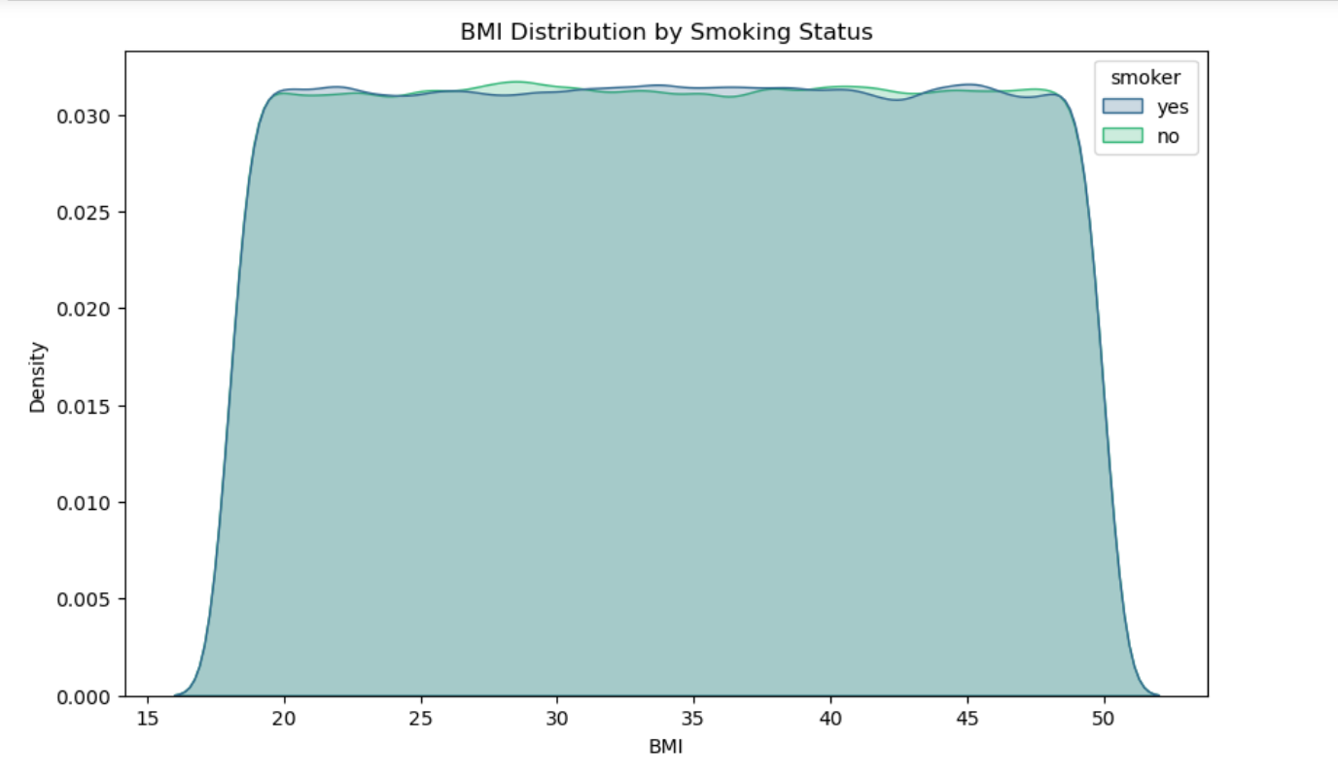
Exploratory Data Analysis

Slide 7
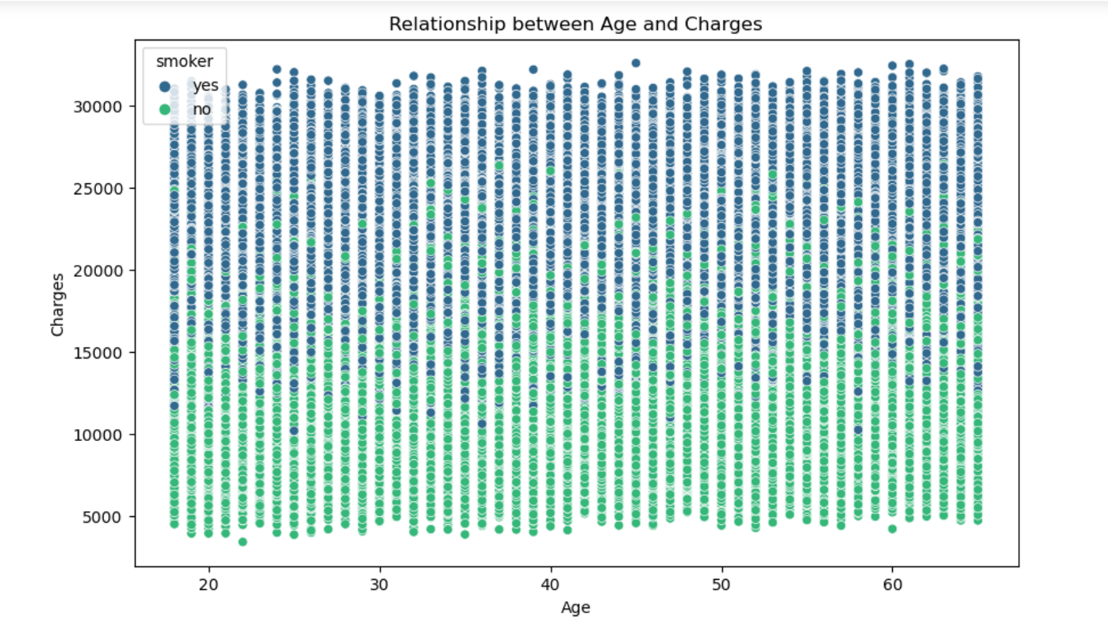
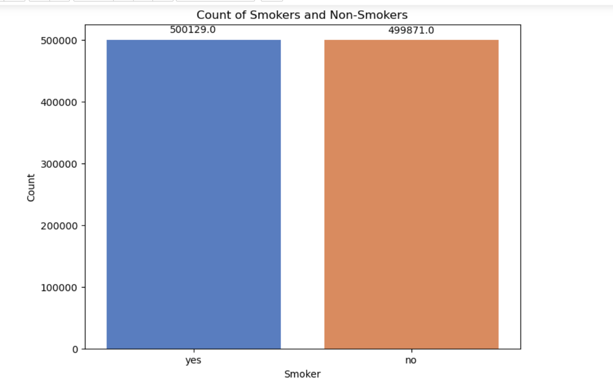

Slide 8
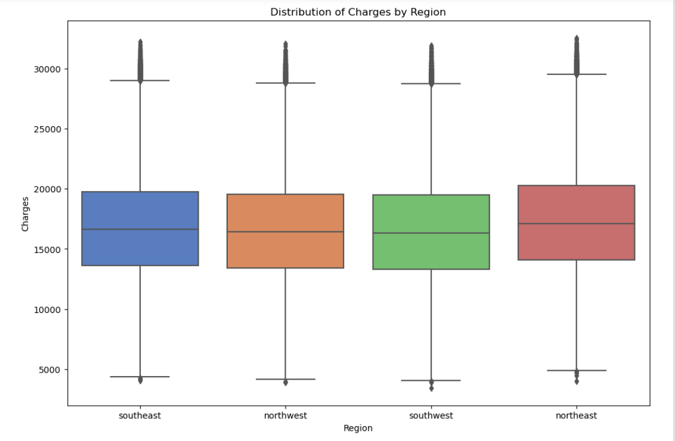
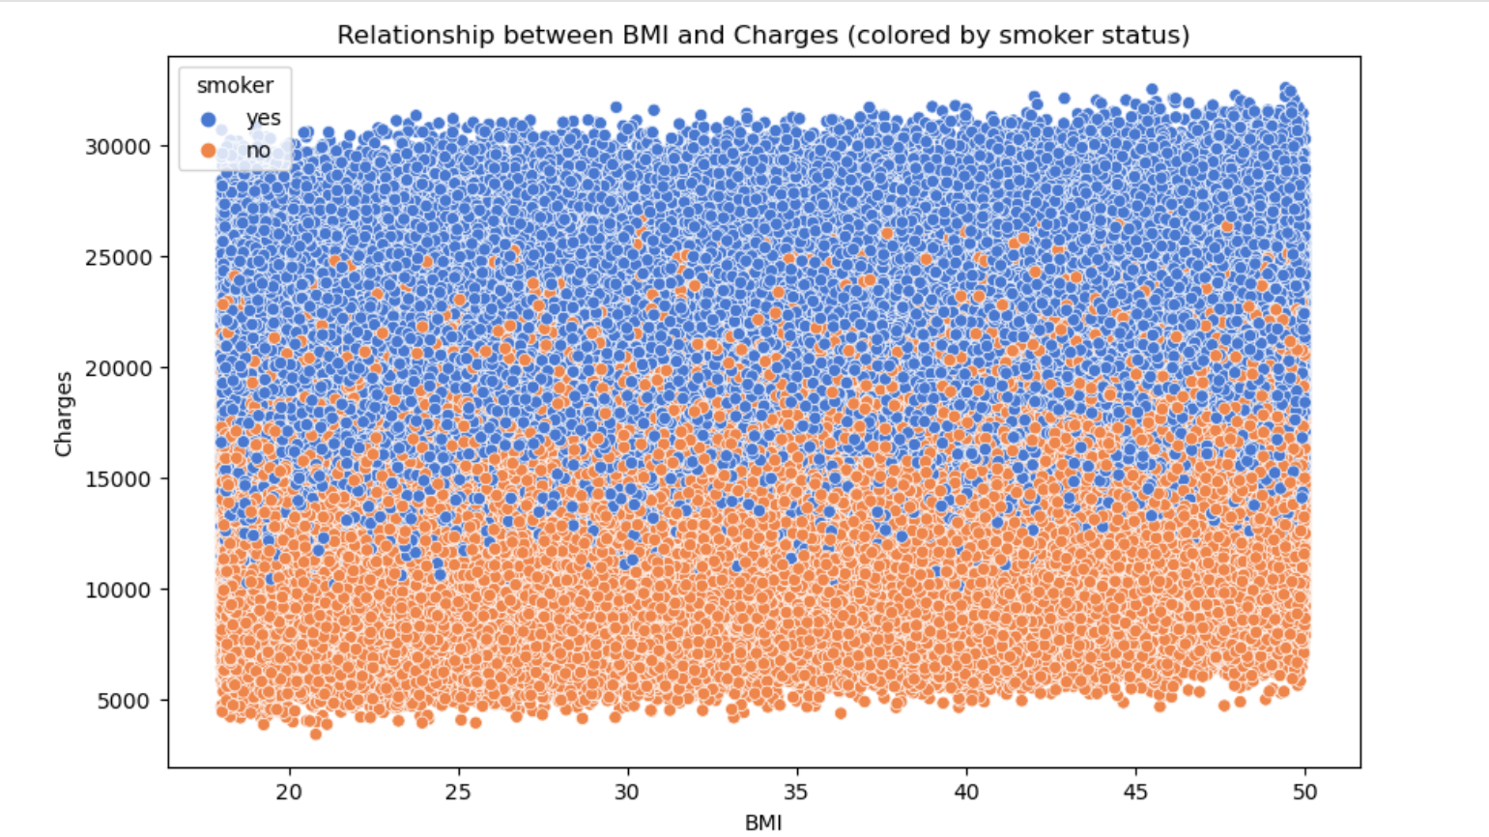

Slide 9
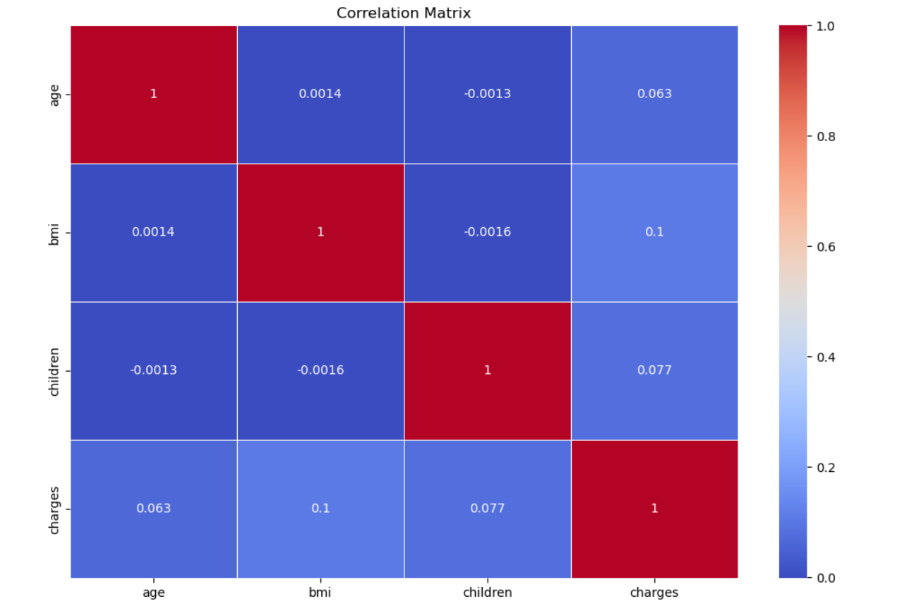
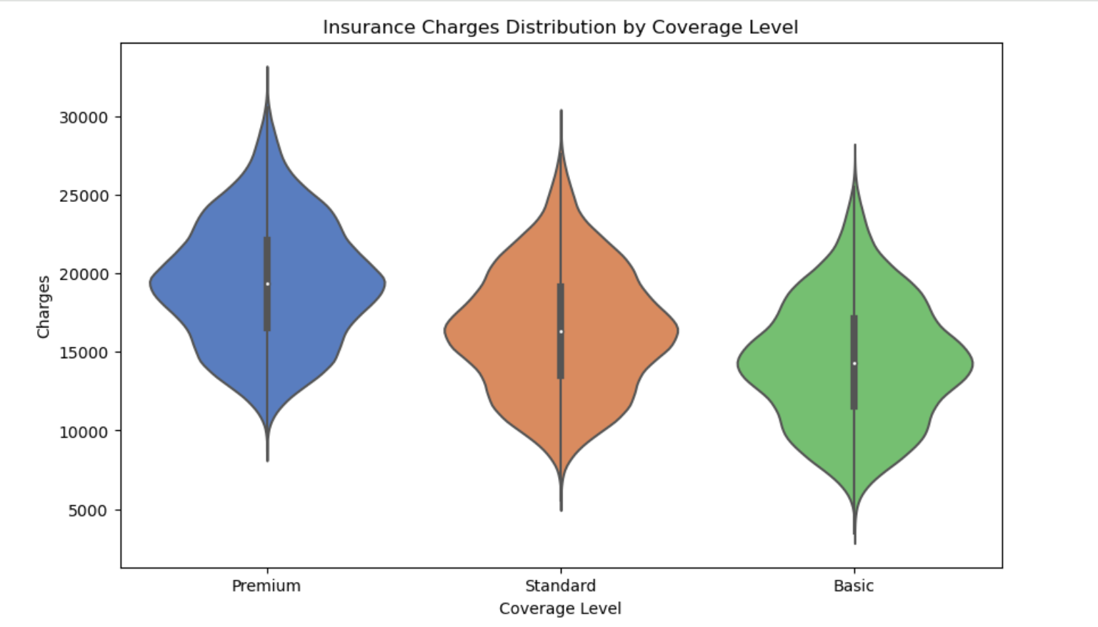

Slide 10
Machine learning predictions
In this project, machine learning techniques are applied to analyze and predict health insurance charges based on various factors.
By leveraging machine learning algorithms, we can build predictive models that estimate health insurance charges based on factors such as age, BMI, smoking status, and region.
These predictive models can help insurance companies better understand risk factors, set appropriate premiums, and make data-driven decisions to optimize business outcomes.

Slide 11
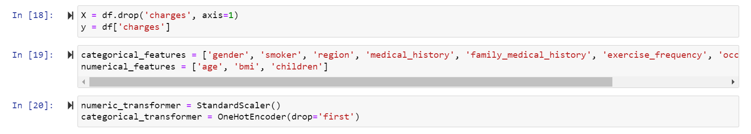
Regression models used in this project are:
Decision Tree Regression
Random Forest Regression
Linear Regression
Preprocessing

Slide 12
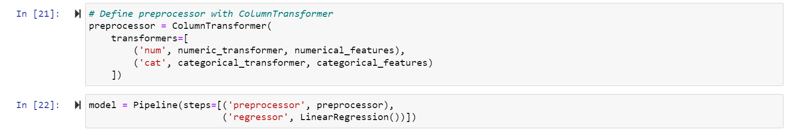
Model Building
The use of pipelines simplifies the workflow by combining preprocessing and modeling steps.
ColumnTransformer allows for applying different transformations to different types of features.
The model selected initially is Linear Regression, but other models can be easily substituted.

Slide 13
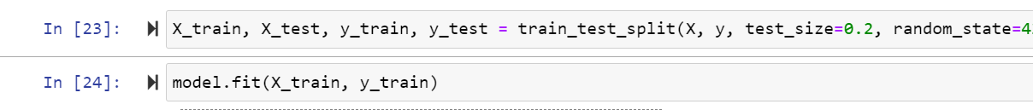
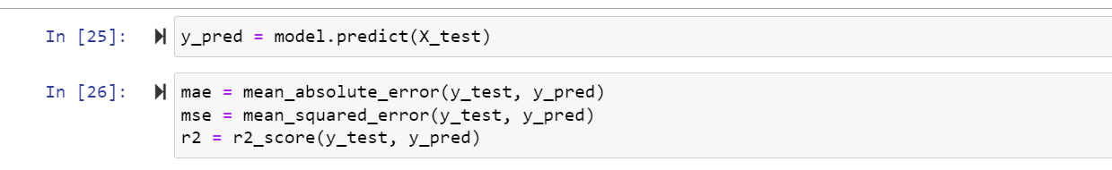
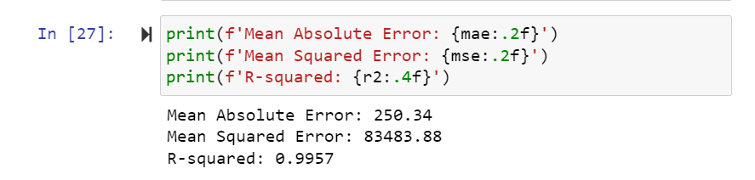
Model Evaluation Results
Model Evaluation

Slide 14
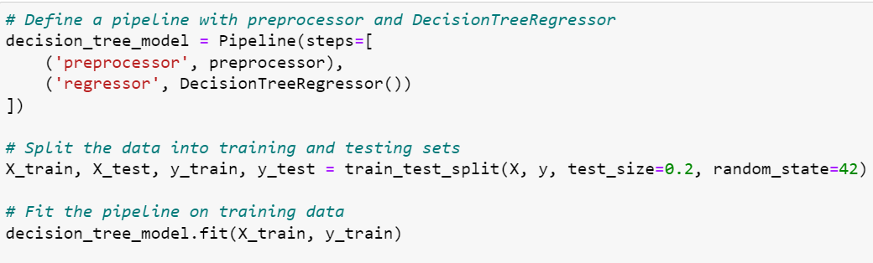
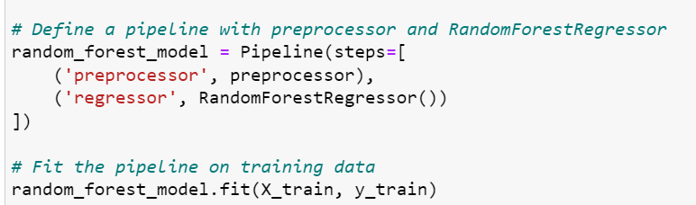
Model building with Decision Tree and Random Forest Regressor

Slide 15
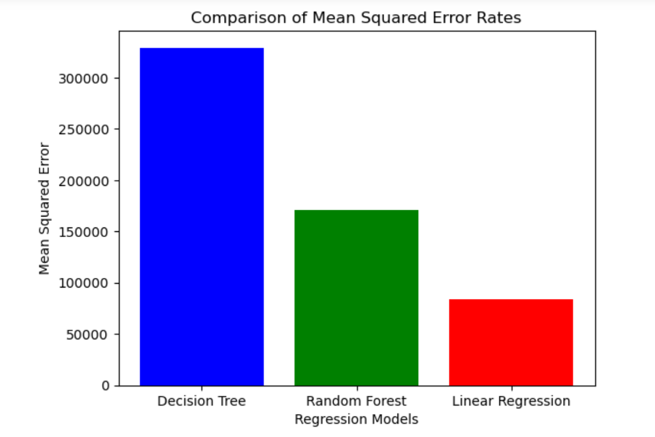
Decision Tree Regressor:
MSE: 329418.30
MAE: 457.84
R-squared: 0.9831
Random Forest Regressor:
MSE: 170077.18
MAE: 334.78
R-squared: 0.9913

Slide 16
Linear Regression model emerges as the preferred choice for predicting healthcare charges due to its outstanding performance metrics
Linear Regression exhibits the lowest MSE and MAE, indicating superior predictive accuracy and precision.
With the highest R-squared value among the models, Linear Regression explains the most variance in the data.
The exceptional performance of Linear Regression makes it the recommended choice for predicting healthcare charges.

Slide 17
Conclusion
Our analysis involved robust data preprocessing and model building, utilizing Linear Regression, Decision Tree Regressor, and Random Forest Regressor.
The developed models demonstrated strong predictive performance in estimating healthcare charges, with the Linear Regression model exhibiting exceptional accuracy.
Implications: The accurate prediction of healthcare charges can facilitate informed decision-making and resource allocation in healthcare management, aiding in budgeting and financial planning.
The model's accuracy enables informed decision-making and resource allocation in healthcare management.
Applications extend to healthcare cost prediction, budgeting, and identifying cost drivers.

