Slide 1
Results Section
Ayishat/Marshae 1:1
11/21/25

Slide 2
Goal
Answer question: What did the authors find?
What were the results (in relation to the objective/purpose stated in introduction)
Support findings with evidence—from data.
Form of statistics
“Methods are the roadmap, results are the photobook made after the trip”

Slide 3
Goal
What the results section does not do:
Attempt to interpret or analyze findings
To accomplish this:
Only state facts
Summarize findings inn unbiased and logical sequence

Slide 4
Structure: Overview
Data summary in connection with research question
Relatively short section
Audience alternates between text and accompanying figures
Many key findings/statistics are NOT in text, but in accompany tables/figures
Relevant data/findings connect with goal of study

Slide 5
Structure: Overview
Scale in complexity of analysis
Univariate
Bivariate
Multivariate
Additional analysis (e.g heterogeneity/trend)

Slide 6
Structure: Descriptive Statistics
Start with description of sample (demographics, distribution of exposure or outcome)
Highlight key trends in study population
Descriptive statistics
Univariate
Bivariate
Notes:
https://www.sciencedirect.com/science/article/abs/pii/S0895435618309867

Slide 7
Structure: Descriptive Statistics
“50.9% of participants identified female and 49.1% identified as male (Table 1). The average age across the study population was 47 years. The mean age across food security categories besides the high food secure group (49) was 42 years . Non-Hispanic White adults represented majority of the population (42.8%), followed by Non-Hispanic Black (22.4%), Mexican American (15.5%), other Hispanic (9.0%), and individuals that identify with other racial identities or multi-racial (10.3%). For education levels, 25.4% of participants had an education less than 9th grade, 25.5% graduated from high school or an education equivalent, 27.4% attained some level of college, and 21.7% held a college degree or higher.”
Notes:
Comes across again very much like a list. That’s not the goal.

Slide 8
Structure: Descriptive Statistics
“50.9% of participants identified female and 49.1% identified as male (Table 1). The average age across the study population was 47 years. The mean age across food security categories besides the high food secure group (49) was 42 years . Non-Hispanic White adults represented majority of the population (42.8%), followed by Non-Hispanic Black (22.4%), Mexican American (15.5%), other Hispanic (9.0%), and individuals that identify with other racial identities or multi-racial (10.3%). For education levels, 25.4% of participants had an education less than 9th grade, 25.5% graduated from high school or an education equivalent, 27.4% attained some level of college, and 21.7% held a college degree or higher.”
Notes:
Comes across again very much like a list. That’s not the goal.

Slide 9
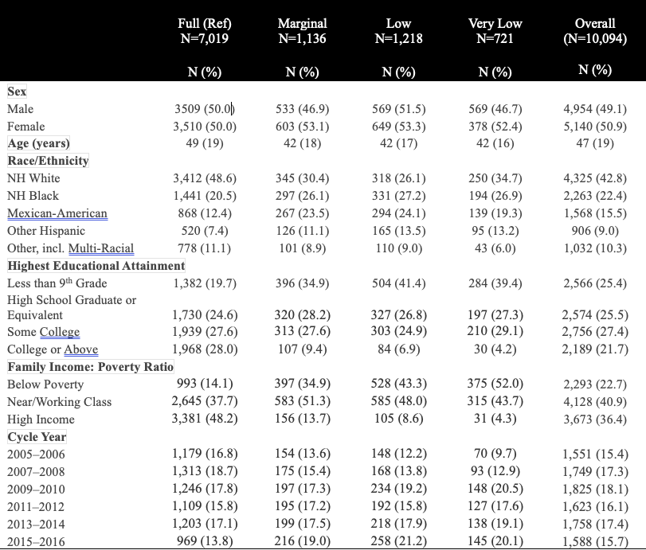
Structure: Descriptive Statistics
0
.
What stands out?
What stands out in relation to the exposure?
What proportion of individuals are exposed/total?
Additional questions to consider:
Deviations in distribution of covariates?
Potential confounding/selection?
Potential subgroup indicators?
Notes:
Comes across again very much like a list. That’s not the goal.

Slide 10
Structure: Main Analysis
Description of key findings from unadjusted* and adjusted of primary exposure/primary outcome
Table 2 or 3; Figure 1 or 2
Focus on significant findings if present, in the context of objective/ hypothesis.
Generally do not include p-values unless for test of heterogeneity/trends etc.
Highlight measure of association [measure of certainty]
Odds Ratio [95% CI]
Rate Ratio [95% CI]
Percent Difference [95% CI]
Notes:
Use similar sentences and words to present similar results and do not try to find new ways to write the same (i.e., synonyms), as this will only confuse the reader.
Ensure Ayishat understands unadjusted and adjusted.
Unadjusted: measure that is crude. Where we can isolate one risk factor and see its impact.
Adjusted takes into account all of those other characterstics we described in our study sample that may have an impact on the exposure and outcome, thus impacting the association. So we need to adjust for those factors.
Also helps trained epidemiogolists evaluate potential confounding caused by variables measured and unmeasured
https://beckydawson.substack.com/p/reading-the-results-section

Slide 11
Structure: Main Analysis
Additional tips:
Present findings with experimental/exposed group compared to reference
Highlight findings with tables/figures referenced
Use the same order when presenting data
Use similar sentences/words to present similar trends
Yes this will feel redundant!
Consistently use decimals for reporting figures
Notes:
https://www.jclinepi.com/article/S0895-4356%2813%2900129-7/fulltext

Slide 12
Structure: Main Analysis
“For BPA, percent differences ranged from 1.80% in the marginal group to 7.61% in the very low food security group, with 95% confidence intervals from –5.91% to 21.23%.”
Recall: We are interested in the association between some exposure and some outcome.
That is does the distribution of Y depend on the presence of A?
What is the magnitude of the measure of the strength of the association we estimate (i.e % difference)? Is it significant? Is it meaningful?
Notes:
This reads more like a list. Like reading off table. This reads less like an sentence detailing measure of association.

Slide 13
Structure: Main Analysis
“For BPA, percent differences ranged from 1.80% in the marginal group to 7.61% in the very low food security group, with 95% confidence intervals from –5.91% to 21.23%.”
Compared to who? i.e 1.80% Higher than who?
Were these values significant?
What was the measure of certainty for each?
This is a categorical exposure were there any notable trends across food security in the way the outcome changed? Does that matter?
Notes:
This reads more like a list. Like reading off table. This reads less like an sentence detailing measure of association.

Slide 14
Structure: Main Analysis
“For BPA, percent differences ranged from 1.80% in the marginal group to 7.61% in the very low food security group, with 95% confidence intervals from –5.91% to 21.23%.”
Compared to who? i.e. 1.80% Higher than who?
Start with your comparison: marginal, low, and/or very low COMPARED to high food security individuals.
Were these values significant?
Identify the significant association to better see picture of data.
What was the measure of certainty for each?
Always indicate keep measure of association w/ measure of certainty [% Difference (95% CI: Lower, Upper)
This is a categorical exposure were there any notable trends across food security in the way the outcome changed? Does that matter?
Several of your phenols trend slightly upwards then downwards. Several are negative % differences indicating higher levels of phenols with reduced food security.
Notes:
This reads more like a list. Like reading off table. This reads less like an sentence detailing measure of association.

Slide 15
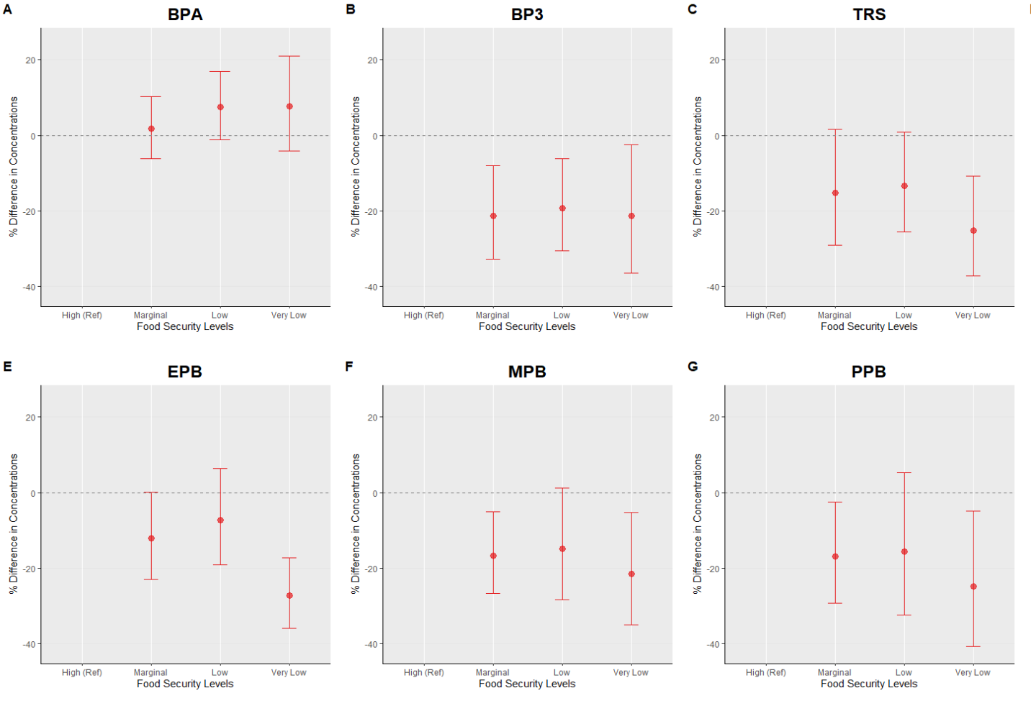
Structure: Main Analysis
Significant findings?
Trends across levels of reduced food security?
Above or below the reference?
Higher or lower concentrations compared to the reference?
Notes:
Practice language.
Signficant in reference group
*

Slide 16
Structure: Secondary Analyses
Think of “Aim 2”
Secondary exposure/outcome
Heterogeneity/Trends/Mediation or other complex analysis proposed
Still in context of main results, now expounding
Are there subgroup effects?
Are there third variables of interest that explain or result in different A→Y association we previously reported on?

Slide 17
Structure: Secondary Analyses
Start each analyses in new paragraph
Indicate w/ sentence beginning of new results section to provide context
In the context of interaction/effect measure modification report relevant p_{interaction}.
Discuss subgroup effects in context of relative comparison
Higher/lower, stronger etc.

Slide 18
Structure: Ancillary Analysis
Sensitivity Analysis
Post-Hoc Analysis
In general:
Keep it brief, and utilize space to discuss findings in the context of generating new hypothesis

