Slide 1
DAC_PHASE4
Continue building the analysis by creating visualization using IBM Cognos and integrating Python Code advanced analysis
DONE BY:
AYISHWARYA.C
SUJI.S
SRINITHYA.T

Slide 2
PROCESS1
Here as we created interactive dashboards and reports that display insights such as popular pages, traffic sources, and user engagement metrices.
Step 1: Data Connection and Modeling
Data Connection:
Connect IBM Cognos to your data source, which could be a database, data warehouse, or any other data repository.
Import the necessary tables or datasets containing information about popular pages, traffic sources, and user engagement metrics.
2.Data Modeling:
Create relationships between the tables to establish connections based on common fields (e.g., page ID, source ID, user ID).
Create calculated fields or transformations as needed. For instance, calculate engagement metrics like session duration, bounce rate, etc.

Slide 3
Step 2: Creating Reports
Create Reports:
Design individual reports for popular pages, traffic sources, and user engagement metrics separately.
Drag and drop appropriate fields onto the report canvas to display relevant data.
Apply filters to focus on specific time periods or other relevant criteria.
Visualization:
Use various visualization options such as charts, graphs, and tables to represent data effectively.
Bar charts, line graphs, and pie charts are suitable for showing popular pages and traffic sources.
For user engagement metrics, consider using KPIs, gauges, or heat maps.
Step 3: Creating Dashboards
Create a New Dashboard:
Start a new dashboard project in IBM Cognos.
Add Report Outputs:
Add the reports you created earlier to the dashboard.
Arrange them in a visually appealing manner. Consider placing popular pages and traffic sources side by side for comparison.
Interactivity:
Add interactivity by linking different elements. For instance, clicking on a specific page in the popular pages report could update the traffic sources report dynamically.
Use prompts to enable users to filter data interactively. For example, allow users to select a specific date range or region.

Slide 4
Visualization and Formatting:
Ensure consistency in colors, fonts, and other visual elements across reports and charts to maintain a professional look.
Add tooltips and legends to help users understand the data better.
Testing:
Test the interactivity and responsiveness of the dashboard. Ensure that all linked elements work as expected.
Step 4: Deployment and Sharing
1.Save and Publish:
Save your dashboard and reports in the desired format and publish them to the IBM Cognos server.
2.Set Permissions:
Configure permissions to control who can access the dashboard and reports. Define roles and access levels for different users or groups.
3.Sharing and Collaboration:
Share the dashboard with intended users or teams. They can access it through a web browser, enabling easy collaboration and data-driven decision-making.

Slide 5
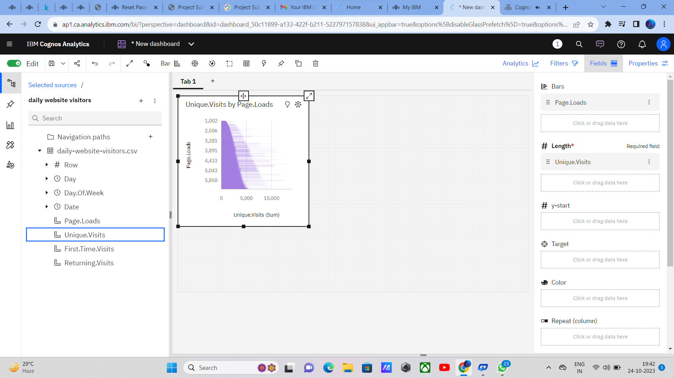
Visualization of bar chart

Slide 6
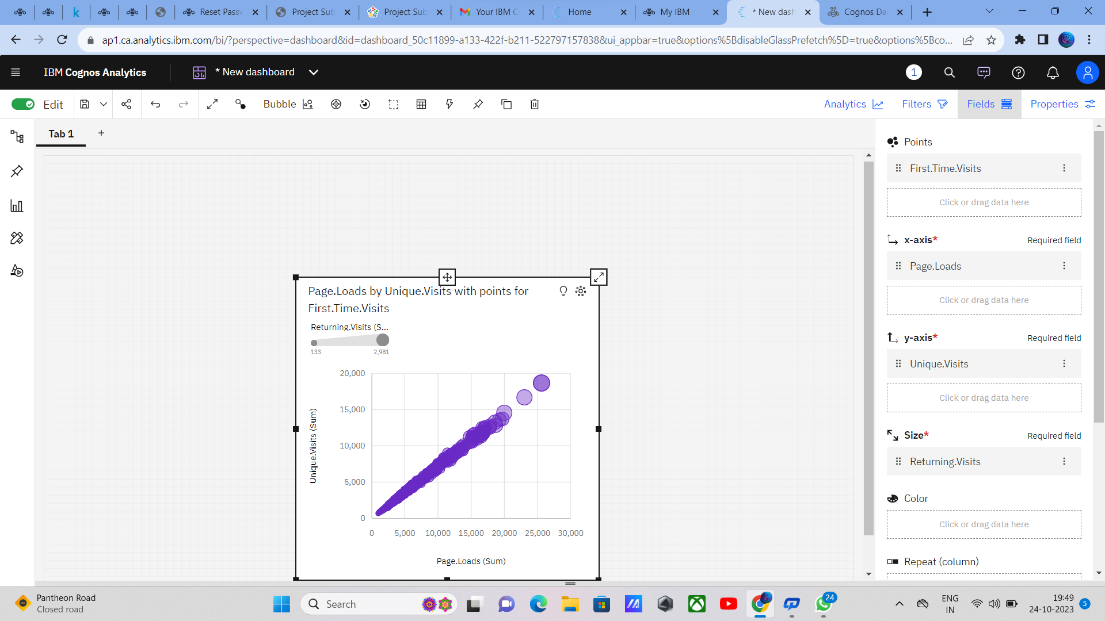
Visualization of bubble sort

Slide 7
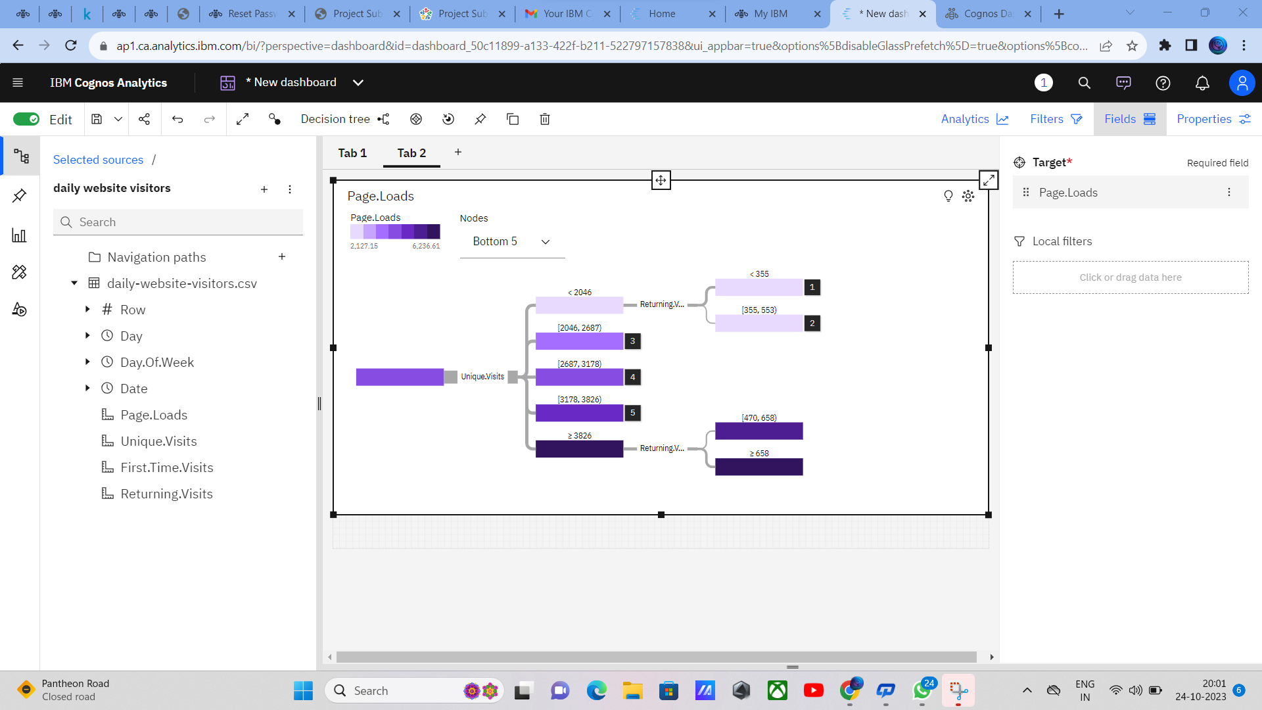
Visualization of Decision tree

Slide 8
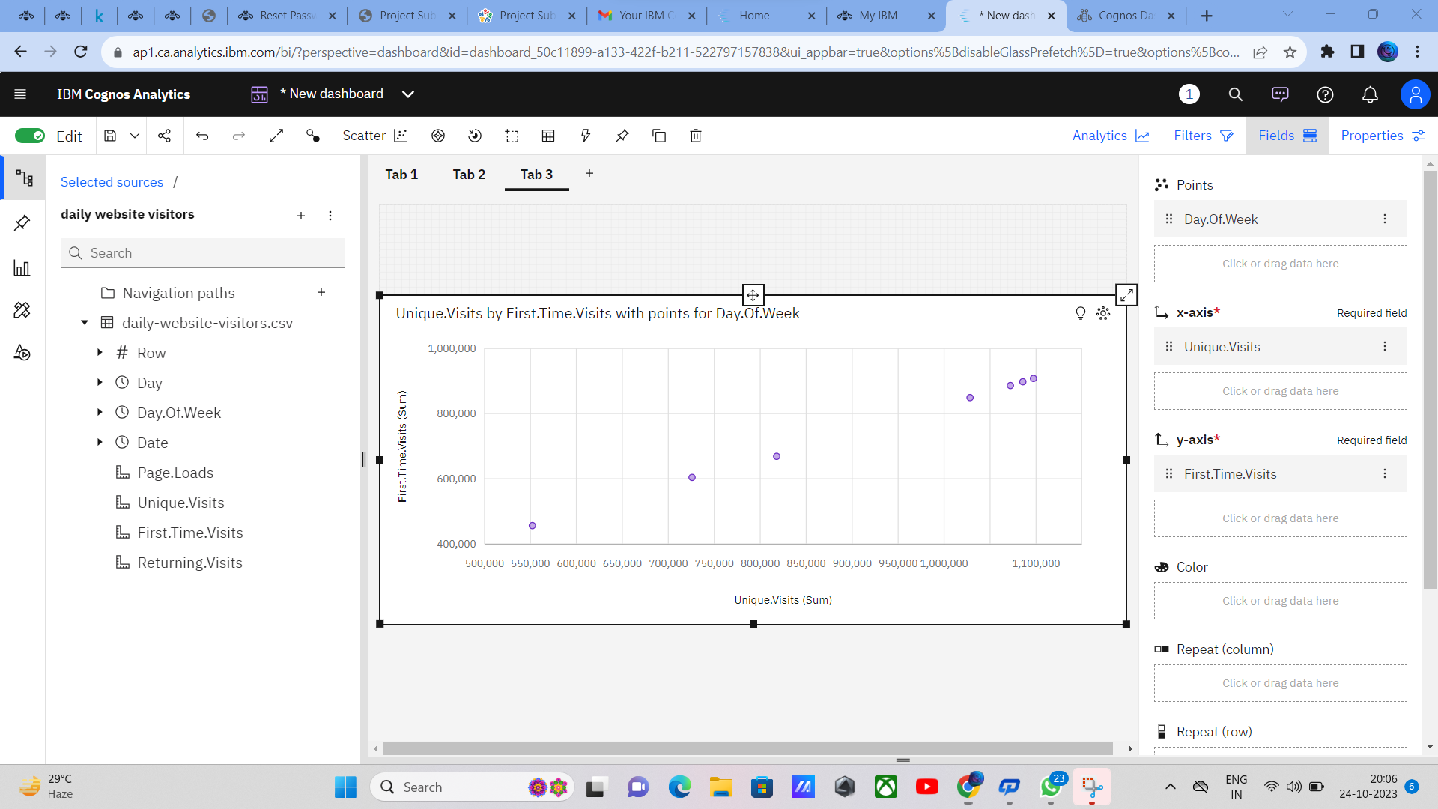
Visualization of Scatter plot

Slide 9
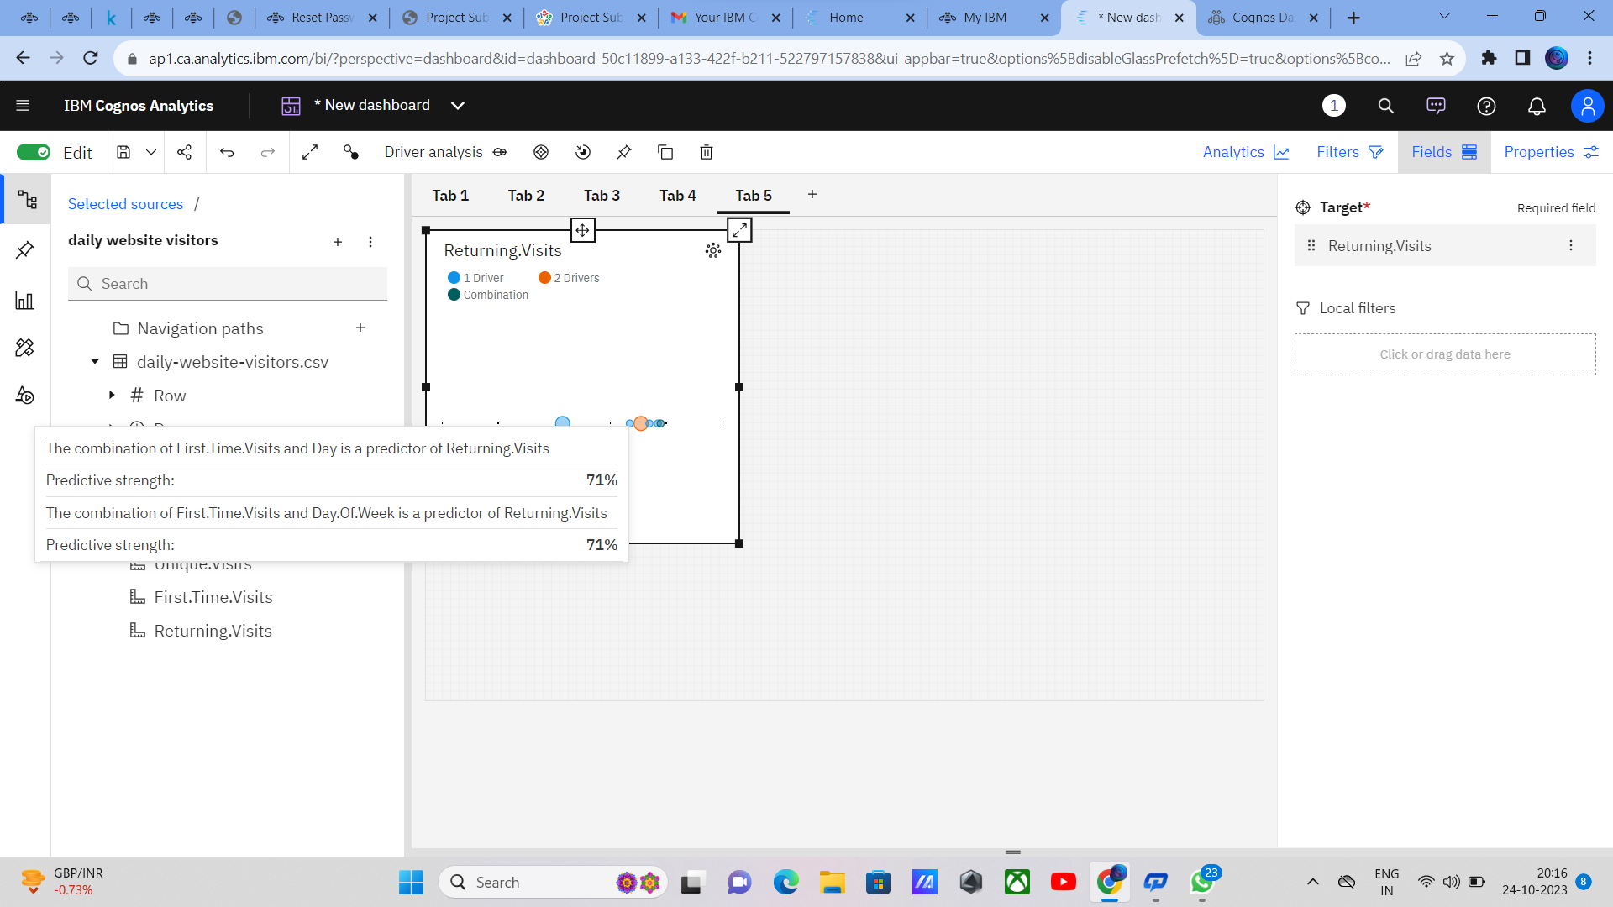
Visualization of Driver analysis

Slide 10
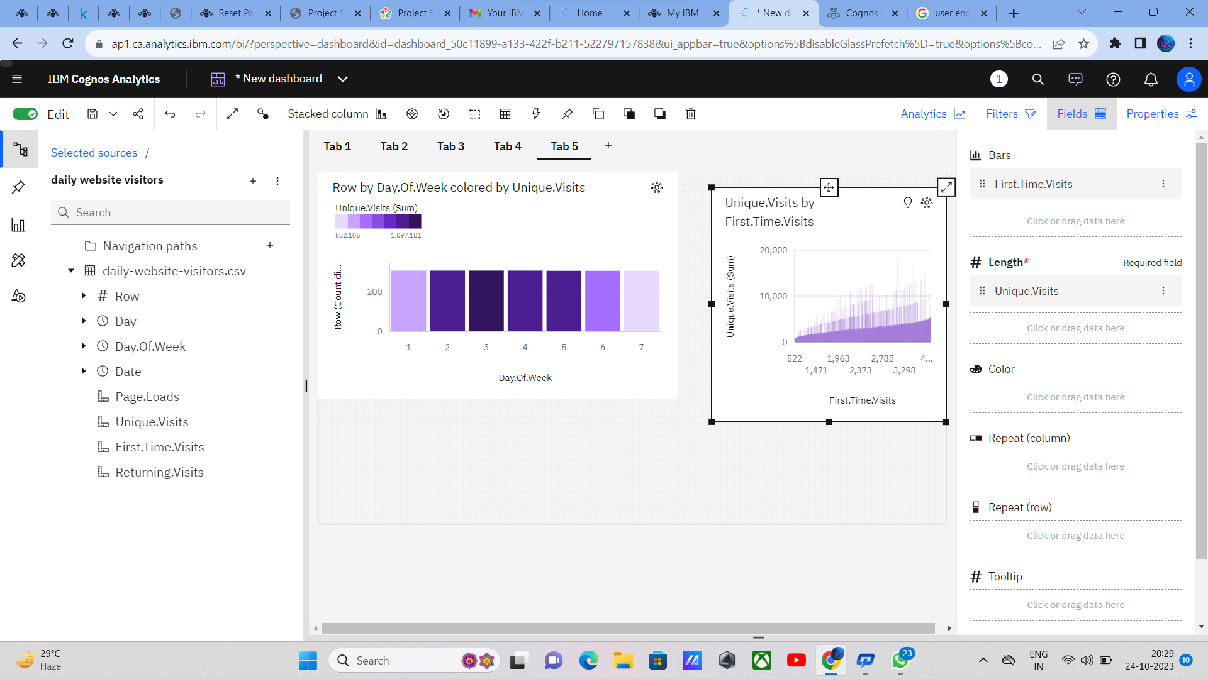
Visualization of Stacked Column

Slide 11
PROCESS 2:
Here as we creating the visualization using integrating Python Code advanced analysis
1. Introduction
Brief overview of the project and its objectives.
Importance of data visualization in deriving meaningful insights from data.
Introduction to the dataset: brief description and its significance.
2. Project Setup and Libraries
Setting up the Python environment: Anaconda, Jupyter Notebooks, or any other IDE.
Installing necessary libraries: NumPy, Pandas, Matplotlib, Seaborn, Plotly, etc.
Importing the dataset into Python for analysis.
3. Data Exploration and Preparation
Exploratory Data Analysis (EDA) techniques: summary statistics, data distribution, etc.
Handling missing values, outliers, and data cleansing techniques.
Feature engineering: creating new features from existing data for visualization.

Slide 12
4. Basic Visualization Techniques
Introduction to basic charts: line plots, scatter plots, bar charts.
Customizing basic charts for better representation.
5. Advanced Visualization Techniques
a. Heatmaps and Correlation Analysis
Creating heatmaps to visualize correlations between variables.
Using diverging color maps to emphasize positive and negative correlations.
b. Interactive Visualizations with Plotly
Building interactive charts: interactive line plots, scatter plots, and histograms.
Adding interactive elements: hover effects, zoom functionalities.
c. Geospatial Visualization
Plotting data on maps: Folium library for leaflet maps.
Creating choropleth maps to visualize data across geographical regions.
6. Time Series Analysis and Visualization
Handling time series data: date-time parsing, frequency analysis.
Creating time series plots, seasonal decomposition, and trend analysis.

Slide 13
7. Advanced Chart Customization
Customizing plot appearance: colors, labels, annotations.
Using styles and themes for consistent and visually appealing charts.
8. Integrating Python Code for Analysis
Writing functions and classes for specific data analysis tasks.
Integrating these functions with visualization techniques.
9. Creating a Dashboard (Optional)
Introduction to dashboard frameworks like Dash or Streamlit.
Building an interactive dashboard to visualize multiple aspects of the data.
10. Conclusion and Insights
Summary of key findings and insights derived from the visualizations and analysis.
How the visualizations helped in understanding the dataset better.

Slide 14
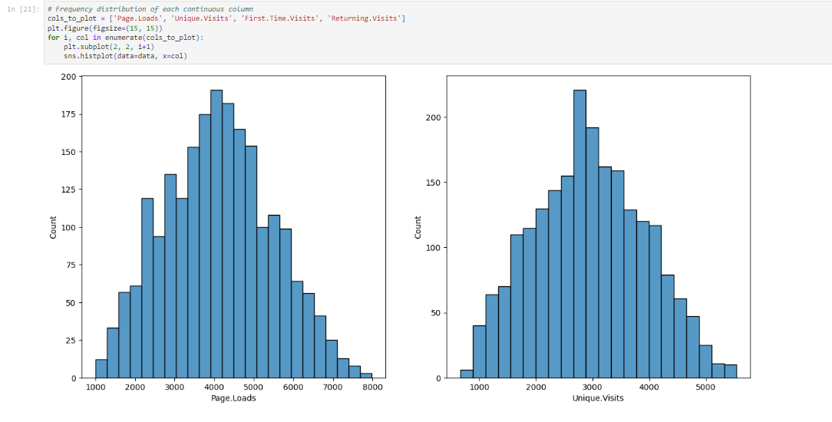
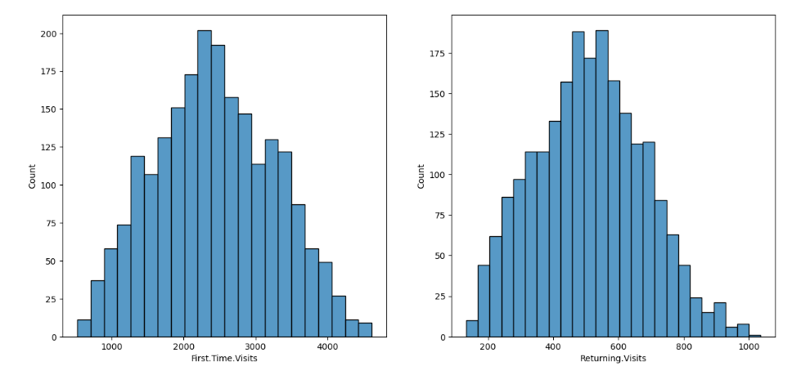

Slide 15
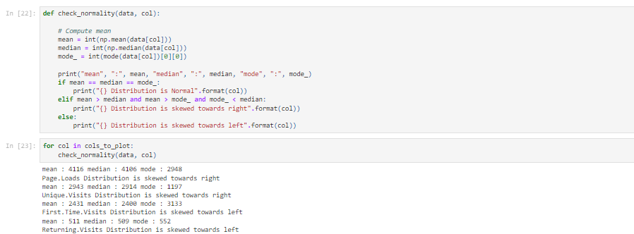

Slide 16
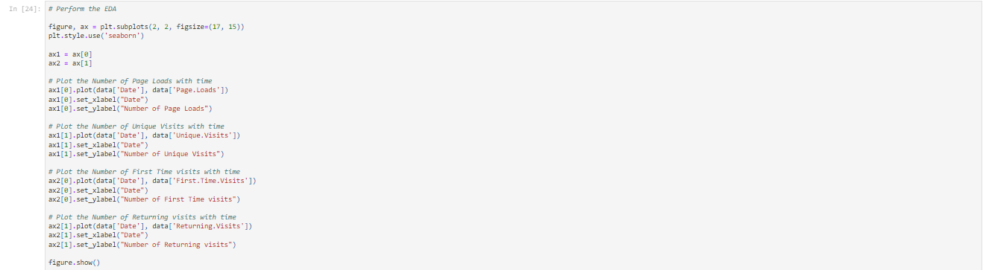
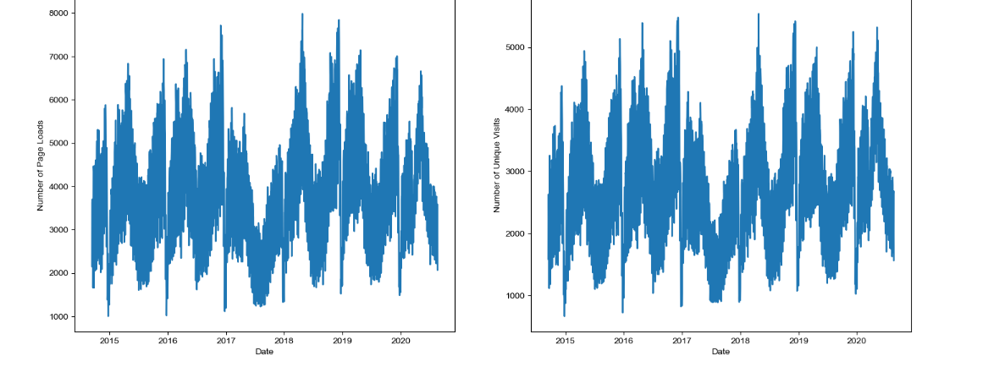
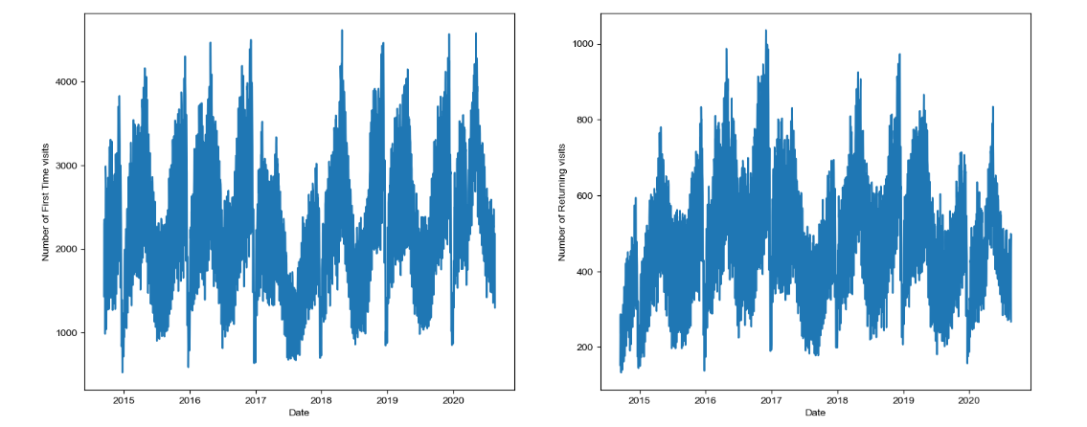

Slide 17
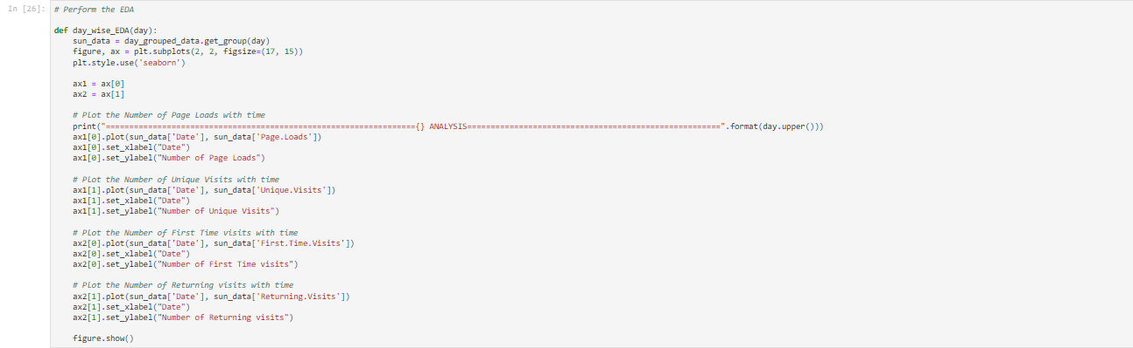
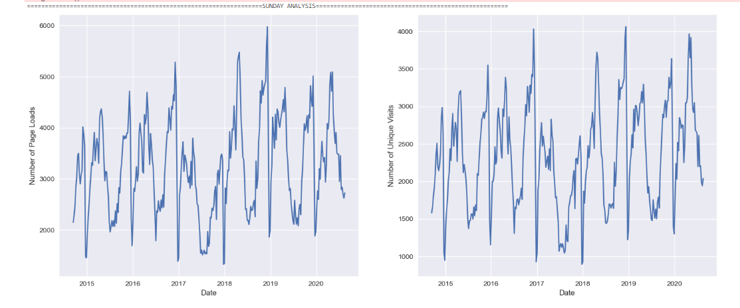
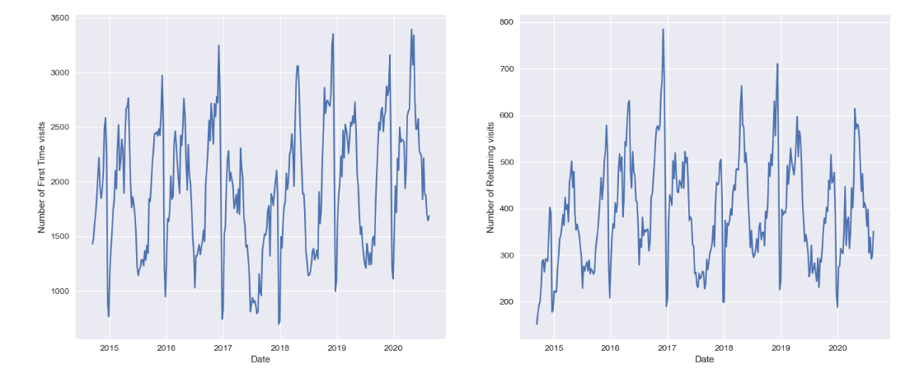

Slide 18
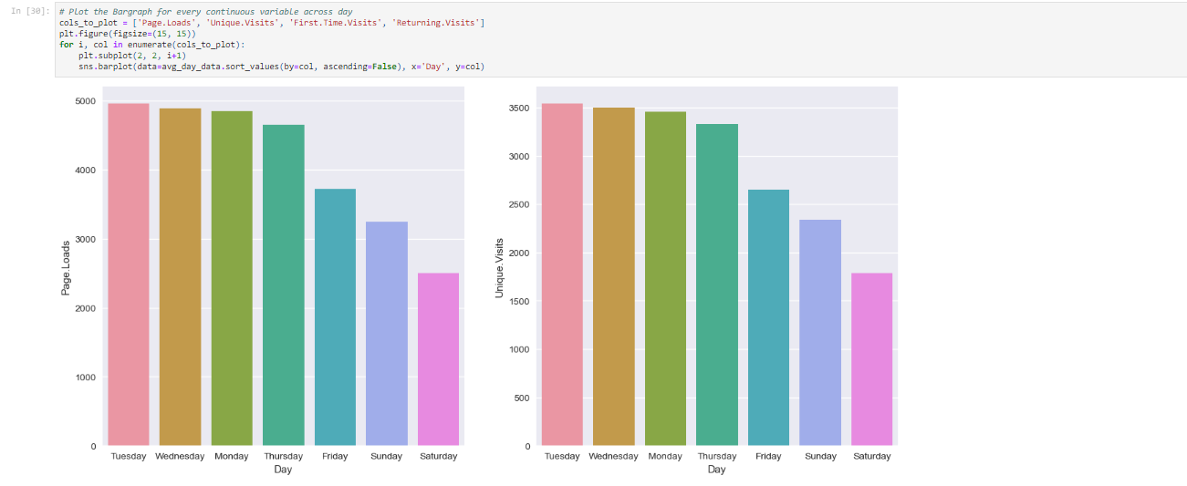
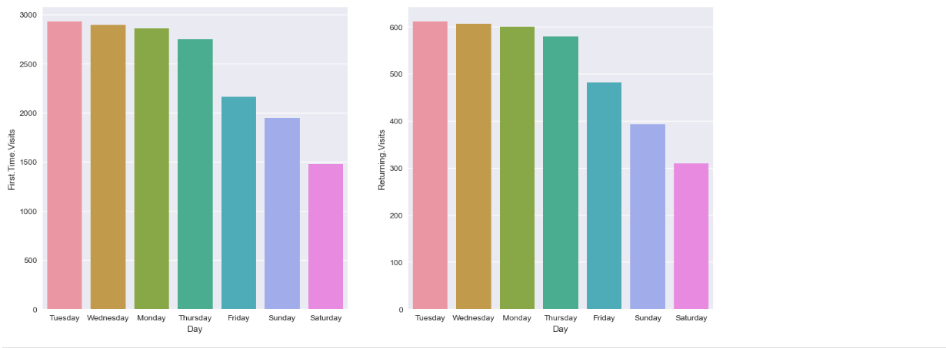

Slide 19
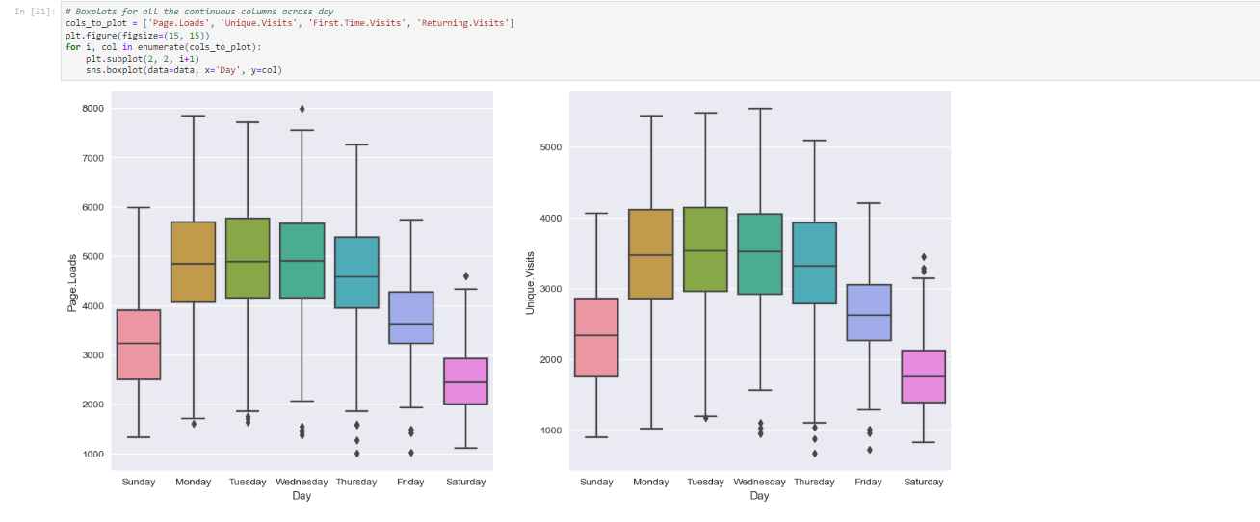
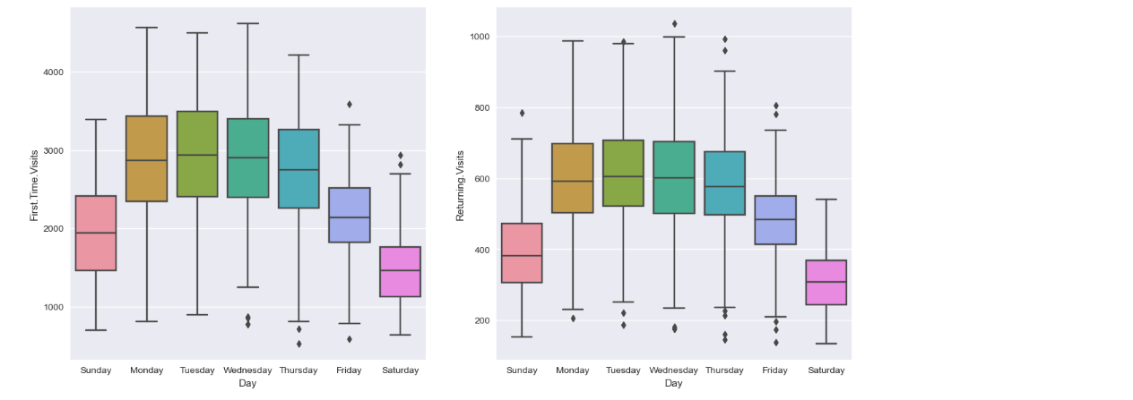

Slide 20
