Slide 1
自然语言处理技术与大语言模型

Slide 2
Outline
AI & NLP
Tokenize
Word Embedding
Transformer
BERT
GPT

Slide 3
AI & NLP
What is NLP？
Definition：
“NLP（Natural Language Processing） is a subfield of AI that focuses on the interaction between computers and humans through natural language. It enables computers to understand, interpret, and generate human language in a meaningful way.”
——Jurafsky & Martin, Speech and Language Processing

Slide 4
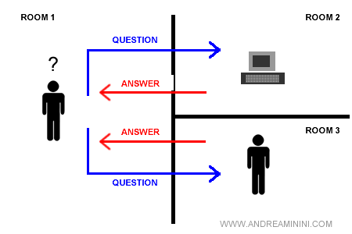
AI & NLP
Turing Test
https://www.andreaminini.net/computer-science/artificial-intelligence/turing-test

Slide 5
AI & NLP
Text Classification
Named Entity Recognition (NER)
Machine Translation
Speech Recognition and Synthesis
Sentiment Analysis
……

Slide 6
Outline
AI & NLP
Tokenize
Word Embedding
Transformer
BERT
GPT

Slide 7
Tokenize
“I felt uneasy about the uncertain future.”
我们该如何处理这样一个文本？？
字符级（char）
I felt uneasy about the uncertain future.
I f e l t u n e a s y a b o u t t h e u n c e r…
单词级（word）
I felt uneasy about the uncertain future.
I felt uneasy about the uncertain future .
Question：easy、uneasy、certain、uncertain……似乎存在一些语法规则？
⭐子词级（sub word）
I felt uneasy about the uncertain future.
I felt un easy about the un certain future .

Slide 8
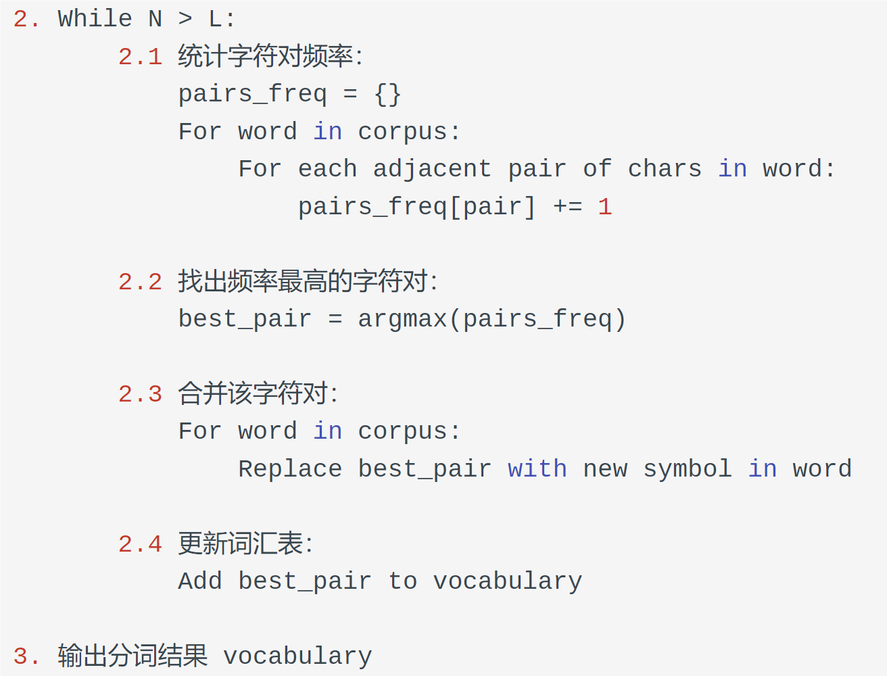
Tokenize
low lowest newer wider
l o w </w>
l o w e s t </w>
n e w e r </w>
w i d e r </w>
l o: 2
o w: 2
w </w>: 1
o w e: 1
e s: 1
……..
BPE算法
lo w </w>
lo w e s t </w>
n e w e r </w>
w i d e r </w>
lo w: 2
w </w>: 1
lo w e: 1
e s: 1
……
low </w>
low e s t </w>
n e w e r </w>
w i d e r </w>
………….

Slide 9
Outline
AI & NLP
Tokenize
Word Embedding
Transformer
BERT
GPT

Slide 10
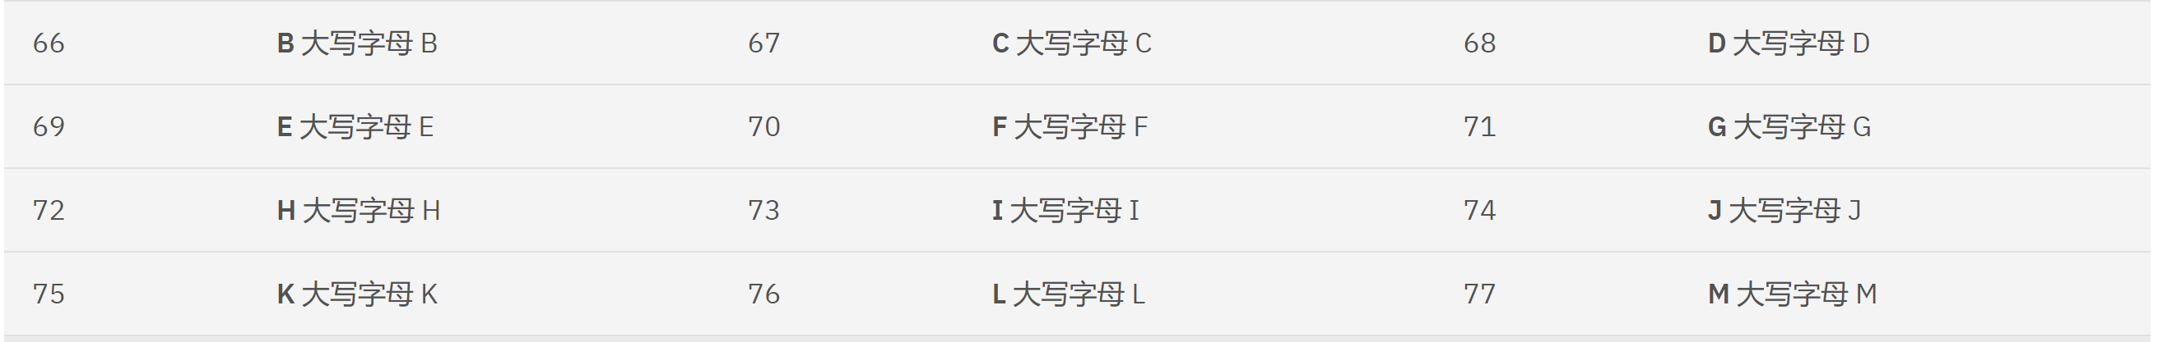
Word Embedding
语料：I felt un easy about the un certain future .
词表：I felt un easy about the certain future .
这样子计算机就能处理了吗？？
ASCII 字符
https://www.ibm.com/docs/zh/sdse/6.4.0?topic=administering-ascii-characters-from-33-126
Question：该怎么让文字变得可计算？？
Answer： 文字向量化！！

Slide 11
Word Embedding
One hot encoding
I felt un easy about the certain future .
word
I | 1 | 0 | 0 | 0 | 0 | 0 | 0 | 0
felt | 0 | 1 | 0 | 0 | 0 | 0 | 0 | 0
un | 0 | 0 | 1 | 0 | 0 | 0 | 0 | 0
easy | 0 | 0 | 0 | 1 | 0 | 0 | 0 | 0
about | 0 | 0 | 0 | 0 | 1 | 0 | 0 | 0
the | 0 | 0 | 0 | 0 | 0 | 1 | 0 | 0
certain | 0 | 0 | 0 | 0 | 0 | 0 | 1 | 0
future | 0 | 0 | 0 | 0 | 0 | 0 | 0 | 1

Slide 12
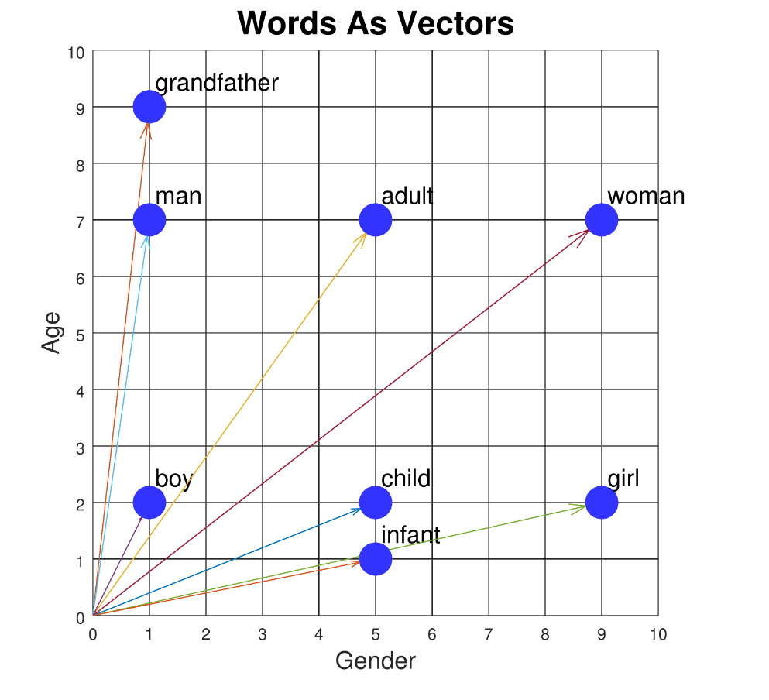
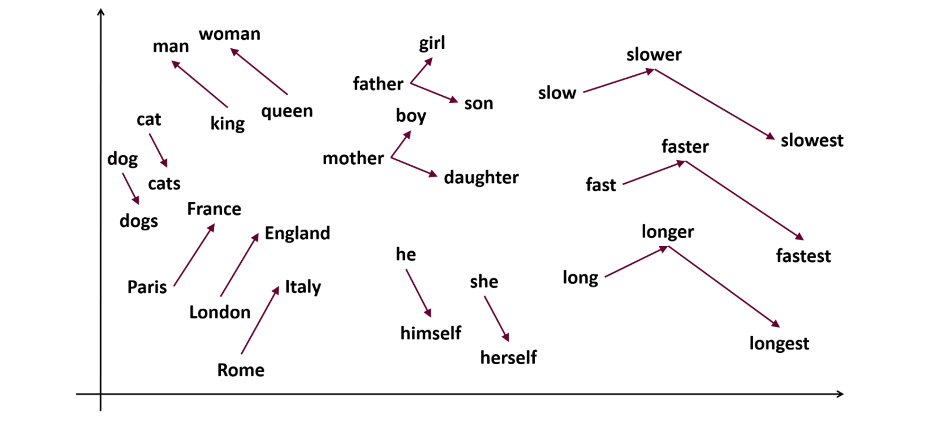
Word Embedding
Word Embedding
(https://samyzaf.com/ML/nlp/nlp.html)
Word Embedding
(https://iq.opengenus.org/one-hot-encoding-in-tensorflow/)

Slide 13
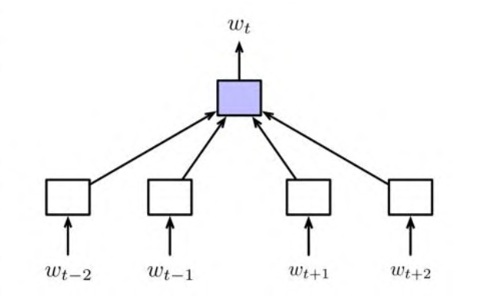
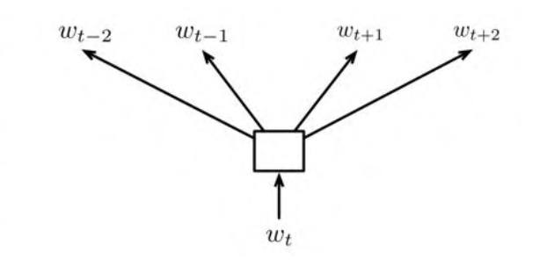
Word Embedding
Word2Vec
CBOW
Skip-Gram
给定一组上下文词来预测中心词，最小化预测与真实中心词之间的误差
给定一个词，来预测该词的上下文内容，最小化预测误差
Output
Hidden layer
Input

Slide 14
Outline
AI & NLP
Tokenize
Word Embedding
Transformer
BERT
GPT

Slide 15
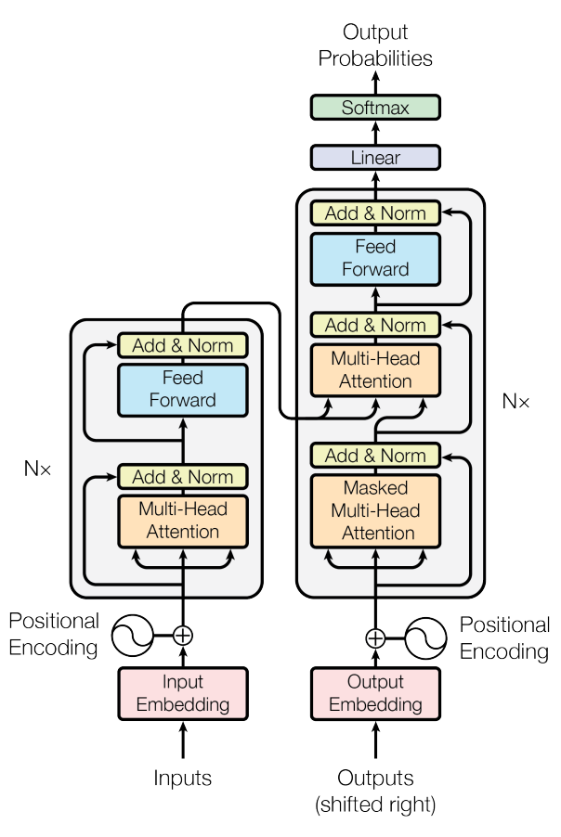
Transformer
Attention is all you need
Multi-Head Attention
Positional Encoding
Question：输出都给模型了？还训练个啥？
https://proceedings.neurips.cc/paper_files/paper/2017/file/3f5ee243547dee91fbd053c1c4a845aa-Paper.pdf

Slide 16
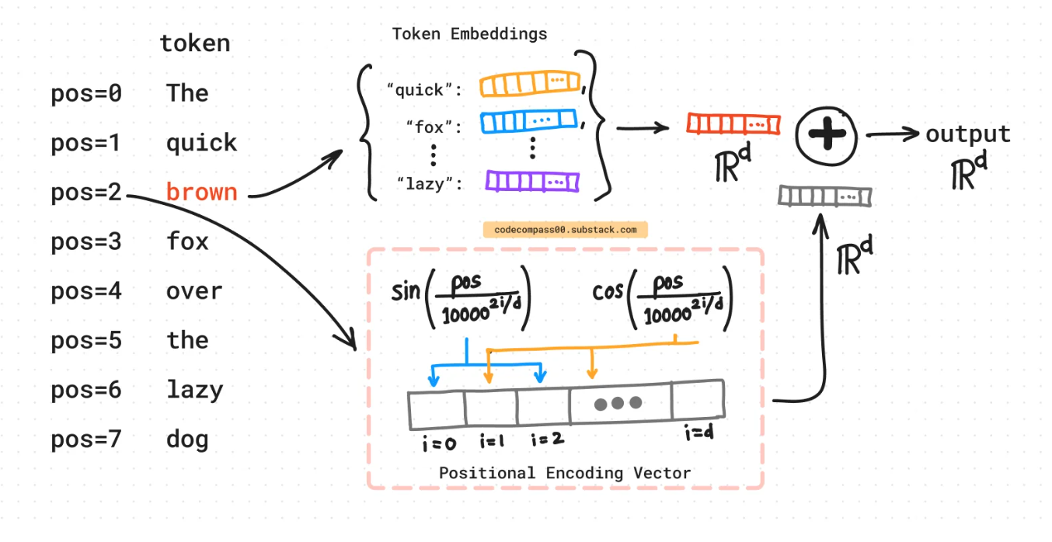
Transformer
Positional Encoding
不是单一数值，而是包含句子中特定位置信息的d维向量（非常像词向量）。
没有整合进模型，而是通过注入词的顺序信息来增强模型输入。
https://codecompass00.substack.com/p/positional-encoding-transformers

Slide 17
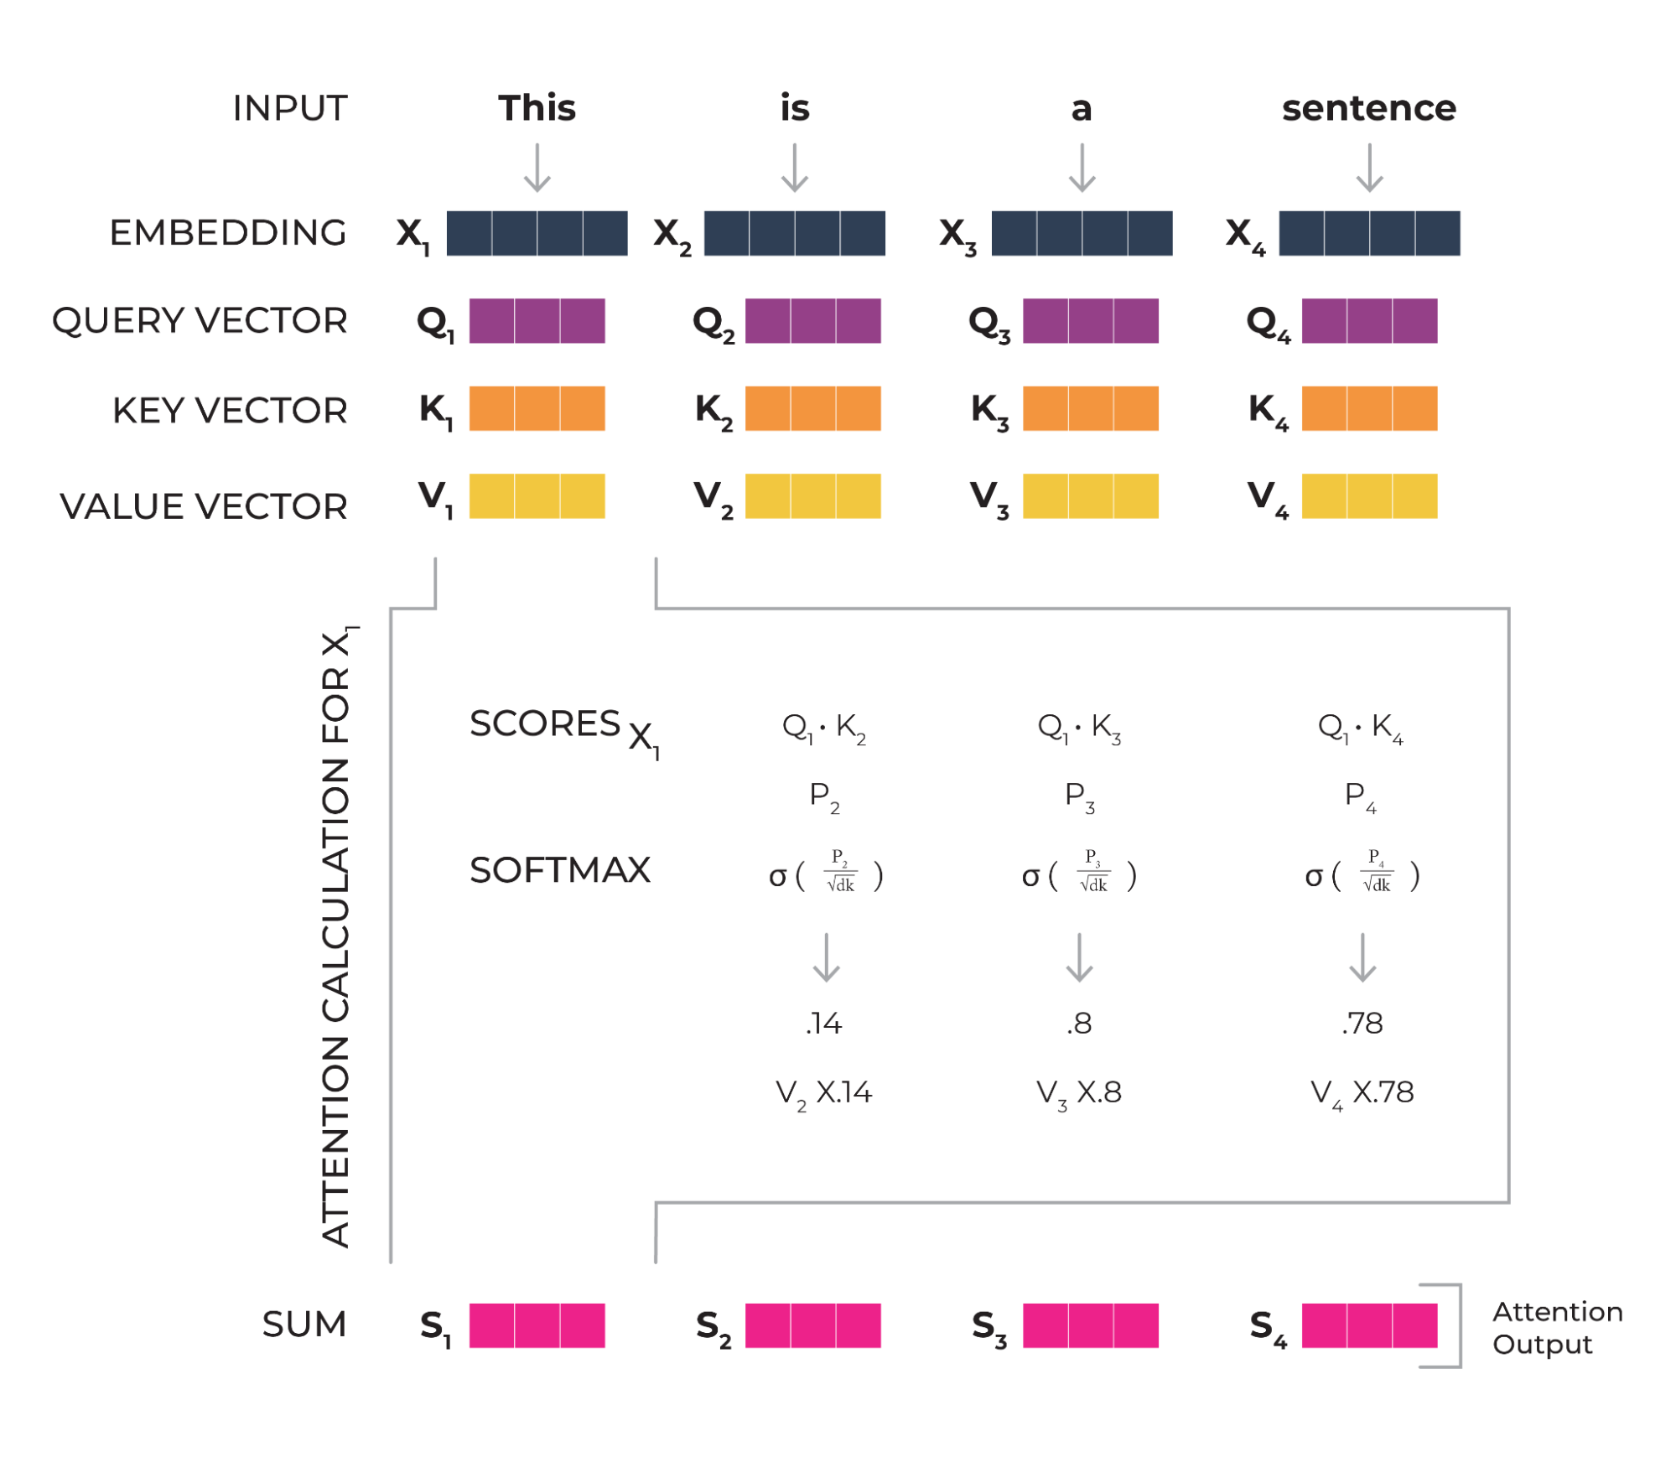
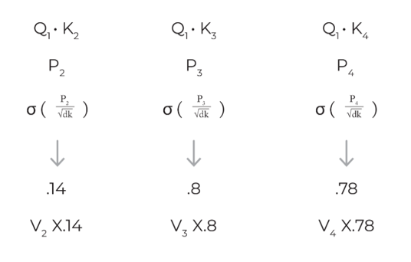
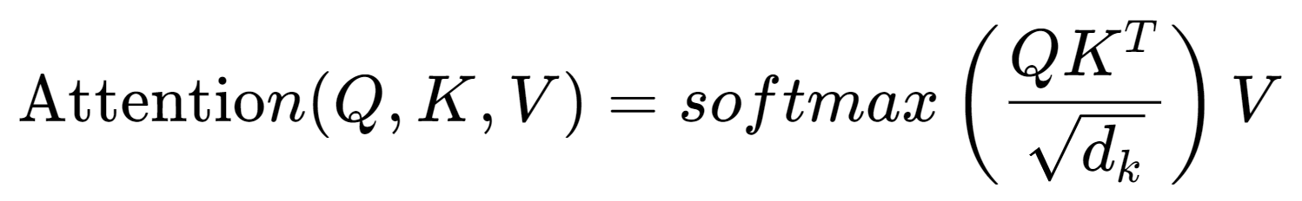
Transformer
Multi-Head Attention
https://arize.com/blog-course/attention-mechanisms-in-machine-learning/

Slide 18
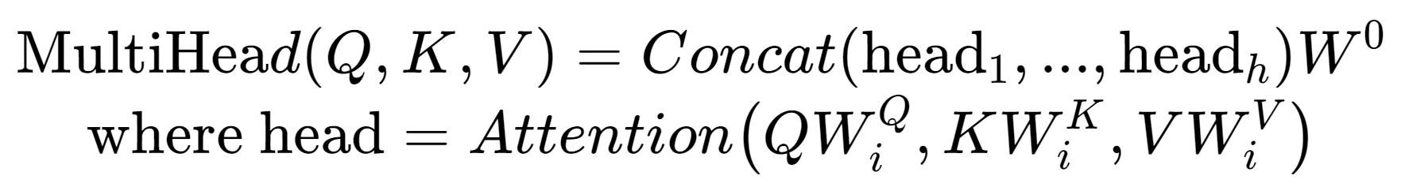
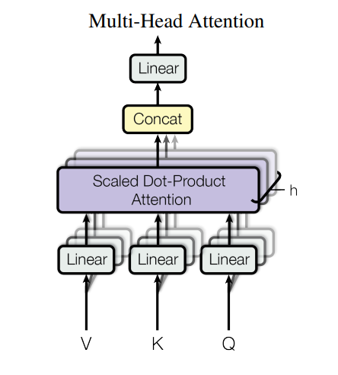
Transformer
Multi-Head Attention
https://proceedings.neurips.cc/

Slide 19
Transformer
Masked Multi-Head Attention
注意！！这里红色的字模型看不见！！
[start] 我 爱 苹 果
I like apples
[start] 我 爱 苹 果

Slide 20
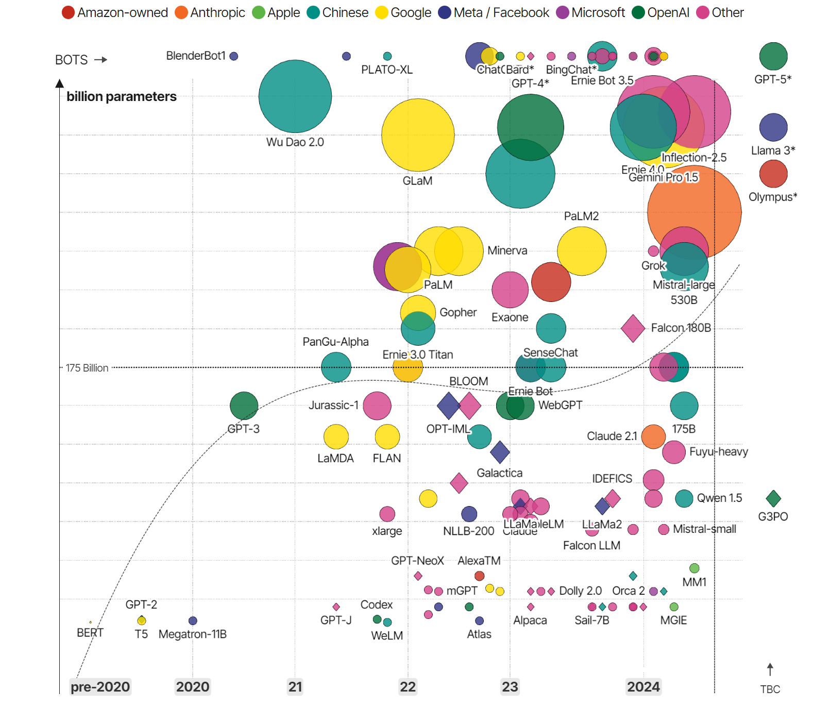
Transformer
https://informationisbeautiful.net/visualizations/the-rise-of-generative-ai-large-language-models-llms-like-chatgpt/

Slide 21
Outline
AI & NLP
Tokenize
Word Embedding
Transformer
BERT
GPT

Slide 22
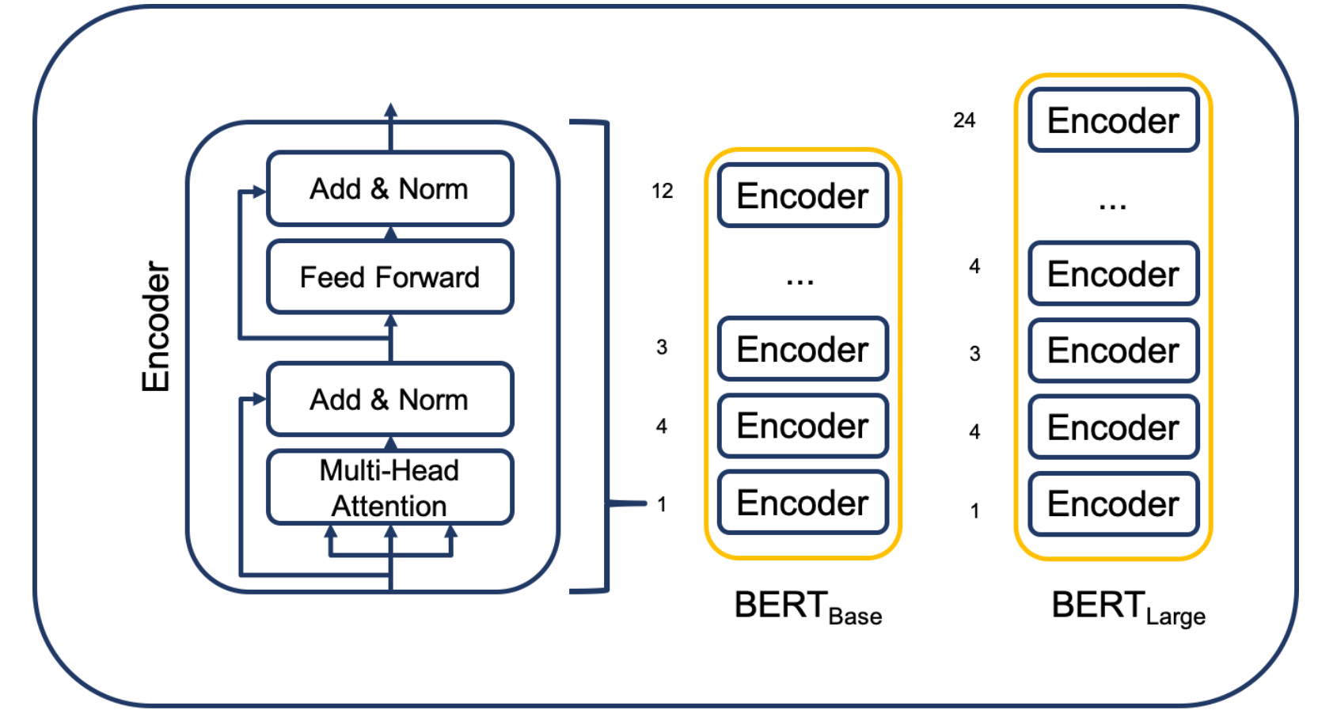
BERT
Encoder only
BERT
(https://humboldt-wi.github.io/blog/research/information_systems_1920/bert_blog_post/)

Slide 23
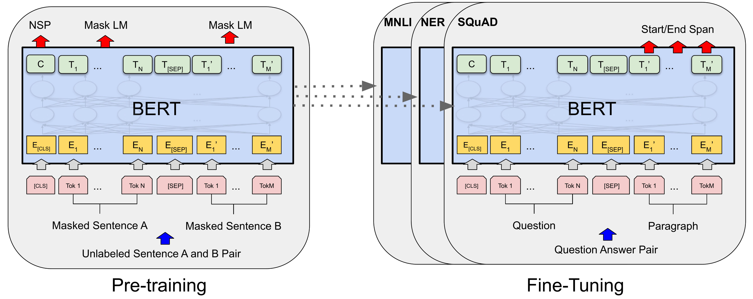
BERT
Pre-training and Fine-Tuning
https://aclanthology.org/N19-1423.pdf

Slide 24
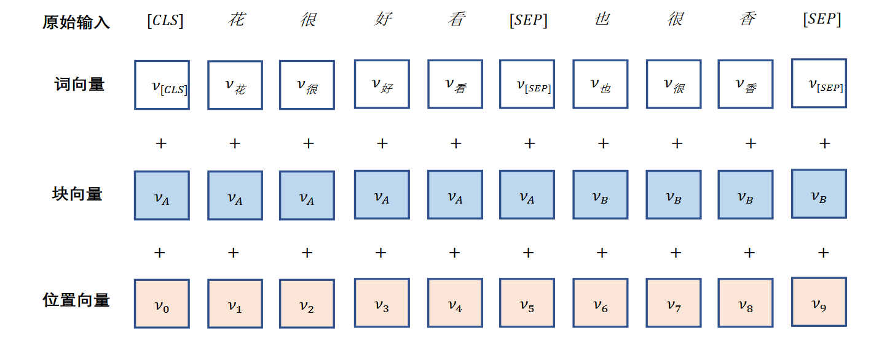
BERT
BERT input

Slide 25
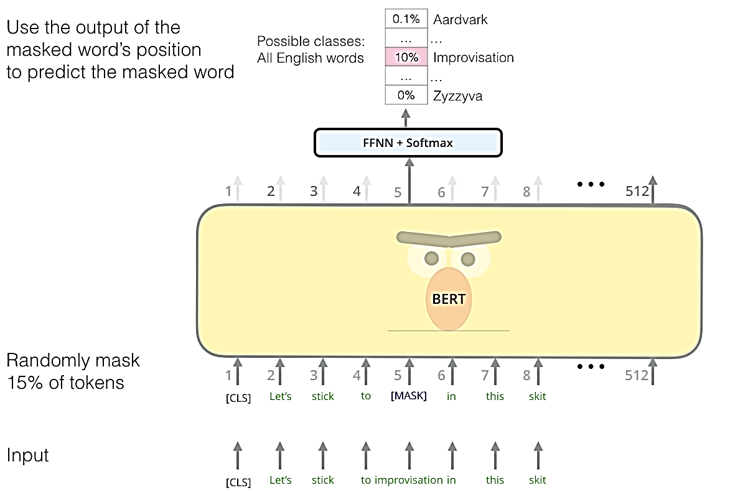
BERT
Pre-training task
Masked Language Model（MLM）

Slide 26
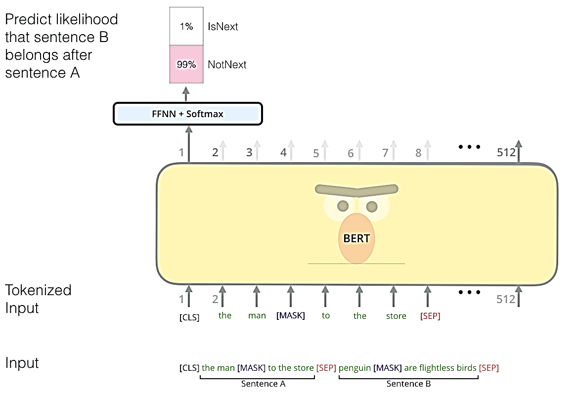
BERT
Pre-training task
Next Sentence Prediction（NSP）

Slide 27
Outline
AI & NLP
Tokenize
Word Embedding
Transformer
BERT
GPT

Slide 28
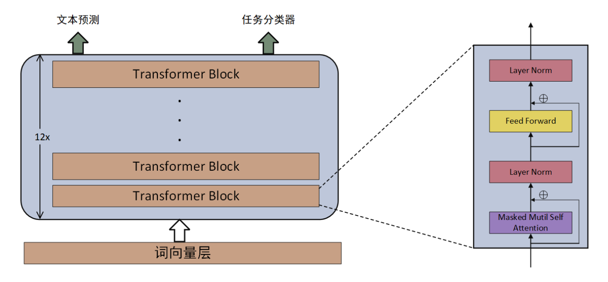
GPT
Decoder only
GPT model

Slide 29
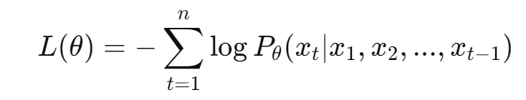
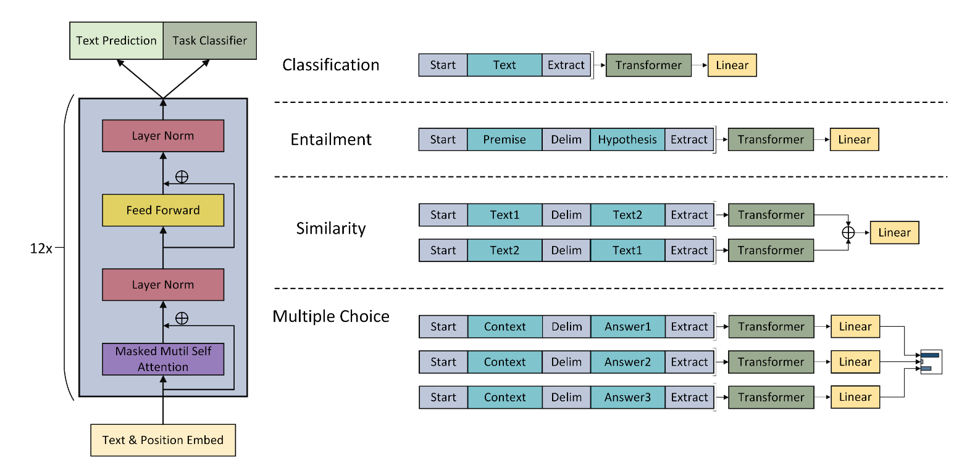
GPT
Pre-training and Fine-Tuning
Next word Prediction

