Slide 1


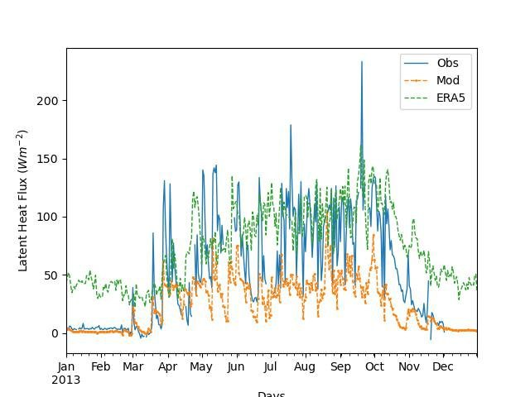
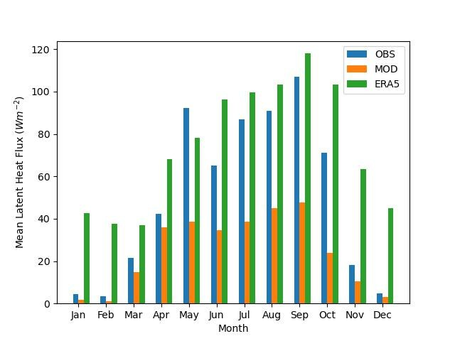
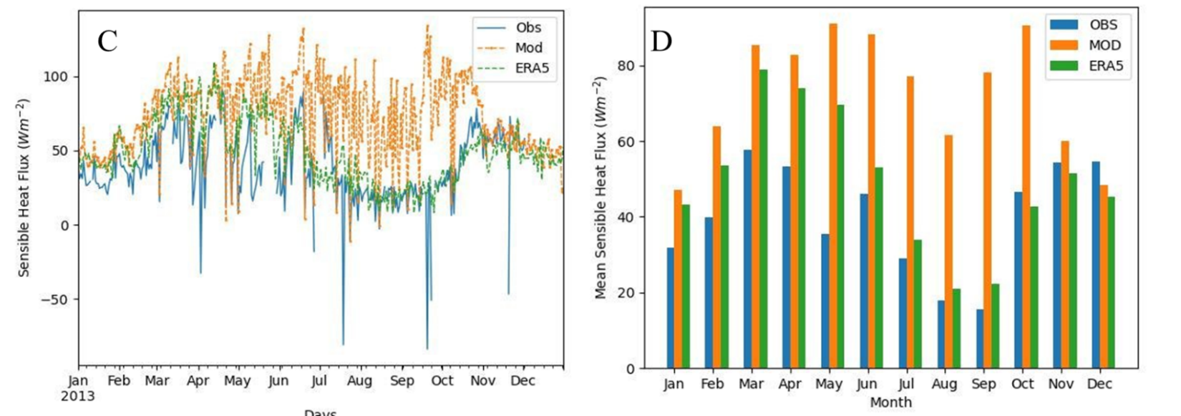
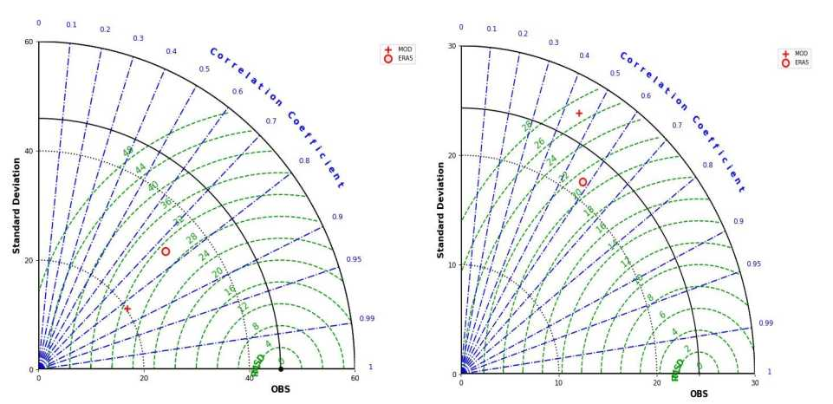
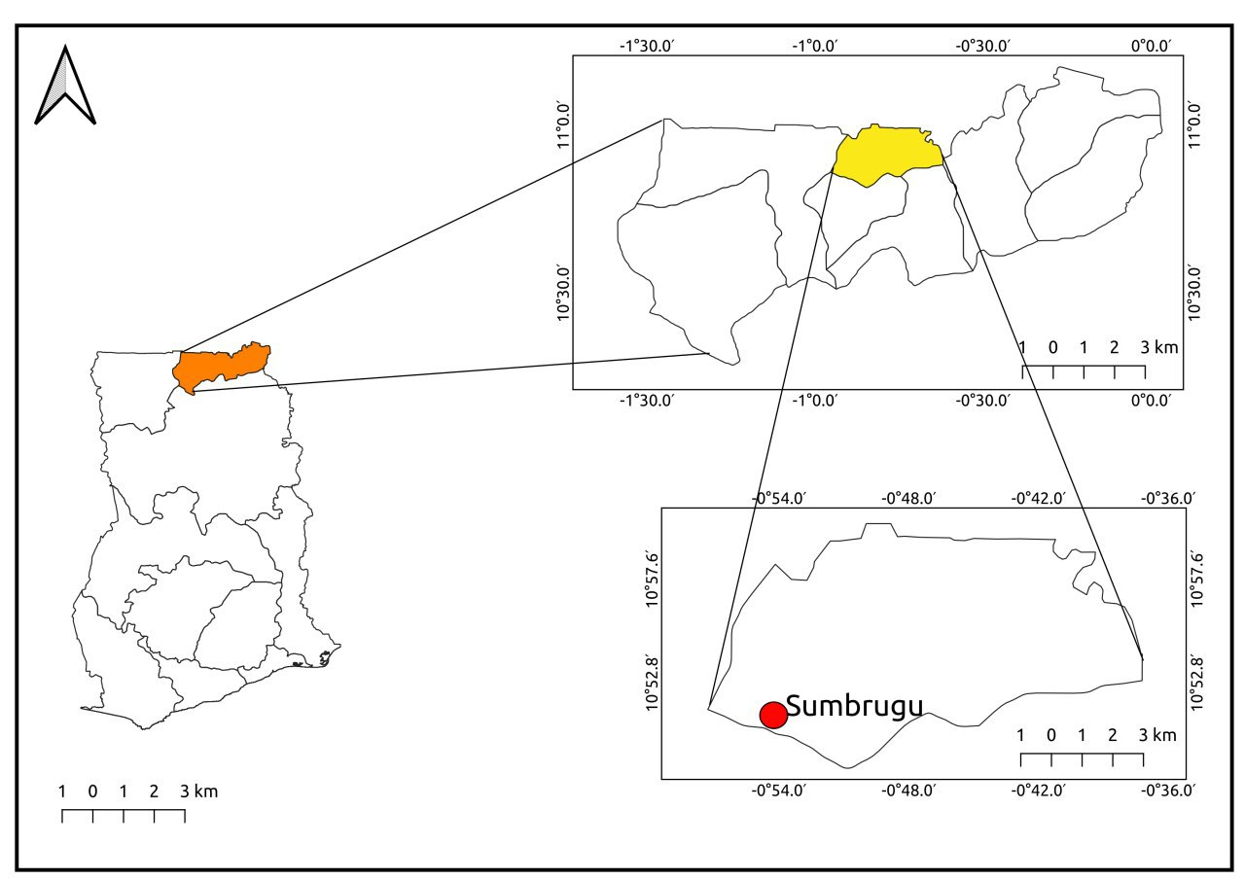

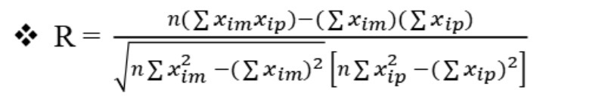
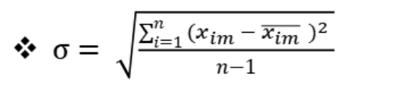

Comparative Study of ERA5 Land Surface Energy Fluxes over a Grassland Ecosystem with Observational Data and Model Simulations
Ayitah Dorkutso Eric, Dadson Bernard Ato, Agyemang Opoku Ware
Correspondence: deayitah@st.Knust.Edu.Gh, badadson@st.Knust.Edu.Gh, owagyemang@st.Knust.Edu.Gh.
Department of Meteorology and Climate Science, Kwame Nkrumah University of Science and Technology, Kumasi, Ghana
Abstract
This study seeks to validate the accuracy and reliability of surface energy fluxes offered by the ERA5 reanalysis dataset. The validation process involves a comparison between the ERA5 reanalysis dataset, observational data from a grassland ecosystem, and data derived from land surface model simulations. Through this comparative analysis, the study aims to identify agreements and discrepancies among the datasets, providing valuable insights into the ERA5 dataset’s performance and its suitability for representing important climatic parameters. The comparison was performed based on the correlation coefficient (R), root mean square error (RMSE), and standard deviation (σ) for latent and sensible heat fluxes in 2013. The RMSE, σ and R for the model and ERA5 are, 32.379 W m⁻², 38.257 W m⁻² and 0.745 and 20.167 W m⁻², 41.566W m⁻², and 0.834 respectively for latent heat fluxes. For sensible heat fluxes estimation, the RMSE, σ and R for the model and ERA5 are, 21.530 W m ⁻² , 59.367 W m⁻² , 0.576 and 26.737 W m⁻² , 44.198 W m⁻², 0.450 respectively. It was found that the ERA5 performed moderately well than the model, however further research must be done to check the closure of the ERA5 reanalysis dataset.
Result and Discussions
A
B
Introduction
Surface energy fluxes play a critical role in the Earth's energy balance, influencing weather patterns, water availability, and ecosystem dynamics within the boundary layer (Andrews et al., 2009). These fluxes refer to the exchange of energy between the land surface and the atmosphere, which occurs through various processes such as radiation, convection, and evapotranspiration. Understanding these energy exchanges is essential for predicting and managing environmental changes.
The aim of this study is to investigate the accuracy of ERA5 reanalysis data for land surface energy fluxes (SEF) over grassland ecosystems by comparing them with observational data and model simulations. The specific objectives are to:
  obtain ERA5 reanalysis data for land surface energy fluxes over grassland ecosystems;
  evaluate the suitability of ERA5 reanalysis land surface energy fluxes as a tool for monitoring and understanding the energy balance of grassland ecosystems; and
  identify any biases or errors in the ERA5 reanalysis data and suggest potential approaches for correcting or mitigating these errors in future studies.
Figure 2: Daily time series and monthly comparison of Latent heat fluxes (A and B) and sensible heat fluxes (C and D) for 2013 at Sumbrugu.
The performance of the observed, model simulation, and ERA5 datasets were tested using the
correlation coefficient, Root Mean Square Error and standard deviation on am Taylor series
diagram to check it’s accuracy and reliability.
Methodology
(E)
(F)
The study was carried out in Sumbrugu (Figure 1) in the Upper East of Ghana at latitude 10.845º N , longitude 0.917º W and elevation of 200 m. The datasets used in this study includes sensible (H) and latent heat fluxes which were measured throughout the course of the year 2013. The dataset was a secondary data that had been taken through the quality control and quality assurance prcedures as explained in Quansah et al. (2015).
Figure 3: Taylor plot for latent heat flux (E) and Sensible heat flux (F) (2013)
Table 1: Summary of the ERA5 and Model simulated surface latent heat flux: RMSE, R and (σ)
Parameter RMSE (W m⁻²) R σ (W m⁻²)
Model 41.566 0.834 20.167 ERA5 38.257 0.745 32.379
Table 2: Summary of the EAR5 and Model simulated surface sensible heat flux RMSE, R and σ
Figure 1: Map of the study sites, including the location of the Eddy Covariance Setup
Parameter RMSE (W m⁻²) R σ (W m⁻²)
Model 44.198 0.450 26.737 ERA5 59.367 0.576 21.530
Bias Estimation Methods
The model performance of the datasets was investigated based on the RMSE, R and σ as represented by equations 1, 2 and 3 respectively.
Conclusion
The model performed better in the dry season with a lower latent heat (-1.234 W m⁻²), but performed moderately poor in the wet season with a maximum latent heat (104.203 W m⁻²).
ERA5 also performed better in the dry season with a maximum surface sensible heat flux (109.71 W m-2) but had a minimum sensible heat flux (7 W m⁻²) in the wet season.
Based on the findings, it was determined that ERA5 provided dependable readings for both sensible and latent heat fluxes.
Therefore, ERA5 data can be used for scientific research, particularly when an observational dataset is lacking.
₍ ₁ ₎
₍ ₂ ₎
₍ ₃ ₎
Recommendation
To improve upon our findings, it is suggested that further research must be done in order t
o validate the accuracy of the ERA5 reanalysis dataset even though it performed moderately
well. This is due to the absence of ground heat to test the energy balance and the closure
of the ERA5 dataset.
Reference
Acknowledgement
We extend our heartfelt gratitude to Dr. Emmanuel Quansah, our supervisor, for his unwavering support and guidance throughout our project. His contributions were priceless and we are immensely grateful for his assistance. To all the lecturers in the Department of Meteorology and Climate Science and everyone who in one way or the other contributed to the success of this project, we say God richly bless you.
Andrews, T., Forster, P. M., and Gregory, J. M. (2009). A surface energy perspective on climate change. Journal of Climate, 22(10):2557–2570.
Quansah, E., Mauder, M., Balogun, A. A., Amekudzi, L. K., Hingerl, L., Bliefernicht, J., and Kunstmann, H., (2015): Carbon dioxide fluxes from contrasting ecosystems in the Sudanian Savanna in West Africa. Carbon Balance and Management, 10(1):1 – 17.

