Slide 1

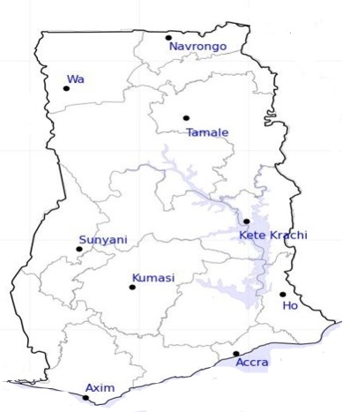



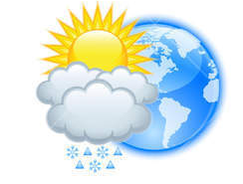







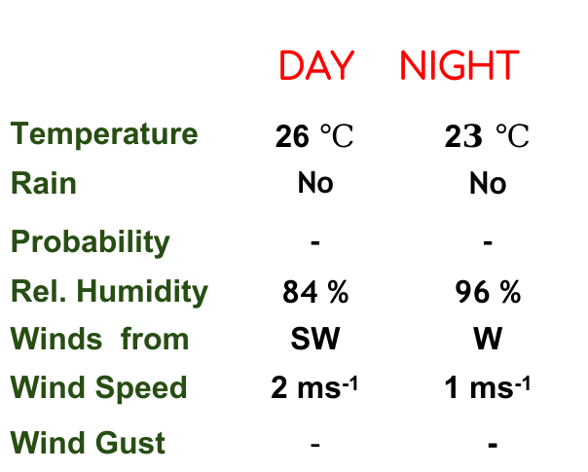
KNUST WEATHER FORECAST
24-HOUR FORECAST
03-12-2022 @ 1200 UTC
Rain
Wind
Dust
.
Forecast Summary (KUMASI)
 | DAY | NIGHT
Temperature | 26 $℃$ | 2$3 ℃$
Rain | No | No
Probability | - | -
Rel. Humidity | 84 % | 96 %
Winds from | SW | W
Wind Speed | 2 ms⁻¹ | 1 ms⁻¹
Wind Gust | - | -
Low risk
Be aware
Be Prepared
Take Action
Department of Meteorology and Climate Science, CoS
SUNSET: 05:49 PM SUNRISE: 6:04 AM
POWERED BY:

