Slide 1

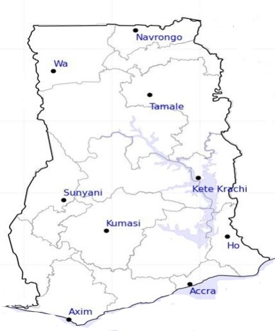




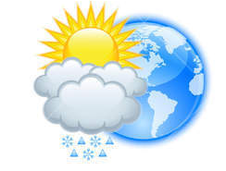






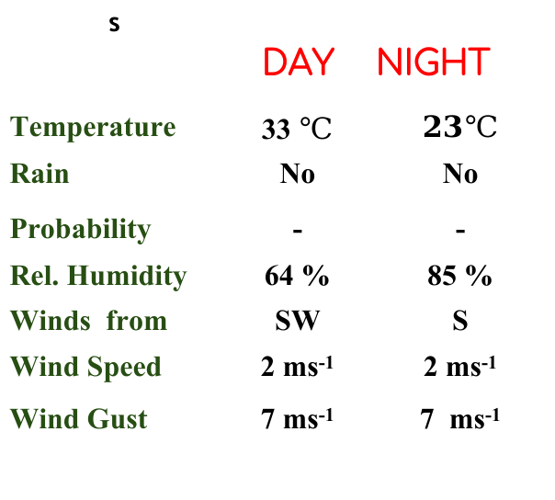
KNUST WEATHER FORECAST
24-HOUR FORECAST
06-02-2023 @ 1200 UTC
Rain
Wind
Dust
.
Forecast Summary (KUMASI)
s | DAY | NIGHT
Temperature | 33 $℃$ | $$23℃$$
Rain | No | No
Probability | - | -
Rel. Humidity | 64 % | 85 %
Winds from | SW | S
Wind Speed | 2 ms⁻¹ | 2 ms⁻¹
Wind Gust | 7 ms⁻¹ | 7 ms⁻¹
Low risk
Be aware
Be Prepared
Take Action
Department of Meteorology and Climate Science, CoS
SUNSET: 06:17 PM SUNRISE: 6:24 AM
POWERED BY:

