Slide 1

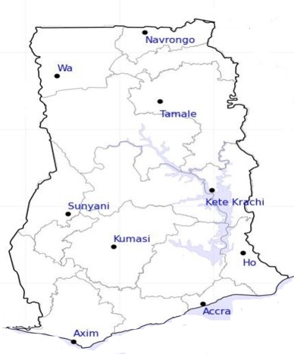




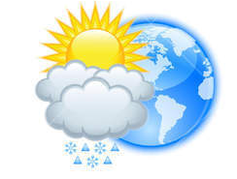






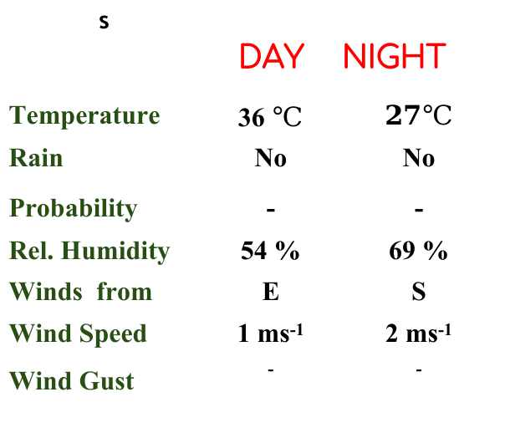
KNUST WEATHER FORECAST
24-HOUR FORECAST
13-02-2023 @ 1200 UTC
Rain
Wind
Dust
.
Forecast Summary (KUMASI)
s | DAY | NIGHT
Temperature | 36 $℃$ | $$27℃$$
Rain | No | No
Probability | - | -
Rel. Humidity | 54 % | 69 %
Winds from | E | S
Wind Speed | 1 ms⁻¹ | 2 ms⁻¹
Wind Gust | ⁻ | ⁻
Low risk
Be aware
Be Prepared
Take Action
Department of Meteorology and Climate Science, CoS
SUNSET: 06:18 PM SUNRISE: 6:23 AM
POWERED BY:

