Slide 1

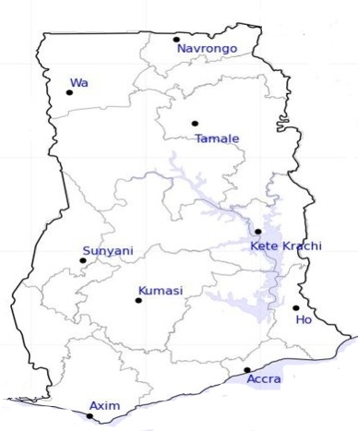




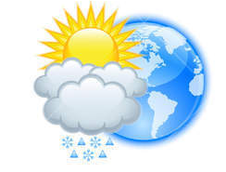






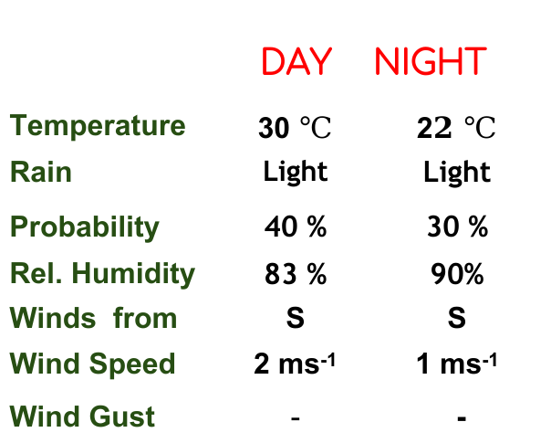
KNUST WEATHER FORECAST
24-HOUR FORECAST
19-12-2022 @ 1200 UTC
Rain
Wind
Dust
.
Forecast Summary (KUMASI)
 | DAY | NIGHT
Temperature | 30 $℃$ | 2$2 ℃$
Rain | Light | Light
Probability | 40 % | 30 %
Rel. Humidity | 83 % | 90%
Winds from | S | S
Wind Speed | 2 ms⁻¹ | 1 ms⁻¹
Wind Gust | - | -
Low risk
Be aware
Be Prepared
Take Action
Department of Meteorology and Climate Science, CoS
SUNSET: 05:51 PM SUNRISE: 6:06 AM
POWERED BY:

