Slide 1

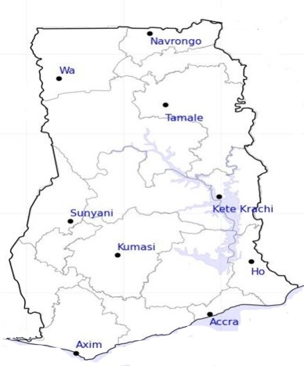




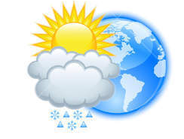






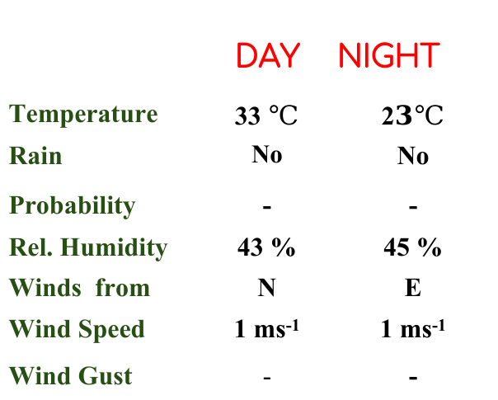
KNUST WEATHER FORECAST
24-HOUR FORECAST
02-01-2023 @ 1200 UTC
Rain
Wind
Dust
.
Forecast Summary (KUMASI)
 | DAY | NIGHT
Temperature | 33 $℃$ | 2$3℃$
Rain | No | No
Probability | - | -
Rel. Humidity | 43 % | 45 %
Winds from | N | E
Wind Speed | 1 ms⁻¹ | 1 ms⁻¹
Wind Gust | - | -
Low risk
Be aware
Be Prepared
Take Action
Department of Meteorology and Climate Science, CoS
SUNSET: 06:03 PM SUNRISE: 6:18 AM
POWERED BY:

