Slide 1

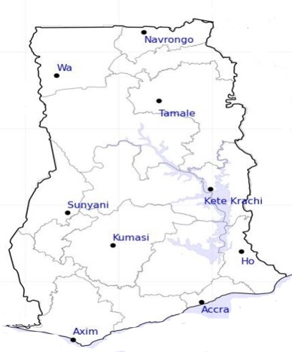




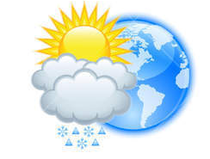






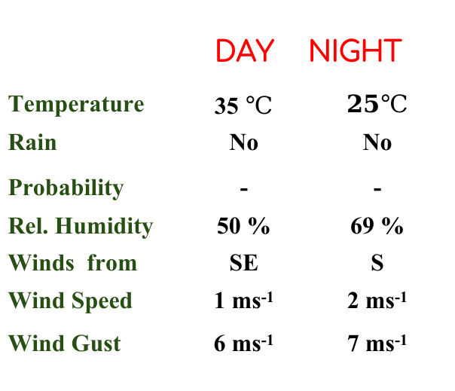
KNUST WEATHER FORECAST
24-HOUR FORECAST
21-01-2023 @ 1200 UTC
Rain
Wind
Dust
.
Forecast Summary (KUMASI)
 | DAY | NIGHT
Temperature | 35 $℃$ | $$25℃$$
Rain | No | No
Probability | - | -
Rel. Humidity | 50 % | 69 %
Winds from | SE | S
Wind Speed | 1 ms⁻¹ | 2 ms⁻¹
Wind Gust | 6 ms⁻¹ | 7 ms⁻¹
Low risk
Be aware
Be Prepared
Take Action
Department of Meteorology and Climate Science, CoS
SUNSET: 06:12 PM SUNRISE: 6:24 AM
POWERED BY:

