Slide 1

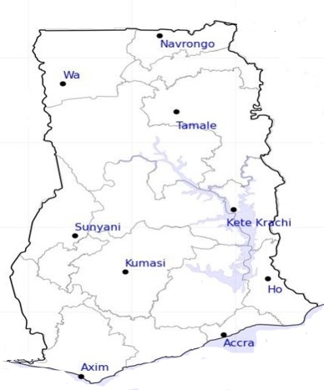




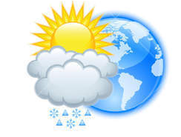






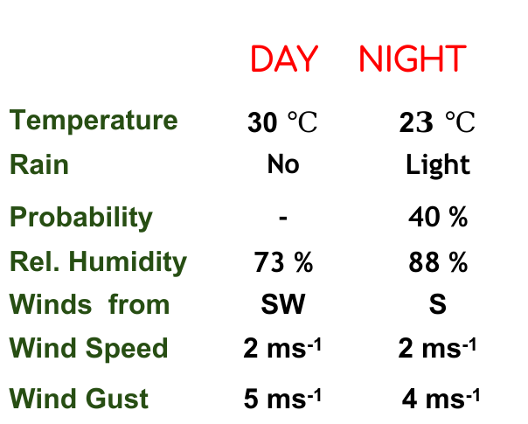
KNUST WEATHER FORECAST
24-HOUR FORECAST
21-11-2022 @ 1200 UTC
Rain
Wind
Dust
.
Forecast Summary (KUMASI)
 | DAY | NIGHT
Temperature | 30 $℃$ | 2$3 ℃$
Rain | No | Light
Probability | - | 40 %
Rel. Humidity | 73 % | 88 %
Winds from | SW | S
Wind Speed | 2 ms⁻¹ | 2 ms⁻¹
Wind Gust | 5 ms⁻¹ | 4 ms⁻¹
Low risk
Be aware
Be Prepared
Take Action
Department of Meteorology and Climate Science, CoS
SUNSET: 05:46 PM SUNRISE: 5:59 AM
POWERED BY:

