Slide 1

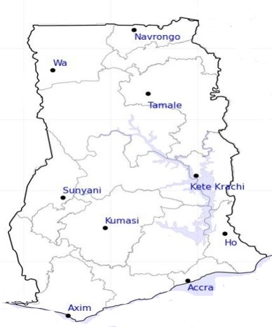




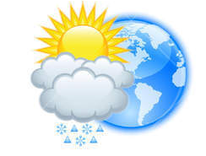






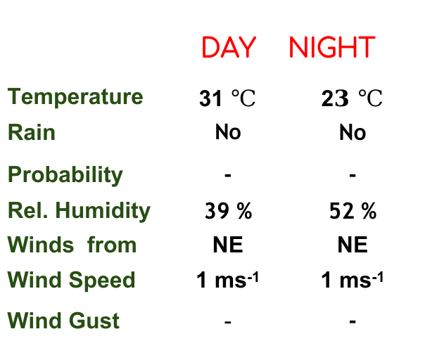
KNUST WEATHER FORECAST
24-HOUR FORECAST
24-12-2022 @ 1200 UTC
Rain
Wind
Dust
.
Forecast Summary (KUMASI)
 | DAY | NIGHT
Temperature | 31 $℃$ | 2$3 ℃$
Rain | No | No
Probability | - | -
Rel. Humidity | 39 % | 52 %
Winds from | NE | NE
Wind Speed | 1 ms⁻¹ | 1 ms⁻¹
Wind Gust | - | -
Low risk
Be aware
Be Prepared
Take Action
Department of Meteorology and Climate Science, CoS
SUNSET: 05:58 PM SUNRISE: 06:14 AM
POWERED BY:

Slide 2

Department of Meteorology and Climate Science, KNUST.
24-HOUR FORECAST
24-12-2022 @ 1200 UTC
Rain
Wind
Dust
Forecast Summary (KUMASI)
 | DAY | NIGHT
Temperature | 31 $℃$ | 2$3 ℃$
Rain | No | No
Probability | - | -
Rel. Humidity | 39 % | 52 %
Winds from | NE | NE
Wind Speed | 1 ms⁻¹ | 1 ms⁻¹
Wind Gust | - | -
Low risk
Be aware
Be Prepared
Take Action
SUNSET: 05:58 PM SUNRISE: 06:14 AM

