Slide 1

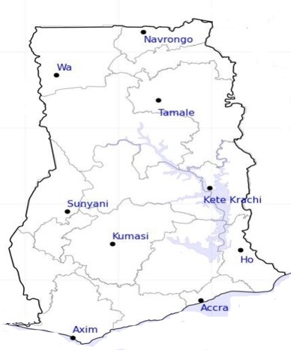




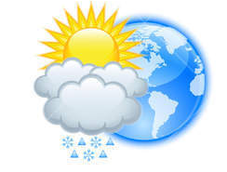






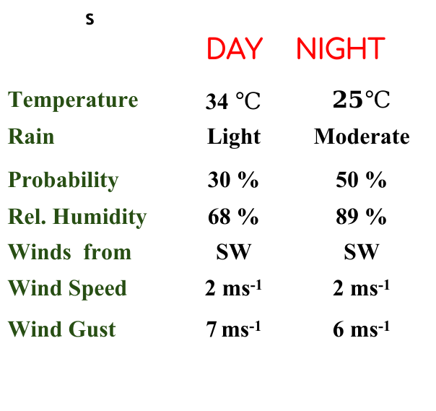
KNUST WEATHER FORECAST
24-HOUR FORECAST
26-02-2023 @ 1200 UTC
Rain
Wind
Dust
.
Forecast Summary (KUMASI)
s | DAY | NIGHT
Temperature | 34 $℃$ | $$25℃$$
Rain | Light | Moderate
Probability | 30 % | 50 %
Rel. Humidity | 68 % | 89 %
Winds from | SW | SW
Wind Speed | 2 ms⁻¹ | 2 ms⁻¹
Wind Gust | 7 ms⁻¹ | 6 ms⁻¹
Low risk
Be aware
Be Prepared
Take Action
Department of Meteorology and Climate Science, CoS
SUNSET: 06:19 PM SUNRISE: 6:20 AM
POWERED BY:

