Slide 1

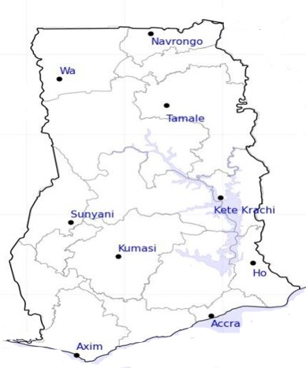




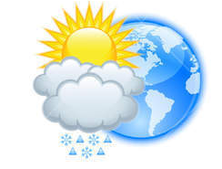






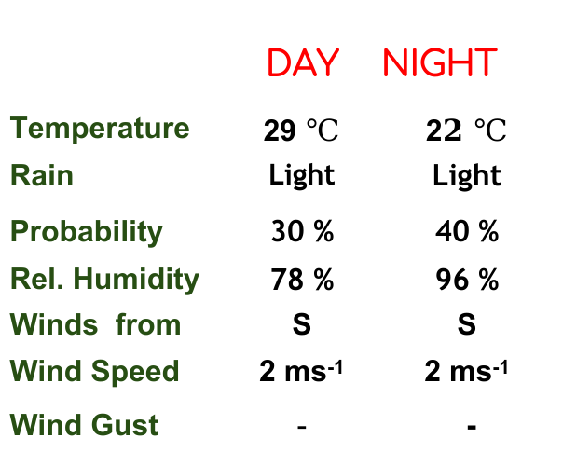
KNUST WEATHER FORECAST
24-HOUR FORECAST
28-11-2022 @ 1200 UTC
Rain
Wind
Dust
.
Forecast Summary (KUMASI)
 | DAY | NIGHT
Temperature | 29 $℃$ | 2$2 ℃$
Rain | Light | Light
Probability | 30 % | 40 %
Rel. Humidity | 78 % | 96 %
Winds from | S | S
Wind Speed | 2 ms⁻¹ | 2 ms⁻¹
Wind Gust | - | -
Low risk
Be aware
Be Prepared
Take Action
Department of Meteorology and Climate Science, CoS
SUNSET: 05:48 PM SUNRISE: 6:02 AM
POWERED BY:

