Slide 1

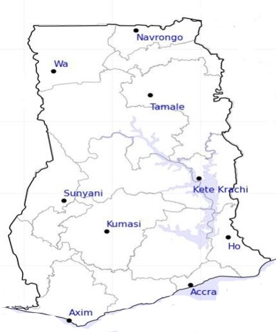




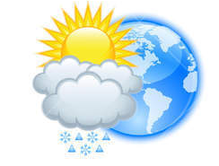






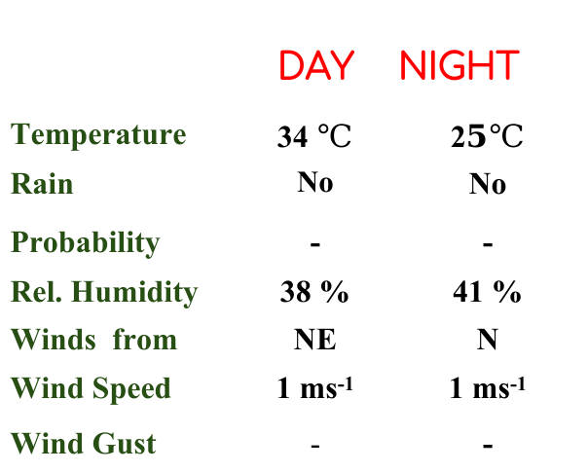
KNUST WEATHER FORECAST
24-HOUR FORECAST
31-12-2022 @ 1200 UTC
Rain
Wind
Dust
.
Forecast Summary (KUMASI)
 | DAY | NIGHT
Temperature | 34 $℃$ | 2$5℃$
Rain | No | No
Probability | - | -
Rel. Humidity | 38 % | 41 %
Winds from | NE | N
Wind Speed | 1 ms⁻¹ | 1 ms⁻¹
Wind Gust | - | -
Low risk
Be aware
Be Prepared
Take Action
Department of Meteorology and Climate Science, CoS
SUNSET: 06:02 PM SUNRISE: 6:18 AM
POWERED BY:

