Slide 1


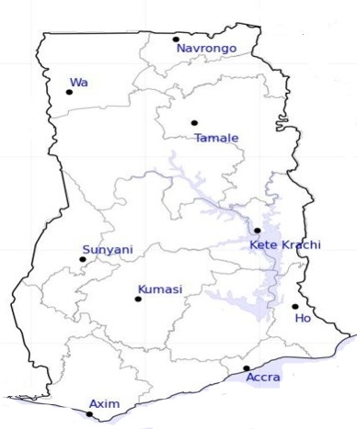


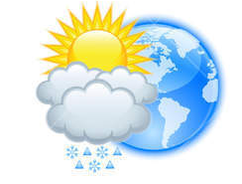







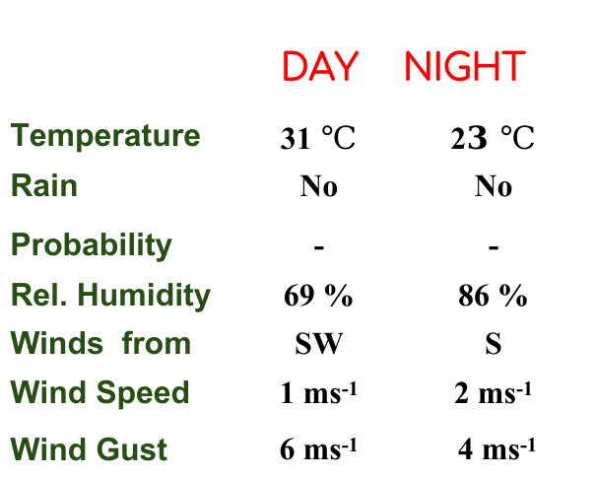
Department of Meteorology and Climate Science, KNUST.
24-HOUR FORECAST
08-11-2022 @ 1200 UTC
Rain
Wind
Dust
Forecast Summary (KUMASI)
 | DAY | NIGHT
Temperature | 31 $℃$ | 2$3 ℃$
Rain | No | No
Probability | - | -
Rel. Humidity | 69 % | 86 %
Winds from | SW | S
Wind Speed | 1 ms⁻¹ | 2 ms⁻¹
Wind Gust | 6 ms⁻¹ | 4 ms⁻¹
Low risk
Be aware
Be Prepared
Take Action
SUNSET: 05:46 PM SUNRISE: 05:55 AM

