Slide 1
College Parking system Vashishth Technologies Minor project
Branch: MBA(TECH.)(IT)
Name: Anunay Khetan
Roll No: I028
Date of Presentation: 10th March 2019

Slide 2
INTRODUCTION
This is a Prototype for College Parking System.
the application allows the following interactions:
Book a location to park a vehicle.
Select choice of vehicle (2 wheeler or 4 wheeler)

Slide 3
USERS
application is basically designed for college students.
Although it is a generic application as it is very simple and easy to use.
It supports various features like user login (restricted to only college users), booking of parking spots of choice, etc.

Slide 4
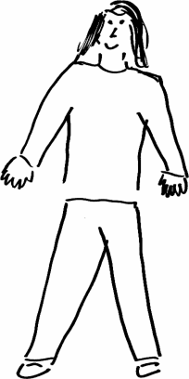
PERSONA
Name : Anunay Khetan
Gender : Male
Age : 21
Lives in : Mumbai
Desig. : Student
EDUCATION: MBA (Tech.) (Currently pursuing) - IT
ROLES & RESPONSIBILITIES: Student
Anunay Khetan is a student of SVKM’s NMIMS (MPSTME) of MBA (Tech.) (IT) Branch of 3rd year who comes to college with his own vehicle.

Slide 5
SCENARIO
Scenario 1:
Anunay Khetan is a student of SVKM’s NMIMS (MPSTME) and has to travel to college daily.
He needs to search for parking location daily.
He can use the parking application, which avoids:
Difficulty in searching of parking location
Wastage of time in searching for free slot.

Slide 6
INTERACTIVE DEVICES REQUIRED
The interactive devices required to run the application are:
1. Display Device (SmartPhone)
2. Physical control (Sound: Confirmation of actions).
4. Positioning, pointing (Touch Pad, Touch Sensitive Screen, Eyegaze)
Currently the prototype is designed for any Android but since the icons and other terminologies used are generic, it can be implemented for any smartphone with the above mentioned devices or hardware.

Slide 7
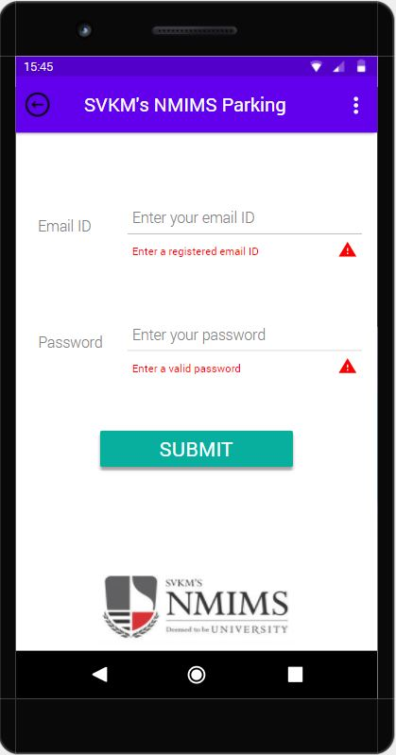
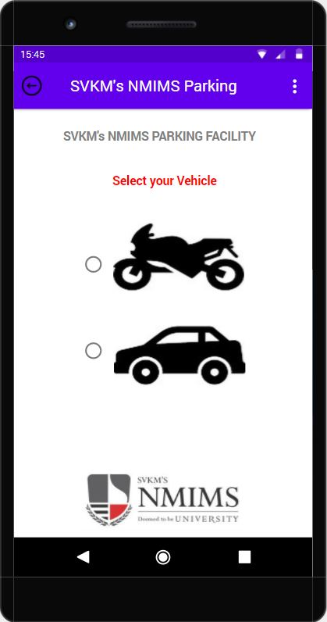
DESIGN RULES (1 OF 7)
We have used SHNEIDERMAN’S eight golden rules for designing the prototype which are discussed in detail below:
STRIVE FOR CONSISTENCY:
We have utilized familiar icons, colors, menu hierarchy.
User need not learn new representations for the same actions.
It helps user become familiar with the digital landscape of the product.

Slide 8
DESIGN RULES (2 OF 7)
2. ENABLE FREQUENT USERS TO USE SHORTCUTS:
Since it is a Parking application, it must be user friendly and thus there are limited shortcuts available throughout the application.
However, users can navigate back to previous page using the “back” option on certain pages.
Using the “MENU” shortcut available on “HOME”, user can easily move to the desired screen which enable user for easy access.
3. OFFER INFORMATIVE FEEDBACK:
The user will get to know where he/she is throughout the application.
User will get an error message which gives a brief idea to the user to rectify and clear the error. For Ex: If the user leaves the “Email” field blank, he/she will get an error.

Slide 9
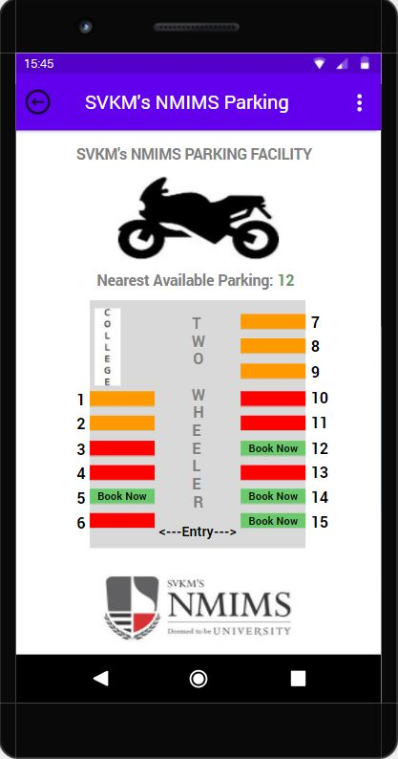
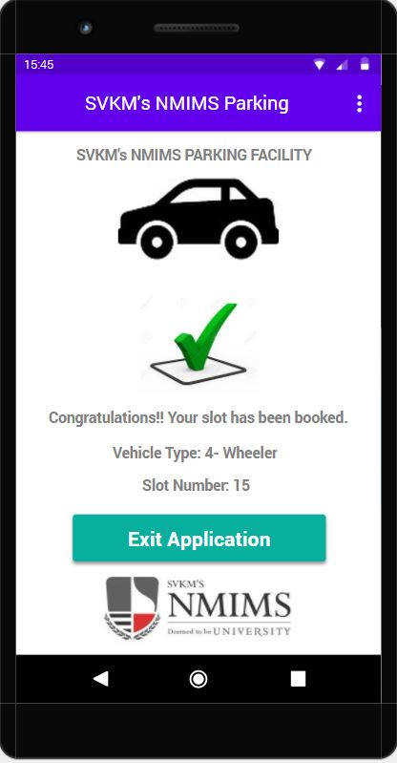
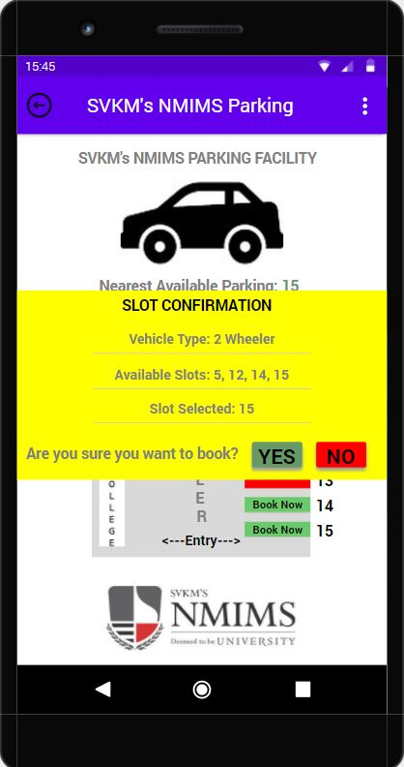
DESIGN RULES (3 OF 7)
4. Design Dialogue to yield closure:
The users don’t have to keep on guessing while using the application
The user gets a clear idea about what their action has resulted to.
The users are given appreciation whenever the task is completed. For Ex: Thank You, Congratulations, etc as it can be seen in above highlighted images.

Slide 10
DESIGN RULES (4 OF 7)
5. OFFER SIMPLE ERROR HANDLING:
User receives error correction message entailing proper instructions to correct the error
For ex:
1. If user leaves the email field empty or enters a different value, then he/she gets an error message saying that “Enter a valid registered Email ID”
All this helps the user to handle the error with ease.

Slide 11
DESIGN RULES (5 OF 7)
6. PERMIT EASY REVERSAL OF ACTIONS:
Users are allowed to reverse their actions at the initial stages but later on, it is restricted due to security purpose.
For ex:
1. As soon as the App is opened, the user can exit using the “EXIT” key on the login screen itself.
2. When payment is initiated user can only “cancel” the transaction to reverse their action(s) at the later stage.
Thus, users can easily reverse their action however it is limited.

Slide 12
DESIGN RULES (6 OF 7)
7. SUPPORT INTERNAL LOCUS OF CONTROL:
users are allowed to initiate and can take full control of events occurring in the application.
For ex:
1. Using the MENU option available on the Right top corner of the screen, users can select the desired page they want to visit.
Thus, user gets complete access to the application from the Home page itself, although user cannot directly move to later stage of Process using this due to security purpose.

Slide 13
DESIGN RULES (7 OF 7)
8. REDUCE SHORT – TERM MEMORY LOAD:
Since human attention is limited, it is capable of maintaining around 7 +/- 2 in the short term memory at one time.
Thus, the interface is designed as simple as possible with proper information hierarchy and choosing recognition over recall.
For ex:
The parking slot to be booked by the user is shown to the user throughout the booking process.
This helps the user to book the parking slot with ease and without remembering data.
Also, user is updated through text/image on every page notifying them about their location so that they need not remember.

Slide 14
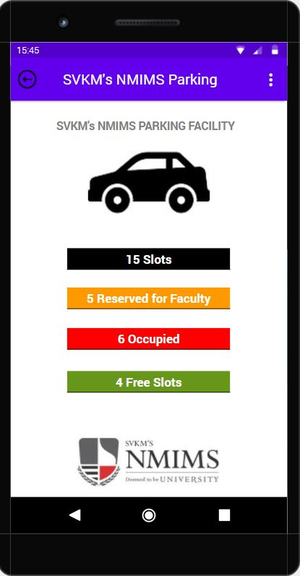
NAVIGATION DESIGN, SCREEN DESIGN & LAYOUT (1 of 2)
The application follows the principles of Gestalt’s psychology:
PROXIMITY: The grouping is done using the color code, using spaces between two text field or options. For ex: White space between two options, grey color bar for input text field, etc.
SIMILARITY: There are 4 types of option in parking. They are categorized as total slots, slots reserved for staf, occupied slots and free slots and differentiated using red, green, orange color code.
SYMMETRY: The color code remains the same no matter what the type of vehicle is. The map for the 2 types of vehicle is also symmetric.

Slide 15
NAVIGATION DESIGN, SCREEN DESIGN & LAYOUT (2 of 2)
4. CONTINUITY: The information of data available in the application is in flow of lines and is thus aligned. For ex: in page shown in figure, text is aligned with the text resembling the information about the particular data field.
5. CLOSURE: as soon as the user log out the application, the user is displayed a message that “Congratulations! Your parking slot has been booked.”. By reading this message, he/she gets an idea that his/her ask has been completed. Thus, the application attains closure.

Slide 16
FUTURE WORK
If the design has to be implemented, then following are the additions to be made:
Addition of database: The prototype discussed here is just a idea how the application will look like. It is not connected to the database and thus needs to be connected to database before realizing. This would allow to update slot status for a particular location.
Facility for visitors to use the parking system: The visitor can download the application to book a particular slot. The app currently allows only registered user to book a slot and doesn’t allow outsiders to use the application.
All this could have not been implemented in the prototype due to tool constraint as it doesn’t support database and all the above actions can be performed only if there’s a proper and valid database.

Slide 17
CONCLUSION
Thus, this application helps the college student to book a parking location with ease and without wasting his/her time.
The application helps the students as well the college staff to easily locate their vehicle too.
Using this application, the users need not face the common problems.
They will have a record of parking locations.
They will have a record where they exactly parked their vehicle.
Time can be easily saved and even frustration of searching for parking spot will also be eliminated.

Slide 18
THANK YOU
ANUNAY KHETAN

