Slide 1
Web Frontend Accessibility
Inhalte im Web-Browser barrierefrei gestalten
Teil 5
Aykut Şensoy

Slide 2
VoiceOver - General Basics
I strongly recommend using Safari browser. Other browsers do not work reliably on the Mac and can therefore behave incorrectly.
Prefer the English system language in case of confusion. The translations of the controls and the spoken German are sometimes strange.

Slide 3
VoiceOver - General Basics
Turn VoiceOver ON and OFF Command + F5
Default VO (VoicerOver) Keys Control + Option
Voice Settings (Rate, Pitch, Volume, Voice) Step 1 → choose setting Shift + VO + Command + ⬅ / ➡️ Step 2 → change setting Shift + VO + Command + ⬆️ / ⬇️

Slide 4
VoiceOver - Web Rotor Basics
Web Rotor as Wheel Step 1 → open wheel and select option VO + Command + ⬅ / ➡️ Step 2 → navigate with selected option VO + Command + ⬆️ / ⬇️
Web Rotor as Menu Step 1 → open menu VO + U Step 2 → select option ⬅ / ➡️ Step 3 → navigate with selected option ⬆️ / ⬇️ Step 4 → jump to selected option ↩️

Slide 5
VoiceOver – Landmarks (Orientierungspunkte)
Open Web Rotor and select Landmarks and navigate as described in Web Rotor Basics.
Alternatively, you can navigate using keyboard shortcuts. Forward: VO + Command + N Backward: Shift + VO + Command + N

Slide 6
VoiceOver - Headings (Überschriftten)
Open Web Rotor and select Headings and navigate as described in Web Rotor Basics.
Alternatively, you can navigate using keyboard shortcuts. Forward: VO + Command + H (all levels) VO + Command + M (same levels) Backward: Shift + VO + Command + H (all levels) Shift + VO + Command + M (same levels)

Slide 7
VoiceOver - Links
Open Web Rotor and select Links and navigate as described in Web Rotor Basics.
Alternatively, you can navigate using keyboard shortcuts. Forward: VO + Command + L Backward: Shift + VO + Command + L

Slide 8
VoiceOver - Form Controls (Formularsteuerungen)
Open Web Rotor and select Form Controls and navigate as described in Web Rotor Basics.
Alternatively, you can navigate using keyboard shortcuts. Forward: VO + Command + J Backward: Shift + VO + Command + J

Slide 9
VoiceOver - Text
Find Next Plain Text VO + Command + P
Find Previous Plain Text Shift + VO + Command + P
Read Current Paragraph VO + P
Pause or Resume Speaking ("Shut-Up" Key) Control

Slide 10
VoiceOver - Text
Read Current Character VO + C
Read Current Word VO + W
Read Current Line VO + L
Read Current Sentence VO + S

Slide 11
VoiceOver - Images
Open VoiceOver Utility → Web → Web Roter → active checkbox: Images
Open Web Rotor and select Images and navigate as described in Web Rotor Basics.
Alternatively, you can navigate using keyboard shortcuts. Forward: VO + Command + G Backward: Shift + VO + Command + G

Slide 12
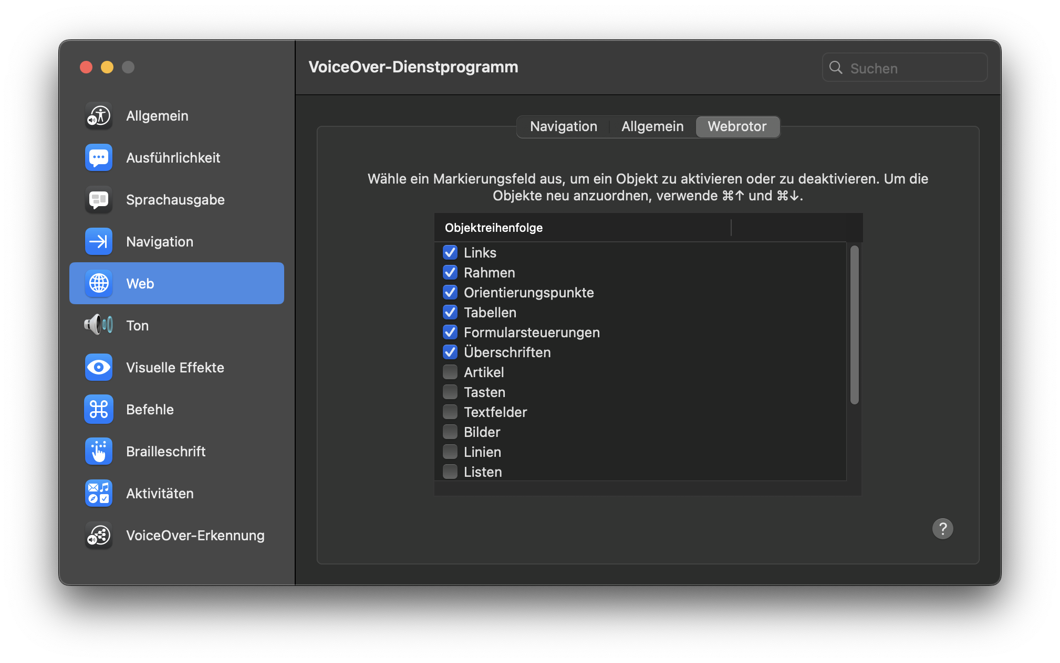
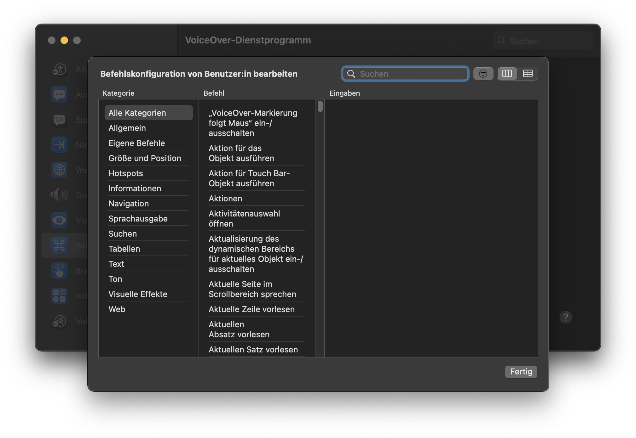
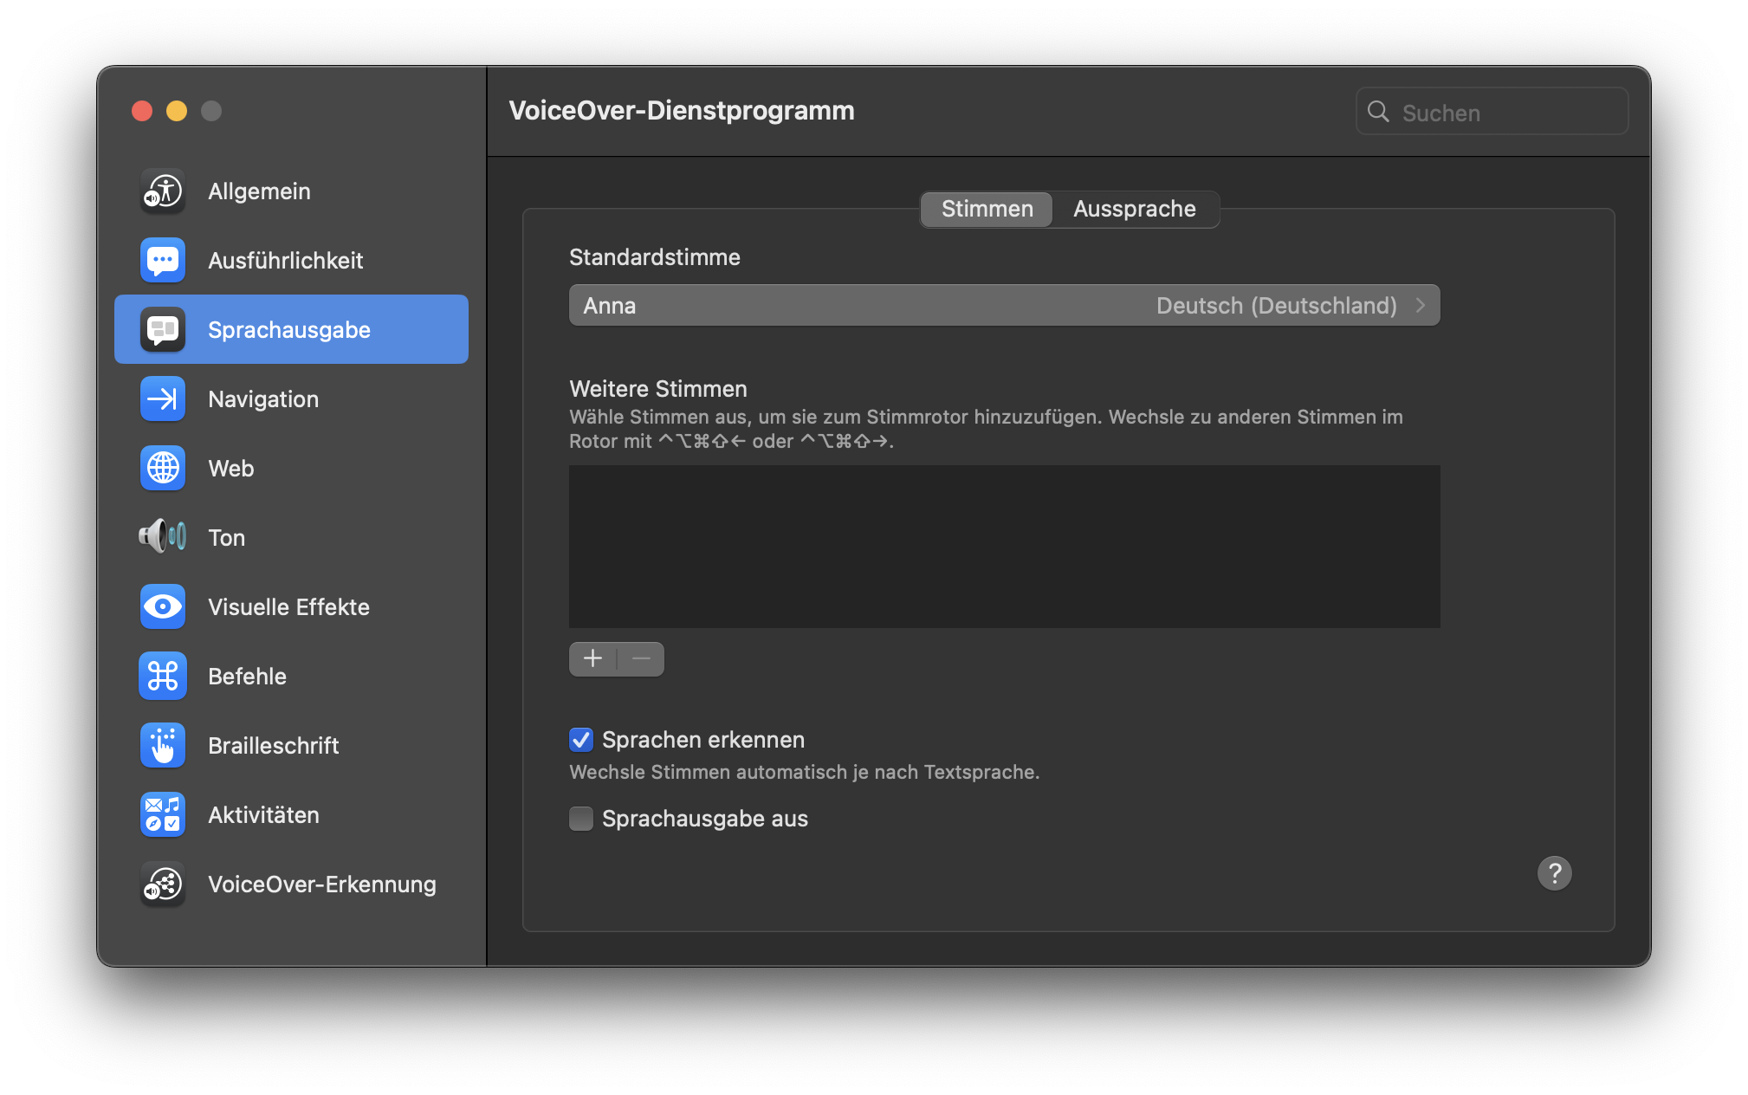
VoiceOver Utility (VoiceOver Dienstprogramm)

Slide 13
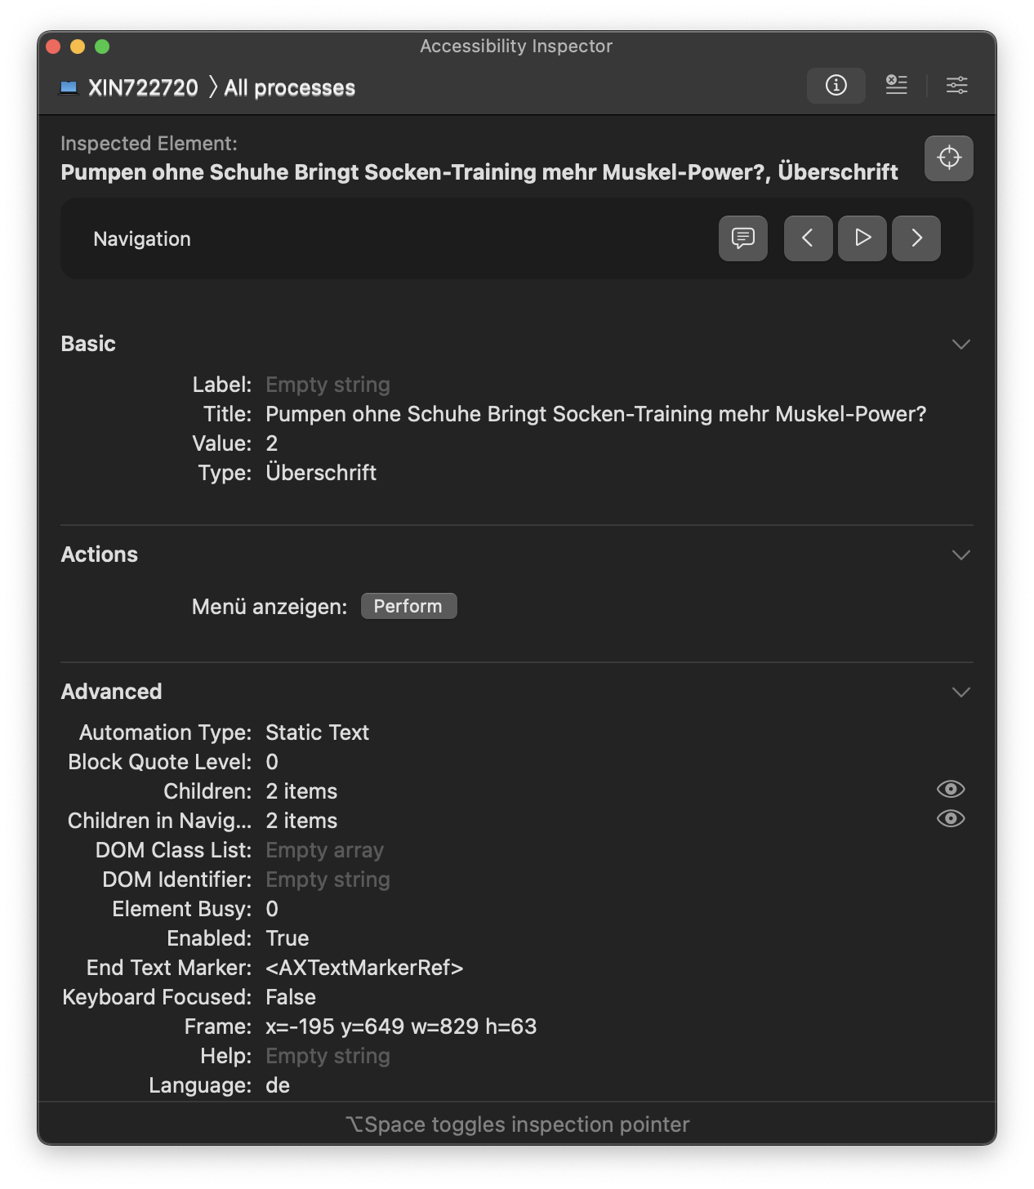
Accessibility Inspector

