Slide 1
How to say
NO
to AI

Slide 2
Who the hell are you?
Ayla Taylor
Data scientist
Brandeis University Computational Linguistics MS (2022)
Deeply disillusioned with the industry

Slide 3
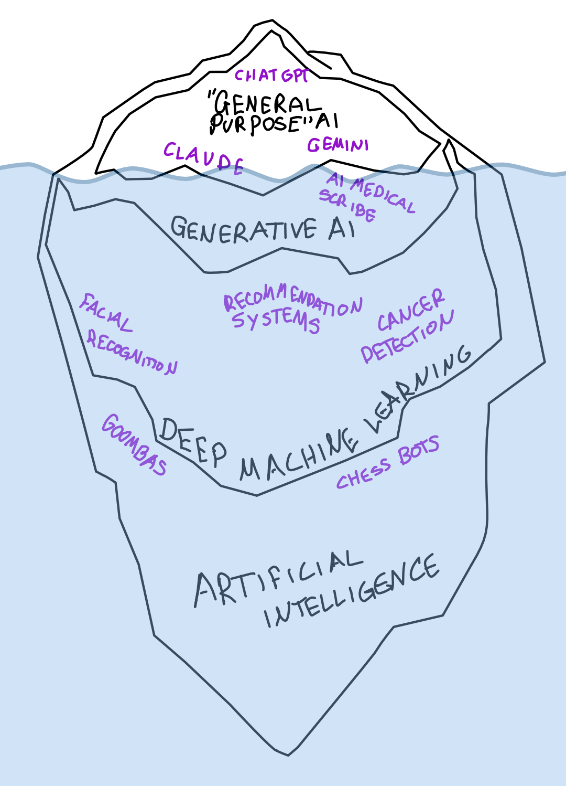
A note on terminology:
“Artificial Intelligence” is a marketing term
I am primarily talking about “general purpose” generative AI
ALL forms of AI should be examined critically

Slide 4


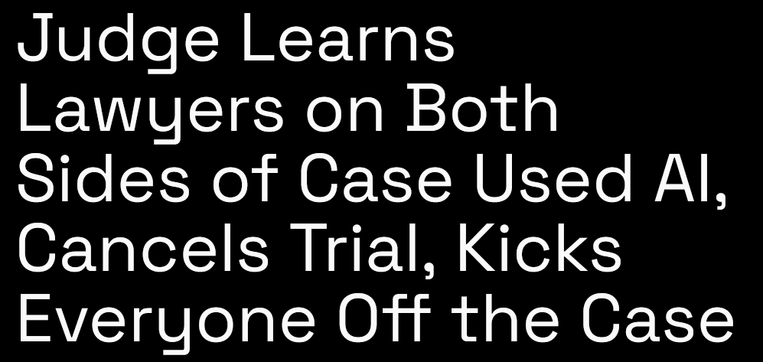
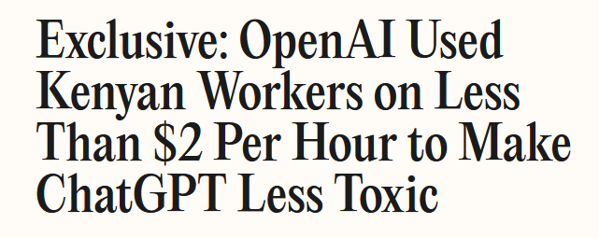
AI sucks.

Slide 5
Just a few AI harms...
Mass labor replacement and exploitation
Concentration and consolidation of wealth
Systemic bias favoring dominant narratives
Increasing energy and water use
Loss of information integrity
Psychological and emotional distress
Theft of intellectual property

Slide 6
“AI is here to stay, so you better get used to it!”
Notes:
You probably have heard this a lot.

Slide 7
Introduction to frameworks of AI resistance
How YOU can resist
Responses to common arguments
Audience directed activity

Slide 8









“Artificial Intelligence”
Narrative
Data
Resource
Extraction
Adoption
Policy
Funding
Data Centers
Labor
Surveillance
Notes:
Call out the hype
Follow the funders
Take back our data
Fight extractive data centers
Combat resource extraction
Advocate for the rights of workers
Just say No
Challenge permissive governance
Reject surveillance

Slide 9
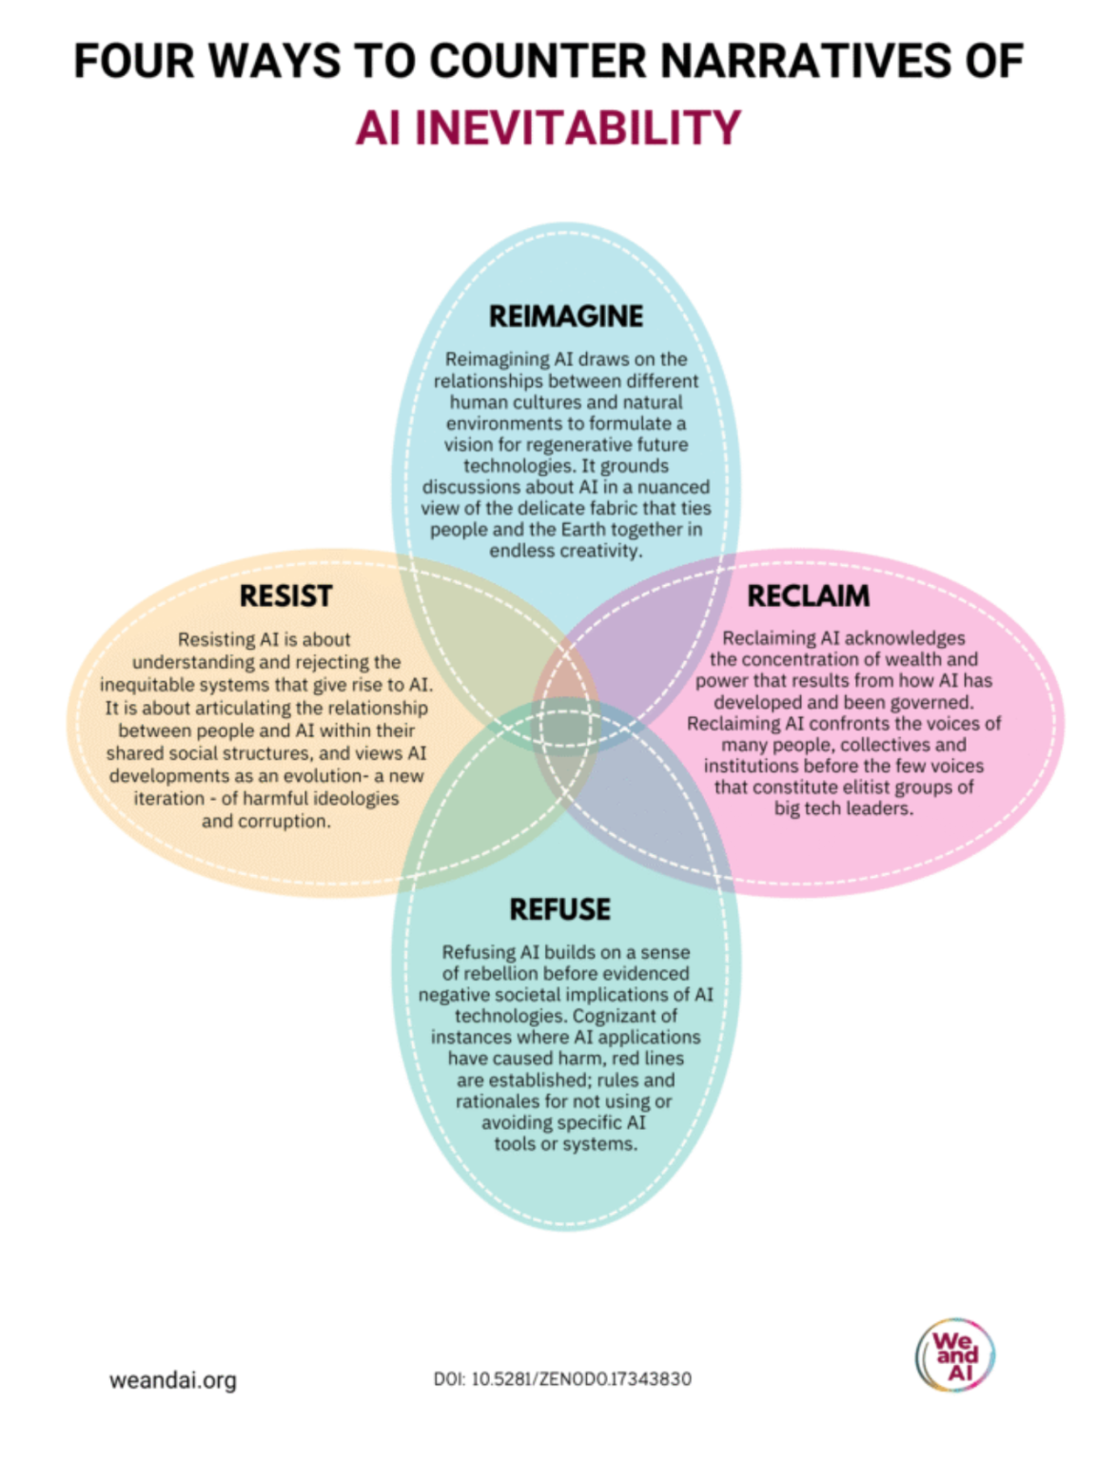
Resisting AI: Rejecting the ideologies of extraction, datafication and automation
Refusing AI: Targeted Oppositions to AI Applications
Reclaiming AI: Giving communities control of technology design, development and use
Reimagining AI: Collectively reshaping tech narratives through environmental, decolonial lenses

Slide 10
Introduction to frameworks of AI resistance
How YOU can resist
Responses to common arguments
Audience directed activity

Slide 11
Resisting AI in your personal life...
Learn about the eugenic origins and extractive present of AI and discuss with your friends and family
  Ghost in the Machine (documentary film)
  Empires of AI by Karen Hao (book)
  More Everything Forever by Adam Becker (book)
  “The TESCREAL Bundle: Eugenics and the promise of utopia through artificial general intelligence” (article)

Slide 12
Resisting AI in your personal life...
Avoid “luxury surveillance” such as smart devices and wearables
  Surveillance repackaged as convenience and status symbols
Avoid using AI when you can
  Stop using Google search (DuckDuckGo allows you to turn off the AI results at least)
  Fight back against AI usage at work (or at least “say yes, do no”)
  Follow guides for how to turn off AI features (notoai.org)

Slide 13
Resisting AI in your personal life...
Get off Big Tech
  Chrome → Firefox
  Gmail → Proton Mail
  Microsoft Word → LibreOffice
  Amazon/Audible → Bookshop.org/LibreFM
  Spotify → Qobuz
  WhatsApp → Signal
  GoogleMaps → OpenStreetMaps
  Windows → Linux

Slide 14
Resisting AI in your community...
Start conversations about AI harms at work and school
  Work together with coworkers and classmates (!!!)
  Focus on what they care most about (labor, creativity, environment, etc)
  “Do the benefits outweigh the harms?”

Slide 15
Resisting AI in your community...
Call your representatives and tell them your opinion on AI
  Support regulation
  Don’t take money from AI PACs
  No AI in schools
Research surveillance in your community (Flock, etc)

Slide 16
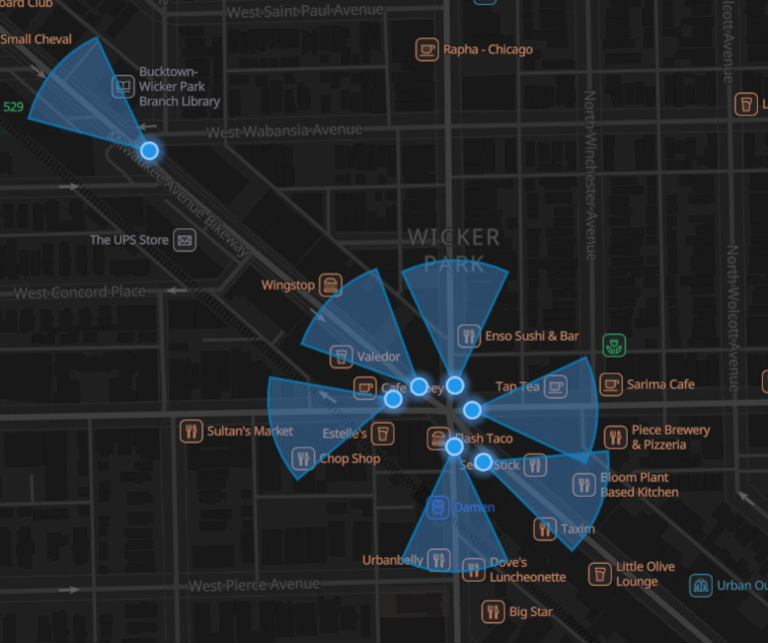
from deflock.org

Slide 17
Resisting AI in your community...
Find out about any planned data centers in your area and get involved in resistance
  Illinois Quantum and Microelectronics Park
  Several smaller ones on the South Side
  Joliet Technology Center

Slide 18
Resisting AI around the world...
We and AI
DAIR Institute
Algorithm Watch
Data Labelers Association

Slide 19
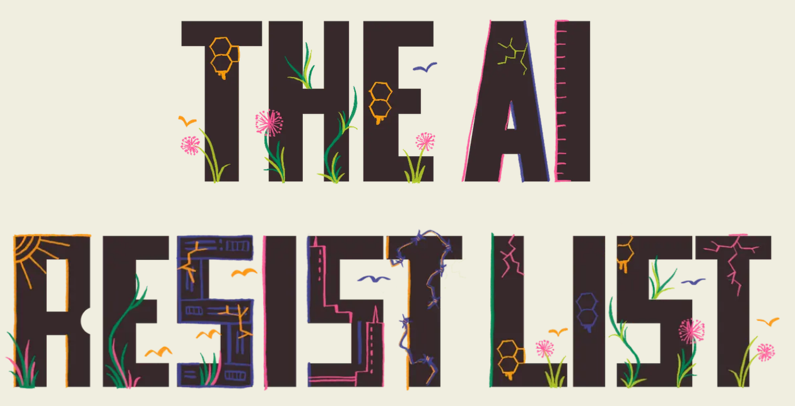
https://airesistlist.org/

Slide 20
Introduction to frameworks of AI resistance
How YOU can resist
Responses to common arguments
Audience directed activity

Slide 21
“There are so many unethical systems, why are you so focused on AI?”
Why should we add another unnecessary, harmful system on top of all the others? Especially one that specifically enables other harms?

Slide 22
“It’s fine, I review everything I generate with AI.”
Editing is harder than people think! And people are more likely to accept things than change them.

Slide 23
“You can use AI for good things!”
Is that good actually worth the harm? And are you sure it isn’t creating hidden harm?

Slide 24
“You are just a Luddite.”
Given that the Luddites actually had very reasonable demands and only turned to machine breaking when all avenues of legal complaint had been eliminated, thank you!

Slide 25
“AI makes me more productive!”
Does it? There is evidence it just creates the illusion of productivity.

Slide 26
“I don’t want to be left behind.”
Understandable. But the current AI industry is an unsustainable bubble, and it is probably more reasonable to hold on to your skills rather than focus on AI.

Slide 27
“I have so much work that I have to use AI to keep up!”
That is a labor issue. You are being given unreasonable amount of work and your employer probably needs to hire more people.

Slide 28
“I need to use AI because I don’t know how to write/draw/code/etc.”
Learning is one of the great joys of life and if anyone criticizes you for being a beginner, they are an asshole.

Slide 29
Ask yourself:
Is my use of AI in accordance with my values?
Do the benefits outweigh the harms?

Slide 30
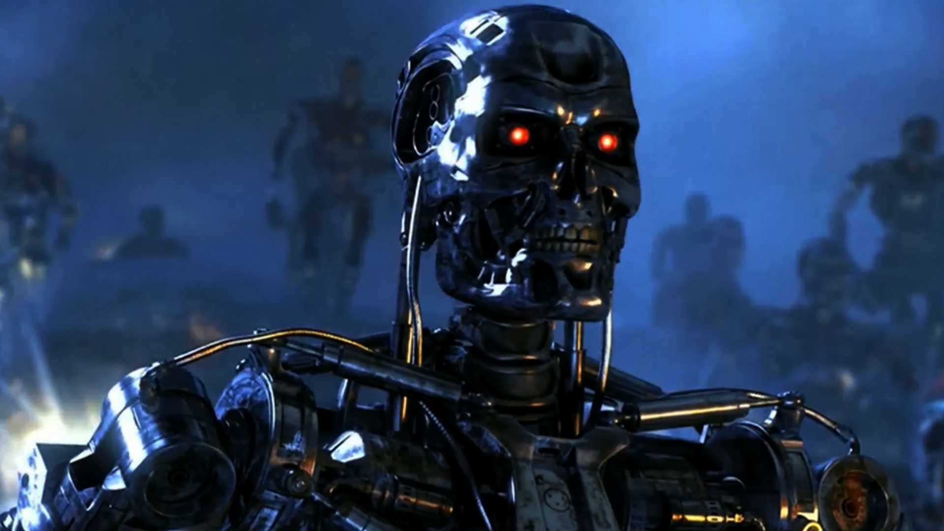
A note on “existential risk”

Slide 31
Introduction to frameworks of AI resistance
How YOU can resist
Responses to common arguments
Audience directed activity

Slide 32
Next….
Make … anti-AI stickers
Plan … specific actions
Discuss … what we feel
Learn … more background info

