Slide 1
A Practical Introduction to BIG DATA
Alvaro del Castillo San Félix (alvarodelcastillo@gmail.com)
21st June, esLibre 2019, Granada
https://github.com/aylabs/bigdata-practical-intro
v1.2

Slide 2

/me: Alvaro del Castillo
Open Source believer and coder!
Cofounder of Barrapunto and Bitergia
Working in different roles in Tech companies
Now in Paradigma Digital as Software Architect filling the BBVA Data Lake in the Transcende project. We are hiring!
In the process of surfing the Machine Learning wave
GitHub:
https://github.com/acs/
LinkedIn:
https://www.linkedin.com/in/acslinkedin/
Twitter:
https://twitter.com/acstw
Email:
alvaro.delcastillo@gmail.com

Slide 3

Summary
Data
Big
Practical
Open Source
https://www.pexels.com/photo/notebook-1226398/

Slide 4

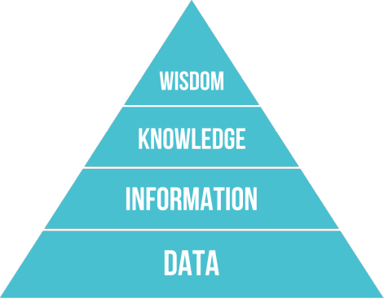
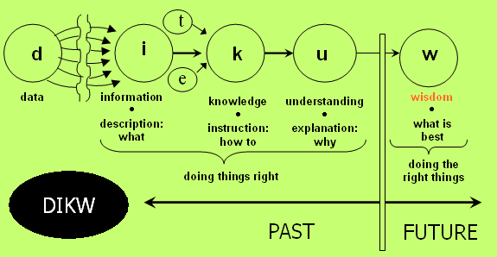
Data
https://en.wikipedia.org/wiki/DIKW_pyramid
"Typically information is defined in terms of data, knowledge in terms of information, and wisdom in terms of knowledge"
https://www.pexels.com/photo/person-holding-string-lights-photo-818563/
By Longlivetheux - Own work, CC BY-SA 4.0, https://commons.wikimedia.org/w/index.php?curid=37705247

Slide 5

Big
The 3 Vs of Big Data:
Volume: Scalability (up to the infinite)
Velocity: Performance
Variety: Flexibility
2 more Vs:
Veracity: data quality Value: from data to business
Extra:
Clouds of cheap commodity computers
https://www.pexels.com/photo/bandwidth-close-up-computer-connection-1148820/

Slide 6

Big Data Architectures
Batch
Streaming
Lambda Architecture: Batch + Streaming in a single platform
https://www.pexels.com/photo/golden-gate-bridge-san-francisco-1591382/

Slide 7

Batch Data Processing
Data Collection
From upstream to staging
From staging to raw
Data Modelling
Automatic data modelling using inference
Manual modelling
Data Transformation
From raw to master
https://www.pexels.com/photo/woman-in-blue-dress-walking-on-concrete-staircase-leading-to-buildings-929168/

Slide 8

Stream Data Processing
A data stream is an ordered sequence of instances (packets)
The instances arrives in a continuous flow
Instead of collection, near real-time processing of the stream (stream mining)
The data is also modelled and processed, and optionally, it can be stored
Twitter, Netflix, Spotify, TCP/UDP … some samples of data streaming
https://www.pexels.com/photo/time-lapse-photography-of-waterfall-2108374/

Slide 9

Lambda Architecture: Batch + Stream
http://lambda-architecture.net/
Batch Layer
Serving Layer
Batch Process
https://es.m.wikipedia.org/wiki/Archivo:Orange_lambda.svg
Batch View
Query
Raw Data
Batch Process
Batch View
Streaming Data
Query
Speed Layer
Real Time View
Stream Process
Real Time View

Slide 10

Spark and Lambda relationship
RDDs, Datasets and Dataframes (Batch and Stream)
Structured Streaming (Stream)
https://www.pexels.com/photo/beach-coast-island-landscape-348520/

Slide 11

Practical
Spark as the reference platform for building Big Data platforms:
Data collection
Data modelling
Data transformations
Distributed data processing (scalability and performance) based on data partitioning
https://www.pexels.com/photo/person-holding-pumpkin-beside-woman-1374545/

Slide 12

Open Source
Apache Hadoop “umbrella”:
Apache HDFS
Apache Spark
Many others
https://www.pexels.com/photo/flying-hot-air-balloon-above-snow-covered-mountain-1740103/

Slide 13

Apache Spark Basics
https://spark.apache.org/
Unified analytics engine for large-scale data processing
Data processing done in memory (fast!) and distributed (scalable)
Easy to use API (Scala, Python, Java and R) hiding the distributed complexity (in most cases).
Extra batteries: SQL, Streaming, Machine Learning, Graphs

Slide 14

Research Paper: RDDs in the core
https://pages.databricks.com/rs/094-YMS-629/images/nsdi_spark.pdf
«Resilient Distributed Datasets: A Fault-Tolerant Abstraction for In-Memory Cluster Computing»
The immutable data to be processed in converted to RDDs with strong typing and distributed to the cluster for its processing in large clusters in a fault-tolerant manner.
Friendly for programmers with a simple but powerful functional API
https://www.pexels.com/photo/night-sky-over-city-road-1775302/

Slide 15

Spark Cluster Types
Standalone: default one used in one node deployments. Your local dev is executed with the same cluster code than in production.
Apache Mesos
Apache Hadoop Yarn
Kubernetes: the hotter one
https://www.pexels.com/photo/sears-tower-usa-1722183/

Slide 16

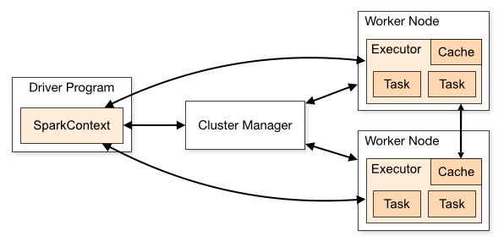
Execution of Sparks programs
https://www.pexels.com/photo/person-holding-surfboard-standing-on-rock-1749580

Slide 17

Playing with Apache Spark
Let’s try to do it all together:
Download Apache Spark (you need Java to execute it):
https://spark.apache.org/downloads.html (DO IT!)
Start Apache Spark Shell
Follow the practical session
https://www.pexels.com/photo/white-singer-sewing-machine-783590/

Slide 18

Transformations and actions
The way Spark models the data processing
Transformations don’t execute anything: Laziness
Transformations are chained (DAG) and optimized (Catalyst) before their execution
DAG: Direct Acyclic Graph describing the processing to be done on the data
Actions fire the current DAG and execute the transformations in the cluster
https://www.pexels.com/photo/multicolored-smoke-bomb-digital-wallpaper-1471748/

Slide 19

The used API: SparkSQL (Dataset API)
https://spark.apache.org/docs/latest/sql-programming-guide.html
Spark SQL is a Spark module for structured data processing: extra optimization based on the knowledge of the data
Build on top of RDDs:
Dataset is a RDD with an schema (structure of data)
DataFrame is a Dataset organized into named columns (Rows, like a SQL table)
https://www.pexels.com/photo/mountains-nature-arrow-guide-66100/

Slide 20

Starting Apache Spark Shell
https://spark.apache.org/docs/latest/quick-start.html
SparkSession is the entry point to programming Spark with the Dataset and DataFrame API. Be sure to use Java 1.8.
https://www.pexels.com/photo/sparkler-new-year-s-eve-sylvester-sparks-38196/
acastillo@acastillo:~/devel/spark/spark-2.4.3-bin-hadoop2.7$ JAVA_HOME=/usr/lib/jvm/java-8-openjdk-amd64/ bin/pyspark
SparkSession available as 'spark'. (the shell is the driver)
>>> spark.sparkContext.appName
u'PySparkShell'
>>> textFile = spark.read.text("README.md")
>>> textFile
DataFrame[value: string]
>>> textFile.count()
105
>>> textFile.show(3, False)
+------------------------------------------------------------------------------+
|value |
+------------------------------------------------------------------------------+
|# Apache Spark |
| |
|Spark is a fast and general cluster computing system for Big Data. It provides|
+------------------------------------------------------------------------------+

Slide 21

Partitions and transformations
>>> textFile.rdd.getNumPartitions()
1 one worker used
>>> textFile.repartition(8).rdd.getNumPartitions()
8 eight workers used
>>> textFile.filter(textFile.value.contains("Spark")).count()
20
acastillo@acastillo:~/devel/spark/spark-2.4.3-bin-hadoop2.7$ cat README.md | grep Spark | wc -l
20
https://www.pexels.com/photo/woman-walking-in-beach-509127/

Slide 22
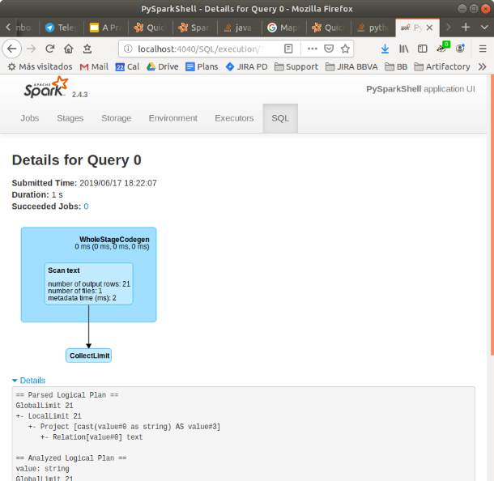

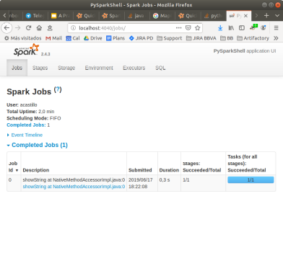
The Spark Web console
https://www.pexels.com/photo/selective-focus-photo-of-magnifying-glass-1194775/

Slide 23
Jobs, Stages and Tasks
A job is created and executed once an action is executed.
The job is divided in tasks. Each task works with a partition. Tasks are distributed in the executors available.
Tasks are grouped in stages: there is no shuffle between the tasks inside the same stage.
https://www.pexels.com/photo/multicolored-smoke-bomb-digital-wallpaper-1471748/

Slide 24

Sending an App to Spark Cluster
acastillo@acastillo:~/devel/spark/spark-2.4.3-bin-hadoop2.7$ cat simple.py
"""SimpleApp.py"""
from pyspark.sql import SparkSession
logFile = "/home/acastillo/devel/spark/spark-2.4.3-bin-hadoop2.7/README.md"
spark = SparkSession.builder.appName("SimpleApp").getOrCreate()
logData = spark.read.text(logFile).cache()
numAs = logData.filter(logData.value.contains('a')).count()
numBs = logData.filter(logData.value.contains('b')).count()
print("Lines with a: %i, lines with b: %i" % (numAs, numBs))
spark.stop()
acastillo@acastillo:~/devel/spark/spark-2.4.3-bin-hadoop2.7$ JAVA_HOME=/usr/lib/jvm/java-8-openjdk-amd64 bin/spark-submit simple.py
…
Lines with a: 62, lines with b: 31
…
https://www.pexels.com/photo/achievement-adult-agreement-arms-1243521/

Slide 25

Main transformations
A narrow transformation does not need shuffle (partitions exchange between executors); wide yes.
Narrow: map, filter, flatMap, sample, union
Wide: join, distinct, intersection, groupByKey, reduceByKey, sort, partitionBy, repartition, coalesce, dropDuplicates
https://www.pexels.com/photo/battle-black-and-white-board-game-challenge-358562/

Slide 26

Main actions
Count, collect, reduce, lookup, save, head, show, foreach
Be careful: the results of the actions could return all data to the driver (memory and disk usage risks).
https://www.pexels.com/photo/action-adult-athlete-blur-213775/

Slide 27


Using GitHub archive data
acastillo@acastillo:~/devel/spark/spark-2.4.3-bin-hadoop2.7$ wget http://data.githubarchive.org/2019-05-31-21.json.gz
acastillo@acastillo:~/devel/spark/spark-2.4.3-bin-hadoop2.7$ gunzip 2019-05-31-21.json.gz
acastillo@acastillo:~/devel/spark/spark-2.4.3-bin-hadoop2.7$ JAVA_HOME=/usr/lib/jvm/java-8-openjdk-amd64/ bin/pyspark
>>> events = spark.read.json("2019-05-31-21.json")
>>> events.count()
63826
>>> events.printSchema()
root
|-- actor: struct (nullable = true)
| |-- avatar_url: string (nullable = true)
| |-- display_login: string (nullable = true)
…
>>> events.select("repo.name").show(20, False)
+---------------------------------------+
|name |
+---------------------------------------+
|kedacore/keda |
|OSSIA/score |
|Unity-Technologies/ml-agents |
…
>>> events.filter("repo.name = 'eslibre/charlas'").select("actor.display_login", "created_at","type", "payload.pull_request.html_url").show(truncate=False)
+-------------+--------------------+----------------+------------------------------------------+
|display_login|created_at |type |html_url |
+-------------+--------------------+----------------+------------------------------------------+
|dfurmans |2019-05-31T21:37:33Z|PullRequestEvent|https://github.com/eslibre/charlas/pull/43|
+-------------+--------------------+----------------+------------------------------------------+
https://www.pexels.com/photo/top-view-of-library-with-red-stairs-1261180/

Slide 28
Using GitHub archive data
acastillo@acastillo:~/devel/spark/spark-2.4.3-bin-hadoop2.7/github$ wget http://data.githubarchive.org/2019-05-31-{0..23}.json.gz
acastillo@acastillo:~/devel/spark/spark-2.4.3-bin-hadoop2.7/github$ du -sh .
5,7G
acastillo@acastillo:~/devel/spark/spark-2.4.3-bin-hadoop2.7$ JAVA_HOME=/usr/lib/jvm/java-8-openjdk-amd64/ bin/pyspark
>>> events = spark.read.json("github/2019-05-31-*.json")
>>> events.count()
1767137
>>> from pyspark.sql.functions import desc
>>> events.groupby("repo").count().select("repo.name","count").sort(desc("count")).show(10, False)
+-------------------------------------+-----+
|name |count|
+-------------------------------------+-----+
|Parkboyoung11/Kirito |9197 |
|willcbaker-ext/subt |3587 |
…
>>> events.registerTempTable("events")
>>> spark.sql("select repo.name, count(*) as count from events group by repo order by count desc limit 10").show()
+--------------------+-----+
| name|count|
+--------------------+-----+
|Parkboyoung11/Kirito| 9197|
| willcbaker-ext/subt| 3587|
…
https://www.pexels.com/photo/top-view-of-library-with-red-stairs-1261180/
Volume: 2/12/2011 -> 6/19/2019: 3049 days * 5.7GB = 17 TB
Variety: more than 20 types of events
Velocity: 2M events/day, 1388 events/s

Slide 29

Main pitfalls
Out of Memory errors in workers (in shuffle operations mainly)
Out of Memory errors in the driver, executing program in the driver
Bad partitioning of the data
Implementing algorithms not suitable for data partitioning (recursive ones)
https://www.pexels.com/photo/man-person-street-shoes-2882/

Slide 30

A real use case using Spark
BBVA Transcendence: http://www.expansion.com/empresas/banca/2019/01/03/5c2d1480468aeb73778b45db.html
https://www.pexels.com/photo/activity-blueprint-building-building-site-583393/

Slide 31

Credits
https://spark.apache.org/
https://www.pexels.com/
https://www.paradigmadigital.com/
https://www.bbva.com/
https://www.pexels.com/photo/black-and-white-connected-hands-love-265702/
https://github.com/aylabs/bigdata-practical-intro

