Slide 1

CSIS 1230-01 programming for everyone iI
Introduction to Web APIs

Slide 2
OUTLINE
What clients and servers are, and how they talk using HTTP
What a URL and query parameters work
Core HTTP methods (GET, POST, PUT, DELETE)
HTTP status codes (2XX, 4XX, 5XX)
Basics of authentication (API keys, Bearer tokens)
Handson with browser and Postman

Slide 3
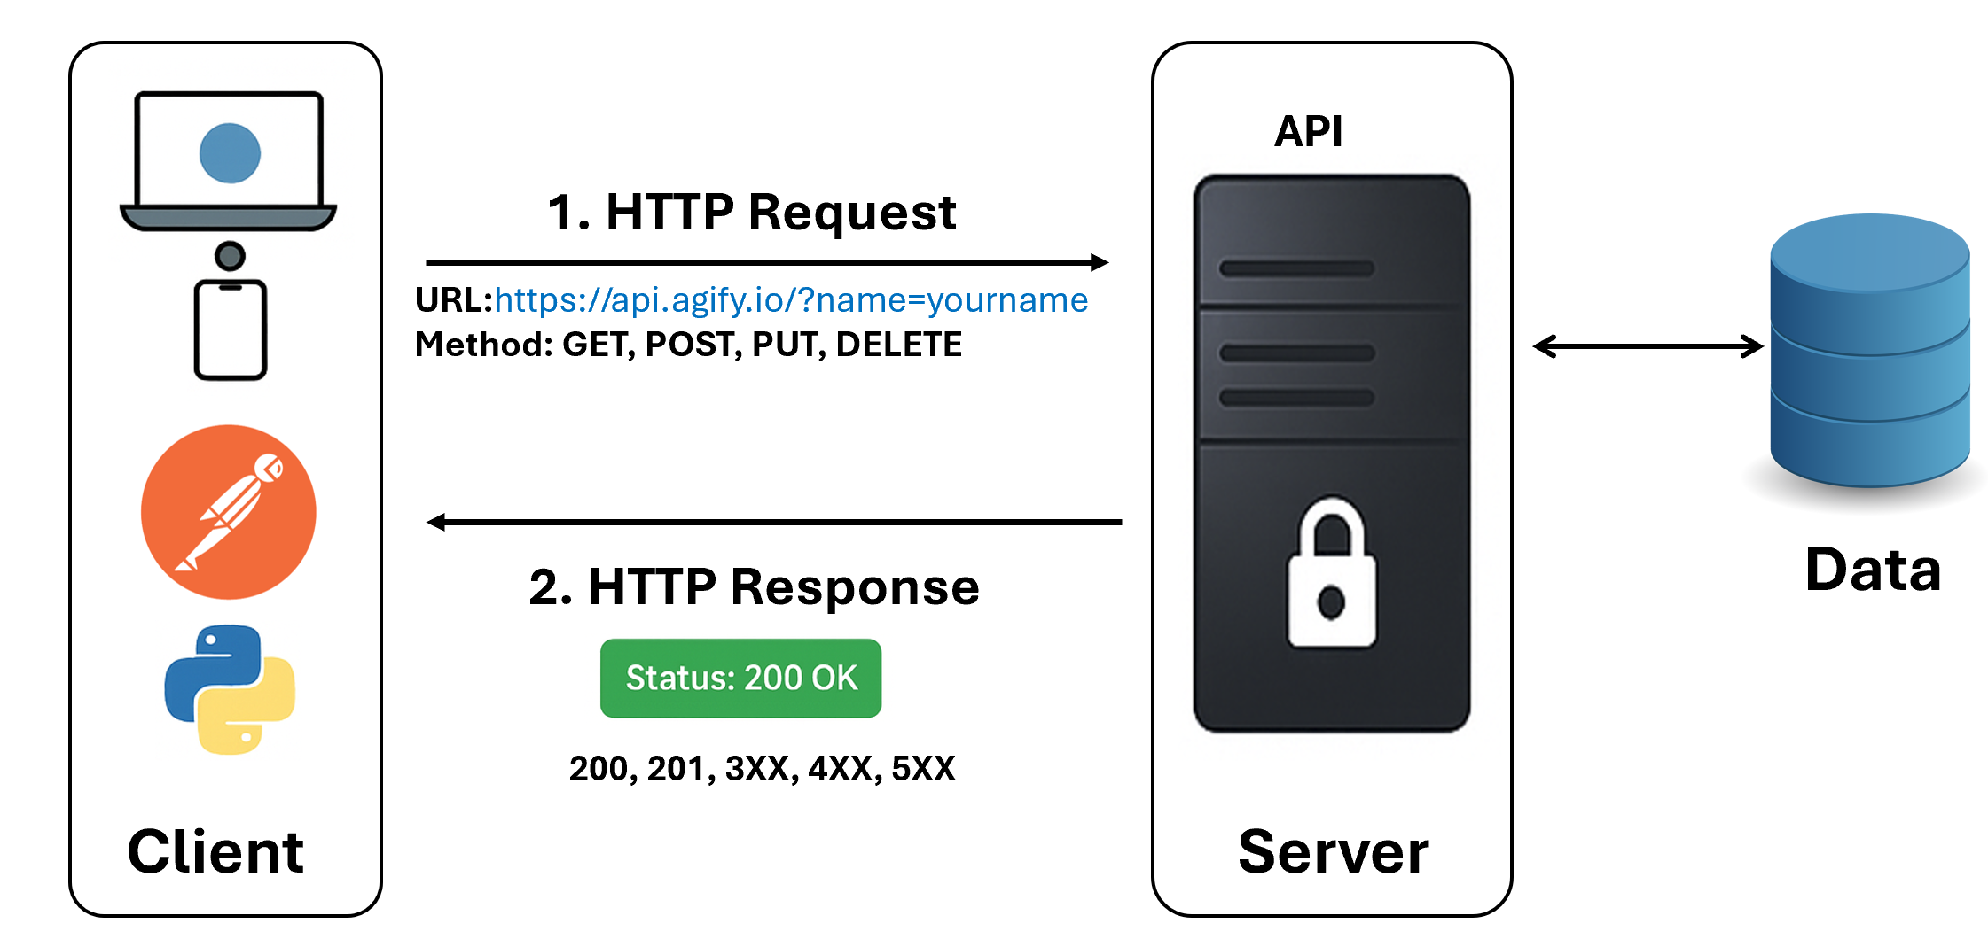
Client – server communication via http

Slide 4
Client – server (restaurant)
CLIENT | API | SERVER
You have a need (food). | List of rules for what to order | Receives your order
You look at the menu to see what you can order | Tells you what dishes you can order | Prepares the food exacts as described on the menu
Send your order to the server. | How to ask for each by name
Wait for your food | What you will get back | Server to You (Client)

Slide 5
Client – server (web terms)
Client: Your web browser, Python program, Postman app, etc.
Basically, anything that requests data.
Server: A powerful computer running somewhere in the world that responds
with data.
API: (Application Programming Interface): The "menu" or "contract" that
defines how a client and server can talk to each other.

Slide 6
Client – server (Demo)
Client: Your web browser makes a request to https://www.northpark.edu/
(REQUEST)
Server: North Park’s servers send back HTML, CSS and images
(RESPONSE)
Your browser assembles it all into what you see.

Slide 7
HTTP
Hypertext Transfer Protocol.
The language the client uses to communicate with the server.
The set of rules (a protocol) that allows your computer (or phone, browser, app, etc.) to talk to servers on the internet, fetch data like web pages or APIs, send data, and display results.

Slide 8
ANATOMY of a url
Uniform Resource Locator:
Full address of a specific resource on the internet.
Example; https://jsonplaceholder.typicode.com/posts?userId=1
https → protocol (secure HTTP)
jsonplaceholder.typicode.com → server (domain)
/posts → path (resource) on the server
?userId=1 → query parameter (`userId` equals 1) – returns record(s) where userId is 1

Slide 9
HTTP Methods
Method | Function
GET | Retrieve this information (e.g., “GET the weather for Chicago”)
POST | Here is some information, please create a new record (e.g., “POST a new tweet”)
PUT | Update this existing information. (e.g., “UPDATE my user profile”)
DELETE | Please delete this information. (e.g., “DELETE this post”)

Slide 10
Status codes
2XX Success: 200 OK (GET/PUT), 201 Created (POST), 204 No Content (DELETE)
4XX Client Errors: 400 Bad Request, 401 Unauthorized, 403 Forbidden, 404 Not Found
5XX Server Errors: 500 Internal Server Error, 502 Bad Gateway, 503 Service Unavailable
Why they matter?
Your code should check the status code and handle errors nicely.

Slide 11
Status codes
Code | Name | Meaning | Common Causes
200 | OK | Success! | The request worked perfectly (e.g., your AAPL ticker data was returned).
400 | Bad Request | Client Error | The server didn't understand the request (often due to a syntax error in your JSON).
401 | Unauthorized | Client Error | You aren't authenticated. In your case, it's likely that GitHub PAT being invalid or expired.
403 | Forbidden | Client Error | You are authenticated, but you don't have permission to see this specific resource.
404 | Not Found | Client Error | The specific URL or endpoint you're hitting doesn't exist.
500 | Internal Server Error | Server Error | A generic "something went wrong" on the server's end.
502 | Bad Gateway | Server Error | One server received an invalid response from another server it was trying to talk to.

Slide 12
auth
API Key: a secret string you send (often in a header)
Basic Auth: username, password (only over HTTPS)
Bearer Token / OAuth2/ JWT: You send a token in the `Authorization` header

Slide 13
Class exercise
Download postman or use your web browser
Make HTTP Request for data available at the following URLs or End points
https://jsonplaceholder.typicode.com/todos?userId=2
https://jsonplaceholder.typicode.com/posts?userId=1
https://reqres.in/api/users?page=1

Slide 14
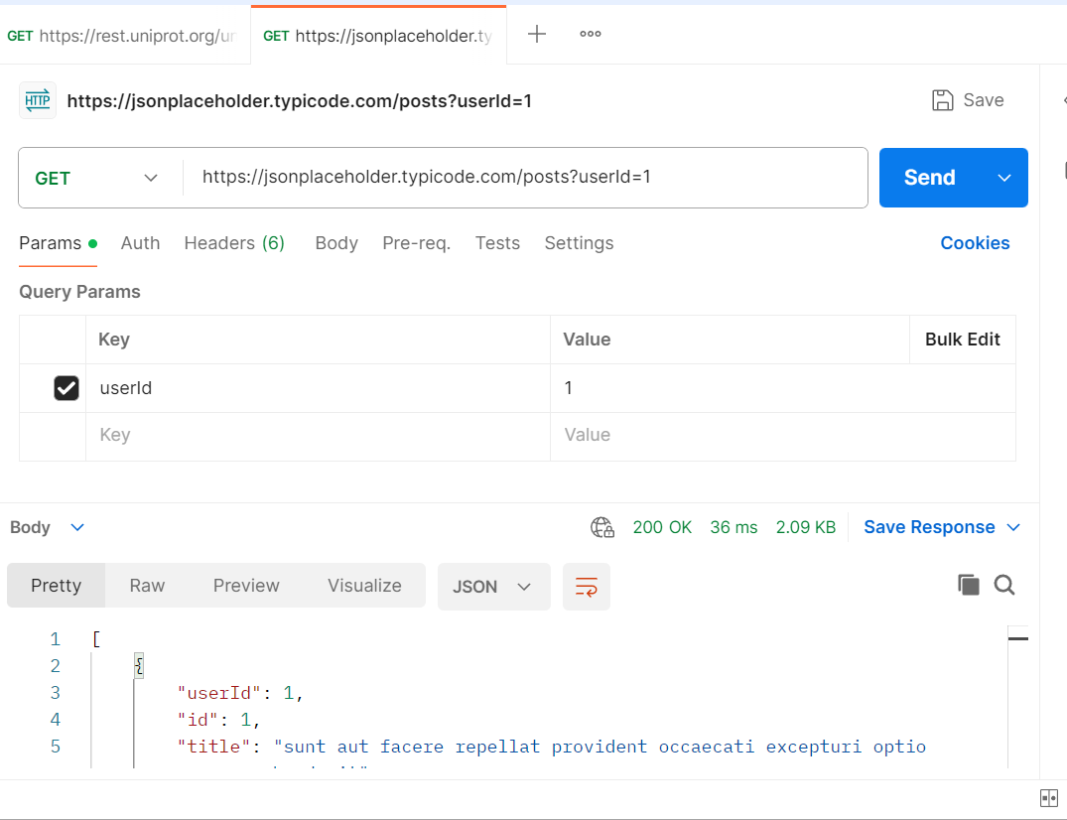
FREE API
https://jsonplaceholder.typicode.com/posts?userId=1

Slide 15
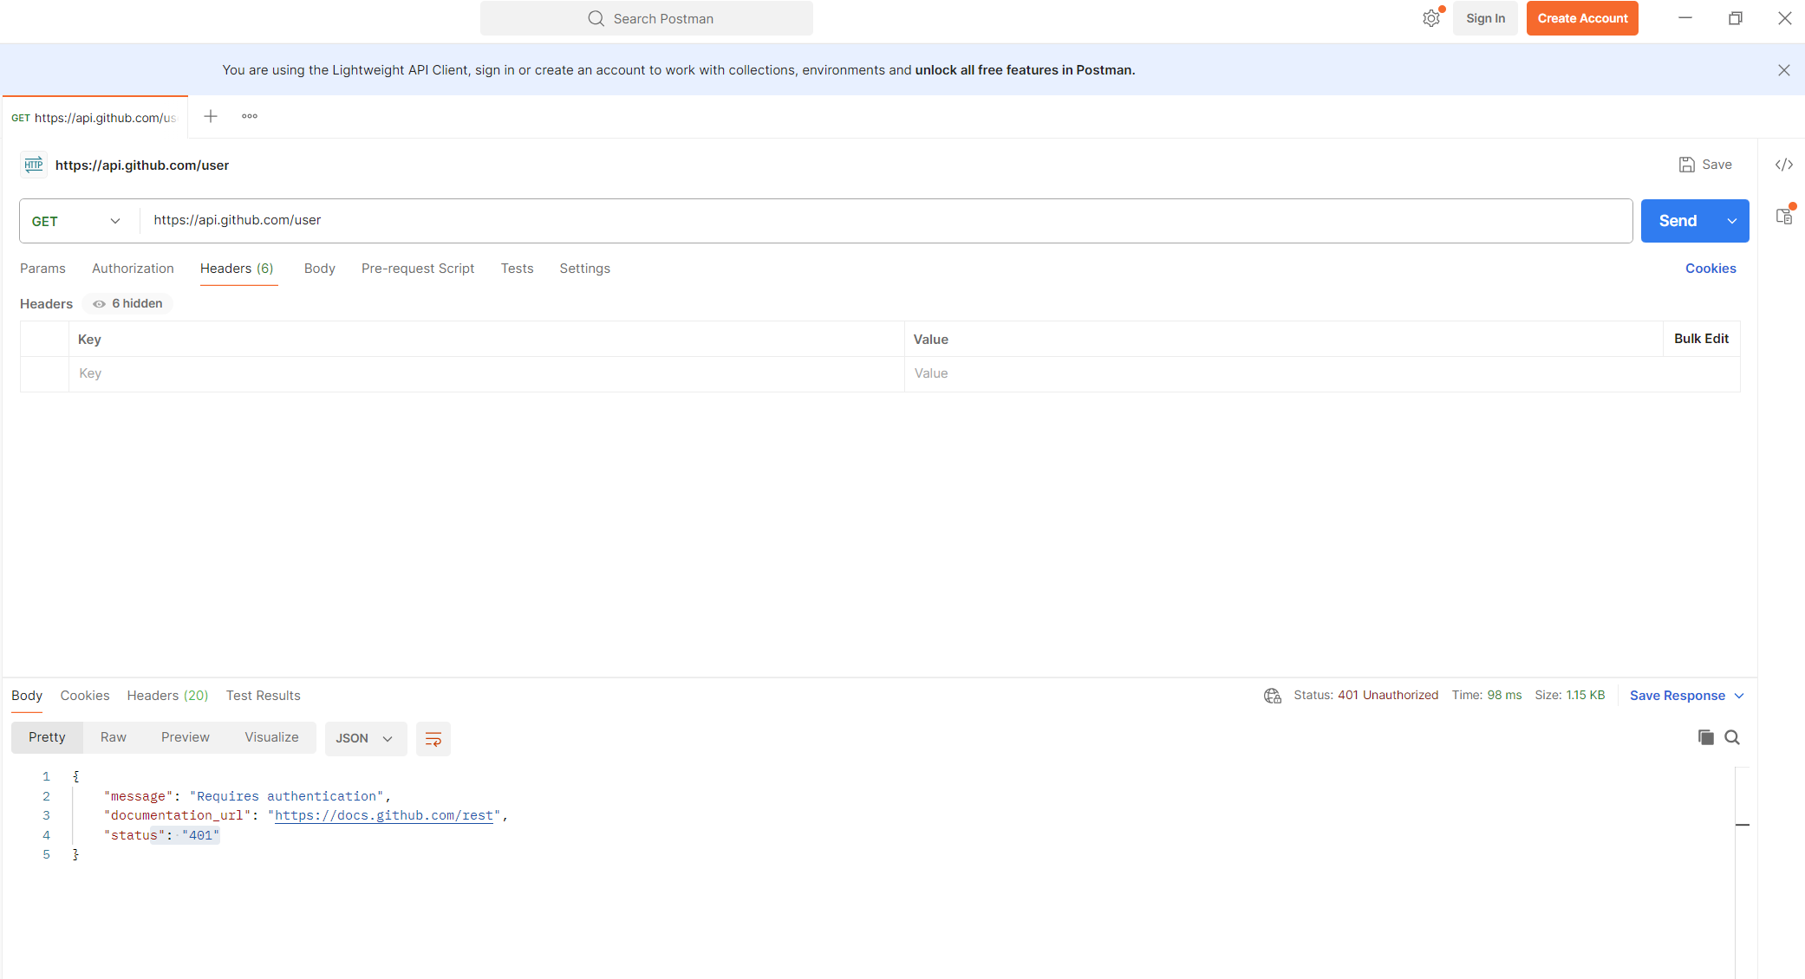
AUTH required
https://api.github.com/user

Slide 16
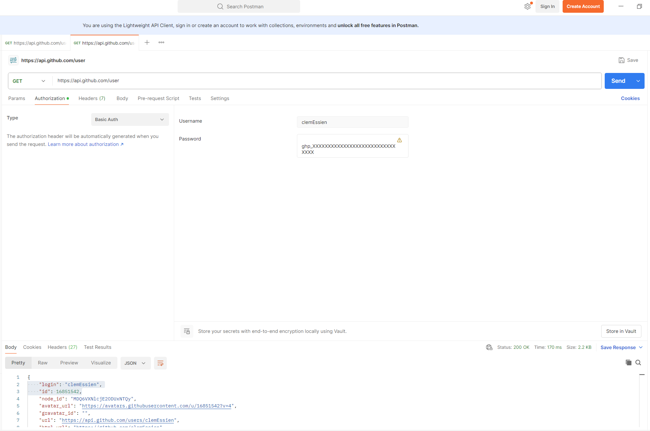
AUTH required (FIXED)
https://api.github.com/user

Slide 17
Good habits
Use the right HTTP method for the job (GET for read, POST for create, etc.).
Always check the status code and handle non‑2xx cases.
Use timeouts to avoid hanging requests.
Keep API keys/tokens out of public code; prefer environment variables.
Read the API docs: required parameters, auth, rate limits, and example responses.

Slide 18
quiz
In HTTP, which part tells the server what action you want (read/create/update/delete)?
What is the difference between 200 OK and 201 Created?
True/False: GET should change data on the server.
Which header often carries tokens for APIs (e.g., OAuth2/JWT)?
What is a query parameter? Give an example using ?key=value.

Slide 19
SUMMARY
Client and Server talk via HTTP (request → response).
Methods describe the action; status codes describe the result.
URLs + query parameters control what you ask for.
You used a browser, Postman, and Python to call real APIs (JSONPlaceholder, Open‑Meteo).

Slide 20
Next
Use Python’s requests library to make:
GET
POST
PUT
DELETE

Slide 21
Questions
Notes:
5. Getting Started Tips
Install: download from python.org or use Anaconda for a bundled scientific stack.
Launch REPL: open a terminal, type python3, experiment.¹⁸
First script: save print("Hello, world!") as hello.py; run python hello.py.¹⁷
Virtual environments: python -m venv venv keeps project packages isolated.
Next steps: Explore The Python Tutorial and beginner MOOCs like “Python for Everybody.”¹⁹

