Slide 1

UNSW-NB 15.
Anomaly Detection Assignment
Lala Ayoade Stephen R2010D11397905

Slide 2

Outline
Problem of Interest
The Problem trying to solve in this assignment
02
Introduction
Proposed Methodology
Simple explanation of anomalies and methods to handle those anomalies
01
03
Approach used to solve the problem of interest along with results
04
Conclusion
Overall Summary of the Presentation along with limitation

Slide 3
Introduction
Anomalies is a pattern in the data that does not conform to the expected behaviour.
What are
Anomalies?
Also referred to as outliers, exceptions, peculiarities, surprise, etc.
Anomalies translate to significant (often critical)
real life entities
Cyber intrusions
Credit card fraud
1
2
3

Slide 4
Introduction
Non-human error: such as equipment failure or weather-related radio communication;
Human error: such as a network service interruption caused by a misconfiguration or a network cable that was accidentally disconnected;
Malicious human behavior: such as an insider attack in which a disgruntled employee destroys the network printer or an external attack in which an opponent attempts to disrupt the network and harm the company's reputation.
Type of
Anomalies?
1
2
3

Slide 5
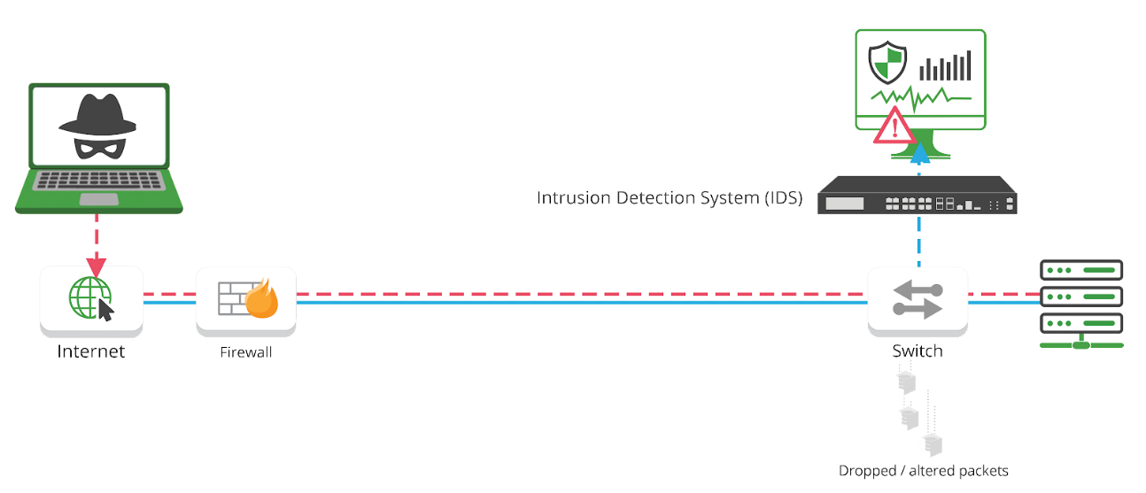
Intrusion detection begins where the firewall ends.
Preventing unauthorized entry is best, but not always possible.
It is important that the system is reliable and accurate and secure.
5
Intrusion Detection System
Intrusion detection begins where the firewall ends.
Preventing unauthorized entry is best, but not always possible.
It is important that the system is reliable and accurate and secure.
Page/ 5

Slide 6

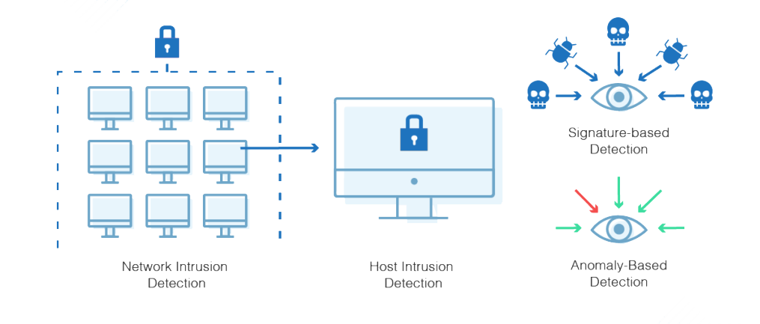
Intrusion detection begins where the firewall ends.
Preventing unauthorized entry is best, but not always possible.
It is important that the system is reliable and accurate and secure.
6
Anomaly Based
Detection System
Anomaly based IDS are based on tracking unknown
unique behavior pattern of detrimental activity
Advantages:
Helps to reduce the “limitations problem”.
Conducts a thorough screening of what comes through.
Intrusion Detection Type
There are two type of Intrusion Detection System
Signature Based System
Anomaly Based System

Slide 7
7
Anomaly Detection of Binary and Multi Class Label in UNSW-NB15 Dataset using Spark Machine Learning
Problem Statement
Problem Statement.

Slide 8
8
Proposed Methodology
Data Preprocessing
01
03
Model Training
Training of Model on the Feature Vector created through Vector Assembler
Cleaning of data , along with filling null values with column rename were performed in this step
Exploratory Data
Analysis
04
Evaluation Metrics
02
Evaluation of Model for both Binary and Multi class
Using Precision, Recall and F1-Score along with confusion Matrix
Data Visualization was implemented using Hive, seaborn and Matplotlib to get useful information

Slide 9
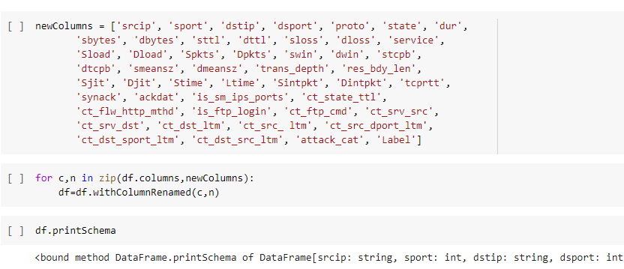
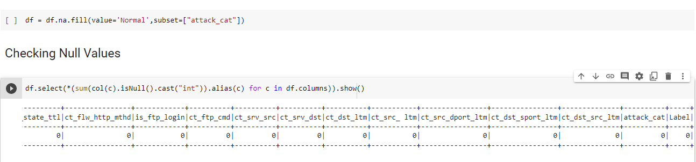
9
Data Pre-processing
Column Rename
All columns name were changed into its original ones
Fill NaN values
Nan Values in attack column are fill with normal.

Slide 10
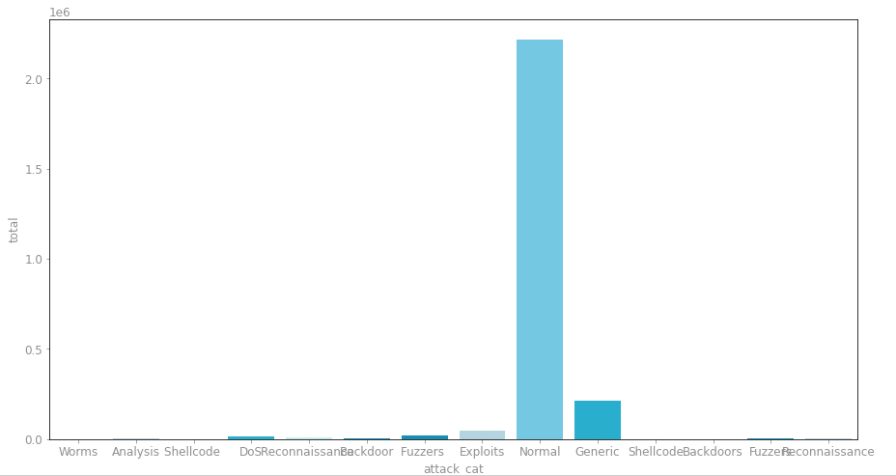
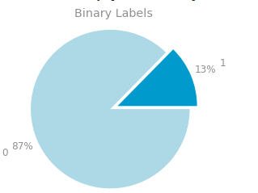
10
Data Visualization
Binary Class Labels
Multi Class Labels

Slide 11
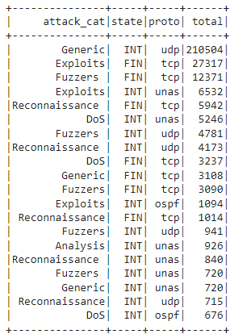
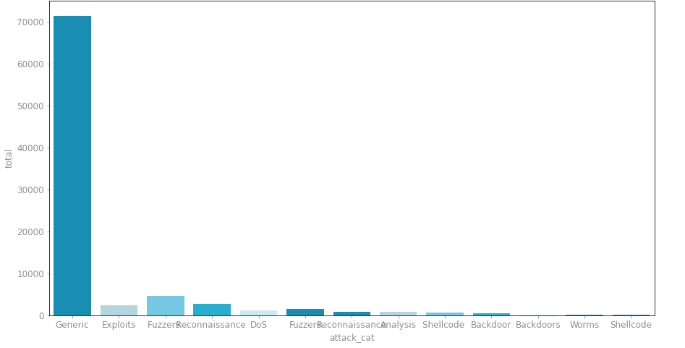
11
Data Visualization
Top State and Protocol used in Attack
FIN and TCP is the most used state and protocol when anomaly attack occur
Generic attack occurred the most with INT and UDP being used by it along with FIN and TCP for Exploit Attack

Slide 12
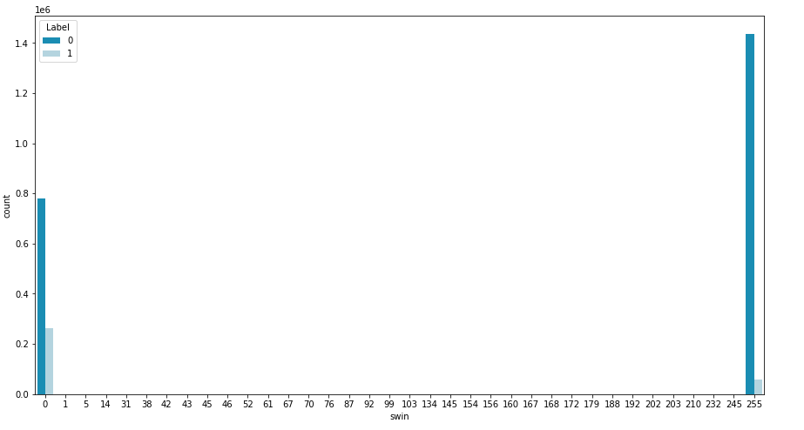
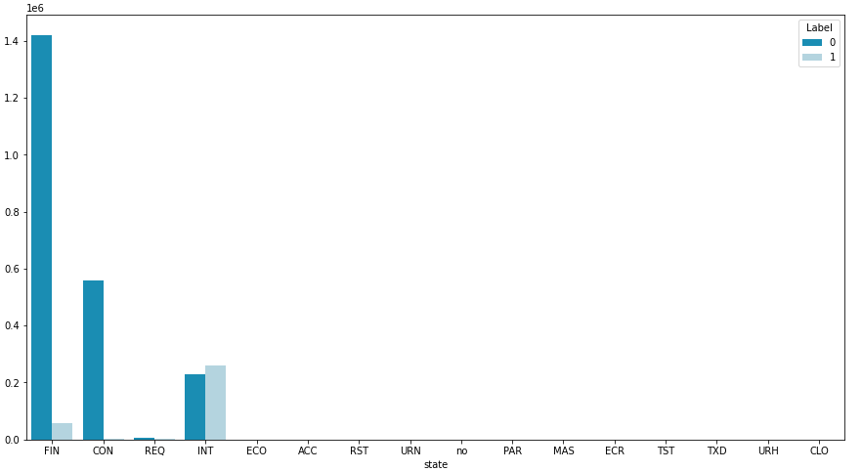
12
Data Visualization
Swin (Source TCP window advertisement)
State
Values are spread only on 0 or 255
Normal data has most of its values at 255
Attack data has most of its value at 0 with small portion at 255 which is an inverse of normal data
For Normal Data: Fin is the most occurred state along with CON and few INT
For Anomaly Data: INT is the most used state along with few Fin and Req

Slide 13
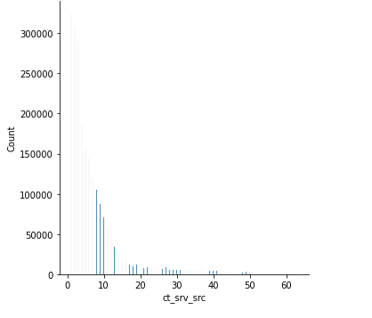
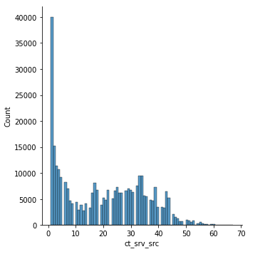
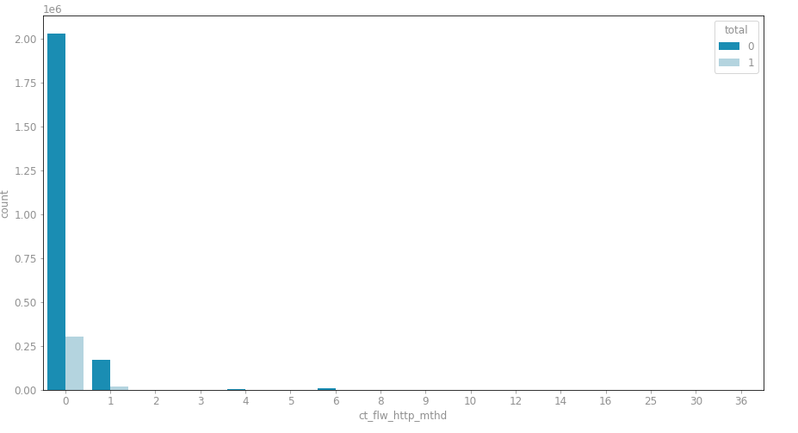
13
Data Visualization
Ct Srv Src
Ct flw http mthd
No. of connections that contain the same service and source address
For normal most of the values are from 0 to 15 shown in Figure 1.
For anomaly most of the values are from 0 to 10 with more distributed between
25 to 35 shown in Figure 2.
No. of flows that has methods such as Get and Post in http service.
For normal almost all the values are 0 and few 1.
In attack data everything is 0 and there is very little
no of 1's

Slide 14
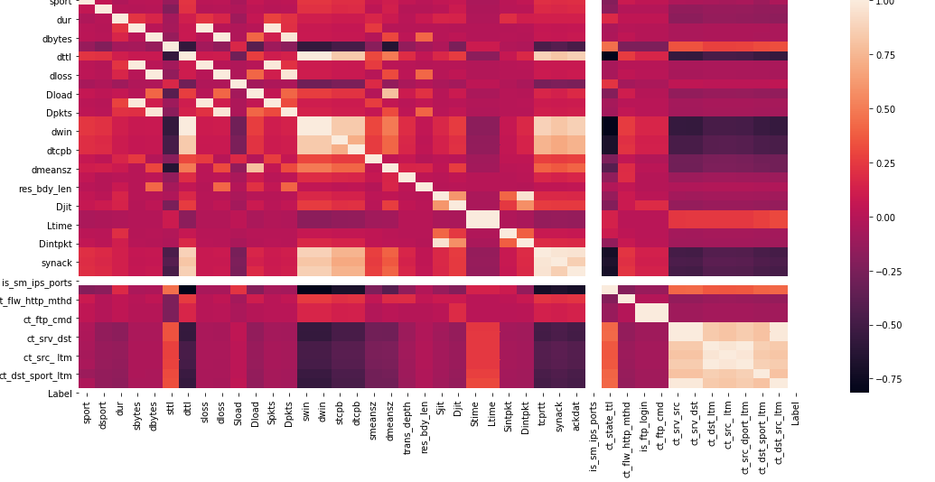
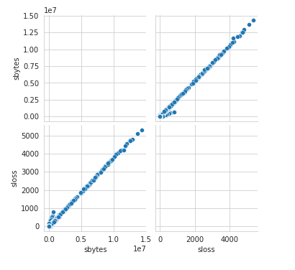
14
Data Visualization
The correlation coefficient has a range of values from -1 to 1.
A number near 0 indicates a lesser connection (precise 0 indicates no association).
A value near 1 indicates a stronger positive correlation.
A number nearer to 1 denotes a more pronounced negative correlation.
Pairplot of sbytes and sloss showing the highly correleated features
Along with this few other highly correlated features are:
dbytes and dpkts
tcprtt and synack
ct_dst_ltm and ct_src_ltm
stime and ltime

Slide 15
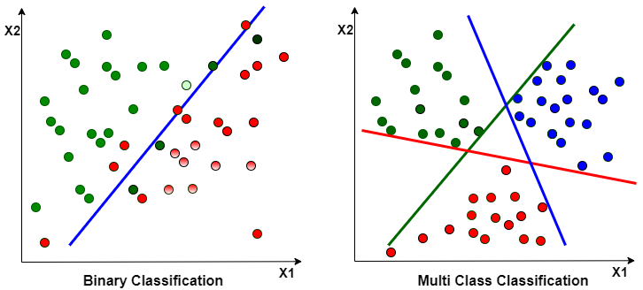
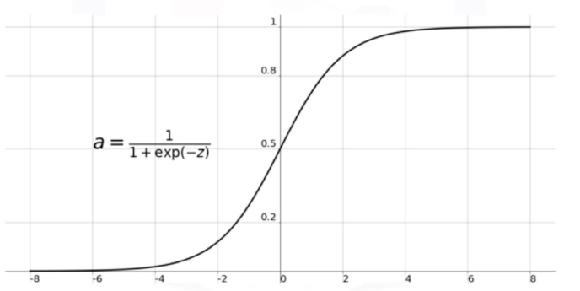
Logistic Regression: It is used to tackle issues involving both binary and multiclass classification. The chance of an event occurring is predicted by fitting data to a Logistic function. This method returns a value between 0 and 1. The intermediate value, 0.5, is regarded as the barrier between classes 1 and 0. If the result is larger than 0.5, it is classified as class 1, and if it is less than 0.5, it is classified as class 0.
15
Model Training
Logistic Regression: It is a classification algorithm used to find the probability of event success and event failure. It is used when the dependent variable is binary(0/1, True/False, Yes/No) in nature. It supports categorizing data into discrete classes by studying the relationship from a given set of labelled data. It learns a linear relationship from the given dataset and then introduces a non-linearity in the form of the Sigmoid function.
Sigmoid Function

Slide 16
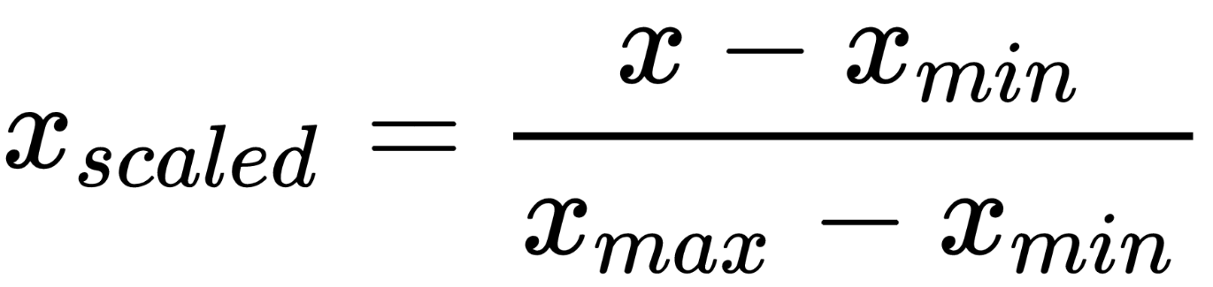
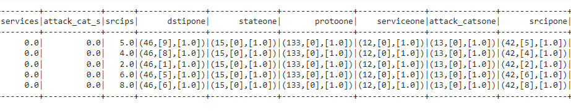
Logistic Regression: It is used to tackle issues involving both binary and multiclass classification. The chance of an event occurring is predicted by fitting data to a Logistic function. This method returns a value between 0 and 1. The intermediate value, 0.5, is regarded as the barrier between classes 1 and 0. If the result is larger than 0.5, it is classified as class 1, and if it is less than 0.5, it is classified as class 0.
16
Feature Assembler
Vector Assembler: It is a transformer that combines a given list of columns into a single vector column. It is useful for combining raw features and features generated by different feature transformers into a single feature vector, in order to train ML models
Before Model Training Three Step were performed:
StringInderxing : Convert String Columns into Numeric Columns
One Hot Encoding: Convert Numeric Column into One Hot Encoding Method
Min Max Scaler: Normalize the data using minmax formula

Slide 17
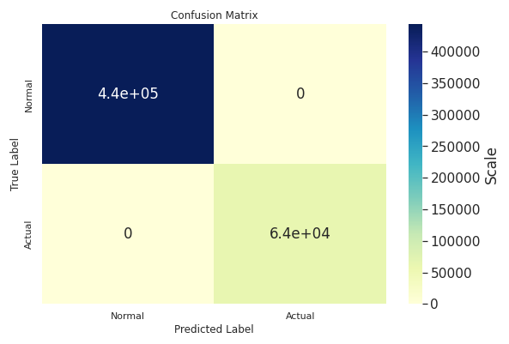

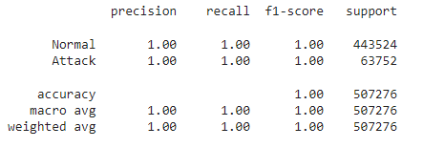
Logistic Regression: It is used to tackle issues involving both binary and multiclass classification. The chance of an event occurring is predicted by fitting data to a Logistic function. This method returns a value between 0 and 1. The intermediate value, 0.5, is regarded as the barrier between classes 1 and 0. If the result is larger than 0.5, it is classified as class 1, and if it is less than 0.5, it is classified as class 0.
17
Binary Classification
Evaluation Metrics
True Negative
False Positive
443088
0
Accuracy
100%
False Negative
True Positive
0
64276
F1-Score
Recall
100%
100%

Slide 18
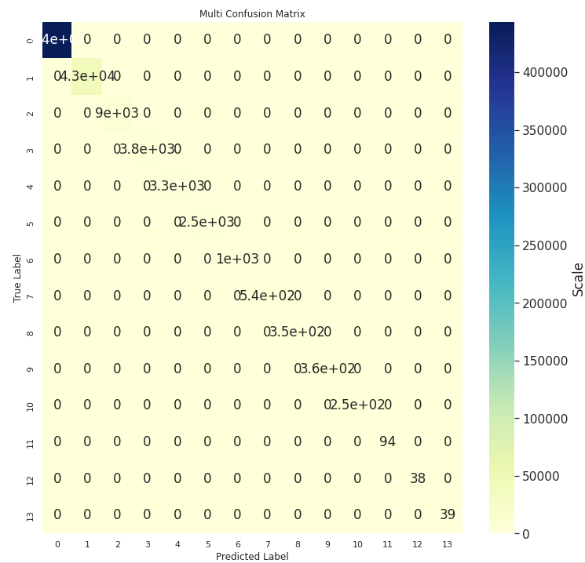
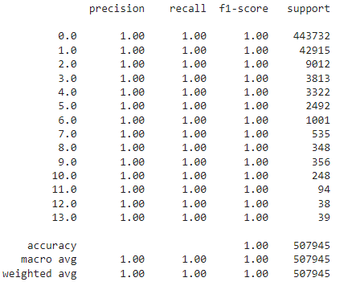
Logistic Regression: It is used to tackle issues involving both binary and multiclass classification. The chance of an event occurring is predicted by fitting data to a Logistic function. This method returns a value between 0 and 1. The intermediate value, 0.5, is regarded as the barrier between classes 1 and 0. If the result is larger than 0.5, it is classified as class 1, and if it is less than 0.5, it is classified as class 0.
18
Multi Classification
Accuracy
100%

Slide 19
Logistic Regression: It is used to tackle issues involving both binary and multiclass classification. The chance of an event occurring is predicted by fitting data to a Logistic function. This method returns a value between 0 and 1. The intermediate value, 0.5, is regarded as the barrier between classes 1 and 0. If the result is larger than 0.5, it is classified as class 1, and if it is less than 0.5, it is classified as class 0.
19
Limitation
1
PCA or Auto encoder methods not implemented to decrease the dimensionality
of the data without effecting the overall information of the dataset
Limitation 1
2
Technique like Smote or RandomUndersampling could have been used to
Oversample and under sample the Labels to balance the overall dataset
Limitation 2
3
Feature Extraction Technique could have been used to extract the important feature so that our model could train only on the importance features and train faster
Limitation 3

Slide 20
Logistic Regression: It is used to tackle issues involving both binary and multiclass classification. The chance of an event occurring is predicted by fitting data to a Logistic function. This method returns a value between 0 and 1. The intermediate value, 0.5, is regarded as the barrier between classes 1 and 0. If the result is larger than 0.5, it is classified as class 1, and if it is less than 0.5, it is classified as class 0.
20
Reference
N. Moustafa and J. Slay, “The evaluation of network anomaly detection systems: statistical analysis of the unsw-nb15 data set and the comparison with the kdd99 data set,” Information Security Journal: A Global Perspective, vol. 25, no. 1-3, pp. 18–31, 2016.
PySpark tutorial for beginners: Python examples. Spark by {Examples}. (2021, September. Retrieved December 18, 2021, from https://sparkbyexamples.com/pyspark-tutorial/
Katari, K. (2020, October 26). Exploratory data Analysis(EDA): Python. Medium. Retrieved December 18, 2021, from https://towardsdatascience.com/exploratory-data-analysis-eda-python-87178e35b14
G., Dr. Ranganathan. “Real Time Anomaly Detection Techniques Using Pyspark Frame Work.” March 2020, vol. 2, no. 1, 2020, pp. 20–30., https://doi.org/10.36548/jaicn.2020.1.003.
Pwint, Phyo & Shwe, Thanda. (2019). Network Traffic Anomaly Detection based on Apache Spark. 222-226. 10.1109/AITC.2019.8920897.
An Approch for the Application of Dynamic Multi-Class Classifier for Network Intrusion Detection Systems
Apache Spark. The Apache Sprk - Lightning-fast cluster computing. http://spark.apache.org/, June 2016.
Ahmad M Karimi, Quamar Niyaz, Weiqing Sun, Ahmad Y Javaid, and Vijay K Devabhaktuni. Distributed network traffic feature extraction for a real-time ids.2016.
G, M. (2021). Intrusion Detection System Using. Advances in Parallel Computing Technologies and Applications, 8.

Slide 21

THANK YOU.

