Slide 1
Data Analysis For Marketing Research
Aylin Ergul

Slide 2
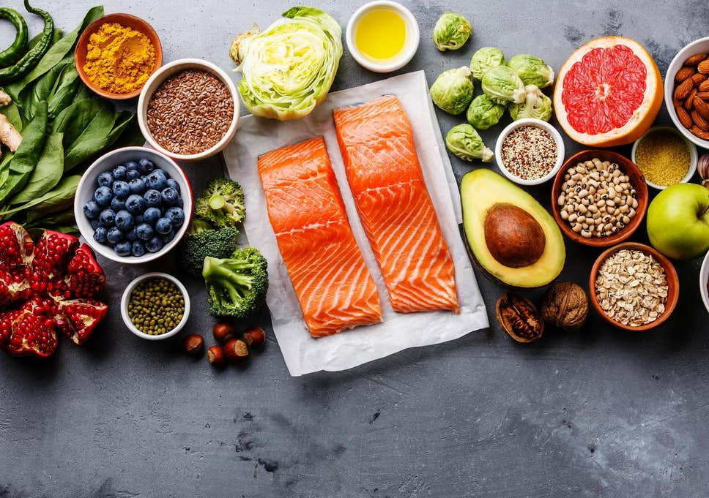
The Problem
In this project problem is not knowing the best neighborhood to open a restaurant which sells healthy foods in Melbourne
And I used the connection between sport-health and food-health

Slide 3

Data
I needed the dataset which includes names and locations of neighborhoods
And the frequency of gyms in these neighborhoods
The dataset which contains information about neighborhood and coordinates has downloaded from internet

Slide 4
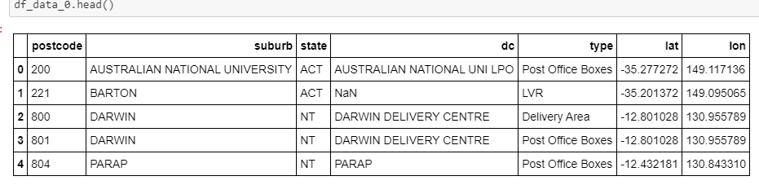
Dataset

Slide 5
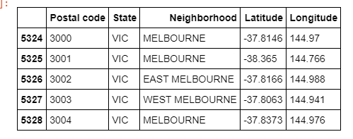
Cleaning Data
Melbourne Data frame
First I removed all null values from dataset.
Then I extracted the suburbs in state of Victoria and after that I got the data only for Melbourne

Slide 6
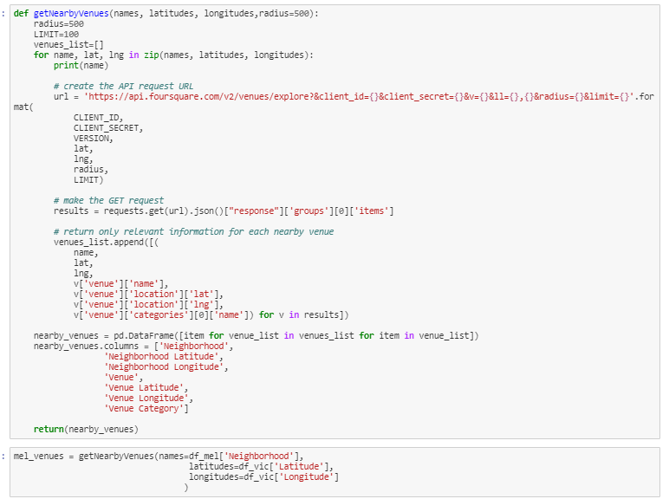
Foursquare API
I used the coordinates to get venues from Foursquare
At this point I had the data about venues their classification and locations

Slide 7
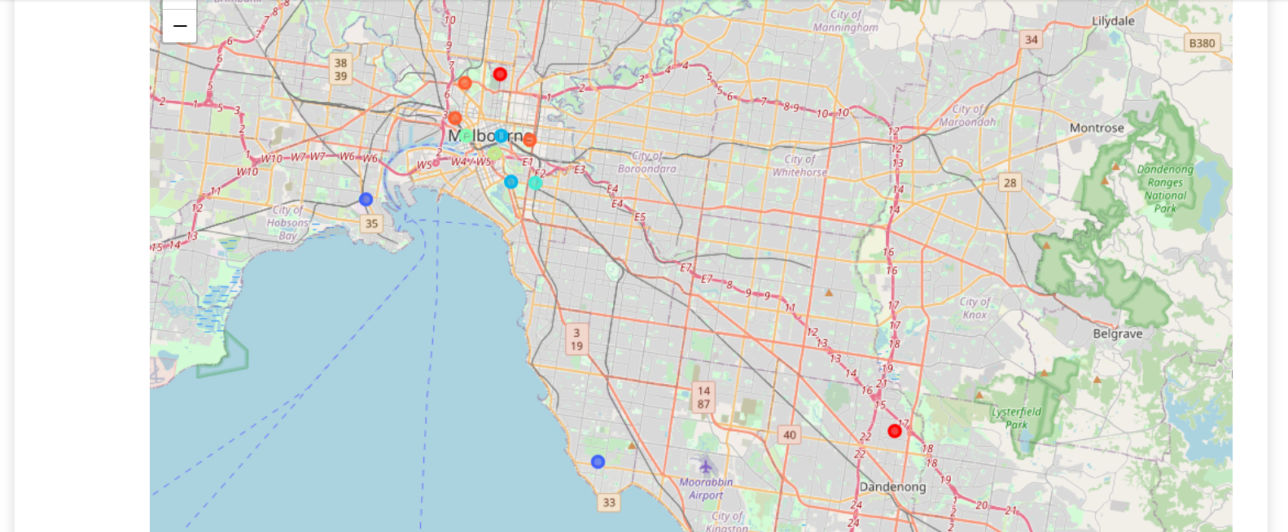
Result
After sorting all neighborhood ordering by the frequency of gyms they have, the data clustered and the results below obtained
By using the map we can say that the best location to open a healthy food restaurant is Port Melbourne and Southbank and center. The results mat be evaluated by finding detailed information like population, transportation etc. For now I just found a general result which is based on sport complexes and their locations.

Slide 8
Thank You

