Slide 1
NASCAR Sponsorship ROI Analysis
Strategic Recommendations for NY Racing
Aylin Yasgul | 2024 Season Analysis
"Which sponsors deliver the best visibility per dollar invested?"
Notes:
Good morning. Today I'll present our analysis of NASCAR sponsorship visibility. We set out to answer a simple question: which sponsors deliver the best exposure for the investment? Let me walk you through what we found.

Slide 2
EXECUTIVE SUMMARY
The Bottom Line
NAPA Auto Parts
Highest total visibility (ranked #1 of 4 sponsors)
PRIMARY RECOMMENDATION
FedEx
The balanced best bet: near-maximum exposure at a materially better value.
Love's Travel Stops
Best efficiency: 82 visibility points per $M
FedEx
The only sponsor ranked top-2 on BOTH dimensions
NASCAR Sponsorship ROI Analysis | NY Racing
2 / 10
Notes:
Let me start with the bottom line before we dive into details. We analyzed four primary sponsors across all 36 races of the 2024 season. The data tells us three things: NAPA delivers the most raw exposure, Love's delivers the best value per dollar, and FedEx is the only sponsor that ranks near the top on both. Based on that, our primary recommendation is FedEx. Now let me show you how we got there.

Slide 3
PROJECT APPROACH
How We Measured Sponsorship Visibility
Data Sources
Race results,
social, news
Scoring Model
Weighted 0-100
composite
Rankings
Visibility and
efficiency
The composite weights four categories:
40%
Race Performance
30%
Media Coverage
20%
Social Engagement
10%
Special Events
NASCAR Sponsorship ROI Analysis | NY Racing
3 / 10
Notes:
To build a fair comparison, we needed a consistent methodology. We gathered data from three sources: race results from public databases, social engagement from Reddit and YouTube, and news coverage from manual tracking. We then built a scoring model that weights these factors by importance for sponsor visibility. Race performance gets 40% because wins and strong finishes put the car on camera; media 30%; social 20%; special events 10%.

Slide 4
TRANSPARENCY
What We Measured, and What We Didn't
Category | Source | Note
Race Performance | Kaggle, Racing Reference | 36 races, full season
Social Media | Google Trends, YouTube API | Fan engagement (proxy)
News Coverage | Manual search | Quality-weighted by tier
Costs | Industry estimates | 15-20% uncertainty
IMPORTANT CAVEAT
Sponsorship costs are estimates, not actual contract values. The industry does not publish these figures. Our efficiency rankings stay stable when tested against high and low estimates.
NASCAR Sponsorship ROI Analysis | NY Racing
4 / 10
Notes:
Before I show you the findings, let me be transparent about what we could and couldn't measure. Most importantly: sponsorship costs are estimates, not actual contract values. The industry does not publish these figures, so we used industry publications and comparable analysis. There is uncertainty here, roughly 15 to 20 percent. With that caveat stated, let me show you what we found.

Slide 5
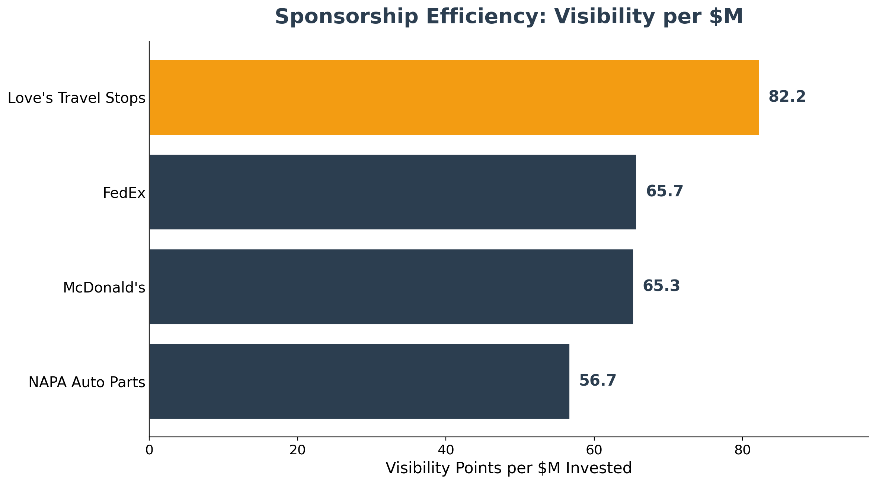
KEY FINDING #1
Highest Visibility Is Not Best Value
SO WHAT?
NAPA leads on exposure but ranks LAST on value per dollar. Love's is the reverse. Paying more does not always buy more visibility.
NASCAR Sponsorship ROI Analysis | NY Racing
5 / 10
Notes:
Our first key finding is the most surprising. NAPA has the highest total visibility, but it ranks LAST in value per dollar. Love's, last in raw exposure, is FIRST in efficiency at 82 points per million. The implication for NY Racing: the most-seen sponsor is not automatically the smartest spend.

Slide 6
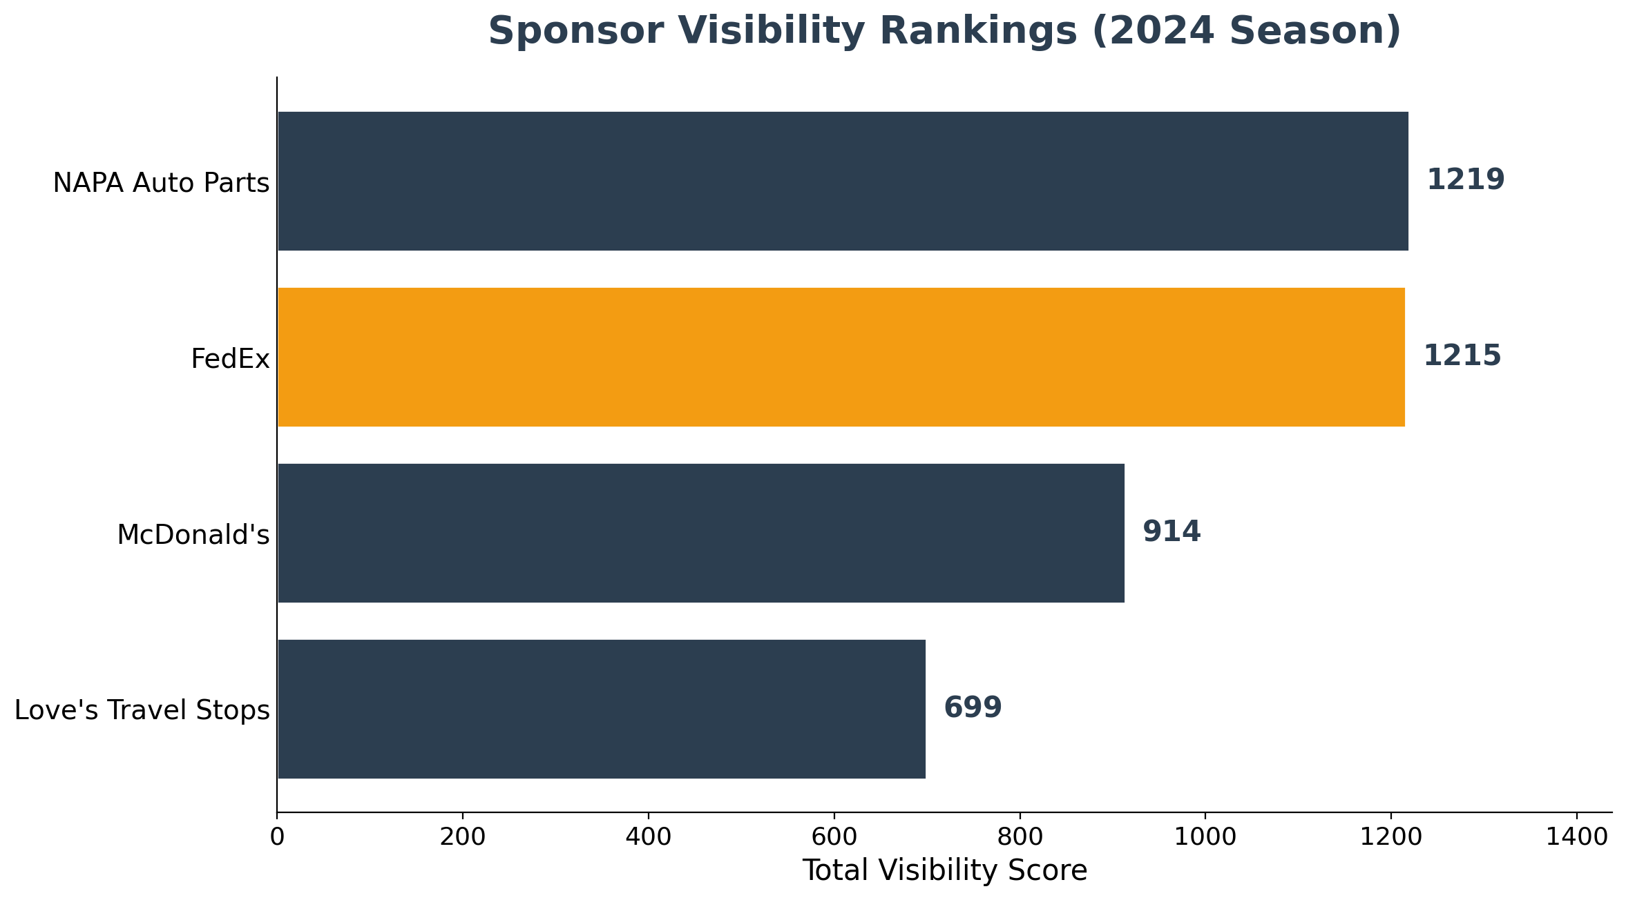
KEY FINDING #2
FedEx Is the Balanced Sweet Spot
SO WHAT?
FedEx ranks #2 in visibility AND #2 in efficiency, capturing 99.7% of the top sponsor's exposure at a better value. No other sponsor is strong on both.
NASCAR Sponsorship ROI Analysis | NY Racing
6 / 10
Notes:
The second pattern is about balance. FedEx sits at number two on both dimensions. It captures almost all of the top sponsor's exposure at a much better value. No other sponsor is strong on both. This is why FedEx becomes our recommendation: it minimizes the trade-off.

Slide 7
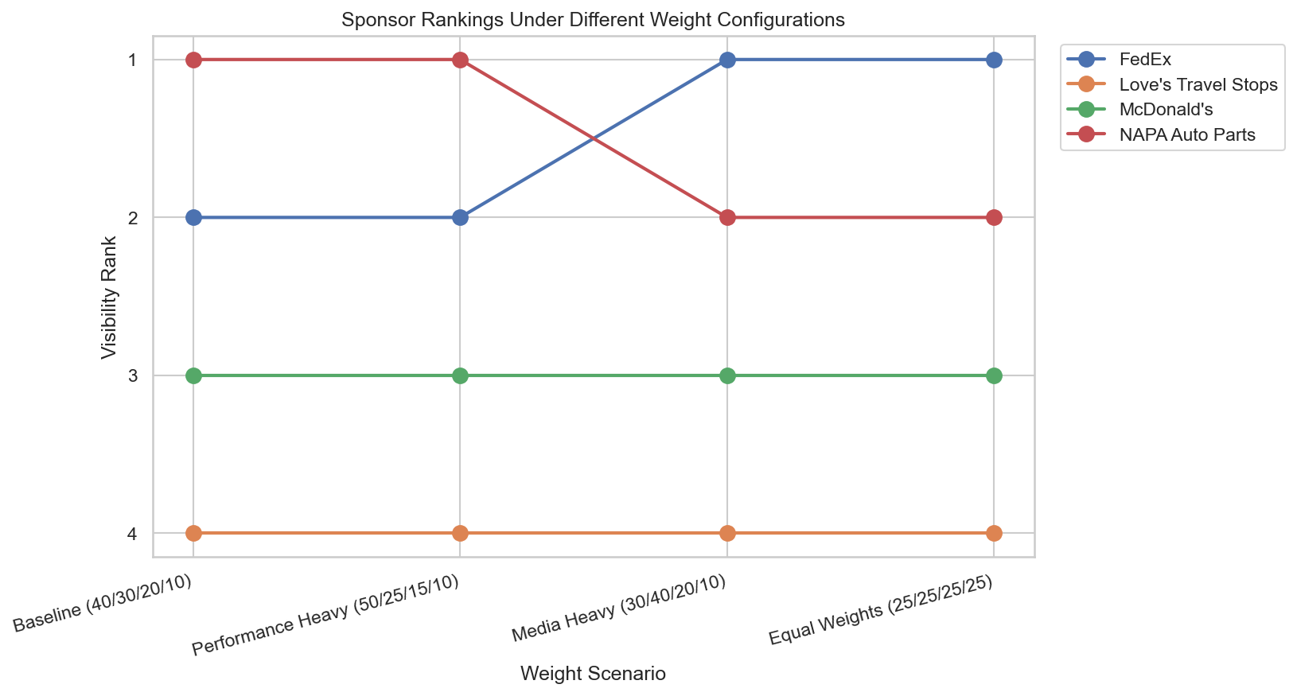
KEY FINDING #3
The Recommendation Is Robust
SO WHAT?
We re-ran the model under four weighting schemes. The ranking moves at most one position. The conclusion does not depend on our exact assumptions.
NASCAR Sponsorship ROI Analysis | NY Racing
7 / 10
Notes:
Finally, and perhaps most importantly for your confidence: the recommendation is robust. We re-ran the model under four different weighting schemes. The ranking barely moved, at most one position. It is a stable pattern in the data, not an artifact of our specific weights.

Slide 8
RECOMMENDATIONS
Who Should NY Racing Pursue?
PRIMARY: FedEx
• Visibility: 1,215 points (Rank #2)
• Efficiency: 65.7 pts/$M (Rank #2)
• Estimated cost: $18.5M
• Most wins (3) of any tracked sponsor
Why: near-max exposure at a better price than the top-visibility option.
ALTERNATIVE: Love's Travel Stops (Value)
Best value per dollar (82 pts/$M) at the lowest cost ($8.5M). Choose it when budget or ROI justification is the priority.
ALTERNATIVE: NAPA Auto Parts (Premium)
Maximum total exposure (1,219 points) if brand awareness outweighs cost. The highest investment at $21.5M.
NASCAR Sponsorship ROI Analysis | NY Racing
8 / 10
Notes:
So what should NY Racing do? Our primary recommendation is FedEx. It is the only sponsor top-two on both visibility and efficiency, it had the most wins, and it delivers near-max exposure at a better price than the top-visibility option. For teams with different priorities, Love's offers the best pure value, and NAPA offers the most exposure if budget is no object.

Slide 9
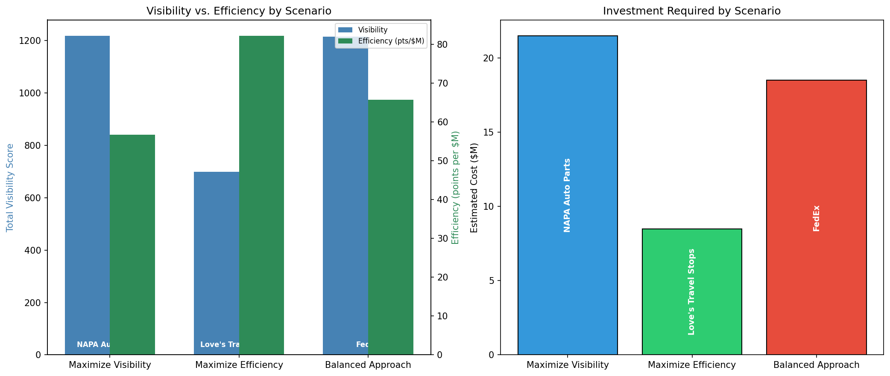
THE DECISION
Choosing Your Strategy
Strategy | Sponsor | Cost
Max Visibility | NAPA | $21.5M
Max Efficiency | Love's | $8.5M
Balanced | FedEx | $18.5M
Question for NY Racing:
Which priority fits your strategic goals - maximum exposure, best value, or balance?
NASCAR Sponsorship ROI Analysis | NY Racing
9 / 10
Notes:
Ultimately, this is a strategic choice, not a math problem. Let me show you the trade-offs. The question for NY Racing is: what matters more, maximum visibility or maximum efficiency per dollar? If it's exposure, NAPA. If it's value, Love's. If it's balance, FedEx.

Slide 10
Recommended Next Steps
1
Immediate
Validate cost estimates with direct team and sponsor conversations
2
This quarter
Analyze 2-3 additional seasons to confirm pattern stability
3
Before deciding
Assess brand fit and activation opportunities beyond visibility
Questions?
Aylin Yasgul | NASCAR Sponsorship ROI Analysis for NY Racing
Notes:
Before we open for questions, let me suggest next steps. First, validate the cost estimates with direct conversations, since that is our biggest source of uncertainty. Second, consider analyzing additional seasons to see if the patterns hold. Third, assess brand fit and activation value that this analysis does not capture. I'm happy to answer questions. What would you like to discuss?

