Slide 1

The Correlation Between Screen Time and Sleep Quality Aylin Yılmaz - 32168

Slide 2
MOTIVATION
As we live in a era of technology, we ultimately happen to be exposed to screens pretty much all the time in a daily life. And there exists a lot of researches, articles on this matter that states being exposed to screen throughout the day can significantly impact the quality of daily life in so many different aspects.By studying the data I acquired from a Iphone’s Screen Time tool and Excel, I aim to:
Understand the relationship between screen usage and sleeping time.
Acknowledge to which extent does being exposed to screen affects sleeping pattern.
Use of tools and analyze the data with respect to the scientific approach.

Slide 3
MY DATASET
Day and the date of the week
Total duration of screen
Total duration of screen before bed
Total duration of sleep
Night waking frequency

Slide 4

MY HYPOTHESIS
Null Hypothesis (H0) : Sleep quality(duration and night waking) is not correlated with screen time.
Alternative Hypothesis (H1) : Sleep quality(duration and night waking) is correlated with screen time.

Slide 5
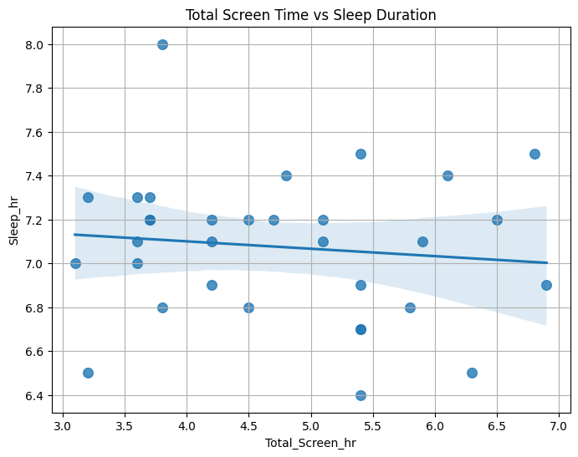
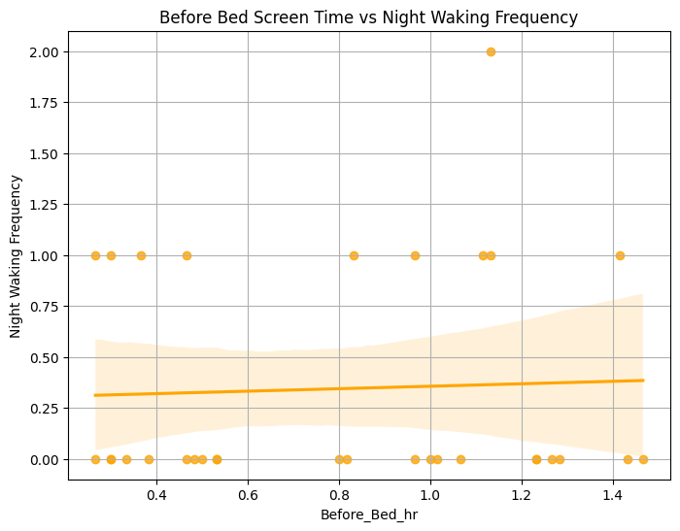
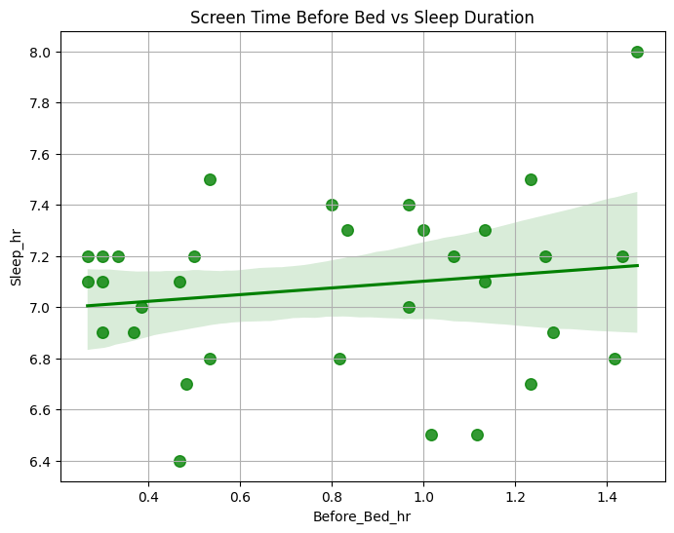
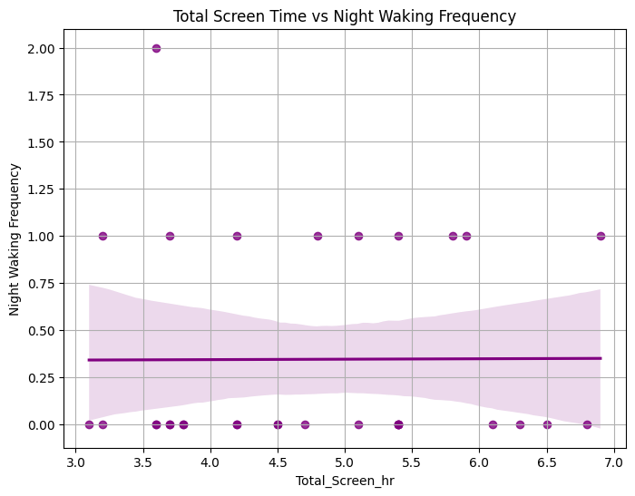
Scatter Plots
First, I wanted to observe the correlation between my dataset to compare screen time vs sleeping quality.

Slide 6
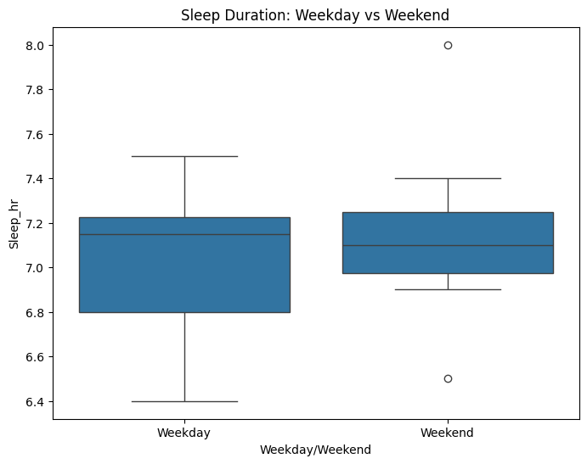
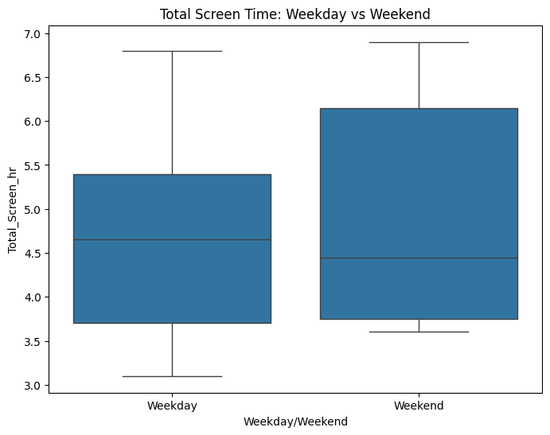
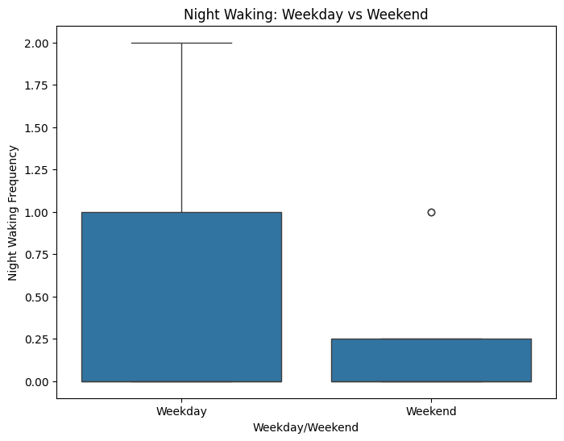
Boxplots
Later on, I classified the days based on whether it is weekend or weekday to observe the durations.

Slide 7
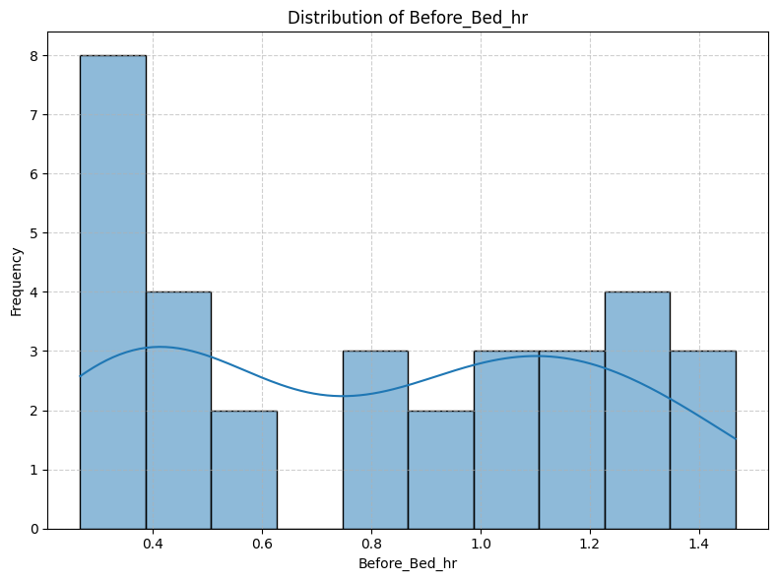
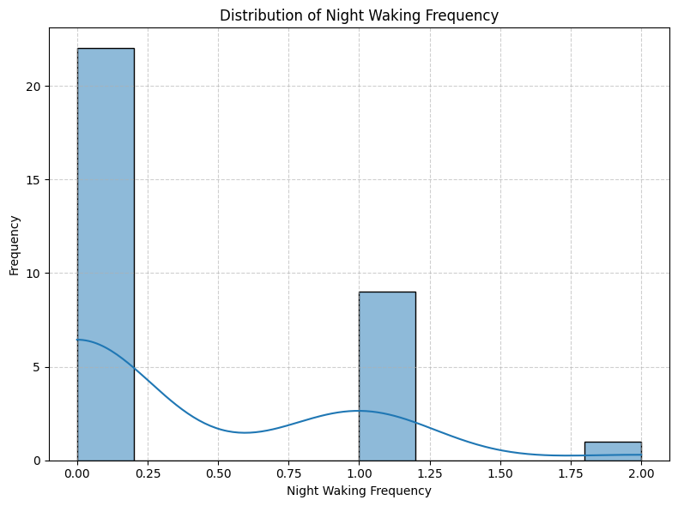
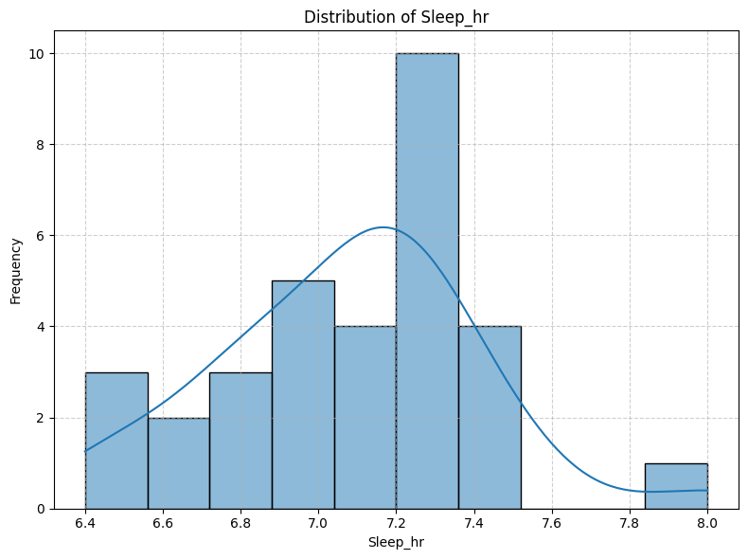
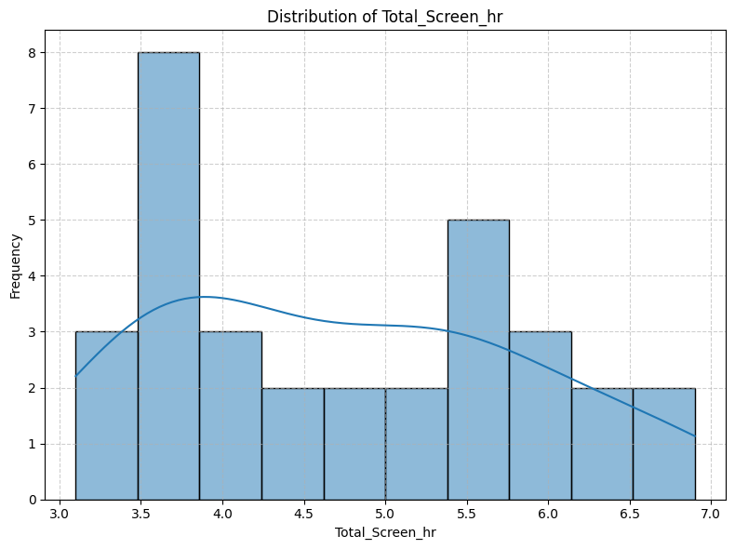
UNIVARIATE ANALYSIS Histograms
The histograms are used to analyze the distributions of sleep duration, total screen hour, screen time before bed and night waking frequency; providing insights into how each component typically distribute.

Slide 8
Statistic Values
Statistics for Total Screen Hour
Mean : 4.74
Median : 4.60
Standard Deviation : 1.11
Statistics for Before Bed Screen Time
Mean : 0.80
Median : 082
Standard deviation : 0.40
Statistics for Total Duration of Sleep
Mean : 7.07
Median : 7.10
Standard Deviation : 0.33
Statistics for Night Waking Frequency
Mean : 0.34
Median : 0
Standard Deviation : 0.55

Slide 9
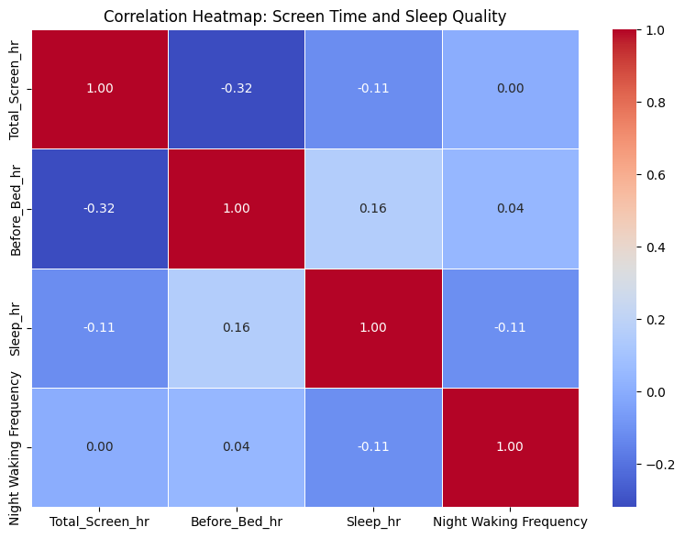
Multivariate Analysis
Correlation Heatmap
The heatmap shows weak correlations between screen time and sleep quality. Total screen time has a slight negative correlation with sleep duration (r = -0.11), and screen time before bed has a small positive correlation (r = 0.16). Night waking frequency shows no meaningful correlation with screen habits. Overall, screen time does not appear to strongly impact sleep quality in this dataset.

Slide 10
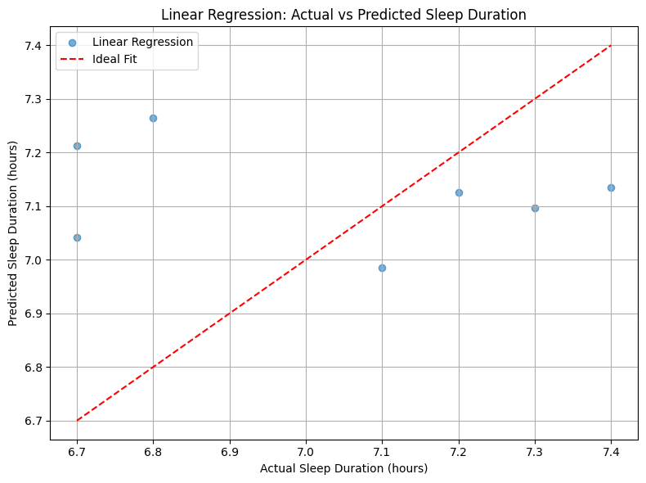
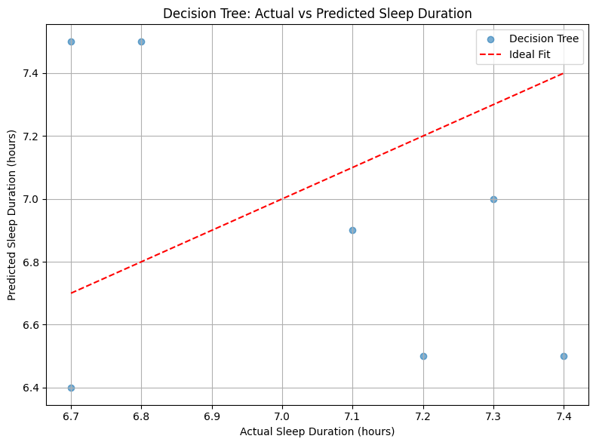
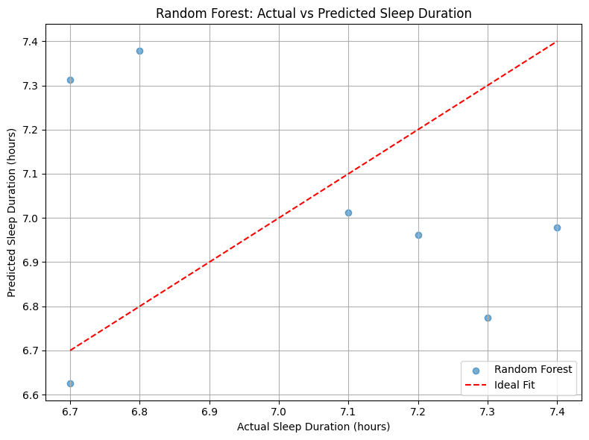
Regression Analysis
Decision Tree
Linear Regression
Random Forest
Linear Regression Results: - Mean Squared Error: 0.104 - R² Score: -0.412
Decision Tree Results:
Mean Squared Error:0.379
- R² Score: -4.153
Random Forest Results:
- Mean Squared Error: 0.176
- R² Score: -1.401
Best Performing Model: Linear Regression with R² = -0.412

Slide 11
Conclusion
Despite applying linear and non-linear regression models, the resulting R² values were negative, indicating that screen time variables did not meaningfully predict sleep duration. This suggests that other factors that are not captured in this dataset, may play a more significant role in influencing sleep quality.
Pearson Correlation Coefficient : -0.11
The p-value is greater than or equal to 0.05.
We fail to reject the null hypothesis.
There is no statistically significant linear correlation between screen time and sleep quality.

Slide 12
Limitations and Future Work
Limitations
Due to small sample size (limited number of days and only my data), the dataset may not capture broader behavioral trends. A larger dataset could provide more variance and statistics.
Sleep durations and night waking up frequency were manually recorded, which may cause potential innacuracies such as forgetting to logging the data in the Excel sheet etc.
Addition to my variables to observe the relationship between screen time and sleep quality, I should have maybe considered another variables such as environmental factors. This could give me broader perspective to understand the relationship between screen time and sleep quality.

Slide 13
Limitations and Future Work
Future Work
Tracking the data over a longer period (e.g., 3–6 months) and including different phases of the year (exam periods, holidays) could be more beneficial to examine behavioral changes.
Extending the project by including multiple people to compare variability in screen habits and sleep responses would be a better fit for this project. Because group analysis could reveal broader trends.
Different kind of machine learning techniques could be used to enrich the project.

