Slide 1

Electronic Health Records (EHRs)
EHRs Introduction.
EHRs Types.
EHRs VS EMRs.
EHRs Example.

Slide 2
INTRODUCTION
An Electronic Health Record (EHR) is a digital version of a patient's paper chart. It contains the patient's medical history, diagnoses, medications, treatment plans, immunization dates, allergies, radiology images, and laboratory test results.
The EHR automates and streamlines the clinician's workflow, ensuring quick access to critical patient data and supporting evidence-based decision-making.

Slide 3
INTRODUCTION (CONT.)
Definition: An Electronic Health Record (EHR), also known as Electronic Medical Record (EMR). It is a real-time, patient-centered record that makes information available instantly and securely to authorized users.

Slide 4
EHRs VS EMRs
The ability to share complete information instantly is one of the main differences between an EMR and an EHR. An EMR captures information from a single care provider, which is only available to that one care provider. However, EHRs are designed to be used by multiple care providers and healthcare organizations.

Slide 5
TYPES OF EHRs :
Basic EHRs.
Specialized EHRs.
Integrated EHRs.
Cloud-Based EHRs.
Open Source EHRs.
Patient Portals.
#74e3ff

Slide 6
TYPES OF EHRs (CONT.)
Basic EHRs: These are fundamental systems that contain patient information, medical histories, diagnoses, medications, and treatment plans.
Specialized EHRs: These are tailored for specific medical specialties or areas of focus, such as systems designed for mental health, oncology, or pediatrics. They often include specialized templates and features relevant to those specialties.

Slide 7
TYPES OF EHRs (CONT.)
Integrated EHRs: These connect with other systems such as pharmacy systems, laboratory systems, and imaging systems to facilitate streamlined data exchange and comprehensive patient care.

Slide 8
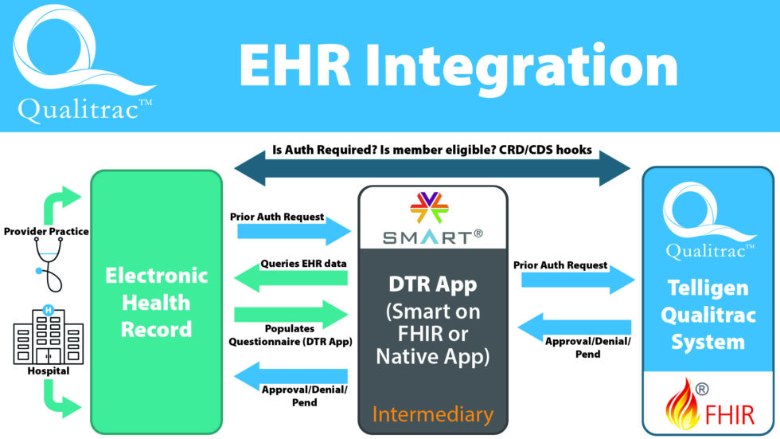

Slide 9
TYPES OF EHRs(CONT.)
Cloud-Based EHRs: These are hosted on remote servers accessed via the internet, offering accessibility from various locations and devices, with the advantage of data backup and security provided by the service provider.

Slide 10
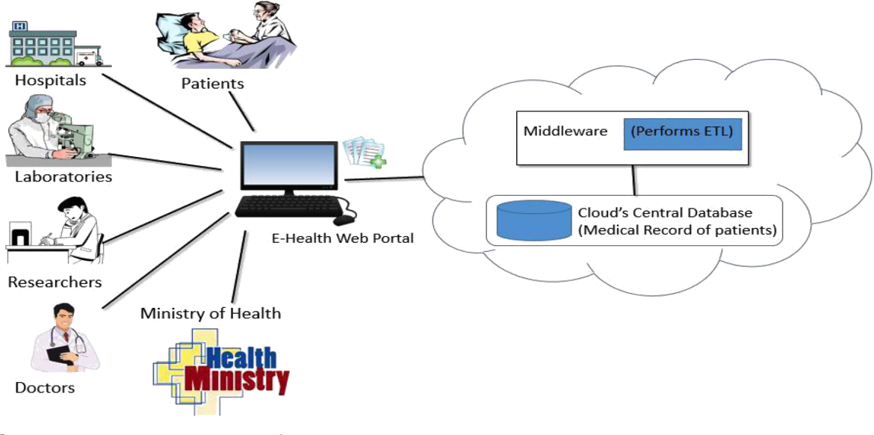

Slide 11
TYPES OF EHRs(CONT.)
Open Source EHRs: These systems have their source code openly available, allowing users to modify and customize the software to suit their specific needs.

Slide 12
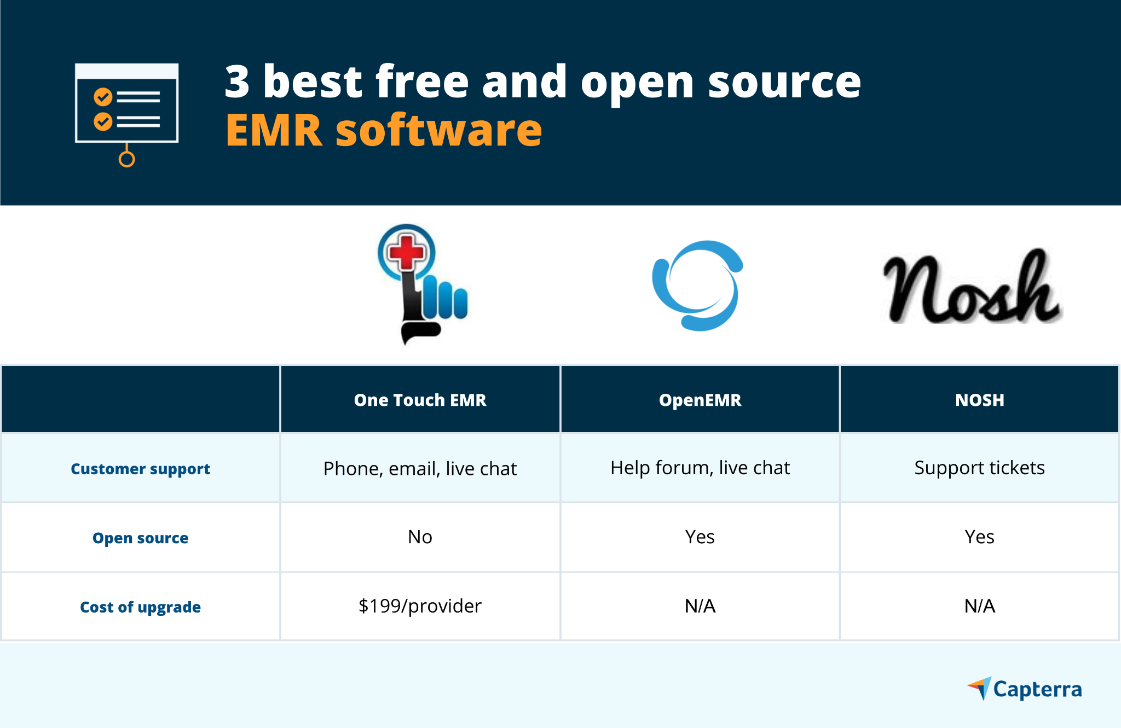

Slide 13
TYPES OF EHRs(Cont.)
Patient Portals: patient portals are interfaces that allow patients to access their health records, communicate with healthcare providers, schedule appointments, and view lab results securely.

Slide 14
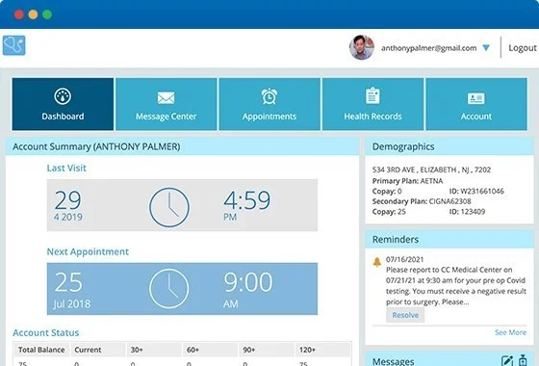

Slide 15
EHRs INCLUDE
PATIENT INFORMATION.
INSURANCE INFORMATION.
MEDICAL HISTORY.
LABORATORY COMPLETE.
ALLERGIES.
IMMUNIZATIONS.

Slide 16
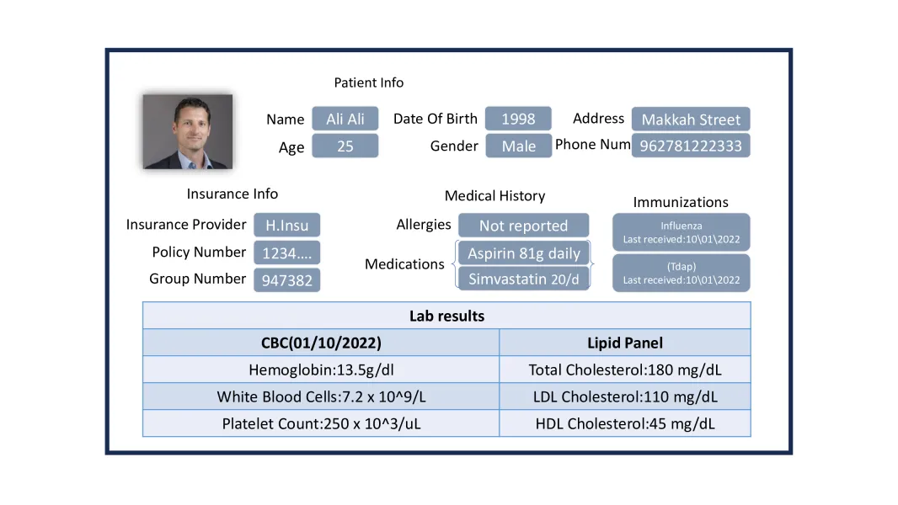

Slide 17
CONCLUSION
Real EHR data is highly sensitive and must be handled with the utmost care to protect patient privacy and comply with relevant regulations, such as the Health Insurance Portability and Accountability Act (HIPAA).

Slide 18
THANK YOU FOR LISTENING
AYMAN HANI ADAS
RAMZI SULTAN HASSANEIN AHMAD YOUSEF ALEQEILI

