Slide 1



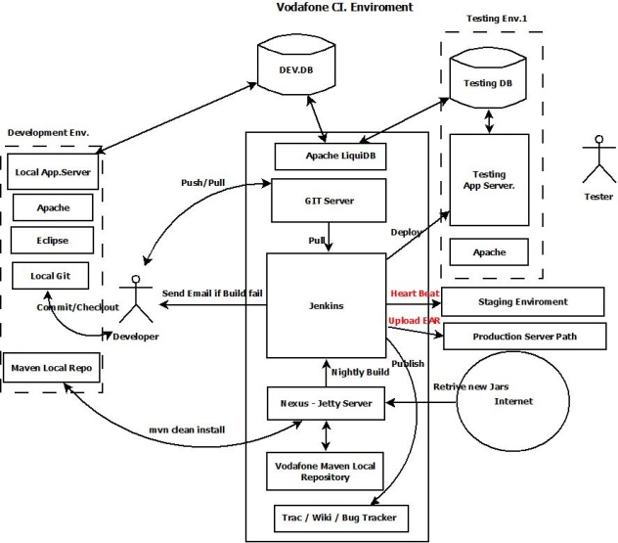


Vodafone portal Continues Integration Environment
Vodafone Portal CI Environment
Ayman Elgharabawy
Vodafone Sr. System Analyst

Slide 2
Executive summary
Continuous integration systems are a vital part of any Agile
team because they help enforce the ideals of Agile development
Jenkins, a continuous build tool, enables teams to focus on
their work by automating the build, artifact management,
and deployment processes.
Jenkins’ core functionality and flexibility allow it to fit in a
variety of environments and can help streamline the
development process for all stakeholders involved

Slide 3
Agenda
Continuous Integration (CI)
What is it?
What are the benefits?
Continuous Build Systems
Jenkins
What is it?
Where does it fit in?
Why should I use it?
What can it do?
How does it work?
Where is it used?
How can I get started?
Putting it all together
Conclusion
References

Slide 4
CI - Defined
“Continuous Integration is a software development practice
where members of a team integrate their work frequently,
usually each person integrates at least daily - leading to
multiple integrations per day. Each integration is verified by
an automated build (including test) to detect integration
errors as quickly as possible” – Martin Fowler

Slide 5
CI – What does it really mean?
At a regular frequency (ideally at every commit), the system
is:
Integrated
All changes up until that point are combined into the project
Built
The code is compiled into an executable or package
Tested
Automated test suites are run
Archived
Versioned and stored so it can be distributed as is, if desired
Deployed
Loaded onto a system where the developers can interact with it

Slide 6
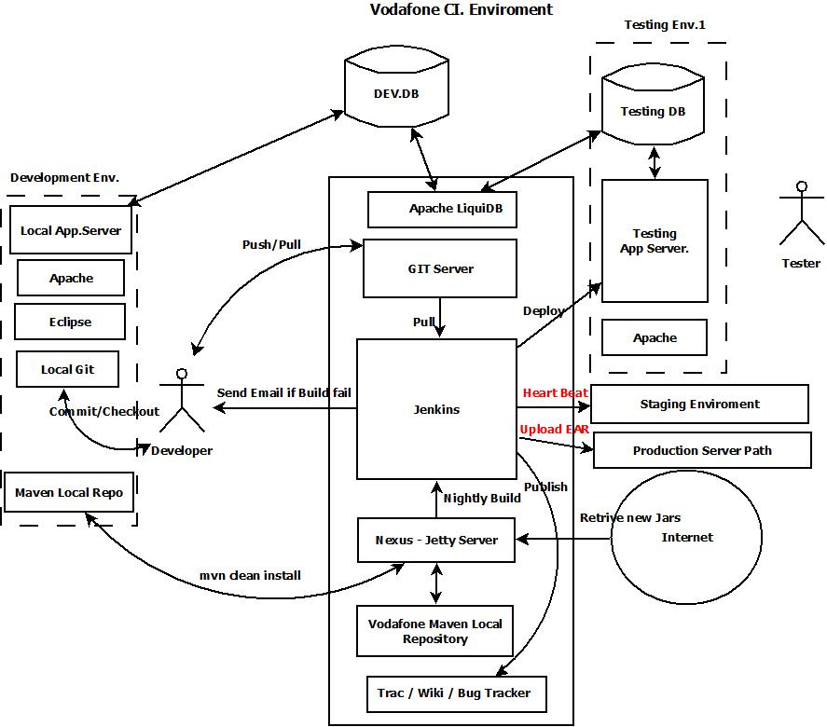
Vodafone Portal CI Proposed Architecture

Slide 7
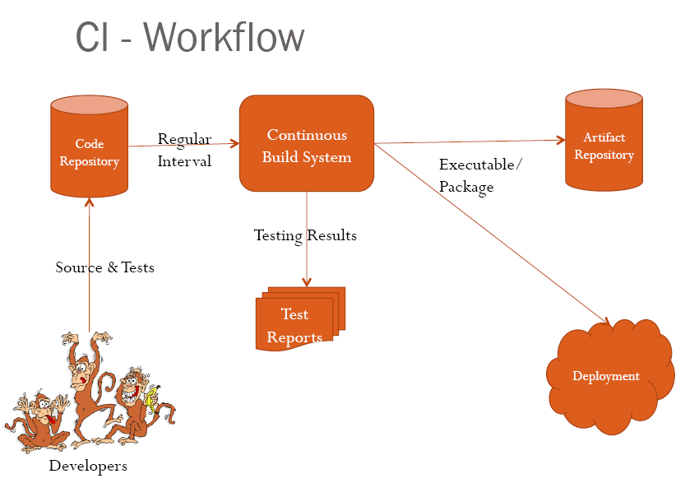

Slide 8
CI – Benefits
Immediate bug detection
No integration step in the lifecycle
A deployable system at any given point
Record of evolution of the project

Slide 9

Vodafone Portal Development Heart beat Concept
Vodafone Portal Projects Type
1-Small project (Done within 1 Week)
No need to have Branch for development.
2-Medium Projects (2-3 Weeks) Could be also committed on Head.
3-Large projects (Migration , Revamping)
Need branch if the changes in code affect >25 % source code.

Slide 10
Vodafone Portal Development Heart beat Concept (Automated release management)
What is the Execution Heart beat.
Execution Heartbeat is (Development , build , deploy) Periodically in a fixed period of time.
-When number of projects increases , the heartbeat becomes small (4-6 days).

Slide 11
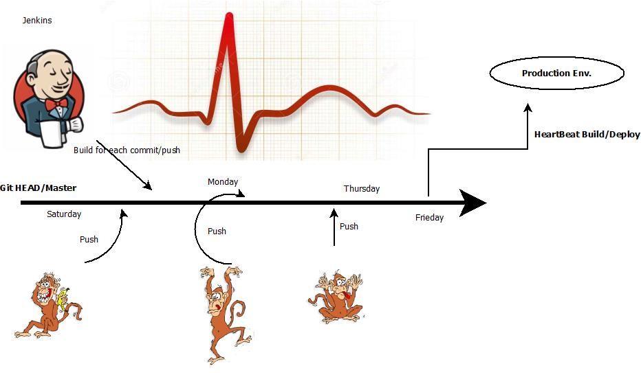
Vodafone Portal Execution Heartbeat

Slide 12
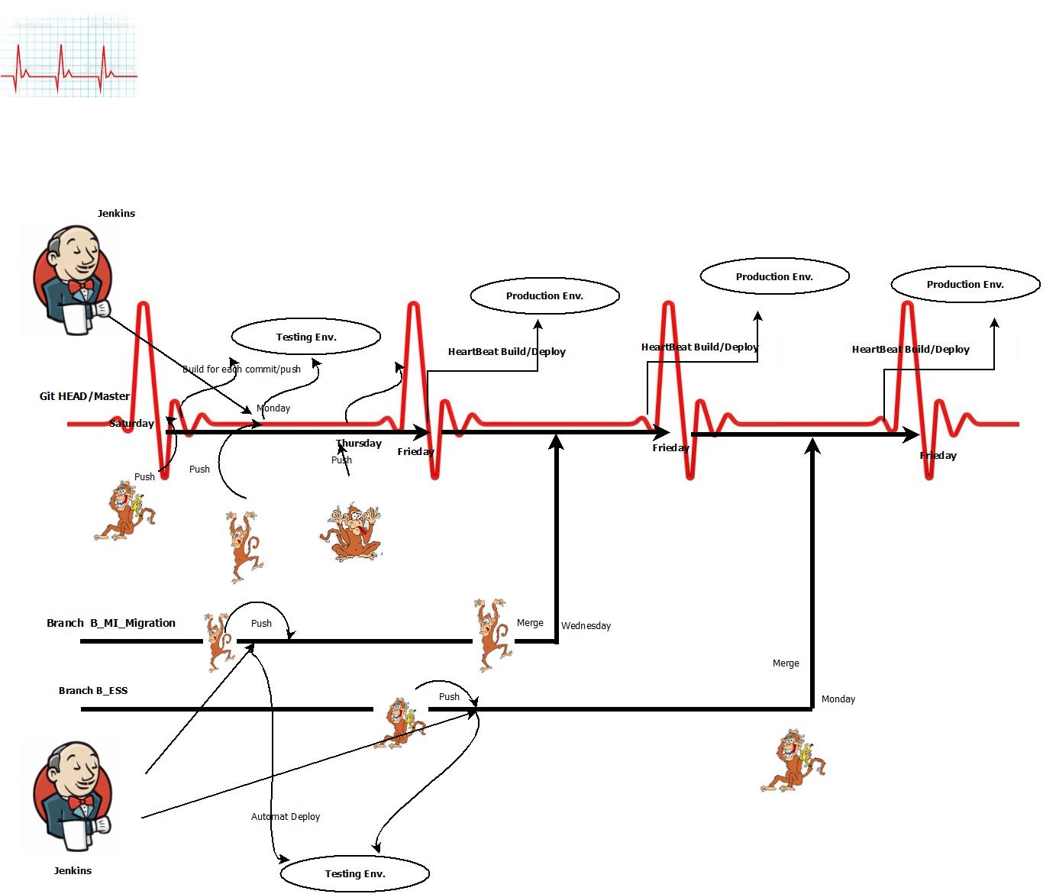

Slide 13
CI – The tools
Code Repositories
SVN, Mercurial, Git
Continuous Build Systems
Jenkins, Bamboo, Cruise Control
Test Frameworks
JUnit,Cucumber, CppUnit
Artifact Repositories
Nexus, Artifactory, Archiva

Slide 14

Jenkins
Branched from Hudson
Java based Continuous Build System
Runs in servlet container
Glassfish, Tomcat
Supported by over 400 plugins
SCM, Testing, Notifications, Reporting,
Artifact Saving, Triggers, External
Integration
Under development since 2005
http://jenkins-ci.org/

Slide 15
Jenkins - History
2005 - Hudson was first release by Kohsuke Kawaguchi of Sun Microsystems
2010 – Oracle bought Sun Microsystems
Hudson was renamed to Jenkins
Oracle continued development of Hudson (as a branch of the original)

Slide 16
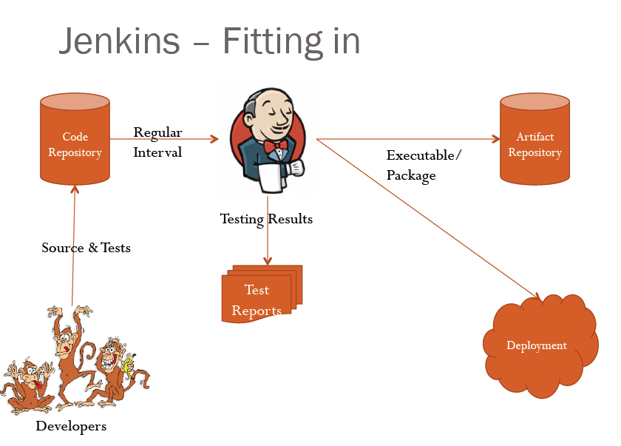
Jenkins – Fitting in

Slide 17
Why Jenkins? Flexibility!
Jenkins is a highly configurable system by itself
The additional community developed plugins provide even more flexibility
By combining Jenkins with Ant, Gradle, or other Build
Automation tools, the possibilities are limitless

Slide 18
What can Jenkins do?
Generate test reports
Integrate with many different Version Control Systems
Push to various artifact repositories
Deploys directly to production or test environments
Notify stakeholders of build status
…and much more

Slide 19
How Jenkins works - Setup
When setting up a project in Jenkins, out of the box you have
the following general options:
- Associating with a version control server
Triggering builds
- Polling, Periodic Building based on other projects
Execution of shell scripts, bash scripts, Ant targets, and Maven
targets
Artifact archival
Publish JUnit test results and Javadocs
Email notifications
As stated earlier, plugins expand the functionality even further

Slide 20
How Jenkins works - Building
Once a project is successfully created in Jenkins, all future
builds are automatic
Building
-Jenkins executes the build in an executer
- By default, Jenkins gives one executer per core on the build server
-Jenkins also has the concept of slave build servers
-Useful for building on different architectures
-Distribution of load

Slide 21
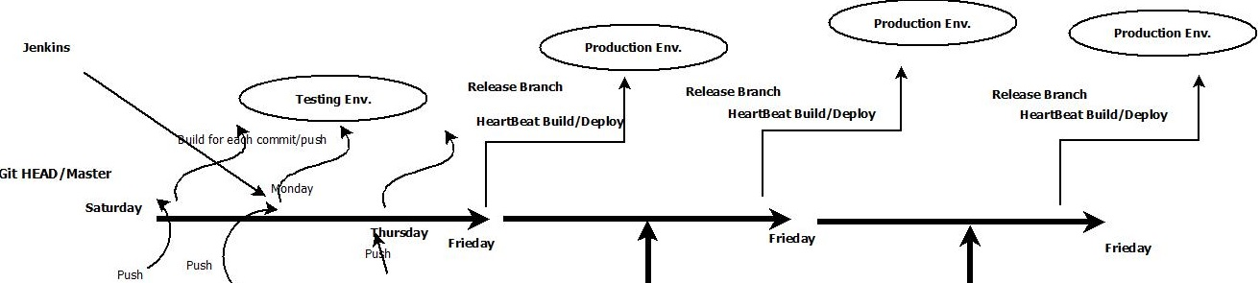
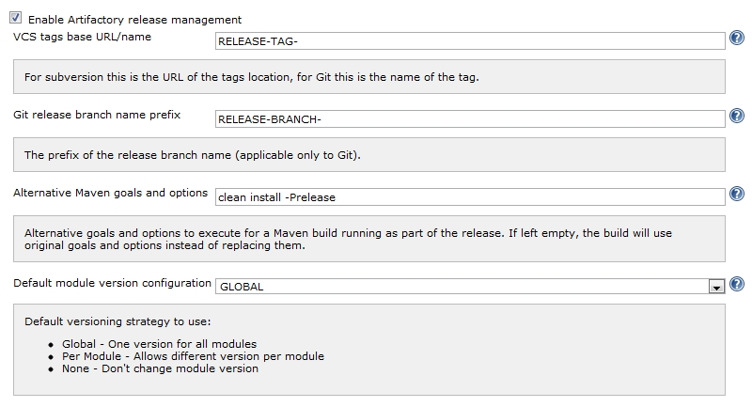
How Jenkins works – Automated Release Management (Heart Beat)
Jenkins Artifactory Plugin - Release Management

Slide 22
How Jenkins works - Reporting
Jenkins comes with basic reporting features
- Keeping track of build status
. Last success and failure
.“Weather” – Build trend
These can be greatly enhanced with the use of pre-build
plugins
Unit test coverage
Test result trending
Findbugs, Checkstyle, PMD

Slide 23
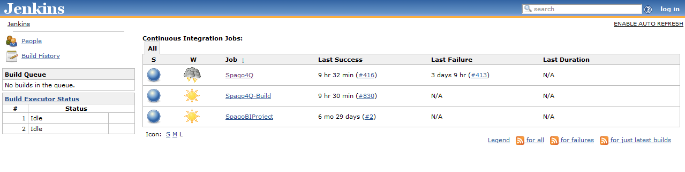
Jenkins by example – Main Page
The main page provides a summary of the projects
.Quick view of
What’s building (“No builds in the queue”)
Build Executor Status (both “Idle”)
Status of the projects

Slide 24
Liquibase
Liquibase is an open source (Apache 2.0 Licensed), database-independent library for tracking, managing and applying database changes.
LIQUIBASE is used by developers in locating and making amendments in the database. The track of all these changes are maintained in an XML file (database changelog file) which serves to overview the list of changes made. It is compatible with any database which java can easily connect to.

Slide 25
Liquibase
Key Features
Efficiently manage multiple databases
Extensible to make changes
Able to keep a track record of database changes
Execution can take place through Maven, command line, Ant etc.

Slide 26
Conclusion
Continuous integration is a necessity on complex projects
due to the benefits it provides regarding early detection of problems.
A good continuous build system should be flexible enough to
fit into pre-existing development environments and provide all the features a team expects from such a system.
Jenkins, a continuous build system, can be an integral part of
any continuous integration system due to it’s core feature set
and extensibility through a plugin system

Slide 27
Maven Repository ,Nexus Server and wiki
Vodafone maven repository that have all the java library that will be used in portal development.
Nexus server is a jetty server that serve for the java library to be downloaded throw maven build to local developer user.
Wiki will be used for code review and bug tracing
We will use TRAC free open source for wiki bug reporting.

Slide 28
Mavenize Existing Portal Code
Parent POM file produce One EAR
Sub modules POMs (SelfServices, MI ,etc..) generate multiple WARs
POM file contains Deploy script to Dev. Application Server.

Slide 29


Thank you……….

Slide 30
References
Continuous Integration – Martin Fowler
http://www.martinfowler.com/articles/continuousIntegration.html
Hudson
http://hudson-ci.org/
Hudson Continuous Integration Server
http://www.code-magazine.com/articleprint.aspx?quickid=0906071&printmode=true
The Hudson Book
http://www.eclipse.org/hudson/the-hudson-book/book-hudson.pdf
Jenkins
https://wiki.jenkins-ci.org
http://corrines-corner2006.blogspot.com/2011/09/freebie-monday_26.html
What is Continuous Integration
http://confluence.public.thoughtworks.org/display/CCNET/What+is+Continuous
+Integration

