Slide 1
Software Engineering Practice Week 6

Slide 2
Project Plan –Tutoring 3
week | Iteration | Start Date | End Date | Release
Week 4 | Iteration 0 | 13/08/2018 | 19/08/2018 | 1
Week 5 | Iteration 1 | 20/08/2018 | 27/08/2018 | 1
Week 6 | Iteration 2 | 27/08/2018 | 2/09/2018 | 1
Week 7 | Iteration 3 | 3/09/2018 | 9/09/2018 | 1
week | Iteration | Start Date | End Date | Release
Week 8 | Iteration 1 | 10/09/2018 | 16/09/2018 | 2
Week 9 | Iteration 2 | 17/09/2018 | 23/09/2018 | 2
Week 10 | Iteration 3 | 24/09/2018 | 2/10/2018 | 2
Week 11 | Iteration 4 | 3/10/2018 | 9/10/2018 | 2
Week 12 | Iteration 5 | 10/10/2018 | 17/10/2018 | 2
Assignment 1
Show Case
Assignment 2
Show Case

Slide 3
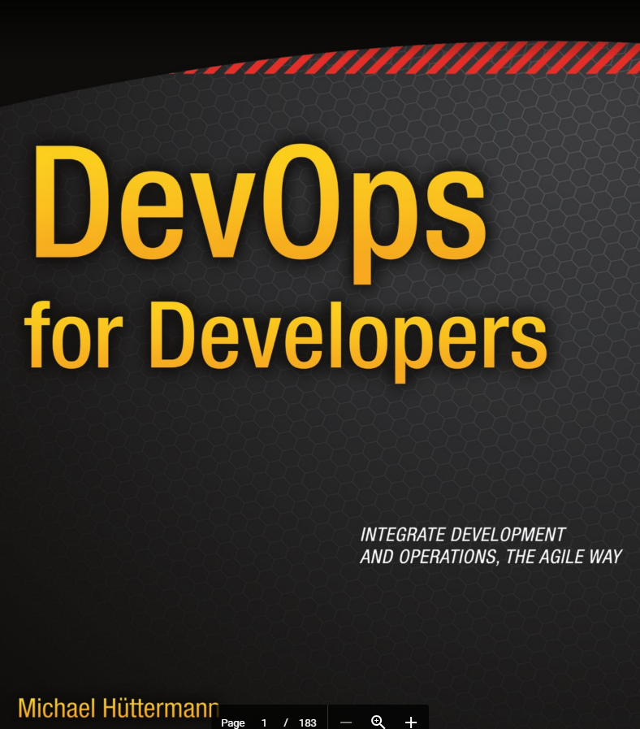
Dev Ops

Slide 4
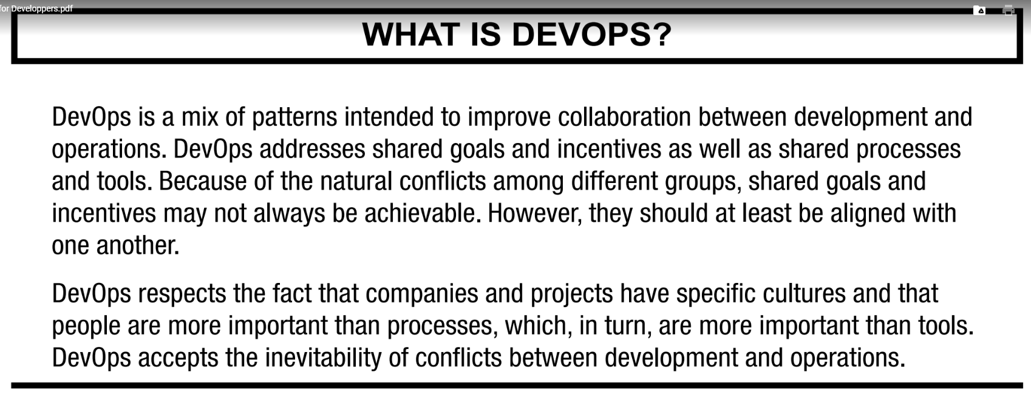

Slide 5
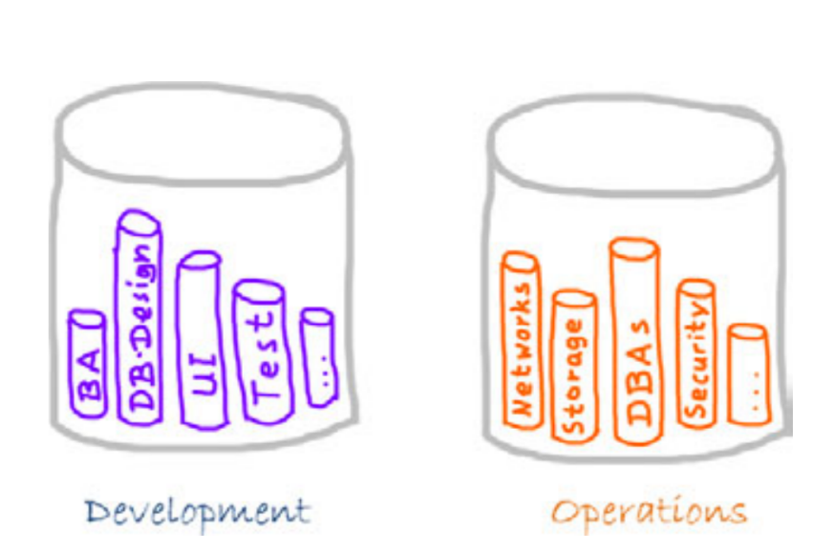
Dev. Ops : blend the operations between development and Operations

Slide 6
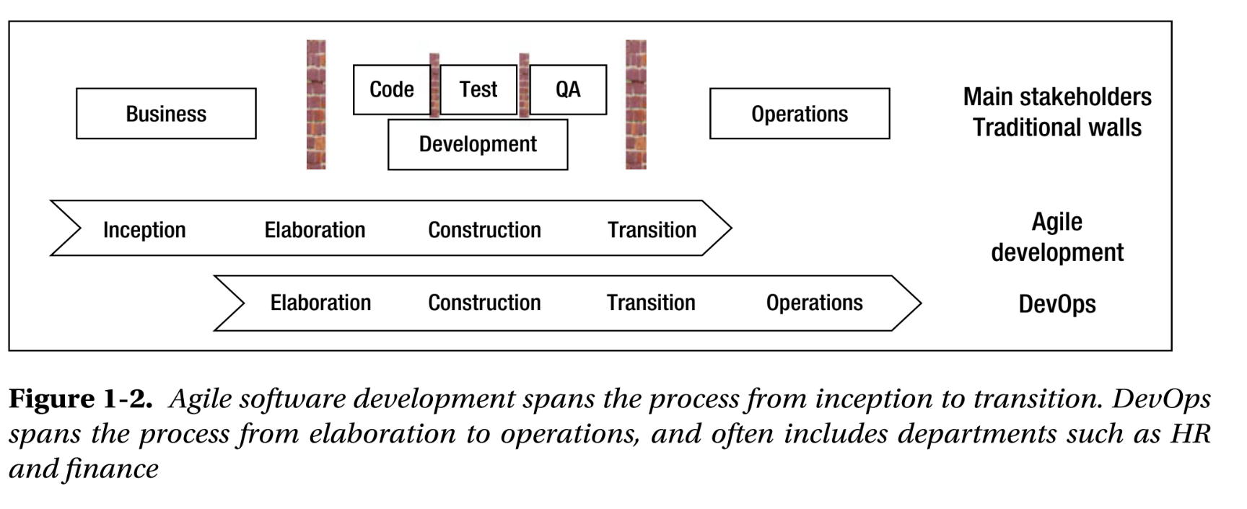

Slide 7
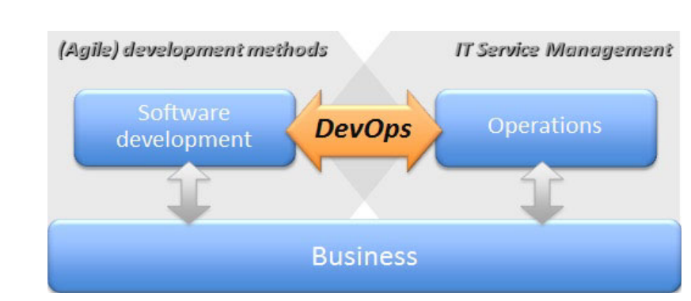

Slide 8
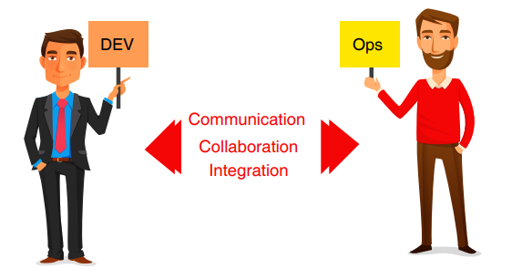
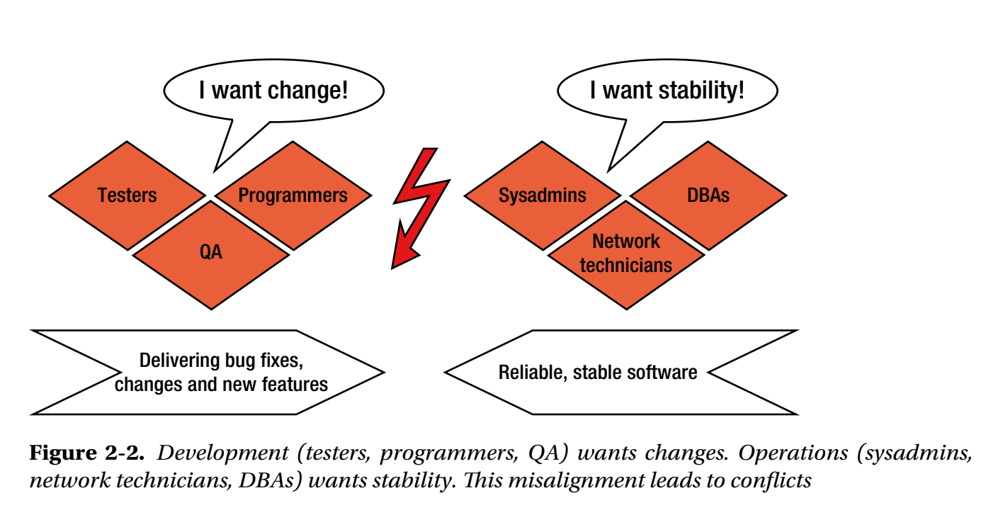

Slide 9
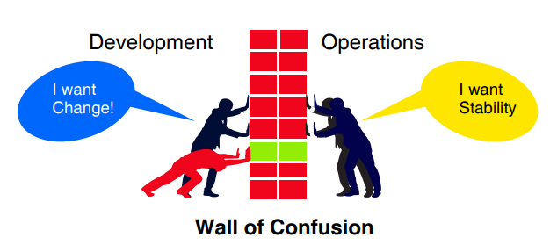

Slide 10






Software Lifecycle Env.
Developer
Tester
Customers
Op. Admin / DBA
View
View
App Server
App Server
App Server
App Server
Development Environment
Testing Environment
Staging Environment
Production Environment
DB

Slide 11
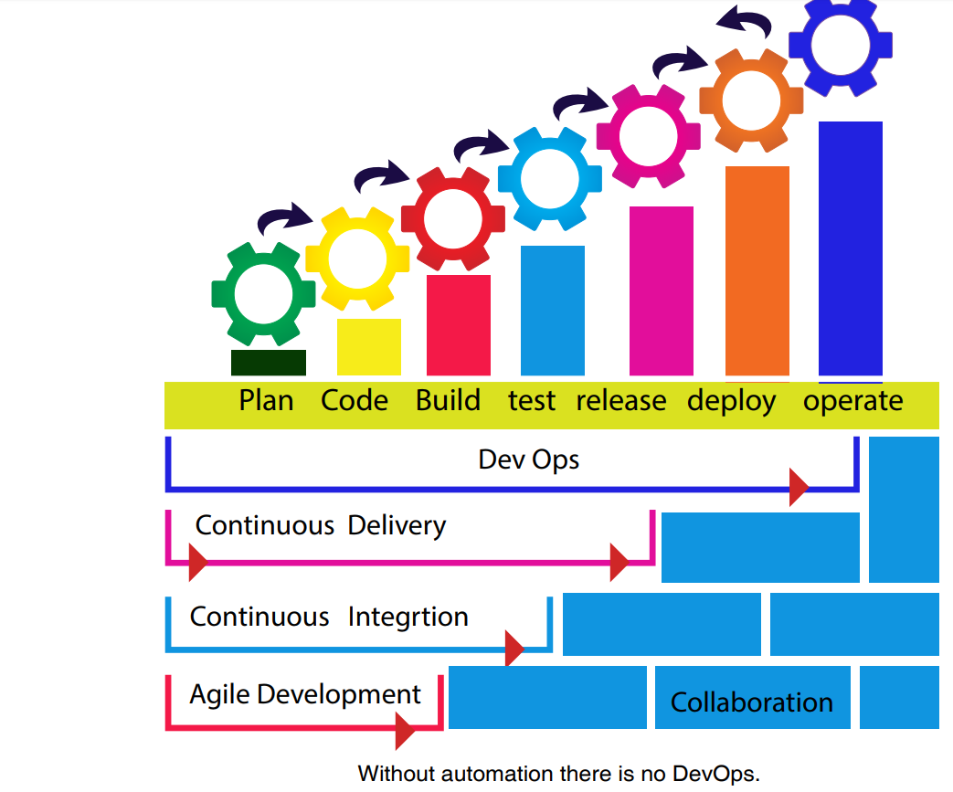

Slide 12
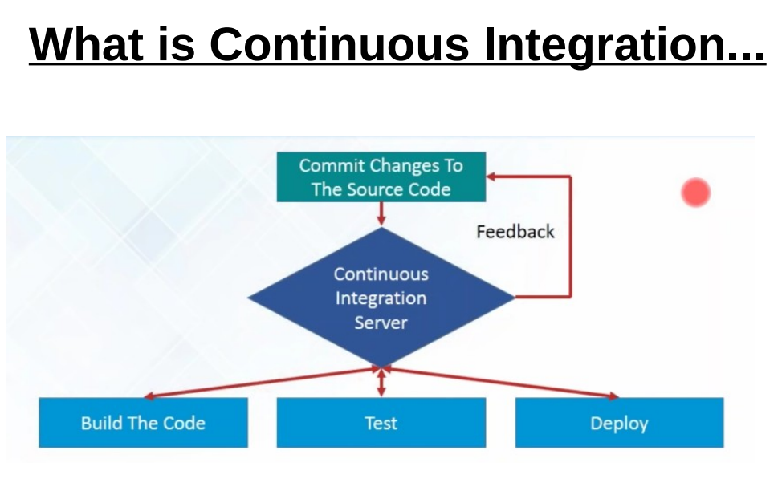
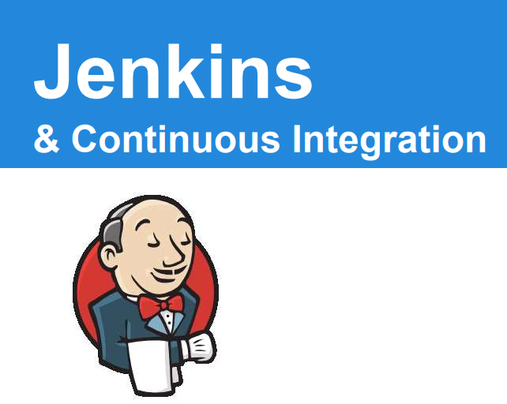

Slide 13
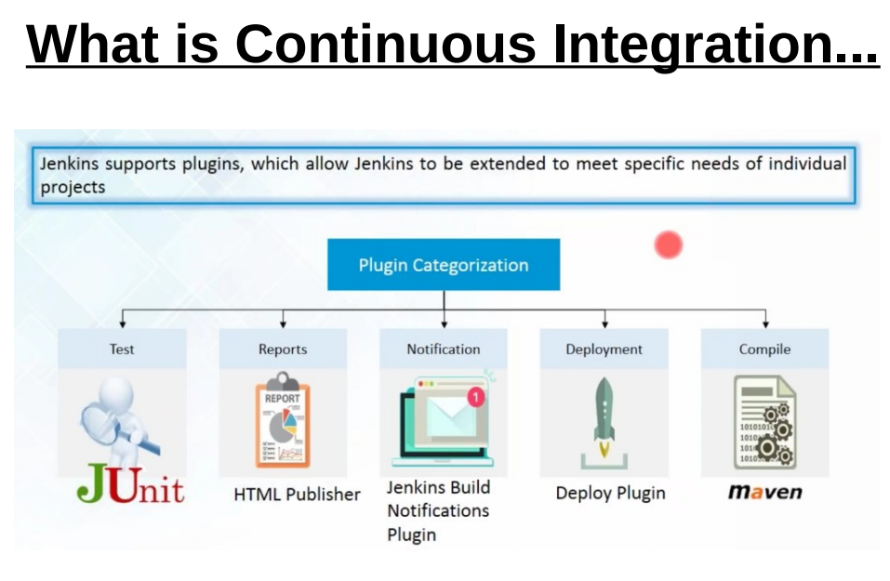

Slide 14
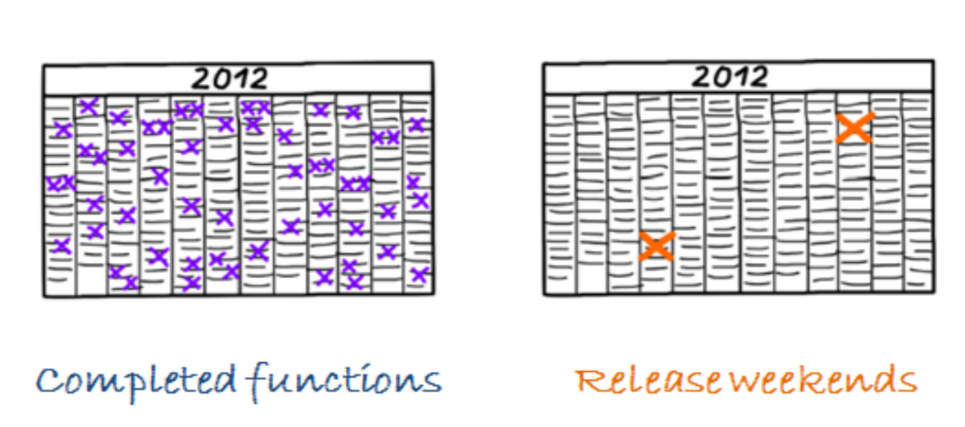

Slide 15
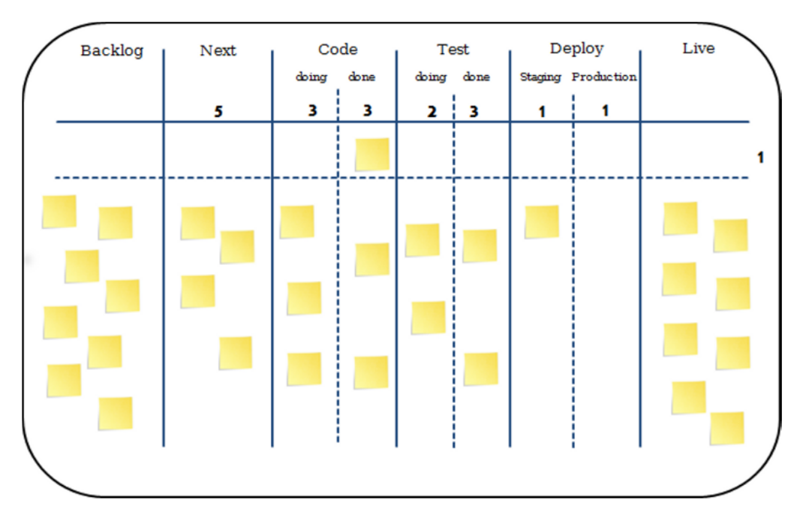
Kanban Board for DevOps

