Slide 1
Cordova
Session 1 : Introduction
Ayman El-Shayeb 2017

Slide 2

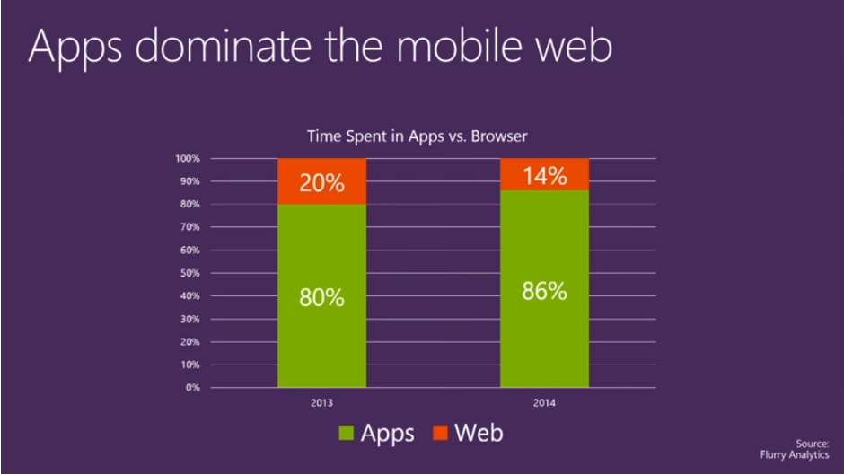

Why learning Mobile
Users number access web using mobile is increased year by years

Slide 3
mobile Development Knowldege path
Native approach
Andriod ( Andriod devices like samsung, Andriod SDK, Andriod Studio , Emultators , java or Kotlin)
IOS (Iphone, Mac devices ( or Mac Virtual machine), Xcode IDE, objective-C)
Windows phone ( windows 8.1 or later, visual studio )
Others ( Blackberry and Firfox os , ...)
Hybrid approach
It uses (HTML, CSS, Javascripts ,...)
Tool to creates Native versions for each platforms (like cordova ,phonegap..)

Slide 4
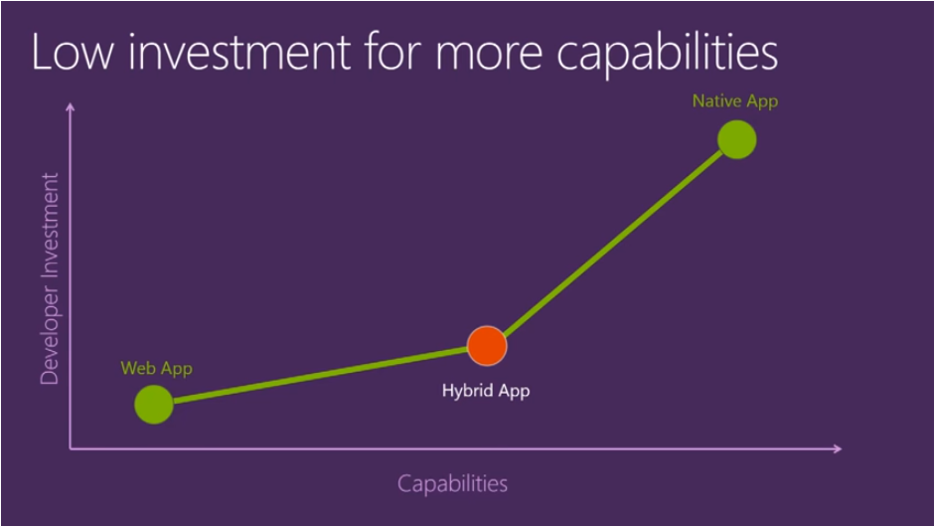
hyprid Technology
web developers already knows about 80% of the knolwedge to write Hybrid App

Slide 5
Needed?
Cordova ( tool to build from HTML to native platform)
Angular 4 ( UI framework)
Ionic 3 ( Mobile framework based on Angular and cordova)
Static content ( Jquery mobile, HTML5, Typescripts, Css3 ,... )
Each sub courses contains many sessions .
Each Session will be about 30 minutes.

Slide 6
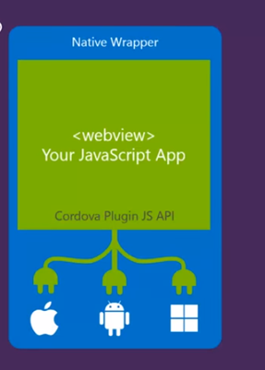
Cordova
Open source project based on Node.js to build native application from web artificates (HTML, Javascripts, Css3)
The story started with PhoneGap project created by Nitobi .
Nitobi donetes his work to Apache with name Cordova
Adobe hired Nitobi and made another folk from Cordova project under the PhoneGap name.
Adobe is still supporting PhoneGap and provides some Clouding services (not free services)

Slide 7
Other Hybrid tools
Phonegap
from Adobe
Provides some clouding services for building and test (not free)
Micorsoft visual studio
It uses cordova as enginee to build hybrid applicaiotns (not free)
Oracle JET
Open source
Using cordova as Enginee
Oracle Mobile Application Framework
Complete Framework that uses JAVA
Red Hat Mobile Application Platform

Slide 8
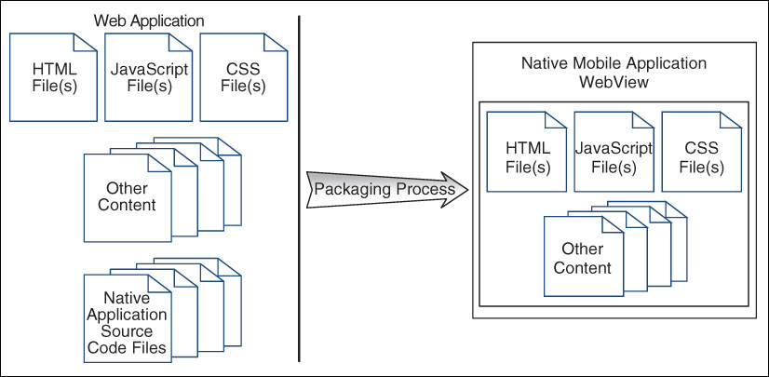
Cordova
Cordova simple idea is to package web application into native applicaiton mobile that runs in WebView containers

Slide 9
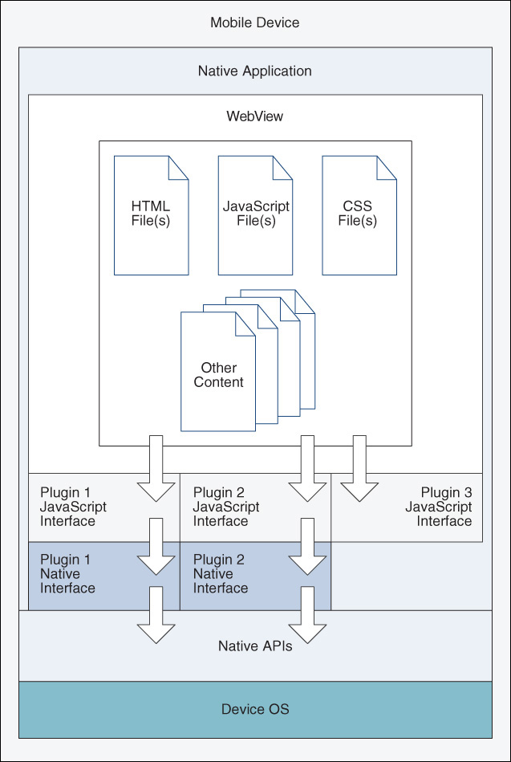
Cordova
Cordova gives the web applications ability to access device main components and native device functionality by simple javascripts
Normal web application that runs on mobile browsers can not access all the devices capabilites as Cordova.

Slide 10
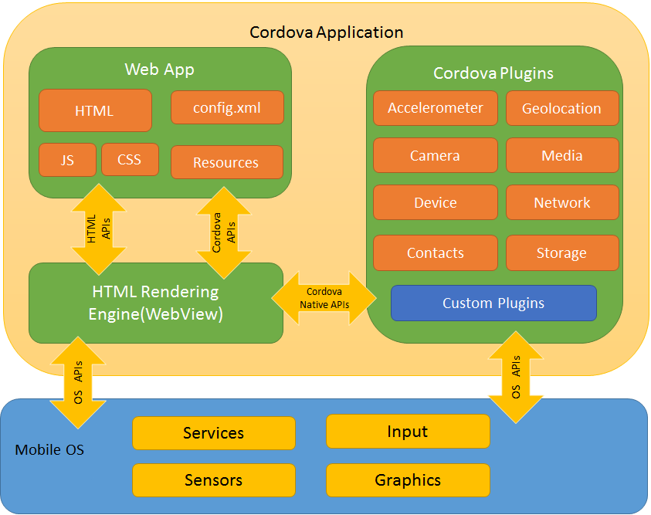
Cordova
Cordova gives the web applications ability to access device main components and native device functionality by simple javascripts
Normal web application that runs on mobile browsers can not access all the devices capabilites as Cordova.

Slide 11
Node.Js
It is a JavaScript runtime built on Chrome's V8 JavaScript engine
By node.js we can build server-side components by JavaScripts (like REST services)
Node.js uses an event-driven, non-blocking I/O model instead of Multithreading java mechanism.
Cordova is a CLI component installed over Node.js

Slide 12
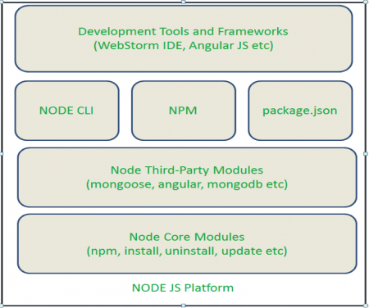
Node js
For us , Node .js is a building and run enviroment tools
Node CLI : to run the corodva command lines
NPM : component to install third party compoents ( cordova in our case)
Package.json : file that contains project dependancy

Slide 13
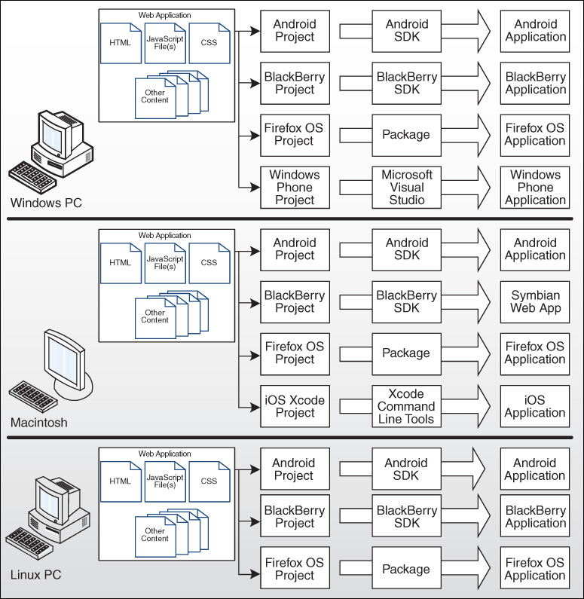
Mobile Platform requirments
From windows machine we can not develop Iphone directly.
From Mac we can not develop Windows phone direclty.
From Linux we can not develop Windows or Iphone applications directly.
We need to test on Virtual machine
Through this course we will focus on the Andriod.

Slide 14
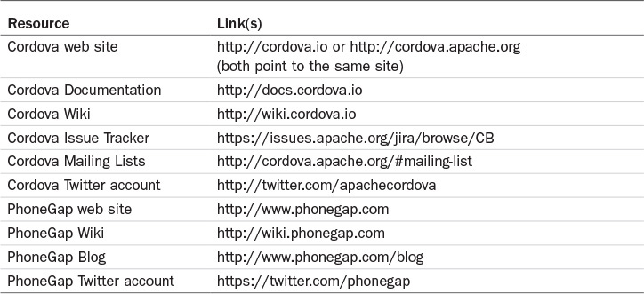
References
Cordova website (https://cordova.apache.org/)
Apache Cordova 4 Programming (John M. Wargo) (https://www.amazon.de/Apache-Cordova-Programming-Mobile/dp/0134048199)

Slide 15
SETUP ENVIRONEMTS
Download Node.js
Download Androids toolkit
Check node.js and Androids

Slide 16
Notes
Cheating Sheets for CLI

