Slide 1
Cordova
Session 4 : Corodva API
Ayman El-Shayeb 2017

Slide 2
Alert ApPlication
Purpose
Building simple application with some button to show types of alert
Alert
prompt
Confirm

Slide 3
Alert ApPlication
Prepare the application
Create cordova application
cordova create alerting com.ipoint.cordova.alerting alerting
Access folder alerting
Add android platform
cordova platform add android
Adding dialogs plugin
cordova plugin add cordova-plugin-dialogs

Slide 4
Alert ApPlication
Add extra HTML and extra js (camera.html and camera.js)
Add code to check if alert is available or not
Add code for 3 buttons . One for alert , one for promot and one for conformation

Slide 5
Run code
Run on server to check the HTML and Javascript
Run on simulator to see the different between three
navigator.notification.alert(message, [callback], [title], [buttonLabel])
navigator.notification.confirm(message, [callback], [title],[buttonLabels]);
navigator.notification.prompt(message, [callback], [title], [buttonLabels], [defaultText]);

Slide 6
Note
Alerts syntax
navigator.notification.alert(message, [callback], [title], [buttonLabel])
navigator.notification.confirm(message, [callback], [title],[buttonLabels]);
navigator.notification.prompt(message, [callback], [title], [buttonLabels], [defaultText]);

Slide 7
Hardware alter ApPlication
Purpose
Building simple application with some button to show types of alert
Beep
vibration

Slide 8
Hardware Alert ApPlication
Prepare the application
Create cordova application
cordova create hardwareAlerting com.ipoint.cordova.hardwareAlerting hardwareAlerting
Access folder hardwareAlerting
Add android platform
cordova platform add android
Adding dialogs plugin
cordova plugin add cordova-plugin-vibration

Slide 9
Hardware Alert ApPlication
Add code to check if alert is available or not
Add code for 2 buttons . One for beep alert, one for viberation

Slide 10
Run code
Run on server to check the HTML and Javascript
Run on simulator to see the different between three
Note
It is not working in simulator

Slide 11
Device Information ApPlication
Purpose
Building simple application displays device information
Beep
vibration

Slide 12
Hardware Alert ApPlication
Prepare the application
Create cordova application
cordova create deviceInformation com.ipoint.cordova.deviceInformation deviceInformation
Access folder deviceInformation
Add android platform
cordova platform add android
Adding dialogs plugin
cordova plugin add cordova-plugin-dialogs
Adding device plugin
cordova plugin add cordova-plugin-device

Slide 13
Hardware Alert ApPlication
Add code to check if alert is available or not
Add code for 1 button to display device information

Slide 14
Run code
Run on server to check the HTML and Javascript
Run on simulator to see the different between three
Note
It is not working in simulator

Slide 15
Network Information ApPlication
Purpose
Building simple application checks the connection

Slide 16
Network Information ApPlication
Prepare the application
Create cordova application
cordova create networkInformation com.ipoint.cordova.networkInformation networkInformation
Access folder networkInformation
Add android platform
cordova platform add android
Adding dialogs plugin
cordova plugin add cordova-plugin-dialogs
Adding device plugin
cordova plugin add cordova-plugin-network-information

Slide 17
Network Information ApPlication
Add code to check if alert is available or not
Add code for to test connection and display the type

Slide 18
Run code
Run on server to check the HTML and Javascript
Run on simulator to see the button
You can disable the network by the simulator

Slide 19

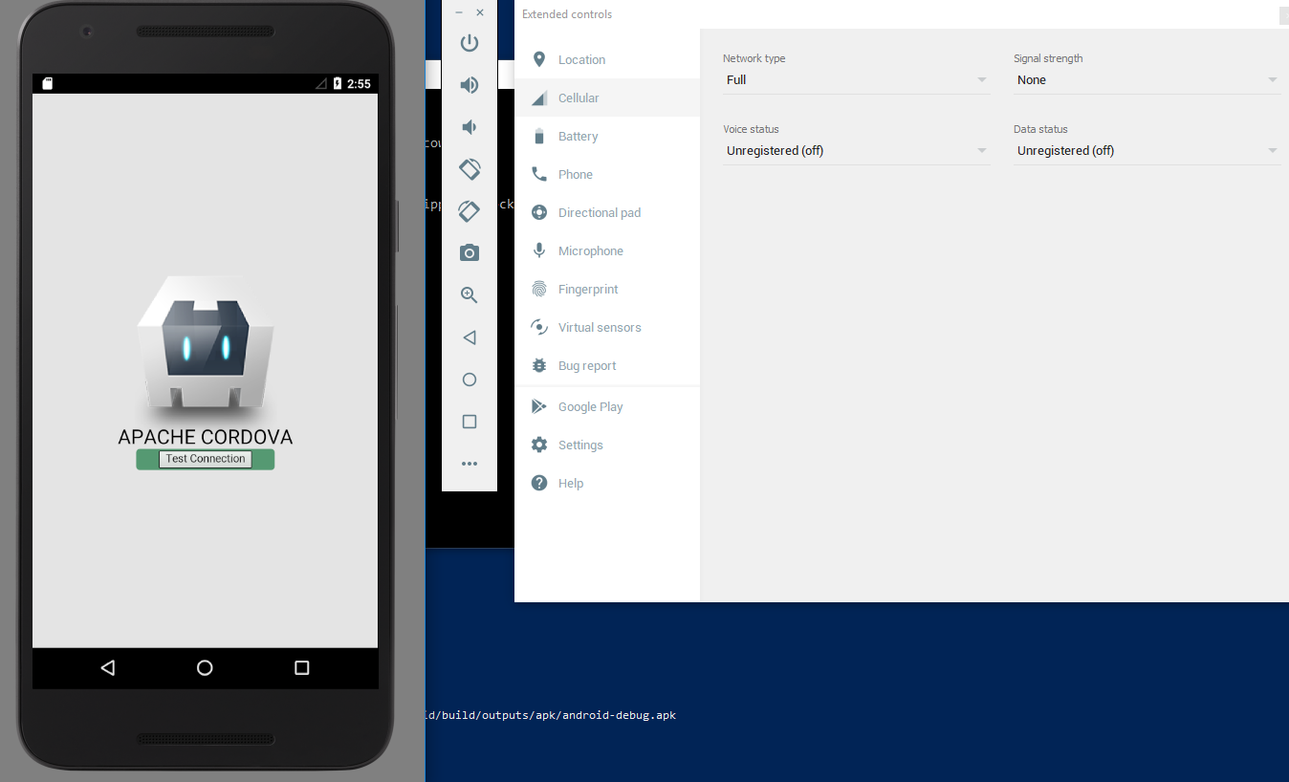


Slide 20
Note
Get connection
var ct = navigator.connection.type;
Connection types
Connection.UNKNOWN
Connection.ETHERNET
Connection.WIFI
Connection.CELL_2G
Connection.CELL_3G
Connection.CELL_4G
Connection.CELL
Connection.NONE

Slide 21
Listen to device Events ApPlication
Purpose
Building simple application illustrates events

Slide 22
Listen to device Events ApPlication
Prepare the application
Create cordova application
cordova create offlineEvent com.ipoint.cordova.offlineEvent offlineEvent
Access folder offlineEvent
Add android platform
cordova platform add android

Slide 23
Listen to device Events ApPlication
Add code to listen to offline event

Slide 24
Run code
Run on server to check the HTML and Javascript
Simulate offline mode

Slide 25
Note
Get connection
var ct = navigator.connection.type;
Connection types
Connection.UNKNOWN
Connection.ETHERNET
Connection.WIFI
Connection.CELL_2G
Connection.CELL_3G
Connection.CELL_4G
Connection.CELL
Connection.NONE

Slide 26
StatusBar ApPlication
Purpose
Building simple application show/hide statusbar

Slide 27
StatusBar ApPlication
Prepare the application
Create cordova application
cordova create statusbar com.ipoint.cordova.statusbar statusbar
Access folder statusbar
Add android platform
cordova platform add android
Add statusbar plugin
cordova plugin add cordova-plugin-statusbar

Slide 28
Listen to device Events ApPlication
Add code to add button for show and hide the statusbar

Slide 29
Run code
Run on server to check the HTML and Javascript
Simulate offline mode

Slide 30
Note
Extra option in Statusbar
StatusBar.overlaysWebView(true);
StatusBar.styleDefault();
StatusBar.backgroundColorByName('orange');

Slide 31
splashpage ApPlication
Purpose
Building simple application show/hide splashpage

Slide 32
splashpage ApPlication
Prepare the application
Create cordova application
cordova create splashpage com.ipoint.cordova.splashpage splashpage
Access folder splashpage
Add android platform
cordova platform add android
Add statusbar plugin
cordova plugin add cordova-plugin-splashscreen

Slide 33
splashpage ApPlication
Add code to add button for show the splashpage

Slide 34
Run code
Run on server to check the HTML and Javascript
Simulate

Slide 35
CONTACTS ApPlication
Purpose
Building simple application to create contact and search contact

Slide 36
CONTACTS ApPlication
Prepare the application
Create cordova application
cordova create contacts com.ipoint.cordova.contacts contacts
Access folder contacts
Add android platform
cordova platform add android
Add contacts plugin
cordova plugin add cordova-plugin-contacts

Slide 37
CONTACTS ApPlication
Add code to add two input fields and two buttons
One button for add
One button for search
var newContact = navigator.contacts.create();
newContact.displayName = name;
newContact. phoneNumbers = [number];
newContact.save(onSuccess, onFailure);

Slide 38
Run code
Run on server to check the HTML and Javascript
Simulate offline mode

Slide 39
Note
Navigator.contacts has many fields
id: A globally unique identifier. (DOMString)
displayName: The name of this Contact, suitable for display to end users. (DOMString)
name: An object containing all components of a persons name. (ContactName)
nickname: A casual name by which to address the contact. (DOMString)
phoneNumbers: An array of all the contact's phone numbers. (ContactField[])
emails: An array of all the contact's email addresses. (ContactField[])
addresses: An array of all the contact's addresses. (ContactAddress[])
ims: An array of all the contact's IM addresses. (ContactField[])
organizations: An array of all the contact's organizations. (ContactOrganization[])
birthday: The birthday of the contact. (Date)
note: A note about the contact. (DOMString)
photos: An array of the contact's photos. (ContactField[])
categories: An array of all the user-defined categories associated with the contact. (ContactField[])
urls: An array of web pages associated with the contact. (ContactField[])

Slide 40
Note
Navigator.contacts has other methods
Save
Find
Pickcontact
Remove
clone

