Slide 1

Javascript Tips 1
Ayman El-Shayeb, Specialist in Egypt Center
Nov 26, 2015
Notes:
This is a sample Title Slide with Picture ideal for including a dark picture with a brief title and subtitle.
A selection of pre-approved title slides are available in the HPE Title Slide Library. The location of the library will be communicated later.
To insert a slide with a different picture from the HPE Title Slide Library:
Open the file HPE_16x9_Title_Slide_Library.pptx
From the Slide thumbnails pane, select the slide with the picture you would like to use in your presentation and click Copy (Ctrl+C)
Open a copy of the new HPE 16x9 template (Standard or Events) or your current presentation
In the Slide thumbnails pane, click Paste (Ctrl+V)
A Paste Options clipboard icon will appear. Click the icon and select Keep Source Formatting. (Ctrl+K)

Slide 2
Introduction
JavaScript is the number one programming language in the world.
A lot of systems go with its factions like Node.js , mongoDB and cordova
However, Javascript has a lot of tricks that should be take in consideration.

Slide 3
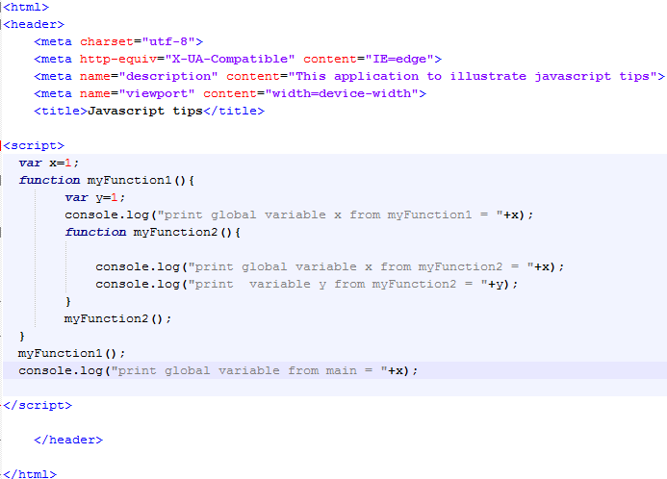
Scoping
In javascript, there are two scopes global scope and functional scope.
We can access global variables from anywhere.
Child function can access the parent function variable.
Notes:
This is a sample Picture with Caption slide ideal for including a picture with a brief descriptive statement.
To Replace the Picture on this Sample Slide (this applies to all slides in this template that contain replaceable pictures)
Select the sample picture and press Delete. Click the icon inside the shape to open the Insert Picture dialog box. Navigate to the location where the picture is stored, select desired picture and click on the Insert button to fit the image proportionally within the shape.
Note: Do not right-click the image to change the picture inside the picture placeholder. This will change the frame size of the picture placeholder. Instead, follow the steps outlined above.
Tip: use the Crop tool to reposition a picture within a placeholder. From the Picture Tools Format tab on the ribbon, click the Crop button. Click and drag the picture within the placeholder to reposition. To scale the picture within the placeholder (while Crop is active), grab a round corner handle and drag to resize. Hold Shift key to constrain picture aspect ratio when resizing.

Slide 4
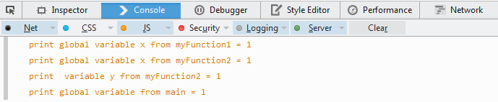
Scoping
Notes:
This is a sample Picture with Caption slide ideal for including a picture with a brief descriptive statement.
To Replace the Picture on this Sample Slide (this applies to all slides in this template that contain replaceable pictures)
Select the sample picture and press Delete. Click the icon inside the shape to open the Insert Picture dialog box. Navigate to the location where the picture is stored, select desired picture and click on the Insert button to fit the image proportionally within the shape.
Note: Do not right-click the image to change the picture inside the picture placeholder. This will change the frame size of the picture placeholder. Instead, follow the steps outlined above.
Tip: use the Crop tool to reposition a picture within a placeholder. From the Picture Tools Format tab on the ribbon, click the Crop button. Click and drag the picture within the placeholder to reposition. To scale the picture within the placeholder (while Crop is active), grab a round corner handle and drag to resize. Hold Shift key to constrain picture aspect ratio when resizing.

Slide 5
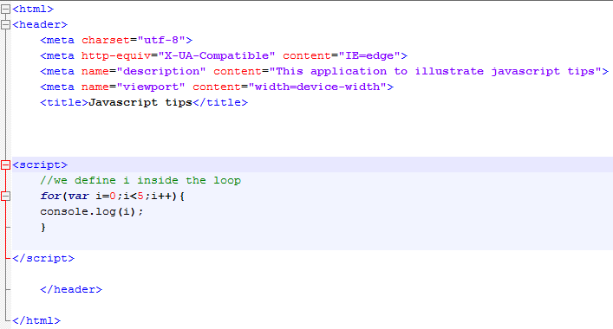
Scoping (looping variable)
- Here we define “i” in the start of the loop
Notes:
This is a sample Picture with Caption slide ideal for including a picture with a brief descriptive statement.
To Replace the Picture on this Sample Slide (this applies to all slides in this template that contain replaceable pictures)
Select the sample picture and press Delete. Click the icon inside the shape to open the Insert Picture dialog box. Navigate to the location where the picture is stored, select desired picture and click on the Insert button to fit the image proportionally within the shape.
Note: Do not right-click the image to change the picture inside the picture placeholder. This will change the frame size of the picture placeholder. Instead, follow the steps outlined above.
Tip: use the Crop tool to reposition a picture within a placeholder. From the Picture Tools Format tab on the ribbon, click the Crop button. Click and drag the picture within the placeholder to reposition. To scale the picture within the placeholder (while Crop is active), grab a round corner handle and drag to resize. Hold Shift key to constrain picture aspect ratio when resizing.

Slide 6
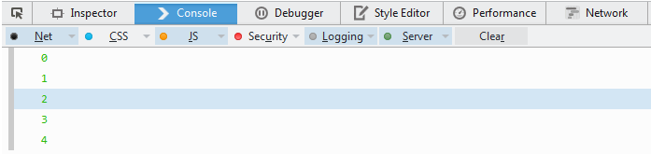
Scoping (looping variable)
- Here we define “i” in the start of the loop
Notes:
This is a sample Picture with Caption slide ideal for including a picture with a brief descriptive statement.
To Replace the Picture on this Sample Slide (this applies to all slides in this template that contain replaceable pictures)
Select the sample picture and press Delete. Click the icon inside the shape to open the Insert Picture dialog box. Navigate to the location where the picture is stored, select desired picture and click on the Insert button to fit the image proportionally within the shape.
Note: Do not right-click the image to change the picture inside the picture placeholder. This will change the frame size of the picture placeholder. Instead, follow the steps outlined above.
Tip: use the Crop tool to reposition a picture within a placeholder. From the Picture Tools Format tab on the ribbon, click the Crop button. Click and drag the picture within the placeholder to reposition. To scale the picture within the placeholder (while Crop is active), grab a round corner handle and drag to resize. Hold Shift key to constrain picture aspect ratio when resizing.

Slide 7
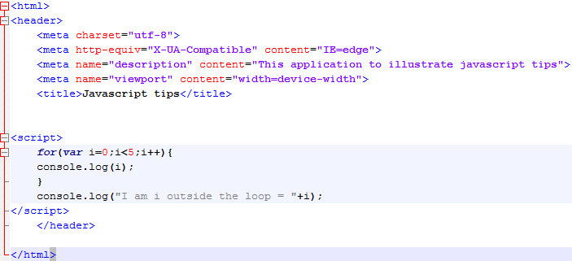
Scoping (looping variable)
Here we define “i” in the start of the loop
We try to write the value of “i” outside the loop
Notes:
This is a sample Picture with Caption slide ideal for including a picture with a brief descriptive statement.
To Replace the Picture on this Sample Slide (this applies to all slides in this template that contain replaceable pictures)
Select the sample picture and press Delete. Click the icon inside the shape to open the Insert Picture dialog box. Navigate to the location where the picture is stored, select desired picture and click on the Insert button to fit the image proportionally within the shape.
Note: Do not right-click the image to change the picture inside the picture placeholder. This will change the frame size of the picture placeholder. Instead, follow the steps outlined above.
Tip: use the Crop tool to reposition a picture within a placeholder. From the Picture Tools Format tab on the ribbon, click the Crop button. Click and drag the picture within the placeholder to reposition. To scale the picture within the placeholder (while Crop is active), grab a round corner handle and drag to resize. Hold Shift key to constrain picture aspect ratio when resizing.

Slide 8
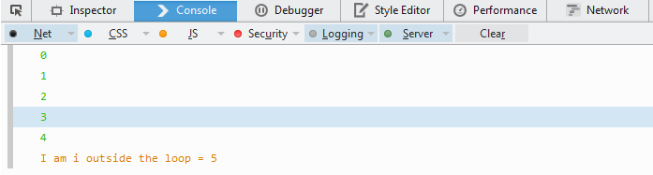
Scoping (looping variable)
- Here we define “i” in the start of the loop
“i” still has a value outside the loop
This is because the blocks in the javascript don’t have scope.
In Javascript , we have global scope and function scope only
Notes:
This is a sample Picture with Caption slide ideal for including a picture with a brief descriptive statement.
To Replace the Picture on this Sample Slide (this applies to all slides in this template that contain replaceable pictures)
Select the sample picture and press Delete. Click the icon inside the shape to open the Insert Picture dialog box. Navigate to the location where the picture is stored, select desired picture and click on the Insert button to fit the image proportionally within the shape.
Note: Do not right-click the image to change the picture inside the picture placeholder. This will change the frame size of the picture placeholder. Instead, follow the steps outlined above.
Tip: use the Crop tool to reposition a picture within a placeholder. From the Picture Tools Format tab on the ribbon, click the Crop button. Click and drag the picture within the placeholder to reposition. To scale the picture within the placeholder (while Crop is active), grab a round corner handle and drag to resize. Hold Shift key to constrain picture aspect ratio when resizing.

Slide 9
Scoping (looping variable)
Here we define “i” in the start of the loop
We try to write the value of “i” outside the loop
Notes:
This is a sample Picture with Caption slide ideal for including a picture with a brief descriptive statement.
To Replace the Picture on this Sample Slide (this applies to all slides in this template that contain replaceable pictures)
Select the sample picture and press Delete. Click the icon inside the shape to open the Insert Picture dialog box. Navigate to the location where the picture is stored, select desired picture and click on the Insert button to fit the image proportionally within the shape.
Note: Do not right-click the image to change the picture inside the picture placeholder. This will change the frame size of the picture placeholder. Instead, follow the steps outlined above.
Tip: use the Crop tool to reposition a picture within a placeholder. From the Picture Tools Format tab on the ribbon, click the Crop button. Click and drag the picture within the placeholder to reposition. To scale the picture within the placeholder (while Crop is active), grab a round corner handle and drag to resize. Hold Shift key to constrain picture aspect ratio when resizing.

Slide 10
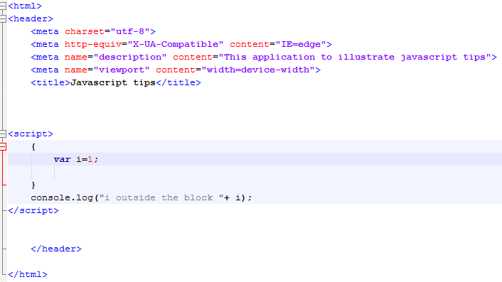
Scoping (looping variable)
Javascript doesn’t have block scope . It has function or global scope only
Notes:
This is a sample Picture with Caption slide ideal for including a picture with a brief descriptive statement.
To Replace the Picture on this Sample Slide (this applies to all slides in this template that contain replaceable pictures)
Select the sample picture and press Delete. Click the icon inside the shape to open the Insert Picture dialog box. Navigate to the location where the picture is stored, select desired picture and click on the Insert button to fit the image proportionally within the shape.
Note: Do not right-click the image to change the picture inside the picture placeholder. This will change the frame size of the picture placeholder. Instead, follow the steps outlined above.
Tip: use the Crop tool to reposition a picture within a placeholder. From the Picture Tools Format tab on the ribbon, click the Crop button. Click and drag the picture within the placeholder to reposition. To scale the picture within the placeholder (while Crop is active), grab a round corner handle and drag to resize. Hold Shift key to constrain picture aspect ratio when resizing.

Slide 11

Scoping (looping variable)
Javascript doesn’t have block scope . It has function or global scope only
Notes:
This is a sample Picture with Caption slide ideal for including a picture with a brief descriptive statement.
To Replace the Picture on this Sample Slide (this applies to all slides in this template that contain replaceable pictures)
Select the sample picture and press Delete. Click the icon inside the shape to open the Insert Picture dialog box. Navigate to the location where the picture is stored, select desired picture and click on the Insert button to fit the image proportionally within the shape.
Note: Do not right-click the image to change the picture inside the picture placeholder. This will change the frame size of the picture placeholder. Instead, follow the steps outlined above.
Tip: use the Crop tool to reposition a picture within a placeholder. From the Picture Tools Format tab on the ribbon, click the Crop button. Click and drag the picture within the placeholder to reposition. To scale the picture within the placeholder (while Crop is active), grab a round corner handle and drag to resize. Hold Shift key to constrain picture aspect ratio when resizing.

Slide 12
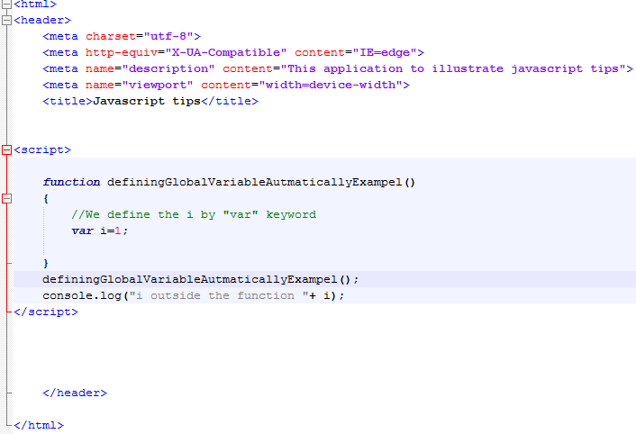
Scoping( Declaring Global variable automatically)
Here , we define “i” by “var” keyword inside the function
Notes:
This is a sample Picture with Caption slide ideal for including a picture with a brief descriptive statement.
To Replace the Picture on this Sample Slide (this applies to all slides in this template that contain replaceable pictures)
Select the sample picture and press Delete. Click the icon inside the shape to open the Insert Picture dialog box. Navigate to the location where the picture is stored, select desired picture and click on the Insert button to fit the image proportionally within the shape.
Note: Do not right-click the image to change the picture inside the picture placeholder. This will change the frame size of the picture placeholder. Instead, follow the steps outlined above.
Tip: use the Crop tool to reposition a picture within a placeholder. From the Picture Tools Format tab on the ribbon, click the Crop button. Click and drag the picture within the placeholder to reposition. To scale the picture within the placeholder (while Crop is active), grab a round corner handle and drag to resize. Hold Shift key to constrain picture aspect ratio when resizing.

Slide 13

Scoping( Declaring Global variable automatically)
- “i” is not seen outside the function
Notes:
This is a sample Picture with Caption slide ideal for including a picture with a brief descriptive statement.
To Replace the Picture on this Sample Slide (this applies to all slides in this template that contain replaceable pictures)
Select the sample picture and press Delete. Click the icon inside the shape to open the Insert Picture dialog box. Navigate to the location where the picture is stored, select desired picture and click on the Insert button to fit the image proportionally within the shape.
Note: Do not right-click the image to change the picture inside the picture placeholder. This will change the frame size of the picture placeholder. Instead, follow the steps outlined above.
Tip: use the Crop tool to reposition a picture within a placeholder. From the Picture Tools Format tab on the ribbon, click the Crop button. Click and drag the picture within the placeholder to reposition. To scale the picture within the placeholder (while Crop is active), grab a round corner handle and drag to resize. Hold Shift key to constrain picture aspect ratio when resizing.

Slide 14
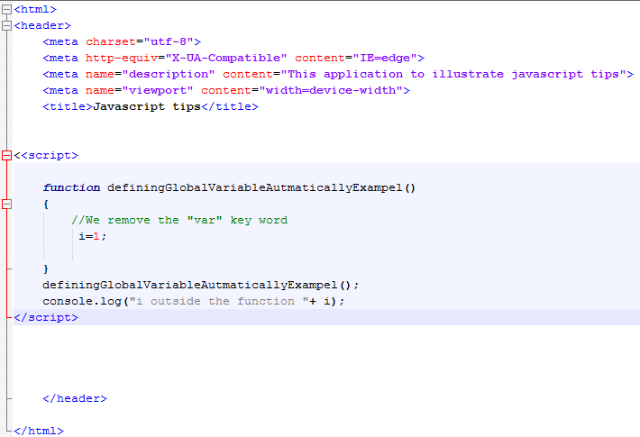
Scoping( Declaring Global variable automatically)
Here we remove the “var” keyword
Notes:
This is a sample Picture with Caption slide ideal for including a picture with a brief descriptive statement.
To Replace the Picture on this Sample Slide (this applies to all slides in this template that contain replaceable pictures)
Select the sample picture and press Delete. Click the icon inside the shape to open the Insert Picture dialog box. Navigate to the location where the picture is stored, select desired picture and click on the Insert button to fit the image proportionally within the shape.
Note: Do not right-click the image to change the picture inside the picture placeholder. This will change the frame size of the picture placeholder. Instead, follow the steps outlined above.
Tip: use the Crop tool to reposition a picture within a placeholder. From the Picture Tools Format tab on the ribbon, click the Crop button. Click and drag the picture within the placeholder to reposition. To scale the picture within the placeholder (while Crop is active), grab a round corner handle and drag to resize. Hold Shift key to constrain picture aspect ratio when resizing.

Slide 15

Scoping( Declaring Global variable automatically)
The default scope of the variable that doesn’t have “var” keyword is global .
Notes:
This is a sample Picture with Caption slide ideal for including a picture with a brief descriptive statement.
To Replace the Picture on this Sample Slide (this applies to all slides in this template that contain replaceable pictures)
Select the sample picture and press Delete. Click the icon inside the shape to open the Insert Picture dialog box. Navigate to the location where the picture is stored, select desired picture and click on the Insert button to fit the image proportionally within the shape.
Note: Do not right-click the image to change the picture inside the picture placeholder. This will change the frame size of the picture placeholder. Instead, follow the steps outlined above.
Tip: use the Crop tool to reposition a picture within a placeholder. From the Picture Tools Format tab on the ribbon, click the Crop button. Click and drag the picture within the placeholder to reposition. To scale the picture within the placeholder (while Crop is active), grab a round corner handle and drag to resize. Hold Shift key to constrain picture aspect ratio when resizing.

Slide 16
Scoping( Declaring Global variable automatically)
Here we remove the “var” keyword
Notes:
This is a sample Picture with Caption slide ideal for including a picture with a brief descriptive statement.
To Replace the Picture on this Sample Slide (this applies to all slides in this template that contain replaceable pictures)
Select the sample picture and press Delete. Click the icon inside the shape to open the Insert Picture dialog box. Navigate to the location where the picture is stored, select desired picture and click on the Insert button to fit the image proportionally within the shape.
Note: Do not right-click the image to change the picture inside the picture placeholder. This will change the frame size of the picture placeholder. Instead, follow the steps outlined above.
Tip: use the Crop tool to reposition a picture within a placeholder. From the Picture Tools Format tab on the ribbon, click the Crop button. Click and drag the picture within the placeholder to reposition. To scale the picture within the placeholder (while Crop is active), grab a round corner handle and drag to resize. Hold Shift key to constrain picture aspect ratio when resizing.

Slide 17
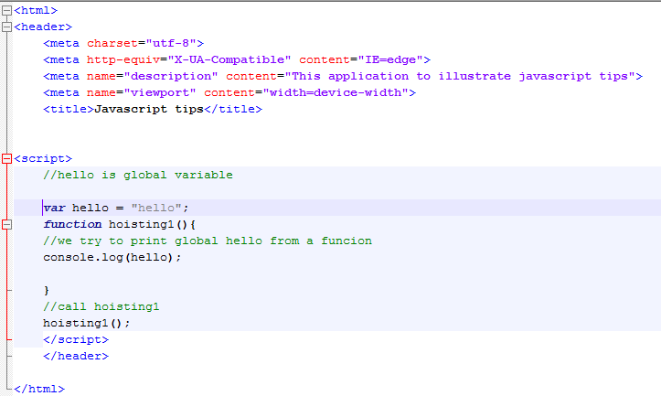
Hoisting behavior
1- Here we try to log the hello , which is defined by global scope.
Notes:
This is a sample Picture with Caption slide ideal for including a picture with a brief descriptive statement.
To Replace the Picture on this Sample Slide (this applies to all slides in this template that contain replaceable pictures)
Select the sample picture and press Delete. Click the icon inside the shape to open the Insert Picture dialog box. Navigate to the location where the picture is stored, select desired picture and click on the Insert button to fit the image proportionally within the shape.
Note: Do not right-click the image to change the picture inside the picture placeholder. This will change the frame size of the picture placeholder. Instead, follow the steps outlined above.
Tip: use the Crop tool to reposition a picture within a placeholder. From the Picture Tools Format tab on the ribbon, click the Crop button. Click and drag the picture within the placeholder to reposition. To scale the picture within the placeholder (while Crop is active), grab a round corner handle and drag to resize. Hold Shift key to constrain picture aspect ratio when resizing.

Slide 18
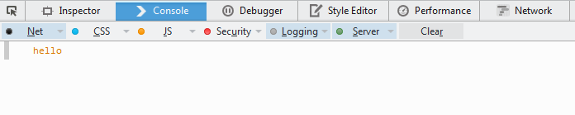
Hoisting behavior
- We see that hello is printed correctly.
- This means we can refer to global Hello inside the function.
Notes:
This is a sample Picture with Caption slide ideal for including a picture with a brief descriptive statement.
To Replace the Picture on this Sample Slide (this applies to all slides in this template that contain replaceable pictures)
Select the sample picture and press Delete. Click the icon inside the shape to open the Insert Picture dialog box. Navigate to the location where the picture is stored, select desired picture and click on the Insert button to fit the image proportionally within the shape.
Note: Do not right-click the image to change the picture inside the picture placeholder. This will change the frame size of the picture placeholder. Instead, follow the steps outlined above.
Tip: use the Crop tool to reposition a picture within a placeholder. From the Picture Tools Format tab on the ribbon, click the Crop button. Click and drag the picture within the placeholder to reposition. To scale the picture within the placeholder (while Crop is active), grab a round corner handle and drag to resize. Hold Shift key to constrain picture aspect ratio when resizing.

Slide 19
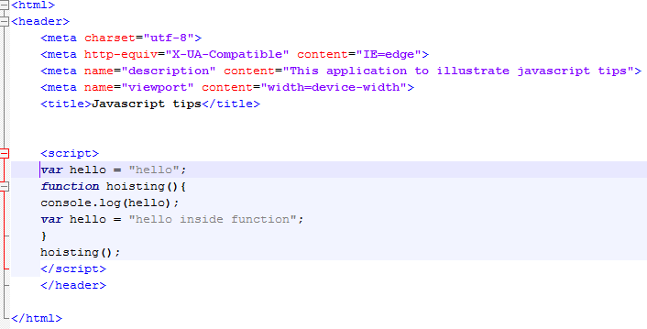
Hoisting behavior
- Here, we have two hello declarations. One is global scope and other is in function scope .
- Local hello is defined at the end of the hoisting() function
- java script takes all declinations and put them at the start of the scope block automatically. (hoisting behavior)
- javascript changes the place of declaration but not the assignment value.
Notes:
This is a sample Picture with Caption slide ideal for including a picture with a brief descriptive statement.
To Replace the Picture on this Sample Slide (this applies to all slides in this template that contain replaceable pictures)
Select the sample picture and press Delete. Click the icon inside the shape to open the Insert Picture dialog box. Navigate to the location where the picture is stored, select desired picture and click on the Insert button to fit the image proportionally within the shape.
Note: Do not right-click the image to change the picture inside the picture placeholder. This will change the frame size of the picture placeholder. Instead, follow the steps outlined above.
Tip: use the Crop tool to reposition a picture within a placeholder. From the Picture Tools Format tab on the ribbon, click the Crop button. Click and drag the picture within the placeholder to reposition. To scale the picture within the placeholder (while Crop is active), grab a round corner handle and drag to resize. Hold Shift key to constrain picture aspect ratio when resizing.

Slide 20

Hoisting behavior
- log prints undefined because logged hello is the local one and it doesn’t take value yet. (javscripts changes the place of declaration to start of the function)
Notes:
This is a sample Picture with Caption slide ideal for including a picture with a brief descriptive statement.
To Replace the Picture on this Sample Slide (this applies to all slides in this template that contain replaceable pictures)
Select the sample picture and press Delete. Click the icon inside the shape to open the Insert Picture dialog box. Navigate to the location where the picture is stored, select desired picture and click on the Insert button to fit the image proportionally within the shape.
Note: Do not right-click the image to change the picture inside the picture placeholder. This will change the frame size of the picture placeholder. Instead, follow the steps outlined above.
Tip: use the Crop tool to reposition a picture within a placeholder. From the Picture Tools Format tab on the ribbon, click the Crop button. Click and drag the picture within the placeholder to reposition. To scale the picture within the placeholder (while Crop is active), grab a round corner handle and drag to resize. Hold Shift key to constrain picture aspect ratio when resizing.

Slide 21
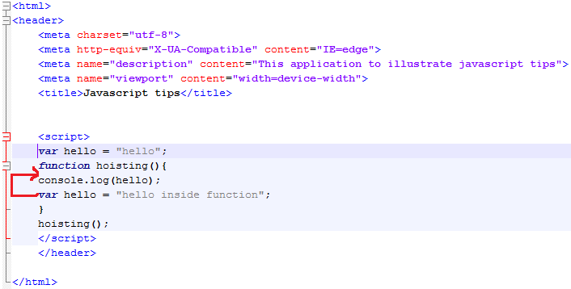
Hoisting behavior
- Here, we have two hello declarations. One is global scope and other is in function scope .
- Local hello is defined at the end of the hoisting() function
- java script takes all declinations and put them at the start of the scope block automatically. (hoisting behavior)
- javascript changes the place of declaration but not the assignment value.
Notes:
This is a sample Picture with Caption slide ideal for including a picture with a brief descriptive statement.
To Replace the Picture on this Sample Slide (this applies to all slides in this template that contain replaceable pictures)
Select the sample picture and press Delete. Click the icon inside the shape to open the Insert Picture dialog box. Navigate to the location where the picture is stored, select desired picture and click on the Insert button to fit the image proportionally within the shape.
Note: Do not right-click the image to change the picture inside the picture placeholder. This will change the frame size of the picture placeholder. Instead, follow the steps outlined above.
Tip: use the Crop tool to reposition a picture within a placeholder. From the Picture Tools Format tab on the ribbon, click the Crop button. Click and drag the picture within the placeholder to reposition. To scale the picture within the placeholder (while Crop is active), grab a round corner handle and drag to resize. Hold Shift key to constrain picture aspect ratio when resizing.

Slide 22
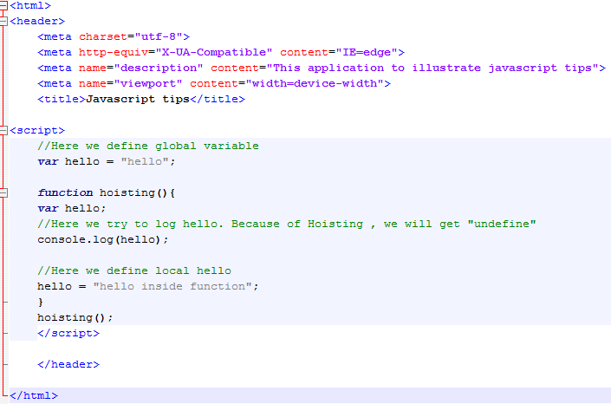
Hoisting behavior
This is the equivalent code
Notes:
This is a sample Picture with Caption slide ideal for including a picture with a brief descriptive statement.
To Replace the Picture on this Sample Slide (this applies to all slides in this template that contain replaceable pictures)
Select the sample picture and press Delete. Click the icon inside the shape to open the Insert Picture dialog box. Navigate to the location where the picture is stored, select desired picture and click on the Insert button to fit the image proportionally within the shape.
Note: Do not right-click the image to change the picture inside the picture placeholder. This will change the frame size of the picture placeholder. Instead, follow the steps outlined above.
Tip: use the Crop tool to reposition a picture within a placeholder. From the Picture Tools Format tab on the ribbon, click the Crop button. Click and drag the picture within the placeholder to reposition. To scale the picture within the placeholder (while Crop is active), grab a round corner handle and drag to resize. Hold Shift key to constrain picture aspect ratio when resizing.

Slide 23
Tips
Use “var” keyword and always give the variable initial values
Define all variables at the start of the scope.
Avoid global variables as much as you can
You can use “use strict” directive in newer versions of browsers

Slide 24
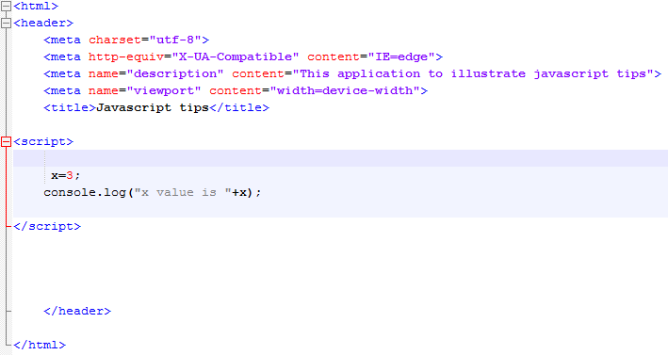
“use strict” directive
Here , we define x without “var”
Notes:
This is a sample Picture with Caption slide ideal for including a picture with a brief descriptive statement.
To Replace the Picture on this Sample Slide (this applies to all slides in this template that contain replaceable pictures)
Select the sample picture and press Delete. Click the icon inside the shape to open the Insert Picture dialog box. Navigate to the location where the picture is stored, select desired picture and click on the Insert button to fit the image proportionally within the shape.
Note: Do not right-click the image to change the picture inside the picture placeholder. This will change the frame size of the picture placeholder. Instead, follow the steps outlined above.
Tip: use the Crop tool to reposition a picture within a placeholder. From the Picture Tools Format tab on the ribbon, click the Crop button. Click and drag the picture within the placeholder to reposition. To scale the picture within the placeholder (while Crop is active), grab a round corner handle and drag to resize. Hold Shift key to constrain picture aspect ratio when resizing.

Slide 25

“use strict” directive
Javascript accepts x and display it corretlly
Notes:
This is a sample Picture with Caption slide ideal for including a picture with a brief descriptive statement.
To Replace the Picture on this Sample Slide (this applies to all slides in this template that contain replaceable pictures)
Select the sample picture and press Delete. Click the icon inside the shape to open the Insert Picture dialog box. Navigate to the location where the picture is stored, select desired picture and click on the Insert button to fit the image proportionally within the shape.
Note: Do not right-click the image to change the picture inside the picture placeholder. This will change the frame size of the picture placeholder. Instead, follow the steps outlined above.
Tip: use the Crop tool to reposition a picture within a placeholder. From the Picture Tools Format tab on the ribbon, click the Crop button. Click and drag the picture within the placeholder to reposition. To scale the picture within the placeholder (while Crop is active), grab a round corner handle and drag to resize. Hold Shift key to constrain picture aspect ratio when resizing.

Slide 26
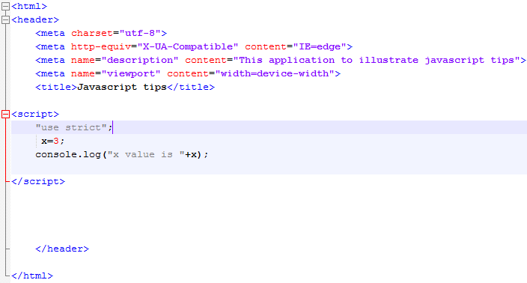
“use strict” directive
Here , we use “use strict” directive
It is just a string in the first of the block of the code
It adds a lot of constrains to make the code safer . One of it is to prevent using variable without previous declarations.
Notes:
This is a sample Picture with Caption slide ideal for including a picture with a brief descriptive statement.
To Replace the Picture on this Sample Slide (this applies to all slides in this template that contain replaceable pictures)
Select the sample picture and press Delete. Click the icon inside the shape to open the Insert Picture dialog box. Navigate to the location where the picture is stored, select desired picture and click on the Insert button to fit the image proportionally within the shape.
Note: Do not right-click the image to change the picture inside the picture placeholder. This will change the frame size of the picture placeholder. Instead, follow the steps outlined above.
Tip: use the Crop tool to reposition a picture within a placeholder. From the Picture Tools Format tab on the ribbon, click the Crop button. Click and drag the picture within the placeholder to reposition. To scale the picture within the placeholder (while Crop is active), grab a round corner handle and drag to resize. Hold Shift key to constrain picture aspect ratio when resizing.

Slide 27

“use strict” directive
Javascript accepts x and display it corretlly
Notes:
This is a sample Picture with Caption slide ideal for including a picture with a brief descriptive statement.
To Replace the Picture on this Sample Slide (this applies to all slides in this template that contain replaceable pictures)
Select the sample picture and press Delete. Click the icon inside the shape to open the Insert Picture dialog box. Navigate to the location where the picture is stored, select desired picture and click on the Insert button to fit the image proportionally within the shape.
Note: Do not right-click the image to change the picture inside the picture placeholder. This will change the frame size of the picture placeholder. Instead, follow the steps outlined above.
Tip: use the Crop tool to reposition a picture within a placeholder. From the Picture Tools Format tab on the ribbon, click the Crop button. Click and drag the picture within the placeholder to reposition. To scale the picture within the placeholder (while Crop is active), grab a round corner handle and drag to resize. Hold Shift key to constrain picture aspect ratio when resizing.

Slide 28
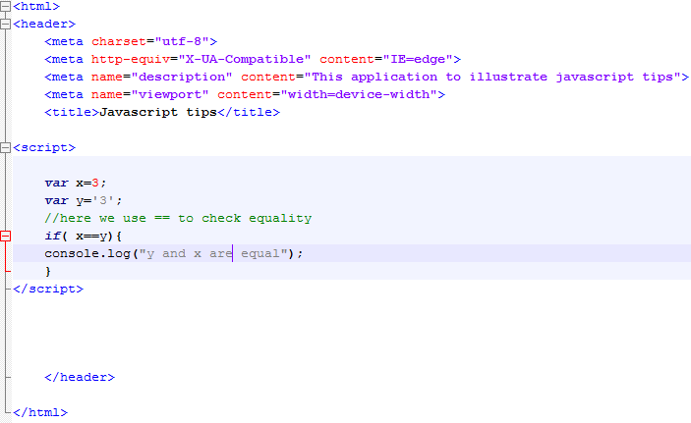
Equal operation
In javascript there are two equal operation (==) and (===)
X is integer
Y is string
We use the == operation to check the equality
Notes:
This is a sample Picture with Caption slide ideal for including a picture with a brief descriptive statement.
To Replace the Picture on this Sample Slide (this applies to all slides in this template that contain replaceable pictures)
Select the sample picture and press Delete. Click the icon inside the shape to open the Insert Picture dialog box. Navigate to the location where the picture is stored, select desired picture and click on the Insert button to fit the image proportionally within the shape.
Note: Do not right-click the image to change the picture inside the picture placeholder. This will change the frame size of the picture placeholder. Instead, follow the steps outlined above.
Tip: use the Crop tool to reposition a picture within a placeholder. From the Picture Tools Format tab on the ribbon, click the Crop button. Click and drag the picture within the placeholder to reposition. To scale the picture within the placeholder (while Crop is active), grab a round corner handle and drag to resize. Hold Shift key to constrain picture aspect ratio when resizing.

Slide 29

Equal operation
X== y returns true
== return true if the values are the same
Notes:
This is a sample Picture with Caption slide ideal for including a picture with a brief descriptive statement.
To Replace the Picture on this Sample Slide (this applies to all slides in this template that contain replaceable pictures)
Select the sample picture and press Delete. Click the icon inside the shape to open the Insert Picture dialog box. Navigate to the location where the picture is stored, select desired picture and click on the Insert button to fit the image proportionally within the shape.
Note: Do not right-click the image to change the picture inside the picture placeholder. This will change the frame size of the picture placeholder. Instead, follow the steps outlined above.
Tip: use the Crop tool to reposition a picture within a placeholder. From the Picture Tools Format tab on the ribbon, click the Crop button. Click and drag the picture within the placeholder to reposition. To scale the picture within the placeholder (while Crop is active), grab a round corner handle and drag to resize. Hold Shift key to constrain picture aspect ratio when resizing.

Slide 30
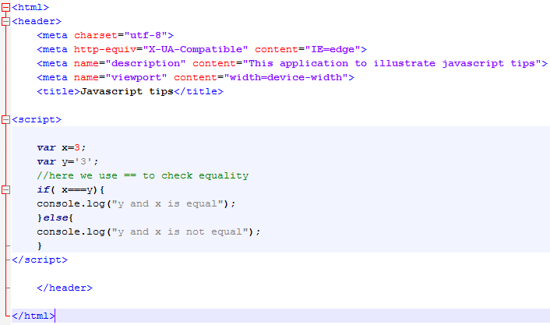
Equal operation
X is integer
Y is string
We use the === operation (treble =) to check the equality
Notes:
This is a sample Picture with Caption slide ideal for including a picture with a brief descriptive statement.
To Replace the Picture on this Sample Slide (this applies to all slides in this template that contain replaceable pictures)
Select the sample picture and press Delete. Click the icon inside the shape to open the Insert Picture dialog box. Navigate to the location where the picture is stored, select desired picture and click on the Insert button to fit the image proportionally within the shape.
Note: Do not right-click the image to change the picture inside the picture placeholder. This will change the frame size of the picture placeholder. Instead, follow the steps outlined above.
Tip: use the Crop tool to reposition a picture within a placeholder. From the Picture Tools Format tab on the ribbon, click the Crop button. Click and drag the picture within the placeholder to reposition. To scale the picture within the placeholder (while Crop is active), grab a round corner handle and drag to resize. Hold Shift key to constrain picture aspect ratio when resizing.

Slide 31

Equal operation
X=== y returns false so we can see the message” y and x is not equal because their types are not the same”
=== returns true , if both side have equal value and with same datatype
Notes:
This is a sample Picture with Caption slide ideal for including a picture with a brief descriptive statement.
To Replace the Picture on this Sample Slide (this applies to all slides in this template that contain replaceable pictures)
Select the sample picture and press Delete. Click the icon inside the shape to open the Insert Picture dialog box. Navigate to the location where the picture is stored, select desired picture and click on the Insert button to fit the image proportionally within the shape.
Note: Do not right-click the image to change the picture inside the picture placeholder. This will change the frame size of the picture placeholder. Instead, follow the steps outlined above.
Tip: use the Crop tool to reposition a picture within a placeholder. From the Picture Tools Format tab on the ribbon, click the Crop button. Click and drag the picture within the placeholder to reposition. To scale the picture within the placeholder (while Crop is active), grab a round corner handle and drag to resize. Hold Shift key to constrain picture aspect ratio when resizing.

Slide 32
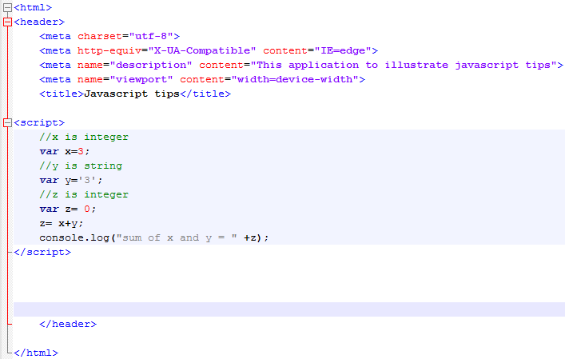
Casting
X is integer
Y is string
Z is integer
- We use “+” operation to calculate the sum of X and Ys
Notes:
This is a sample Picture with Caption slide ideal for including a picture with a brief descriptive statement.
To Replace the Picture on this Sample Slide (this applies to all slides in this template that contain replaceable pictures)
Select the sample picture and press Delete. Click the icon inside the shape to open the Insert Picture dialog box. Navigate to the location where the picture is stored, select desired picture and click on the Insert button to fit the image proportionally within the shape.
Note: Do not right-click the image to change the picture inside the picture placeholder. This will change the frame size of the picture placeholder. Instead, follow the steps outlined above.
Tip: use the Crop tool to reposition a picture within a placeholder. From the Picture Tools Format tab on the ribbon, click the Crop button. Click and drag the picture within the placeholder to reposition. To scale the picture within the placeholder (while Crop is active), grab a round corner handle and drag to resize. Hold Shift key to constrain picture aspect ratio when resizing.

Slide 33

Casting
Here we find that javascript converts the integer to string and concatenate them as string.
This happens although the z is integer !!
So you may need to use === before you do this calculation to do explicate conversation
Notes:
This is a sample Picture with Caption slide ideal for including a picture with a brief descriptive statement.
To Replace the Picture on this Sample Slide (this applies to all slides in this template that contain replaceable pictures)
Select the sample picture and press Delete. Click the icon inside the shape to open the Insert Picture dialog box. Navigate to the location where the picture is stored, select desired picture and click on the Insert button to fit the image proportionally within the shape.
Note: Do not right-click the image to change the picture inside the picture placeholder. This will change the frame size of the picture placeholder. Instead, follow the steps outlined above.
Tip: use the Crop tool to reposition a picture within a placeholder. From the Picture Tools Format tab on the ribbon, click the Crop button. Click and drag the picture within the placeholder to reposition. To scale the picture within the placeholder (while Crop is active), grab a round corner handle and drag to resize. Hold Shift key to constrain picture aspect ratio when resizing.

Slide 34
Casting
X is integer
Y is string
Z is integer
- We use “+” operation to calculate the sum of X and Ys
Notes:
This is a sample Picture with Caption slide ideal for including a picture with a brief descriptive statement.
To Replace the Picture on this Sample Slide (this applies to all slides in this template that contain replaceable pictures)
Select the sample picture and press Delete. Click the icon inside the shape to open the Insert Picture dialog box. Navigate to the location where the picture is stored, select desired picture and click on the Insert button to fit the image proportionally within the shape.
Note: Do not right-click the image to change the picture inside the picture placeholder. This will change the frame size of the picture placeholder. Instead, follow the steps outlined above.
Tip: use the Crop tool to reposition a picture within a placeholder. From the Picture Tools Format tab on the ribbon, click the Crop button. Click and drag the picture within the placeholder to reposition. To scale the picture within the placeholder (while Crop is active), grab a round corner handle and drag to resize. Hold Shift key to constrain picture aspect ratio when resizing.

Slide 35
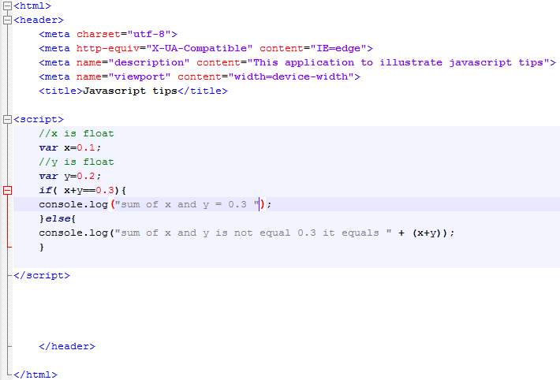
Floating equality
X is float =0.1
Y is float=0.2
We try to check if (x+y = 0.3 ) or not
If no the console will log the real sum
Notes:
This is a sample Picture with Caption slide ideal for including a picture with a brief descriptive statement.
To Replace the Picture on this Sample Slide (this applies to all slides in this template that contain replaceable pictures)
Select the sample picture and press Delete. Click the icon inside the shape to open the Insert Picture dialog box. Navigate to the location where the picture is stored, select desired picture and click on the Insert button to fit the image proportionally within the shape.
Note: Do not right-click the image to change the picture inside the picture placeholder. This will change the frame size of the picture placeholder. Instead, follow the steps outlined above.
Tip: use the Crop tool to reposition a picture within a placeholder. From the Picture Tools Format tab on the ribbon, click the Crop button. Click and drag the picture within the placeholder to reposition. To scale the picture within the placeholder (while Crop is active), grab a round corner handle and drag to resize. Hold Shift key to constrain picture aspect ratio when resizing.

Slide 36

Floating equality
The real sum is 0.30000000000000000004
Floating number implementation is not so accurate , may be there is a very little fraction stored with the number
You can use toFixed() or toPrecision() function to specify the accuracy
Notes:
This is a sample Picture with Caption slide ideal for including a picture with a brief descriptive statement.
To Replace the Picture on this Sample Slide (this applies to all slides in this template that contain replaceable pictures)
Select the sample picture and press Delete. Click the icon inside the shape to open the Insert Picture dialog box. Navigate to the location where the picture is stored, select desired picture and click on the Insert button to fit the image proportionally within the shape.
Note: Do not right-click the image to change the picture inside the picture placeholder. This will change the frame size of the picture placeholder. Instead, follow the steps outlined above.
Tip: use the Crop tool to reposition a picture within a placeholder. From the Picture Tools Format tab on the ribbon, click the Crop button. Click and drag the picture within the placeholder to reposition. To scale the picture within the placeholder (while Crop is active), grab a round corner handle and drag to resize. Hold Shift key to constrain picture aspect ratio when resizing.

Slide 37
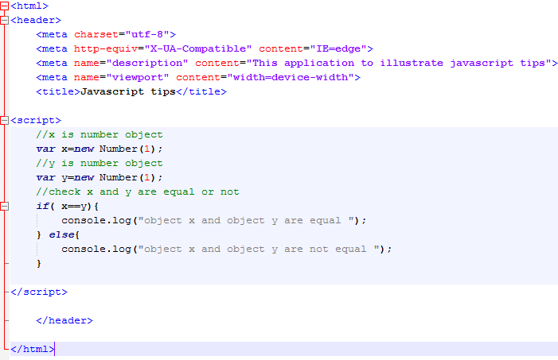
Equal operation between Objects
X is number object
Y is number object
We try to check if X equals y by == operation
Notes:
This is a sample Picture with Caption slide ideal for including a picture with a brief descriptive statement.
To Replace the Picture on this Sample Slide (this applies to all slides in this template that contain replaceable pictures)
Select the sample picture and press Delete. Click the icon inside the shape to open the Insert Picture dialog box. Navigate to the location where the picture is stored, select desired picture and click on the Insert button to fit the image proportionally within the shape.
Note: Do not right-click the image to change the picture inside the picture placeholder. This will change the frame size of the picture placeholder. Instead, follow the steps outlined above.
Tip: use the Crop tool to reposition a picture within a placeholder. From the Picture Tools Format tab on the ribbon, click the Crop button. Click and drag the picture within the placeholder to reposition. To scale the picture within the placeholder (while Crop is active), grab a round corner handle and drag to resize. Hold Shift key to constrain picture aspect ratio when resizing.

Slide 38

Equal operation between Objects
X object doesn’t equal Y object because javascript doesn’t make automatic casting as java and also object doesn’t have equals method as java
Notes:
This is a sample Picture with Caption slide ideal for including a picture with a brief descriptive statement.
To Replace the Picture on this Sample Slide (this applies to all slides in this template that contain replaceable pictures)
Select the sample picture and press Delete. Click the icon inside the shape to open the Insert Picture dialog box. Navigate to the location where the picture is stored, select desired picture and click on the Insert button to fit the image proportionally within the shape.
Note: Do not right-click the image to change the picture inside the picture placeholder. This will change the frame size of the picture placeholder. Instead, follow the steps outlined above.
Tip: use the Crop tool to reposition a picture within a placeholder. From the Picture Tools Format tab on the ribbon, click the Crop button. Click and drag the picture within the placeholder to reposition. To scale the picture within the placeholder (while Crop is active), grab a round corner handle and drag to resize. Hold Shift key to constrain picture aspect ratio when resizing.

Slide 39
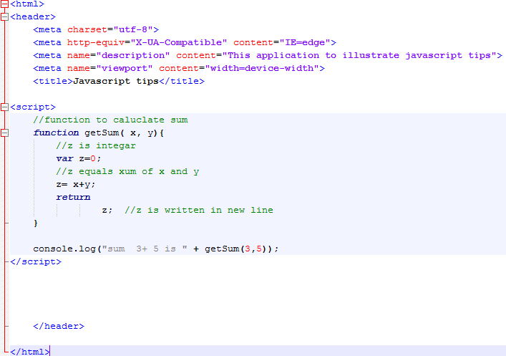
Optional Semi column
We define function to sum x and y
We ad extra “enter” between return and z but we add “;” in the end
Notes:
This is a sample Picture with Caption slide ideal for including a picture with a brief descriptive statement.
To Replace the Picture on this Sample Slide (this applies to all slides in this template that contain replaceable pictures)
Select the sample picture and press Delete. Click the icon inside the shape to open the Insert Picture dialog box. Navigate to the location where the picture is stored, select desired picture and click on the Insert button to fit the image proportionally within the shape.
Note: Do not right-click the image to change the picture inside the picture placeholder. This will change the frame size of the picture placeholder. Instead, follow the steps outlined above.
Tip: use the Crop tool to reposition a picture within a placeholder. From the Picture Tools Format tab on the ribbon, click the Crop button. Click and drag the picture within the placeholder to reposition. To scale the picture within the placeholder (while Crop is active), grab a round corner handle and drag to resize. Hold Shift key to constrain picture aspect ratio when resizing.

Slide 40

Optional Semi column
“getSum” method returns undefined
We got also alert that there is extra statement after return
Notes:
This is a sample Picture with Caption slide ideal for including a picture with a brief descriptive statement.
To Replace the Picture on this Sample Slide (this applies to all slides in this template that contain replaceable pictures)
Select the sample picture and press Delete. Click the icon inside the shape to open the Insert Picture dialog box. Navigate to the location where the picture is stored, select desired picture and click on the Insert button to fit the image proportionally within the shape.
Note: Do not right-click the image to change the picture inside the picture placeholder. This will change the frame size of the picture placeholder. Instead, follow the steps outlined above.
Tip: use the Crop tool to reposition a picture within a placeholder. From the Picture Tools Format tab on the ribbon, click the Crop button. Click and drag the picture within the placeholder to reposition. To scale the picture within the placeholder (while Crop is active), grab a round corner handle and drag to resize. Hold Shift key to constrain picture aspect ratio when resizing.

Slide 41
Optional Semi column
Semi column in javascript is optional
Javascript tries to interpret the line to complete statement . If it can’t then it will go to next line.
Notes:
This is a sample Picture with Caption slide ideal for including a picture with a brief descriptive statement.
To Replace the Picture on this Sample Slide (this applies to all slides in this template that contain replaceable pictures)
Select the sample picture and press Delete. Click the icon inside the shape to open the Insert Picture dialog box. Navigate to the location where the picture is stored, select desired picture and click on the Insert button to fit the image proportionally within the shape.
Note: Do not right-click the image to change the picture inside the picture placeholder. This will change the frame size of the picture placeholder. Instead, follow the steps outlined above.
Tip: use the Crop tool to reposition a picture within a placeholder. From the Picture Tools Format tab on the ribbon, click the Crop button. Click and drag the picture within the placeholder to reposition. To scale the picture within the placeholder (while Crop is active), grab a round corner handle and drag to resize. Hold Shift key to constrain picture aspect ratio when resizing.

Slide 42
Thank you
Ayman.el-shayeb@hpe.com

