Slide 1

Javascript Tips 2
Ayman El-Shayeb, Specialist in Egypt Center
Nov 26, 2015
Notes:
This is a sample Title Slide with Picture ideal for including a dark picture with a brief title and subtitle.
A selection of pre-approved title slides are available in the HPE Title Slide Library. The location of the library will be communicated later.
To insert a slide with a different picture from the HPE Title Slide Library:
Open the file HPE_16x9_Title_Slide_Library.pptx
From the Slide thumbnails pane, select the slide with the picture you would like to use in your presentation and click Copy (Ctrl+C)
Open a copy of the new HPE 16x9 template (Standard or Events) or your current presentation
In the Slide thumbnails pane, click Paste (Ctrl+V)
A Paste Options clipboard icon will appear. Click the icon and select Keep Source Formatting. (Ctrl+K)

Slide 2
Agenda
Access array by random number
Using (negative index, fraction index or string index ) in array
Length property of the array
IndexOf is type sensitive
Slice method
Delete VS splice
instanceof VS isArray
forEach, map , filter, some, every, reduce methods

Slide 3
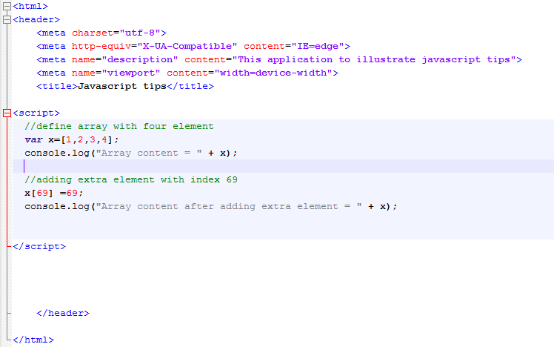
Access array by random number
We define array with four elements
We add new one with positive index
69
Notes:
This is a sample Picture with Caption slide ideal for including a picture with a brief descriptive statement.
To Replace the Picture on this Sample Slide (this applies to all slides in this template that contain replaceable pictures)
Select the sample picture and press Delete. Click the icon inside the shape to open the Insert Picture dialog box. Navigate to the location where the picture is stored, select desired picture and click on the Insert button to fit the image proportionally within the shape.
Note: Do not right-click the image to change the picture inside the picture placeholder. This will change the frame size of the picture placeholder. Instead, follow the steps outlined above.
Tip: use the Crop tool to reposition a picture within a placeholder. From the Picture Tools Format tab on the ribbon, click the Crop button. Click and drag the picture within the placeholder to reposition. To scale the picture within the placeholder (while Crop is active), grab a round corner handle and drag to resize. Hold Shift key to constrain picture aspect ratio when resizing.

Slide 4
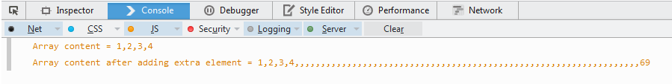
Access array by random number
-javaScript adds empty elements until the last index we add
-Use push() to add extra elements
Notes:
This is a sample Picture with Caption slide ideal for including a picture with a brief descriptive statement.
To Replace the Picture on this Sample Slide (this applies to all slides in this template that contain replaceable pictures)
Select the sample picture and press Delete. Click the icon inside the shape to open the Insert Picture dialog box. Navigate to the location where the picture is stored, select desired picture and click on the Insert button to fit the image proportionally within the shape.
Note: Do not right-click the image to change the picture inside the picture placeholder. This will change the frame size of the picture placeholder. Instead, follow the steps outlined above.
Tip: use the Crop tool to reposition a picture within a placeholder. From the Picture Tools Format tab on the ribbon, click the Crop button. Click and drag the picture within the placeholder to reposition. To scale the picture within the placeholder (while Crop is active), grab a round corner handle and drag to resize. Hold Shift key to constrain picture aspect ratio when resizing.

Slide 5
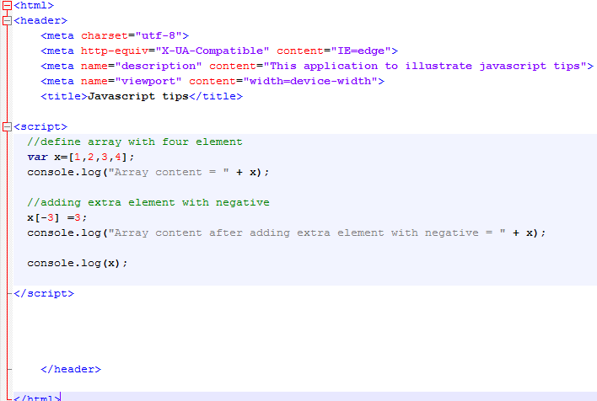
Using fractions , sting , negative index in array
We define array with four element
We add extra element with negative index
Notes:
This is a sample Picture with Caption slide ideal for including a picture with a brief descriptive statement.
To Replace the Picture on this Sample Slide (this applies to all slides in this template that contain replaceable pictures)
Select the sample picture and press Delete. Click the icon inside the shape to open the Insert Picture dialog box. Navigate to the location where the picture is stored, select desired picture and click on the Insert button to fit the image proportionally within the shape.
Note: Do not right-click the image to change the picture inside the picture placeholder. This will change the frame size of the picture placeholder. Instead, follow the steps outlined above.
Tip: use the Crop tool to reposition a picture within a placeholder. From the Picture Tools Format tab on the ribbon, click the Crop button. Click and drag the picture within the placeholder to reposition. To scale the picture within the placeholder (while Crop is active), grab a round corner handle and drag to resize. Hold Shift key to constrain picture aspect ratio when resizing.

Slide 6
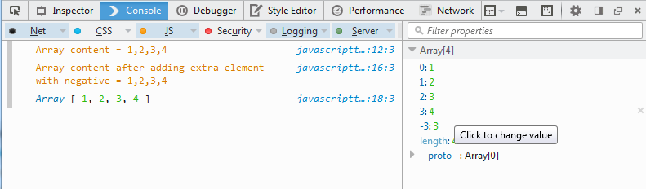
Using fractions , sting , negative index in array
- We will not find the -3 element.
-We can’t access -3 element by iteration through elements
Notes:
This is a sample Picture with Caption slide ideal for including a picture with a brief descriptive statement.
To Replace the Picture on this Sample Slide (this applies to all slides in this template that contain replaceable pictures)
Select the sample picture and press Delete. Click the icon inside the shape to open the Insert Picture dialog box. Navigate to the location where the picture is stored, select desired picture and click on the Insert button to fit the image proportionally within the shape.
Note: Do not right-click the image to change the picture inside the picture placeholder. This will change the frame size of the picture placeholder. Instead, follow the steps outlined above.
Tip: use the Crop tool to reposition a picture within a placeholder. From the Picture Tools Format tab on the ribbon, click the Crop button. Click and drag the picture within the placeholder to reposition. To scale the picture within the placeholder (while Crop is active), grab a round corner handle and drag to resize. Hold Shift key to constrain picture aspect ratio when resizing.

Slide 7
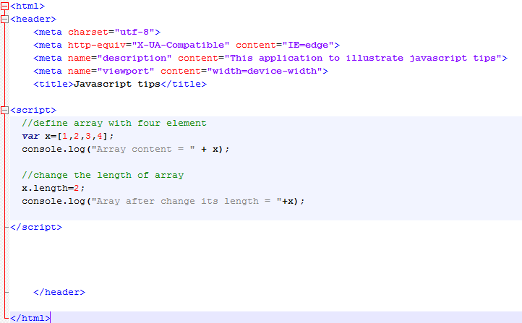
Length property of the array
We define the array by 4 elements
We change the length to 2
Notes:
This is a sample Picture with Caption slide ideal for including a picture with a brief descriptive statement.
To Replace the Picture on this Sample Slide (this applies to all slides in this template that contain replaceable pictures)
Select the sample picture and press Delete. Click the icon inside the shape to open the Insert Picture dialog box. Navigate to the location where the picture is stored, select desired picture and click on the Insert button to fit the image proportionally within the shape.
Note: Do not right-click the image to change the picture inside the picture placeholder. This will change the frame size of the picture placeholder. Instead, follow the steps outlined above.
Tip: use the Crop tool to reposition a picture within a placeholder. From the Picture Tools Format tab on the ribbon, click the Crop button. Click and drag the picture within the placeholder to reposition. To scale the picture within the placeholder (while Crop is active), grab a round corner handle and drag to resize. Hold Shift key to constrain picture aspect ratio when resizing.

Slide 8
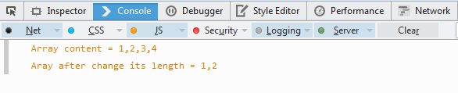
Length property of the array
Array becomes 2 element only
Notes:
This is a sample Picture with Caption slide ideal for including a picture with a brief descriptive statement.
To Replace the Picture on this Sample Slide (this applies to all slides in this template that contain replaceable pictures)
Select the sample picture and press Delete. Click the icon inside the shape to open the Insert Picture dialog box. Navigate to the location where the picture is stored, select desired picture and click on the Insert button to fit the image proportionally within the shape.
Note: Do not right-click the image to change the picture inside the picture placeholder. This will change the frame size of the picture placeholder. Instead, follow the steps outlined above.
Tip: use the Crop tool to reposition a picture within a placeholder. From the Picture Tools Format tab on the ribbon, click the Crop button. Click and drag the picture within the placeholder to reposition. To scale the picture within the placeholder (while Crop is active), grab a round corner handle and drag to resize. Hold Shift key to constrain picture aspect ratio when resizing.

Slide 9
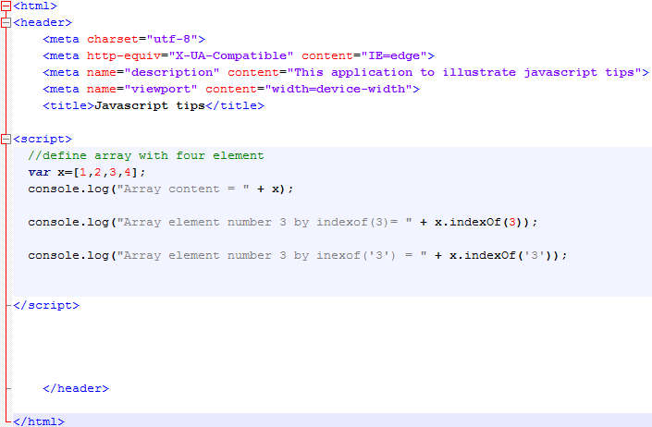
IndexOf is type sensitive
we try to use indexOf by number
We try to use indexOf by string with number value
Notes:
This is a sample Picture with Caption slide ideal for including a picture with a brief descriptive statement.
To Replace the Picture on this Sample Slide (this applies to all slides in this template that contain replaceable pictures)
Select the sample picture and press Delete. Click the icon inside the shape to open the Insert Picture dialog box. Navigate to the location where the picture is stored, select desired picture and click on the Insert button to fit the image proportionally within the shape.
Note: Do not right-click the image to change the picture inside the picture placeholder. This will change the frame size of the picture placeholder. Instead, follow the steps outlined above.
Tip: use the Crop tool to reposition a picture within a placeholder. From the Picture Tools Format tab on the ribbon, click the Crop button. Click and drag the picture within the placeholder to reposition. To scale the picture within the placeholder (while Crop is active), grab a round corner handle and drag to resize. Hold Shift key to constrain picture aspect ratio when resizing.

Slide 10
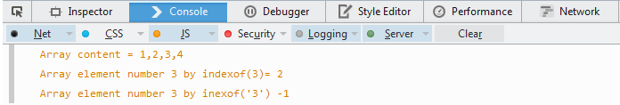
IndexOf is type sensitive
IndexOf(3) returns 2
indexOf(‘3’) returns -1 ( not found)
Notes:
This is a sample Picture with Caption slide ideal for including a picture with a brief descriptive statement.
To Replace the Picture on this Sample Slide (this applies to all slides in this template that contain replaceable pictures)
Select the sample picture and press Delete. Click the icon inside the shape to open the Insert Picture dialog box. Navigate to the location where the picture is stored, select desired picture and click on the Insert button to fit the image proportionally within the shape.
Note: Do not right-click the image to change the picture inside the picture placeholder. This will change the frame size of the picture placeholder. Instead, follow the steps outlined above.
Tip: use the Crop tool to reposition a picture within a placeholder. From the Picture Tools Format tab on the ribbon, click the Crop button. Click and drag the picture within the placeholder to reposition. To scale the picture within the placeholder (while Crop is active), grab a round corner handle and drag to resize. Hold Shift key to constrain picture aspect ratio when resizing.

Slide 11
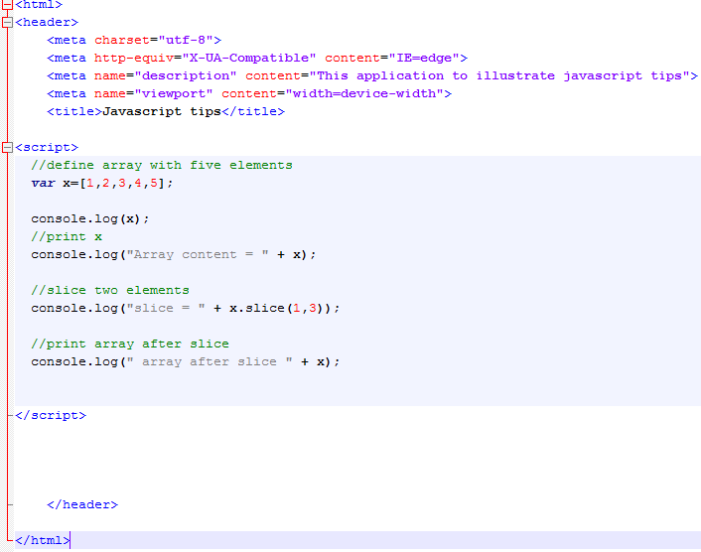
Slice method
Here, we have an array of five elements
We slice 2 elements from the array
We print the elements after slicing
Notes:
This is a sample Picture with Caption slide ideal for including a picture with a brief descriptive statement.
To Replace the Picture on this Sample Slide (this applies to all slides in this template that contain replaceable pictures)
Select the sample picture and press Delete. Click the icon inside the shape to open the Insert Picture dialog box. Navigate to the location where the picture is stored, select desired picture and click on the Insert button to fit the image proportionally within the shape.
Note: Do not right-click the image to change the picture inside the picture placeholder. This will change the frame size of the picture placeholder. Instead, follow the steps outlined above.
Tip: use the Crop tool to reposition a picture within a placeholder. From the Picture Tools Format tab on the ribbon, click the Crop button. Click and drag the picture within the placeholder to reposition. To scale the picture within the placeholder (while Crop is active), grab a round corner handle and drag to resize. Hold Shift key to constrain picture aspect ratio when resizing.

Slide 12
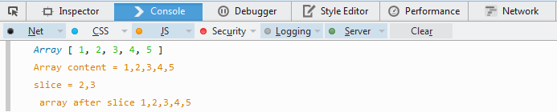
Slice method
The original array is not affected , this means that slice returns new array and if the slice returned array is so big it will affect the memory
Notes:
This is a sample Picture with Caption slide ideal for including a picture with a brief descriptive statement.
To Replace the Picture on this Sample Slide (this applies to all slides in this template that contain replaceable pictures)
Select the sample picture and press Delete. Click the icon inside the shape to open the Insert Picture dialog box. Navigate to the location where the picture is stored, select desired picture and click on the Insert button to fit the image proportionally within the shape.
Note: Do not right-click the image to change the picture inside the picture placeholder. This will change the frame size of the picture placeholder. Instead, follow the steps outlined above.
Tip: use the Crop tool to reposition a picture within a placeholder. From the Picture Tools Format tab on the ribbon, click the Crop button. Click and drag the picture within the placeholder to reposition. To scale the picture within the placeholder (while Crop is active), grab a round corner handle and drag to resize. Hold Shift key to constrain picture aspect ratio when resizing.

Slide 13
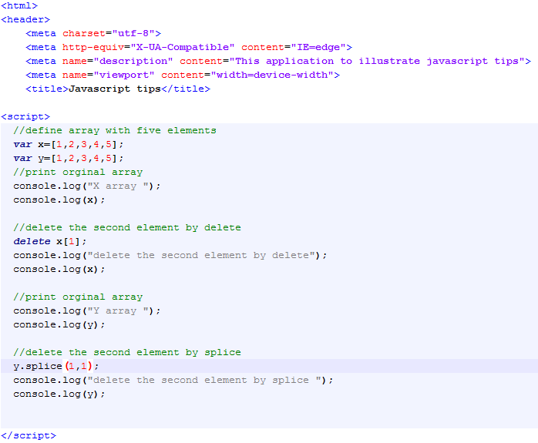
Delete VS splice
Here we have two arrays x, y
We first delete the second element from x by “delete
Then we delete the second element from y by “splice”
Notes:
This is a sample Picture with Caption slide ideal for including a picture with a brief descriptive statement.
To Replace the Picture on this Sample Slide (this applies to all slides in this template that contain replaceable pictures)
Select the sample picture and press Delete. Click the icon inside the shape to open the Insert Picture dialog box. Navigate to the location where the picture is stored, select desired picture and click on the Insert button to fit the image proportionally within the shape.
Note: Do not right-click the image to change the picture inside the picture placeholder. This will change the frame size of the picture placeholder. Instead, follow the steps outlined above.
Tip: use the Crop tool to reposition a picture within a placeholder. From the Picture Tools Format tab on the ribbon, click the Crop button. Click and drag the picture within the placeholder to reposition. To scale the picture within the placeholder (while Crop is active), grab a round corner handle and drag to resize. Hold Shift key to constrain picture aspect ratio when resizing.

Slide 14
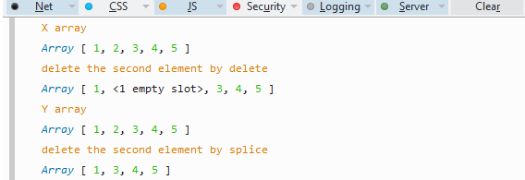
Delete VS splice
“delete” removes the second element and replace it by empty slots. The length of array still as it is
Splice removes the element and decreases its size
Notes:
This is a sample Picture with Caption slide ideal for including a picture with a brief descriptive statement.
To Replace the Picture on this Sample Slide (this applies to all slides in this template that contain replaceable pictures)
Select the sample picture and press Delete. Click the icon inside the shape to open the Insert Picture dialog box. Navigate to the location where the picture is stored, select desired picture and click on the Insert button to fit the image proportionally within the shape.
Note: Do not right-click the image to change the picture inside the picture placeholder. This will change the frame size of the picture placeholder. Instead, follow the steps outlined above.
Tip: use the Crop tool to reposition a picture within a placeholder. From the Picture Tools Format tab on the ribbon, click the Crop button. Click and drag the picture within the placeholder to reposition. To scale the picture within the placeholder (while Crop is active), grab a round corner handle and drag to resize. Hold Shift key to constrain picture aspect ratio when resizing.

Slide 15
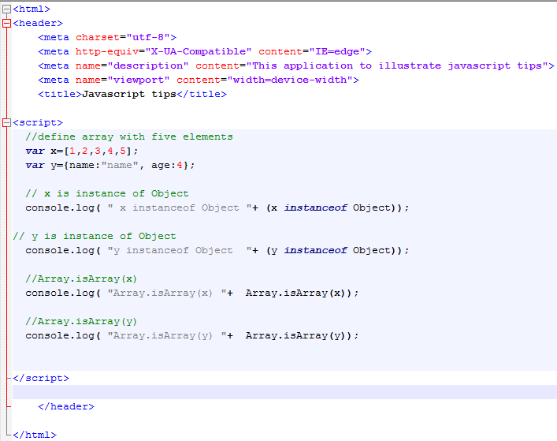
Insteanceof VS isArray
Here we have two variable
X is array and y is object
- We try to exam the results of instanceof and results of Array.isArray
Notes:
This is a sample Picture with Caption slide ideal for including a picture with a brief descriptive statement.
To Replace the Picture on this Sample Slide (this applies to all slides in this template that contain replaceable pictures)
Select the sample picture and press Delete. Click the icon inside the shape to open the Insert Picture dialog box. Navigate to the location where the picture is stored, select desired picture and click on the Insert button to fit the image proportionally within the shape.
Note: Do not right-click the image to change the picture inside the picture placeholder. This will change the frame size of the picture placeholder. Instead, follow the steps outlined above.
Tip: use the Crop tool to reposition a picture within a placeholder. From the Picture Tools Format tab on the ribbon, click the Crop button. Click and drag the picture within the placeholder to reposition. To scale the picture within the placeholder (while Crop is active), grab a round corner handle and drag to resize. Hold Shift key to constrain picture aspect ratio when resizing.

Slide 16
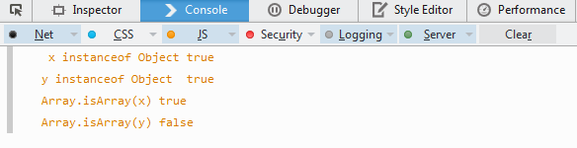
Insteanceof VS isArray
Insteanceof returns true when we tests that Object y is an object
It also returns true when we tests that Array x is an object !!
Array.isArray returns true only in case of x
Notes:
This is a sample Picture with Caption slide ideal for including a picture with a brief descriptive statement.
To Replace the Picture on this Sample Slide (this applies to all slides in this template that contain replaceable pictures)
Select the sample picture and press Delete. Click the icon inside the shape to open the Insert Picture dialog box. Navigate to the location where the picture is stored, select desired picture and click on the Insert button to fit the image proportionally within the shape.
Note: Do not right-click the image to change the picture inside the picture placeholder. This will change the frame size of the picture placeholder. Instead, follow the steps outlined above.
Tip: use the Crop tool to reposition a picture within a placeholder. From the Picture Tools Format tab on the ribbon, click the Crop button. Click and drag the picture within the placeholder to reposition. To scale the picture within the placeholder (while Crop is active), grab a round corner handle and drag to resize. Hold Shift key to constrain picture aspect ratio when resizing.

Slide 17
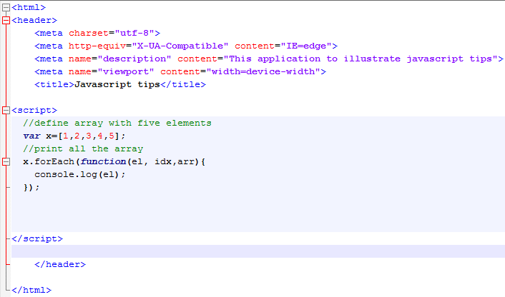
forEach method
Here , we try to print array elements one by one using “forEach”
forEach takes callback function as a parameter to apply to each element
“el” is the current element
“idx” is the element index
“arr” is the array itself
Notes:
This is a sample Picture with Caption slide ideal for including a picture with a brief descriptive statement.
To Replace the Picture on this Sample Slide (this applies to all slides in this template that contain replaceable pictures)
Select the sample picture and press Delete. Click the icon inside the shape to open the Insert Picture dialog box. Navigate to the location where the picture is stored, select desired picture and click on the Insert button to fit the image proportionally within the shape.
Note: Do not right-click the image to change the picture inside the picture placeholder. This will change the frame size of the picture placeholder. Instead, follow the steps outlined above.
Tip: use the Crop tool to reposition a picture within a placeholder. From the Picture Tools Format tab on the ribbon, click the Crop button. Click and drag the picture within the placeholder to reposition. To scale the picture within the placeholder (while Crop is active), grab a round corner handle and drag to resize. Hold Shift key to constrain picture aspect ratio when resizing.

Slide 18
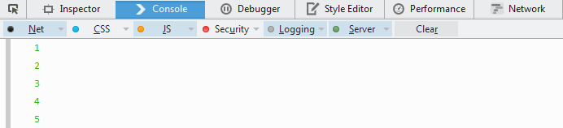
forEach method
Here, we find the printing of each array element
Notes:
This is a sample Picture with Caption slide ideal for including a picture with a brief descriptive statement.
To Replace the Picture on this Sample Slide (this applies to all slides in this template that contain replaceable pictures)
Select the sample picture and press Delete. Click the icon inside the shape to open the Insert Picture dialog box. Navigate to the location where the picture is stored, select desired picture and click on the Insert button to fit the image proportionally within the shape.
Note: Do not right-click the image to change the picture inside the picture placeholder. This will change the frame size of the picture placeholder. Instead, follow the steps outlined above.
Tip: use the Crop tool to reposition a picture within a placeholder. From the Picture Tools Format tab on the ribbon, click the Crop button. Click and drag the picture within the placeholder to reposition. To scale the picture within the placeholder (while Crop is active), grab a round corner handle and drag to resize. Hold Shift key to constrain picture aspect ratio when resizing.

Slide 19
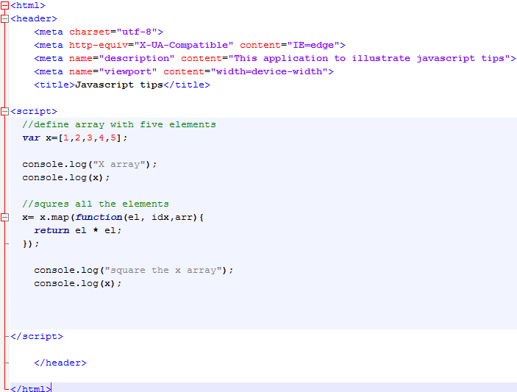
Map method
Here , we try to square each element in the array by map method
Map takes callback function as a parameter to apply to each element
“el” is the current element
“idx” is the element index
“arr” is the array itself
Notes:
This is a sample Picture with Caption slide ideal for including a picture with a brief descriptive statement.
To Replace the Picture on this Sample Slide (this applies to all slides in this template that contain replaceable pictures)
Select the sample picture and press Delete. Click the icon inside the shape to open the Insert Picture dialog box. Navigate to the location where the picture is stored, select desired picture and click on the Insert button to fit the image proportionally within the shape.
Note: Do not right-click the image to change the picture inside the picture placeholder. This will change the frame size of the picture placeholder. Instead, follow the steps outlined above.
Tip: use the Crop tool to reposition a picture within a placeholder. From the Picture Tools Format tab on the ribbon, click the Crop button. Click and drag the picture within the placeholder to reposition. To scale the picture within the placeholder (while Crop is active), grab a round corner handle and drag to resize. Hold Shift key to constrain picture aspect ratio when resizing.

Slide 20
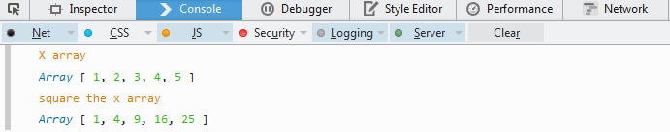
Map method
Each element is squared successfully
Notes:
This is a sample Picture with Caption slide ideal for including a picture with a brief descriptive statement.
To Replace the Picture on this Sample Slide (this applies to all slides in this template that contain replaceable pictures)
Select the sample picture and press Delete. Click the icon inside the shape to open the Insert Picture dialog box. Navigate to the location where the picture is stored, select desired picture and click on the Insert button to fit the image proportionally within the shape.
Note: Do not right-click the image to change the picture inside the picture placeholder. This will change the frame size of the picture placeholder. Instead, follow the steps outlined above.
Tip: use the Crop tool to reposition a picture within a placeholder. From the Picture Tools Format tab on the ribbon, click the Crop button. Click and drag the picture within the placeholder to reposition. To scale the picture within the placeholder (while Crop is active), grab a round corner handle and drag to resize. Hold Shift key to constrain picture aspect ratio when resizing.

Slide 21
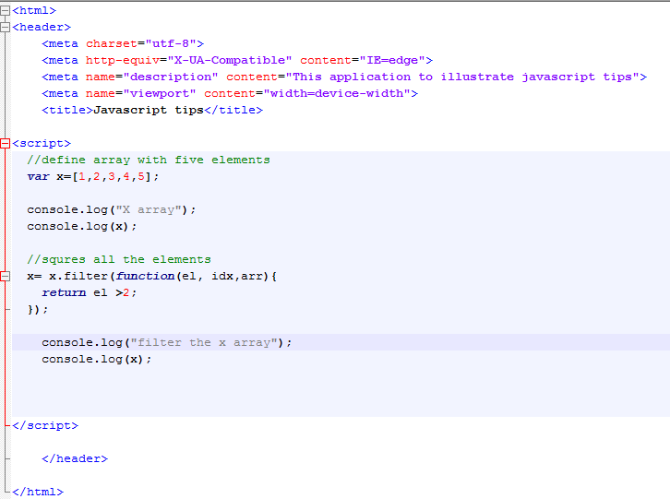
Filter method
Here , we try to filter array to return back only elements >2
Filter takes callback function as a parameter to apply to each element
“el” is the current element
“idx” is the element index
“arr” is the array itself
Notes:
This is a sample Picture with Caption slide ideal for including a picture with a brief descriptive statement.
To Replace the Picture on this Sample Slide (this applies to all slides in this template that contain replaceable pictures)
Select the sample picture and press Delete. Click the icon inside the shape to open the Insert Picture dialog box. Navigate to the location where the picture is stored, select desired picture and click on the Insert button to fit the image proportionally within the shape.
Note: Do not right-click the image to change the picture inside the picture placeholder. This will change the frame size of the picture placeholder. Instead, follow the steps outlined above.
Tip: use the Crop tool to reposition a picture within a placeholder. From the Picture Tools Format tab on the ribbon, click the Crop button. Click and drag the picture within the placeholder to reposition. To scale the picture within the placeholder (while Crop is active), grab a round corner handle and drag to resize. Hold Shift key to constrain picture aspect ratio when resizing.

Slide 22
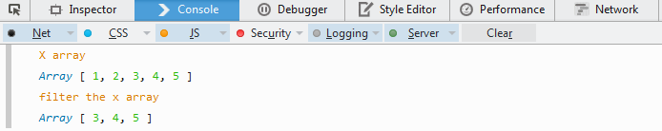
Filter method
Insteanceof returns true when we tests that Object y is an object
It also returns true when we tests that Array x is an object !!
Array.isArray returns true only in case of x
Notes:
This is a sample Picture with Caption slide ideal for including a picture with a brief descriptive statement.
To Replace the Picture on this Sample Slide (this applies to all slides in this template that contain replaceable pictures)
Select the sample picture and press Delete. Click the icon inside the shape to open the Insert Picture dialog box. Navigate to the location where the picture is stored, select desired picture and click on the Insert button to fit the image proportionally within the shape.
Note: Do not right-click the image to change the picture inside the picture placeholder. This will change the frame size of the picture placeholder. Instead, follow the steps outlined above.
Tip: use the Crop tool to reposition a picture within a placeholder. From the Picture Tools Format tab on the ribbon, click the Crop button. Click and drag the picture within the placeholder to reposition. To scale the picture within the placeholder (while Crop is active), grab a round corner handle and drag to resize. Hold Shift key to constrain picture aspect ratio when resizing.

Slide 23
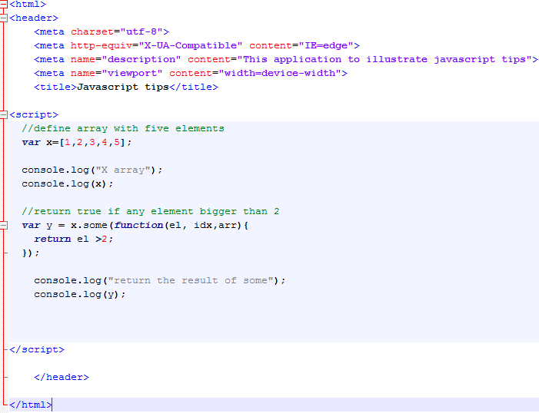
Some method
Here , we try to exam array elements . If any of them >2 or not
Notes:
This is a sample Picture with Caption slide ideal for including a picture with a brief descriptive statement.
To Replace the Picture on this Sample Slide (this applies to all slides in this template that contain replaceable pictures)
Select the sample picture and press Delete. Click the icon inside the shape to open the Insert Picture dialog box. Navigate to the location where the picture is stored, select desired picture and click on the Insert button to fit the image proportionally within the shape.
Note: Do not right-click the image to change the picture inside the picture placeholder. This will change the frame size of the picture placeholder. Instead, follow the steps outlined above.
Tip: use the Crop tool to reposition a picture within a placeholder. From the Picture Tools Format tab on the ribbon, click the Crop button. Click and drag the picture within the placeholder to reposition. To scale the picture within the placeholder (while Crop is active), grab a round corner handle and drag to resize. Hold Shift key to constrain picture aspect ratio when resizing.

Slide 24
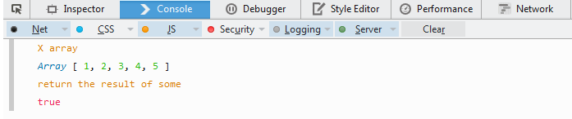
Some method
Javascript finds some elements>2
Notes:
This is a sample Picture with Caption slide ideal for including a picture with a brief descriptive statement.
To Replace the Picture on this Sample Slide (this applies to all slides in this template that contain replaceable pictures)
Select the sample picture and press Delete. Click the icon inside the shape to open the Insert Picture dialog box. Navigate to the location where the picture is stored, select desired picture and click on the Insert button to fit the image proportionally within the shape.
Note: Do not right-click the image to change the picture inside the picture placeholder. This will change the frame size of the picture placeholder. Instead, follow the steps outlined above.
Tip: use the Crop tool to reposition a picture within a placeholder. From the Picture Tools Format tab on the ribbon, click the Crop button. Click and drag the picture within the placeholder to reposition. To scale the picture within the placeholder (while Crop is active), grab a round corner handle and drag to resize. Hold Shift key to constrain picture aspect ratio when resizing.

Slide 25
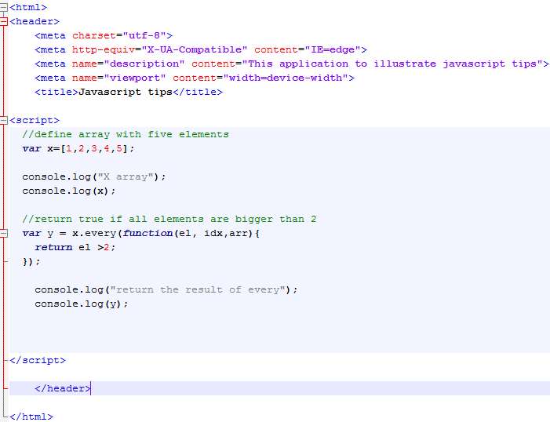
Every method
Here , we try to check if all elements>2
“every” takes callback function as a parameter to apply to each element
“el” is the current element
“idx” is the element index
“arr” is the array itself
Notes:
This is a sample Picture with Caption slide ideal for including a picture with a brief descriptive statement.
To Replace the Picture on this Sample Slide (this applies to all slides in this template that contain replaceable pictures)
Select the sample picture and press Delete. Click the icon inside the shape to open the Insert Picture dialog box. Navigate to the location where the picture is stored, select desired picture and click on the Insert button to fit the image proportionally within the shape.
Note: Do not right-click the image to change the picture inside the picture placeholder. This will change the frame size of the picture placeholder. Instead, follow the steps outlined above.
Tip: use the Crop tool to reposition a picture within a placeholder. From the Picture Tools Format tab on the ribbon, click the Crop button. Click and drag the picture within the placeholder to reposition. To scale the picture within the placeholder (while Crop is active), grab a round corner handle and drag to resize. Hold Shift key to constrain picture aspect ratio when resizing.

Slide 26
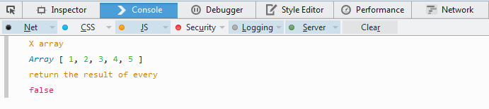
Every method
Javscript finds not all elements bigger than 2 so it returns false
Notes:
This is a sample Picture with Caption slide ideal for including a picture with a brief descriptive statement.
To Replace the Picture on this Sample Slide (this applies to all slides in this template that contain replaceable pictures)
Select the sample picture and press Delete. Click the icon inside the shape to open the Insert Picture dialog box. Navigate to the location where the picture is stored, select desired picture and click on the Insert button to fit the image proportionally within the shape.
Note: Do not right-click the image to change the picture inside the picture placeholder. This will change the frame size of the picture placeholder. Instead, follow the steps outlined above.
Tip: use the Crop tool to reposition a picture within a placeholder. From the Picture Tools Format tab on the ribbon, click the Crop button. Click and drag the picture within the placeholder to reposition. To scale the picture within the placeholder (while Crop is active), grab a round corner handle and drag to resize. Hold Shift key to constrain picture aspect ratio when resizing.

Slide 27
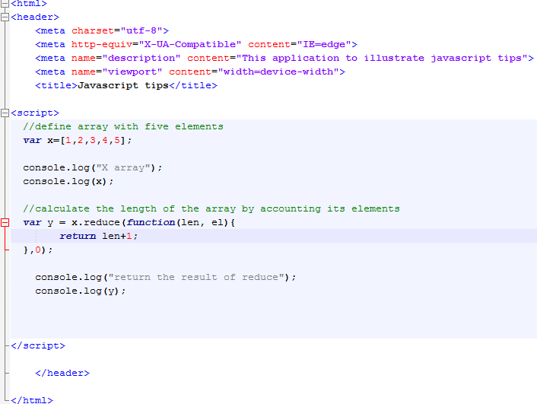
Reduce method
Here , we try to calculate the length of the array by reduce method
“reduce” takes callback function as a parameter to apply to each element and initial value
“len” is any variable that you need to bypass between calling
“el” is an element reference
Notes:
This is a sample Picture with Caption slide ideal for including a picture with a brief descriptive statement.
To Replace the Picture on this Sample Slide (this applies to all slides in this template that contain replaceable pictures)
Select the sample picture and press Delete. Click the icon inside the shape to open the Insert Picture dialog box. Navigate to the location where the picture is stored, select desired picture and click on the Insert button to fit the image proportionally within the shape.
Note: Do not right-click the image to change the picture inside the picture placeholder. This will change the frame size of the picture placeholder. Instead, follow the steps outlined above.
Tip: use the Crop tool to reposition a picture within a placeholder. From the Picture Tools Format tab on the ribbon, click the Crop button. Click and drag the picture within the placeholder to reposition. To scale the picture within the placeholder (while Crop is active), grab a round corner handle and drag to resize. Hold Shift key to constrain picture aspect ratio when resizing.

Slide 28
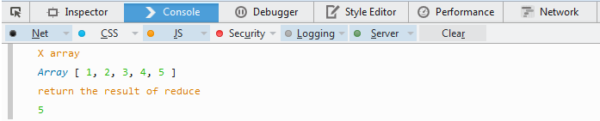
Reduce method
Here , the result is 5 which is the length of the array
Notes:
This is a sample Picture with Caption slide ideal for including a picture with a brief descriptive statement.
To Replace the Picture on this Sample Slide (this applies to all slides in this template that contain replaceable pictures)
Select the sample picture and press Delete. Click the icon inside the shape to open the Insert Picture dialog box. Navigate to the location where the picture is stored, select desired picture and click on the Insert button to fit the image proportionally within the shape.
Note: Do not right-click the image to change the picture inside the picture placeholder. This will change the frame size of the picture placeholder. Instead, follow the steps outlined above.
Tip: use the Crop tool to reposition a picture within a placeholder. From the Picture Tools Format tab on the ribbon, click the Crop button. Click and drag the picture within the placeholder to reposition. To scale the picture within the placeholder (while Crop is active), grab a round corner handle and drag to resize. Hold Shift key to constrain picture aspect ratio when resizing.

Slide 29
Tips
Don’t access array by random number
Don’t use (negative index, fraction index or string index ) to access array
Length property of the array is writable
IndexOf is type sensitive
Slice method returns new array so use it carfully
Delete operation delete elelment in array but doesn’t decrease array size so use splice instead.
use Array.isArray to check the type of variable instead insteadof
forEach, map , filter, some, every, reduce methods are very useful utility methods

Slide 30
Thank you
Ayman.el-shayeb@hpe.com

