Slide 1

Convergence to Expected Value in Repeated Trials
Project-1
MATH-3030-001
Ayman Azad

Slide 2
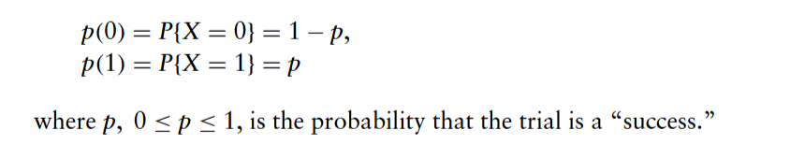
Bernoulli Trials
A Bernoulli trial is a random experiment with two possible outcomes.
Success outcome is 1. Failure is 0.
Notes:
Sheldon M. Ross. (2010). Introduction to Probability Models (10th ed). Academic Press.
This model allows us to compute the expected value and variance exactly, which makes it ideal for studying long-run behavior.

Slide 3
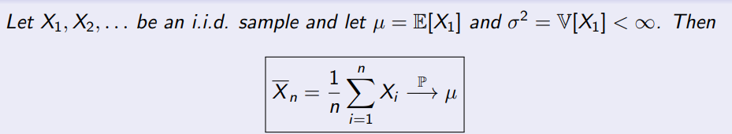
Law of Large Number
The mean of a large sample is close to the mean of distribution.
Notes:
Sheldon M. Ross. (2010). Introduction to Probability Models (10th ed). Academic Press.

Slide 4
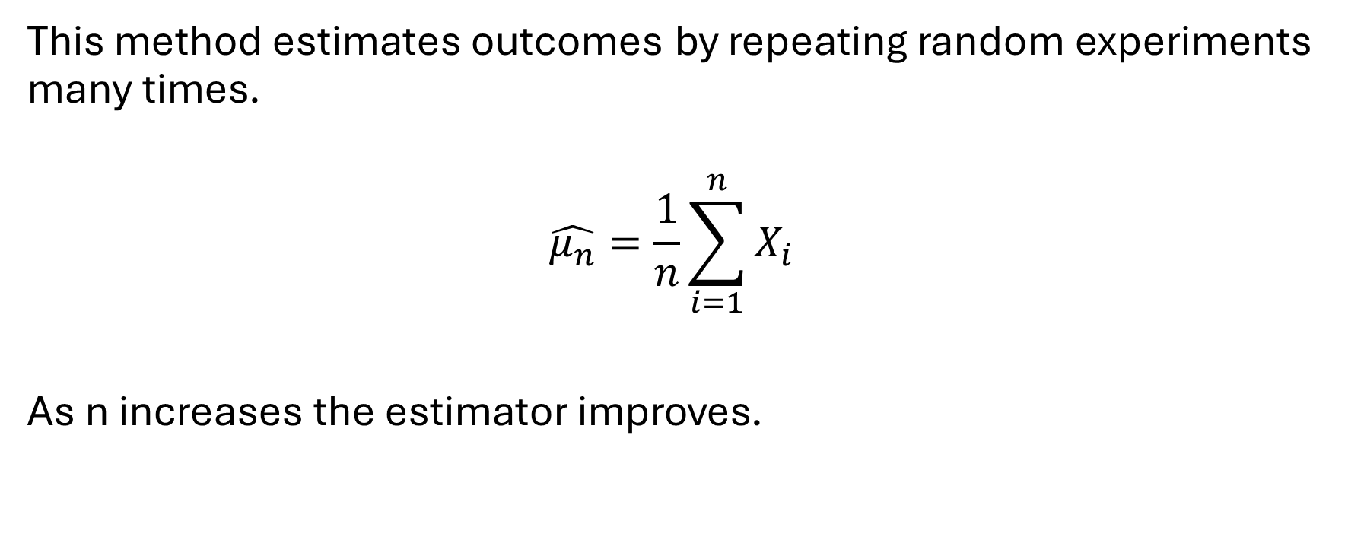
Monte Carlo Method
This method estimates outcomes by repeating random experiments many times.
$$\hat{μ_{n}}=\frac{1}{n}\sum_{i=1}^{n}{X_{i}}$$
As n increases the estimator improves.

Slide 5
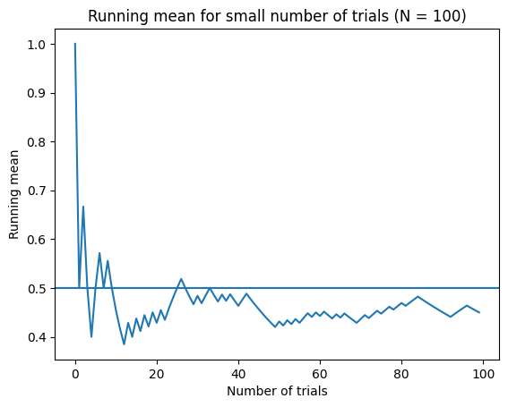
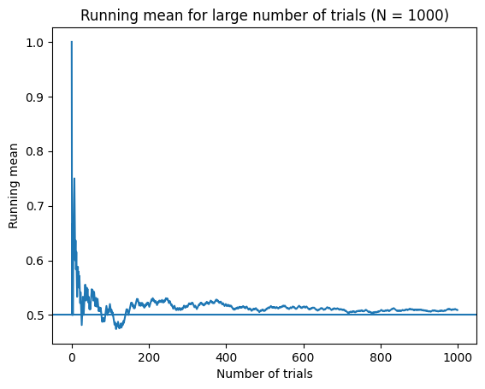
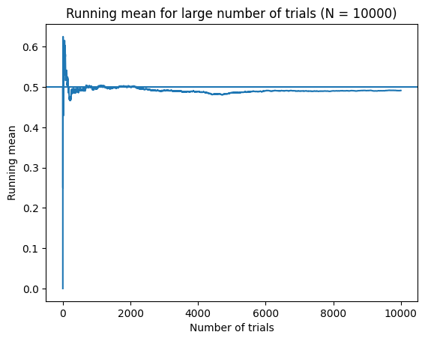
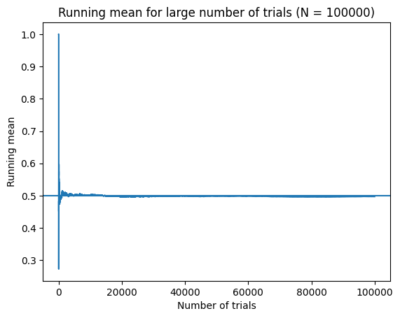

Slide 6
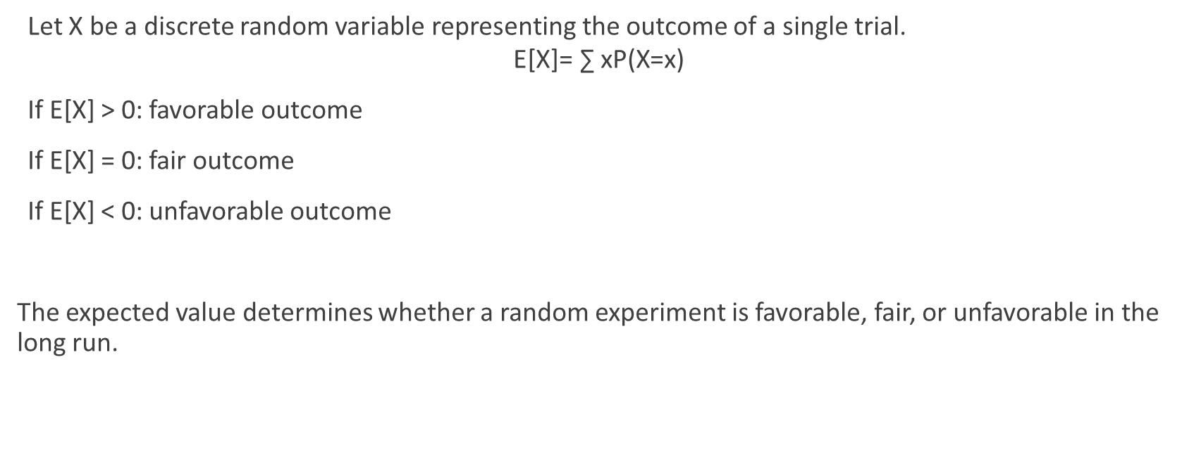
Favorable vs Unfavorable Expected Outcome
Let X be a discrete random variable representing the outcome of a single trial.
$$\text{E}\text{[}\text{X}\text{]=} \text{∑} \text{​}\text{xP}\text{(}\text{X}\text{=}\text{x}\text{)}$$
If E[X] > 0: favorable outcome
If E[X] = 0: fair outcome
If E[X] < 0: unfavorable outcome
The expected value determines whether a random experiment is favorable, fair, or unfavorable in the long run.

Slide 7
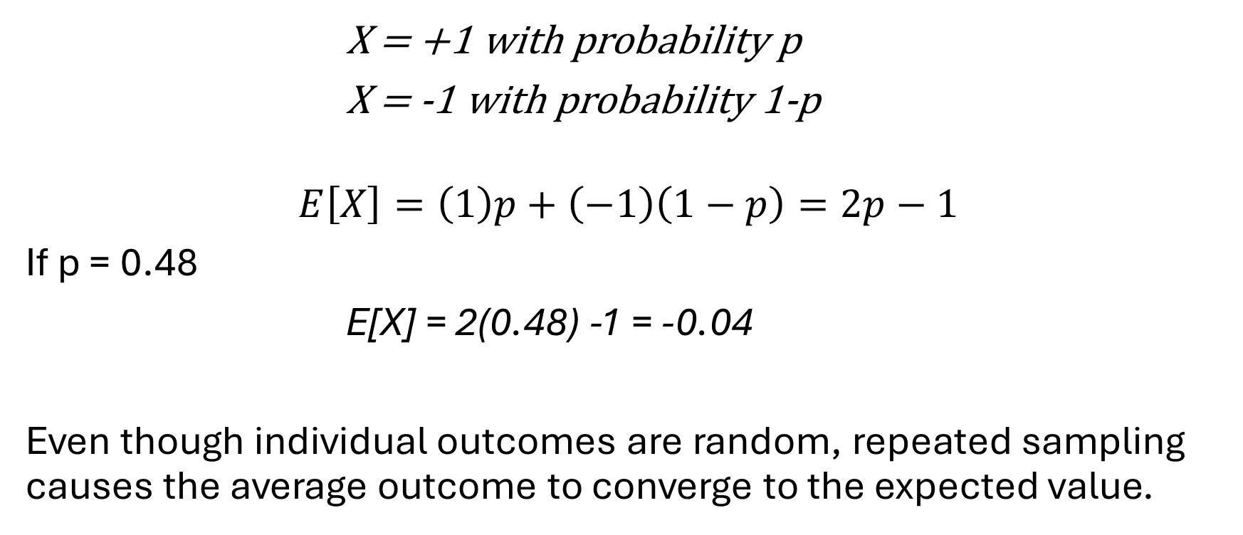
Random Sampling with Gain/Loss
X = +1 with probability p
X = -1 with probability 1-p
$$E\left[X\right]=\left(1\right)p+\left(−1\right)\left(1−p\right)=2p−1$$
If p = 0.48
E[X] = 2(0.48) -1 = -0.04
Even though individual outcomes are random, repeated sampling causes the average outcome to converge to the expected value.

