Slide 1
Sentiment Analysis for Jumia Reviews & Smartphone Price Prediction System
Achieved by:
AYMANE MAGHOUTI
Supervised by:
Prof. KHAMJANE AZIZ

Slide 2
Outline:
0- Introduction
1-Tools used
2- The architecture
3- Model Building
4-System 1: Sentiment Analysis for Jumia Reviews
- Data collection
- Data transformation and cleaning
- Comments Classification Approach
- Algorithms
- Selected model
- Model Deployment in Web Environments
5- System 2: Smartphone Price Prediction System
- Data collection
- Data transformation and cleaning
- Price Prediction Approach
- Algorithms
- Selected model
- Model Deployment in Web Environments
6- Testing the applications
7- References

Slide 3
INTRODUCTION

Slide 4







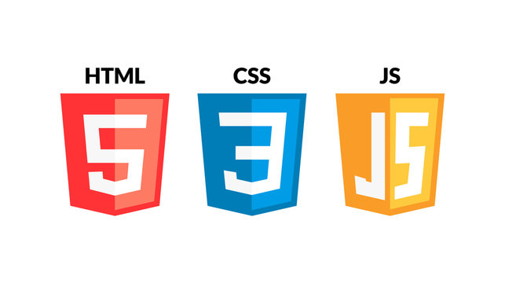

Tools Used

Slide 5
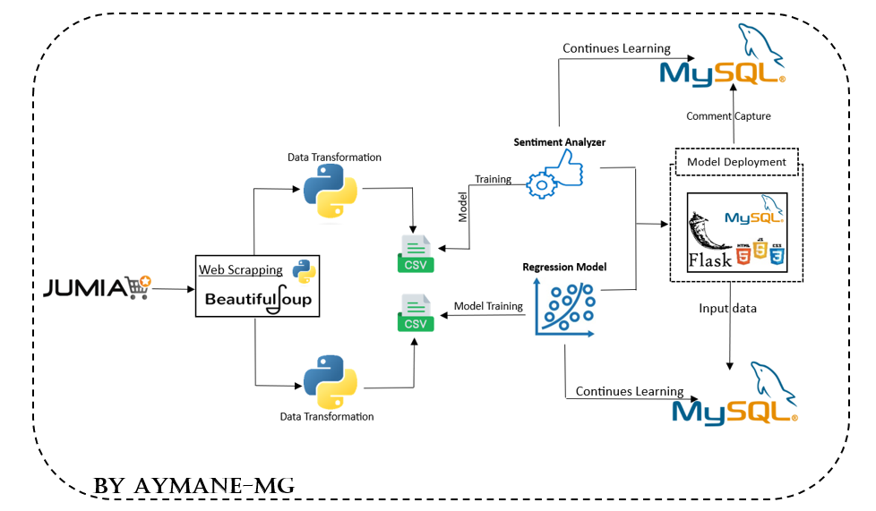
THE ARCHITECTURE

Slide 6
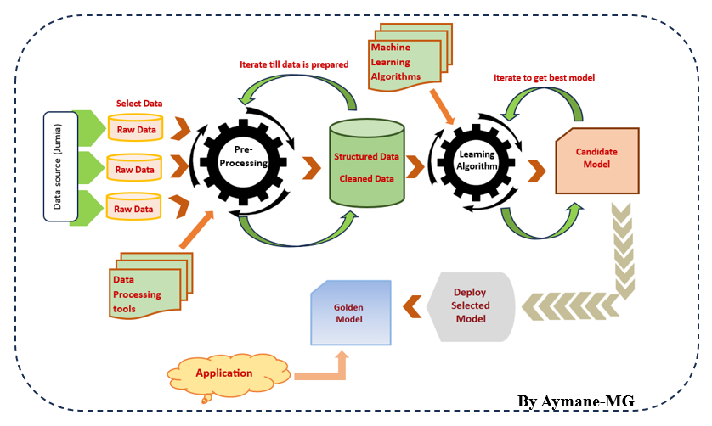
Model Building

Slide 7
System 1: Sentiment Analysis for Jumia Reviews

Slide 8
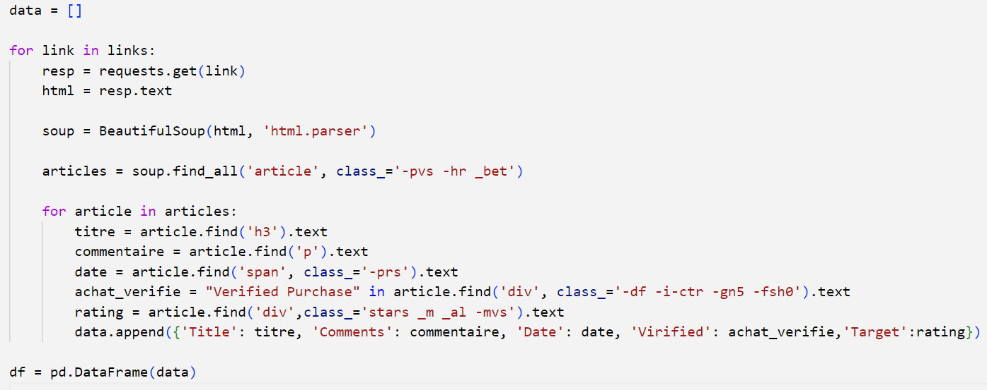
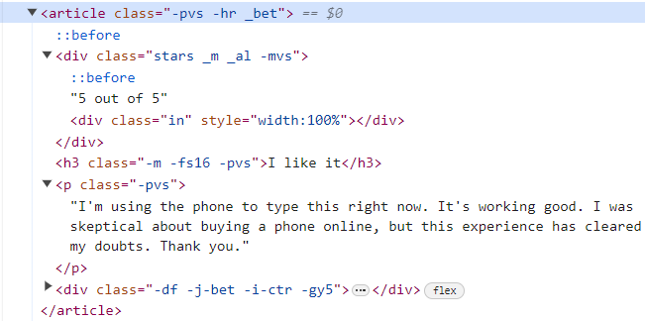


Data collection

Slide 9
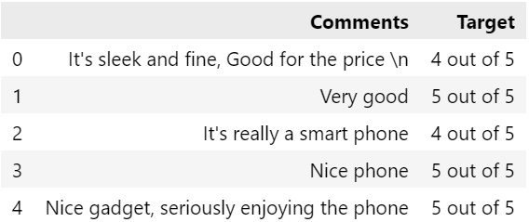
Dataset (Example)

Slide 10
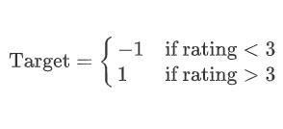

Data Transformation and Cleaning
Text Preprocessing:
- Lowercasing
- Removing Punctuation and Numbers
- Removing Stop Words
- Lemmatization
- Handling Rare Words
Select comments with a rating of 1, 2, 4, and 5:

Slide 11
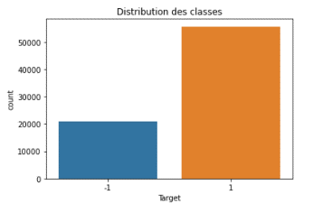
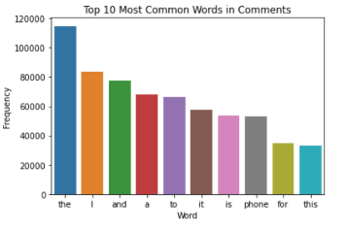
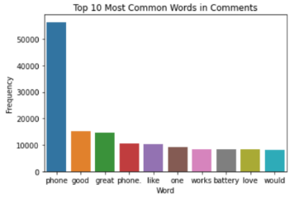
The distribution of classes
Top 10 Most common Words in Comments
Removing Stop Words

Slide 12
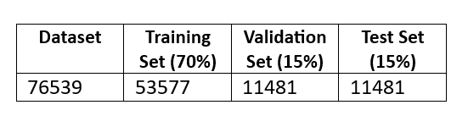
Comments Classification Approach
Split the dataset:
TF-IDF Vectorization:
The TF-IDF vectorizer is employed with the parameter ngram_range=(1,3), capturing unigrams, bigrams, and trigrams.
Algorithms :
Multinomial Naive Bayes
Support Vector Machine (SVM)
Logistic Regression

Slide 13
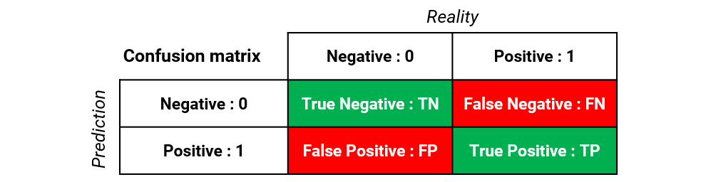
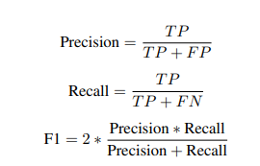

Model Selection :
Metrics :

Slide 14
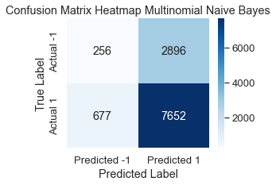
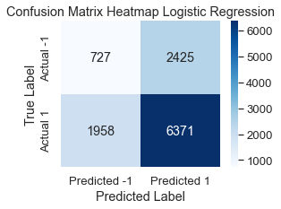
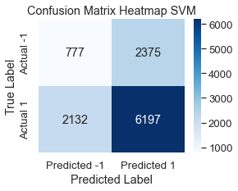
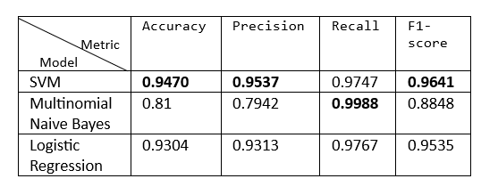

SVM

Slide 15
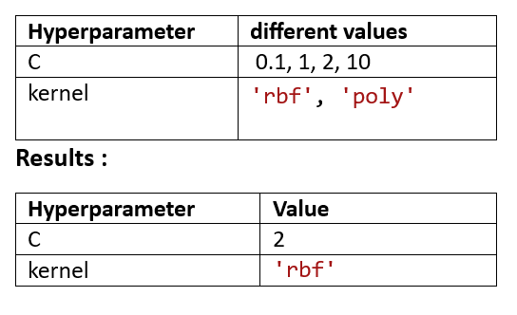
Hyperparameter Tuning (SVM)
RandomizedSearchCV
- 'C': This is the regularization strength, and it's the inverse of the regularization parameter.
- 'Kernel': The kernel function determines the type of decision boundary that the SVM will use.
Final evaluation on the test set:
Precision = 0.93 recall = 0.91 F1-score = 0.92

Slide 16
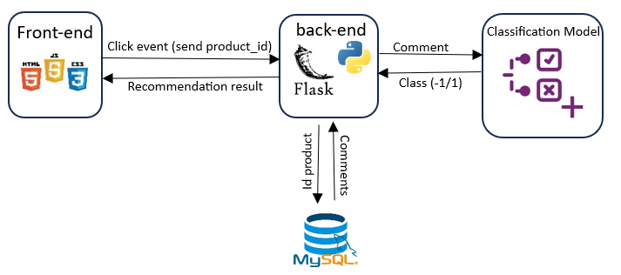
Model Deployment in Web Environments
Web app for product recommendation

Slide 17
System 2: Smartphone Price Prediction System

Slide 18
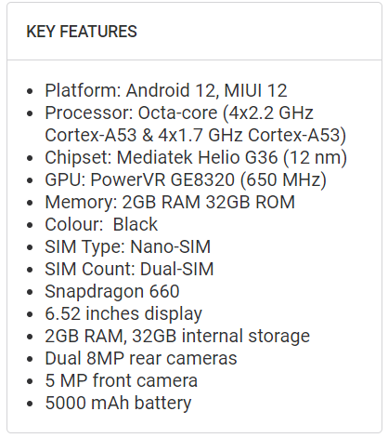
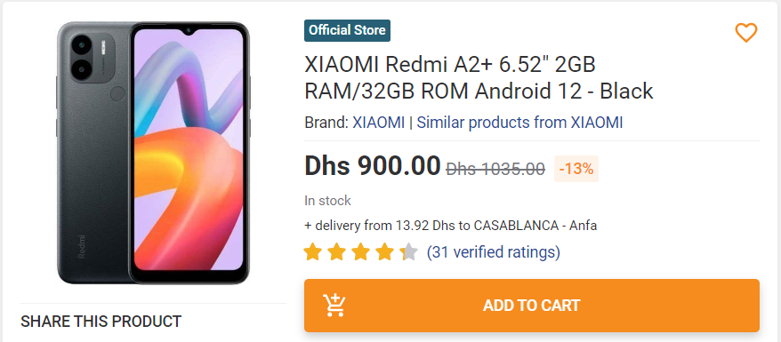
Data collection

Slide 19
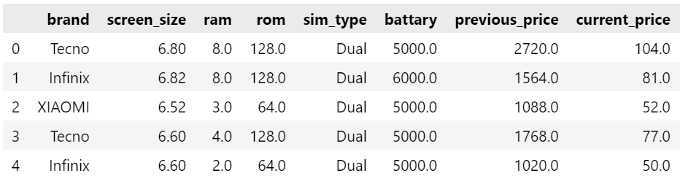
DataSet (Example)

Slide 20
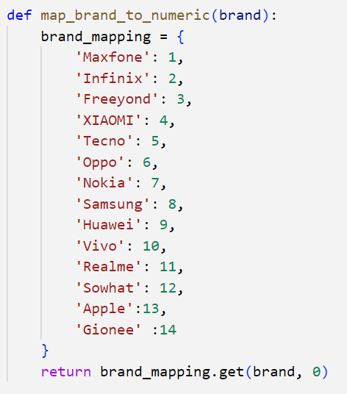
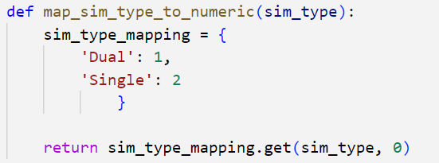
Data Transformation and Cleaning
Encoding Categorical Variables

Slide 21
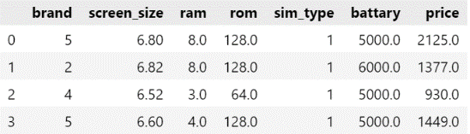
Adding a Mean Price Column
price = (previous_price + current_price) / 2
Dataset (Example)

Slide 22
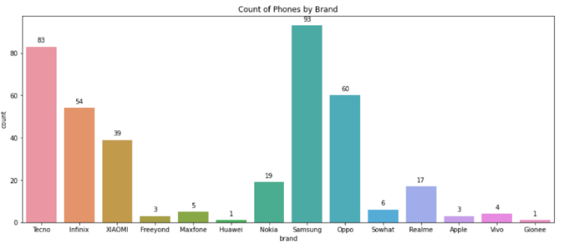
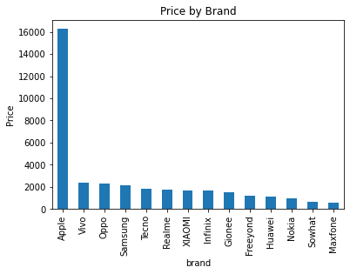
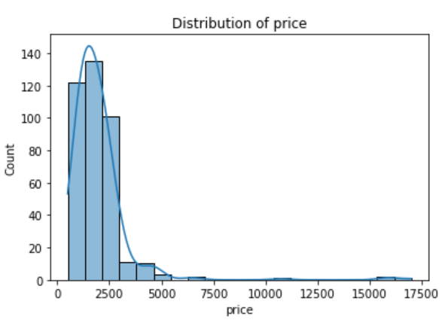
Count of phones by brand
Distribution of price
Price By Brand

Slide 23
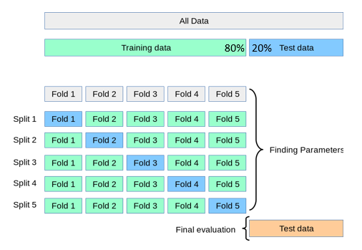
Price Prediction Approach
Cross-Validation technique
Algorithms:
Linear Regression - Lasso - Ridge
XGB regressor
Random forest regression

Slide 24



Model Selection:
Metrics:
Mean Squared Error (MSE):
Mean Absolute Error (MAE):
R-squared (R²):

Slide 25
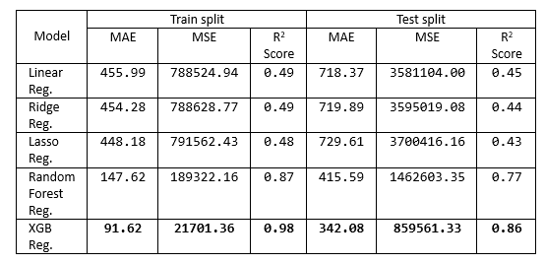

Results :
XGB Reg.

Slide 26
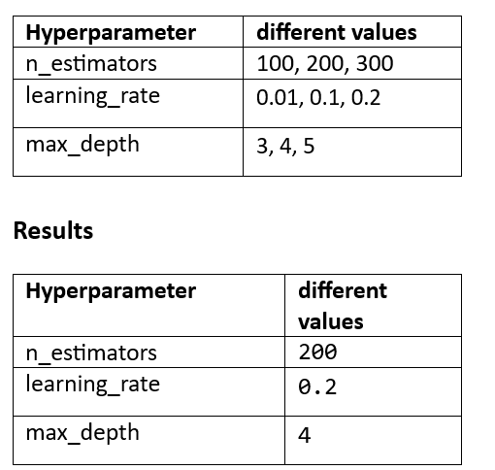
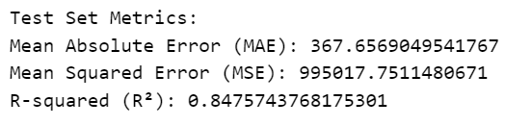
Hyperparameter Tuning (XGB Reg.)
Grid search
- n_estimators: Represents the number of trees
- learning_rate
- max_depth: Specifies the maximum depth of each tree in the ensemble.
Final evaluation on the test set:

Slide 27
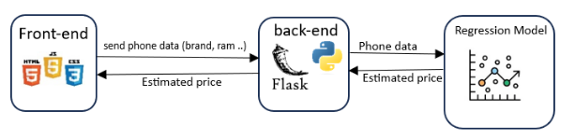
Model Deployment in Web Environments
web app for price estimation

Slide 28
Future Work & Limitation
- volume of comments!
- grammatically incorrect comments!
→So
- algorithms in natural language processing (NLP) to enhance comment understanding.
- SparkML could offer faster processing capabilities.

Slide 29
Testing The Applications
29

Slide 30
- [1] Indriani Sitorus, Analytics Vidhya, Medium, [link], Aug 27, 2020.
- [2] Ziani-Amel, [link], January 26,2020.
- [3] Lazid Lydia, Hacid Kahina, Université Mouloud Mammeri, [link], 2013.
- [4] Kasun Dissanayake, Towards Dev, Medium , [link], Dec 14, 2023.
References

Slide 31
Thank you for your attention !
31

