Slide 1


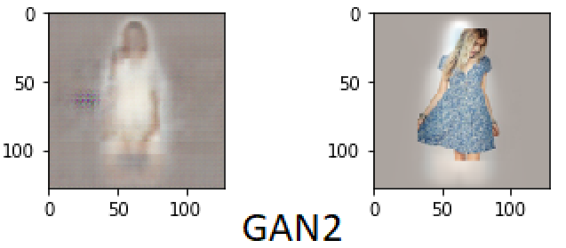
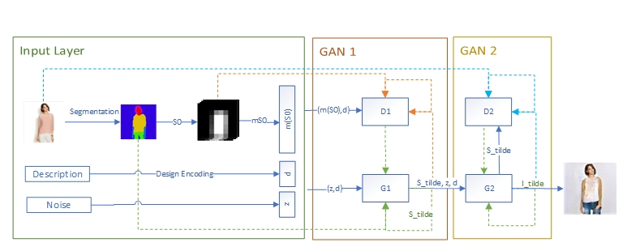
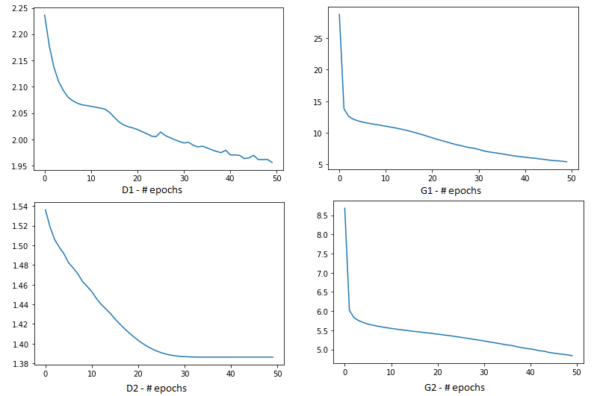
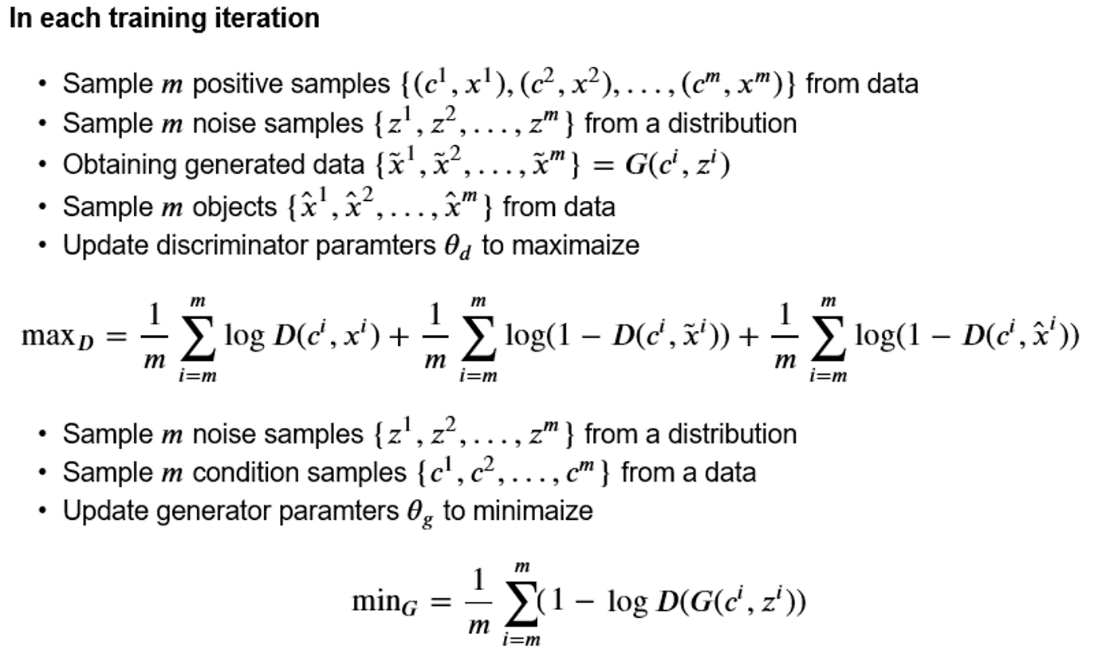
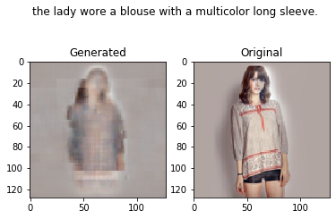
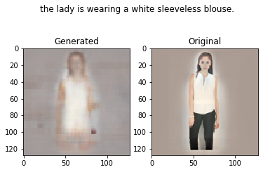
Generative Adversarial Networks – Deep Fashion Nikolay Nikolaev Dobrev (s182578) – Haoyu Zhang (s181774) – Ayman Eleya Zaki (s103861) Supervisors: Ole Winther, Peter Ebert
Challenges
Results
Introduction
½
Conditional GANs
Deep Fashion
minmax loss
Data loading
Features extraction
Language encoding
Transformation and Down-sampling
Body Coherence
Model Architecture
Experiments
Learning rate decay
Strong regularization on the generator
Adding more design features (Skin Color etc.)
Analysis
½
Training
Further work
Train GANs together
Experiment with different loss functions

Slide 2
