Slide 1

Bar-code Scanning Price Comparison App
Ayman M00649153

Slide 2
Introduction
01

Slide 3

Introduction
What is product comparion?
When the price of the same product is compared with different outlets and among different brands.
What is a bar-code?
Machine-readable code in the form of numbers and a pattern of parallel lines of varying widths.
Aim:
Help users save money
Incorporate Google maps
Simple GUI

Slide 4
Literature Review
02

Slide 5
Literature Review
Why literature review?
In order to better understand, evaluate and create a bar-code price comparison app, a literature review was conducted.
To better compare the apps, a few questions need to be answered:
Who are the competitors?
What functionalities do their apps have?
What are their weaknesses?

Slide 6
Application | Supports local groceries | Supports bar-code scanning | Available in U.A.E | Displays location | Allows user to add new products to DB
ShopSavvy | No | Yes | No | Yes | No
Idealo | No | Yes | Yes | No | No
BuyVia | No | Yes | No | Yes | No
Pricena | No | Yes | Yes | Yes | No
Amazon Shopping | No | Yes | Yes | No | No

Slide 7
Software design
03

Slide 8
Software Design
Target Audience
Who are these groups of individuals?
What are their problems?
How does this app help them solve their problem?
Elderly and Disabled
Students
Unemployed person

Slide 9
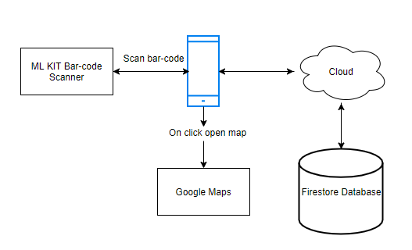
Software Design

Slide 10
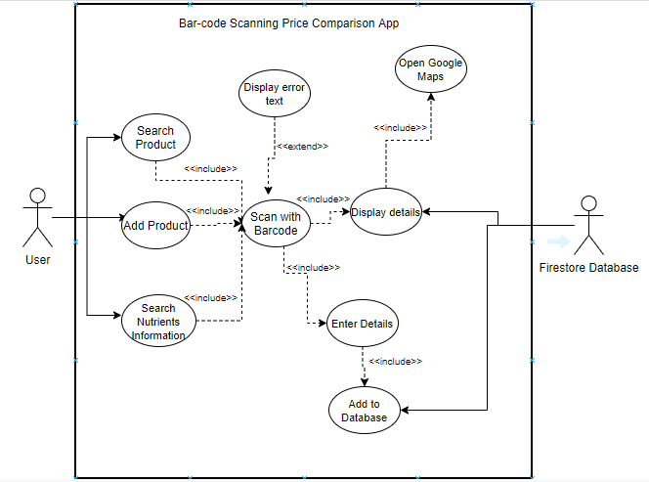
Software Design

Slide 11
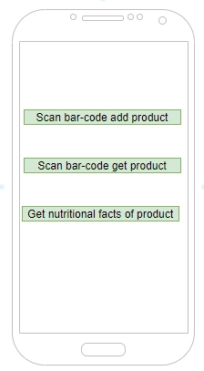
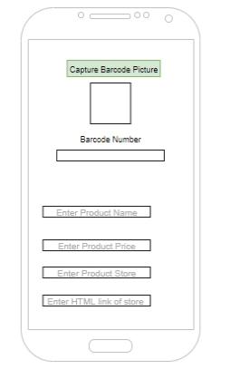
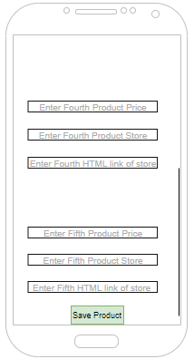
Software Design
Scan bar-code add product

Slide 12
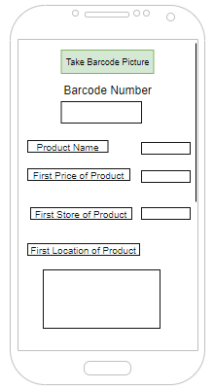
Software Design
Scan bar-code get product

Slide 13
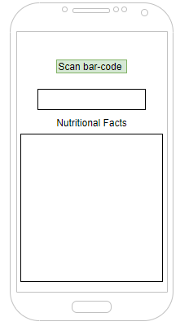
Software Design
Get nutritional facts of product

Slide 14
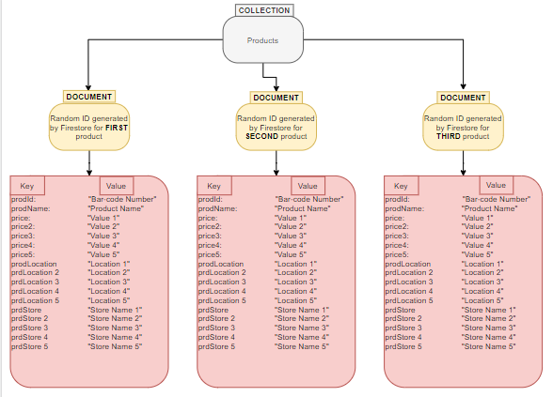
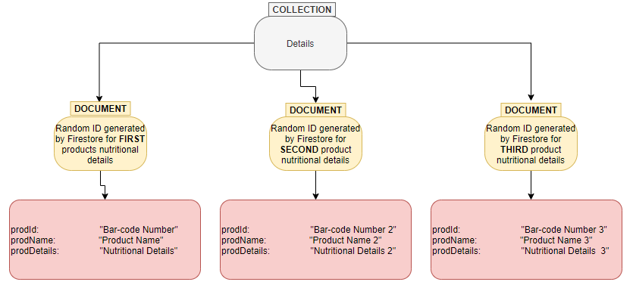
Software Design
Database Design

Slide 15
Implementation
04

Slide 16
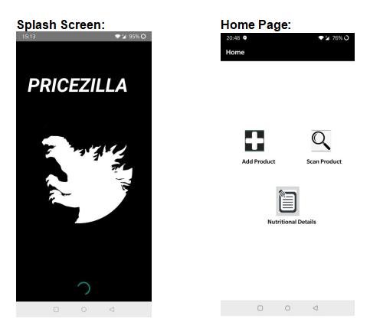
System Screen-shots

Slide 17
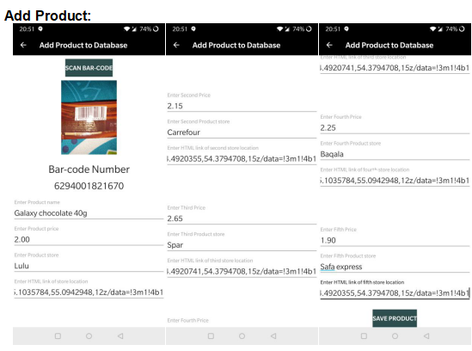
System Screen-shots

Slide 18
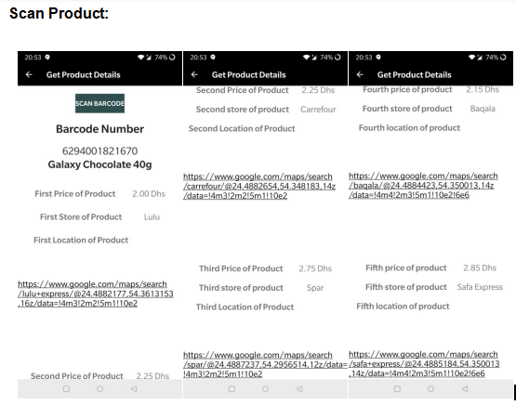
System Screen-shots

Slide 19
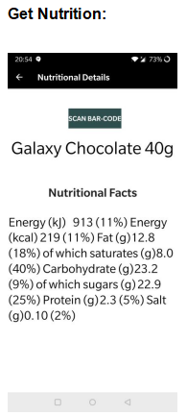
System Screen-shots

Slide 20
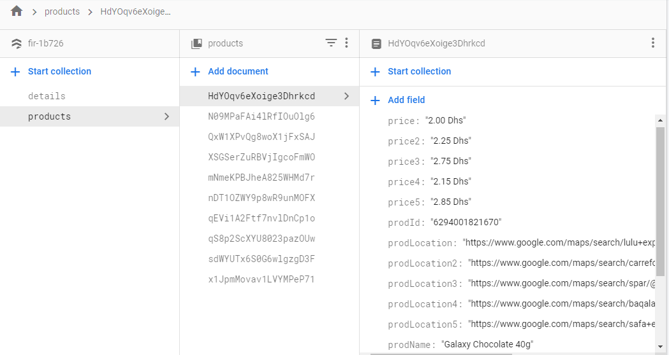
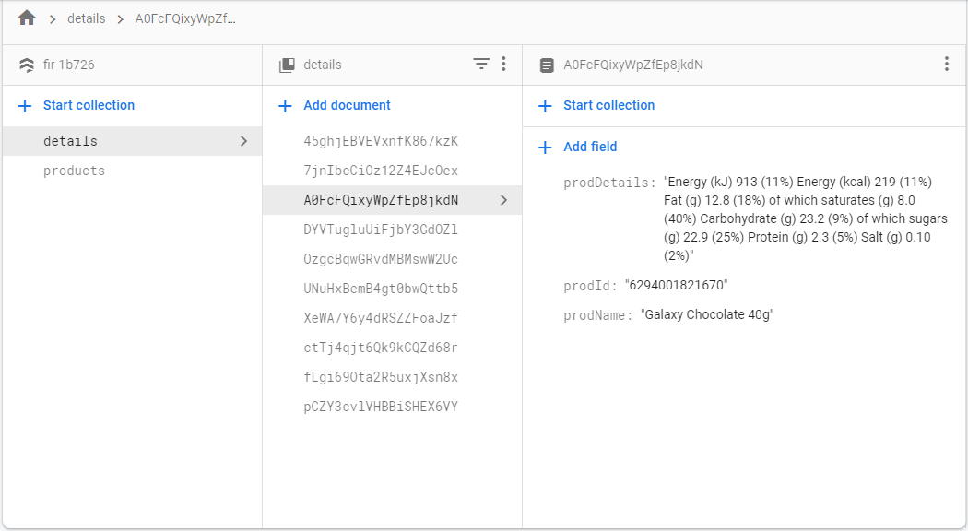
Database

Slide 21
Implemetation
Testing:
Software testing is the process by, which the functionality of a software application is evaluated to identify defects and to check whether the software application has met its specified requirements. (Rajkumar, 2020)
Three types of testing methods are used in this project:
1. White Box Testing: Revolves around INTERNAL testing.
2. Black Box Testing: Revolves around EXTERNAL testing.
3. User evaluation: External users test the app.

Slide 22
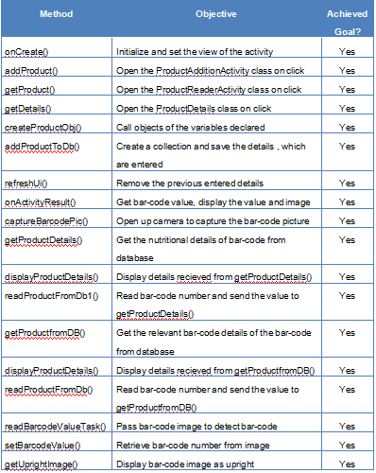
Implemetation
White Box Testing

Slide 23
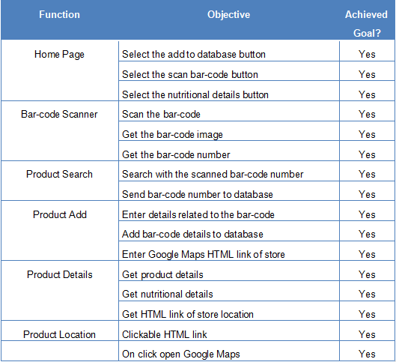
Implemetation
Black Box Testing

Slide 24
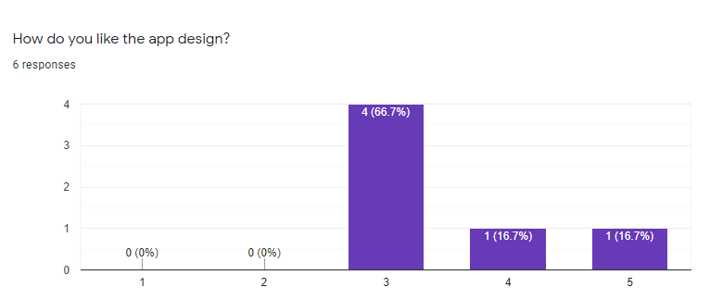
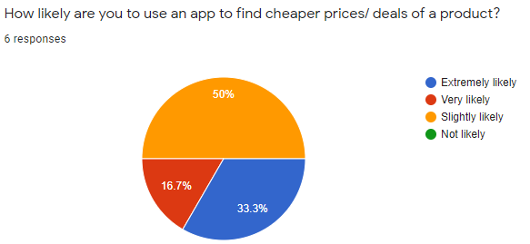
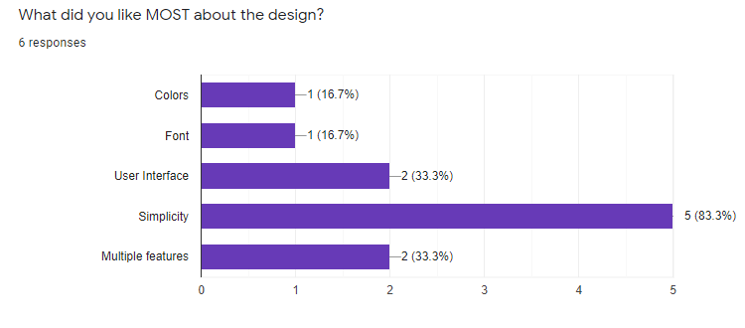
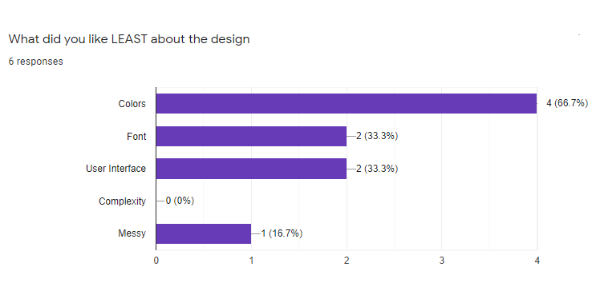
Implemetation
User Evaluation

Slide 25
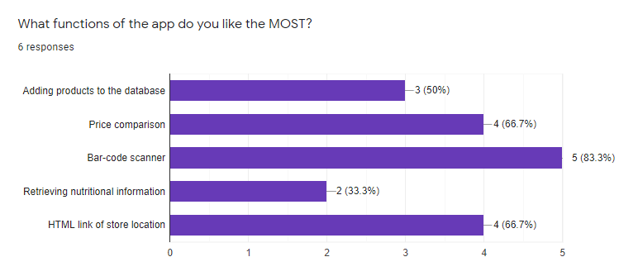
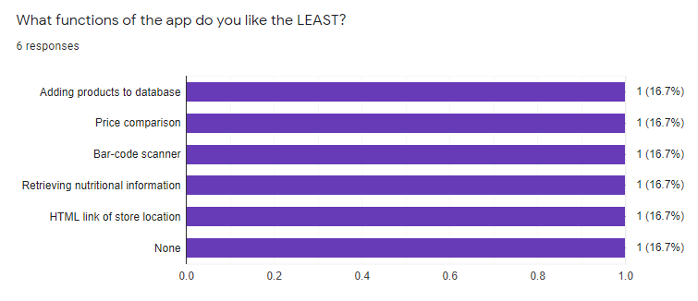
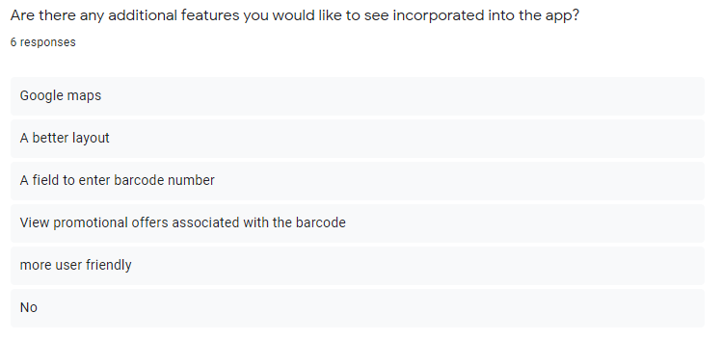
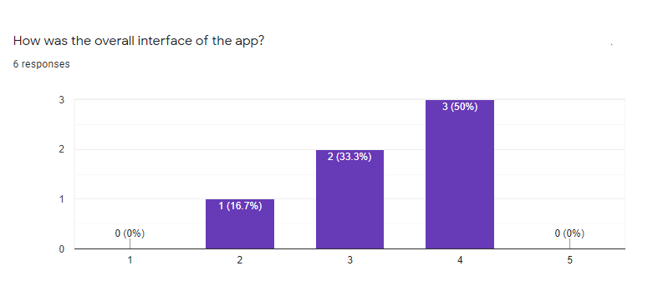
Implemetation
User Evaluation

Slide 26
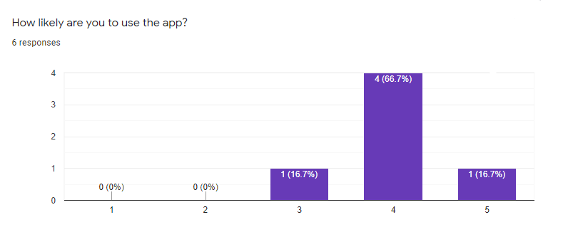
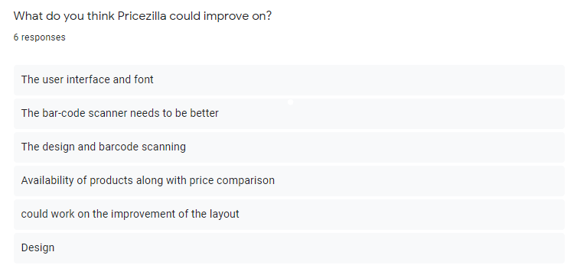
Implemetation
User Evaluation

Slide 27
Conclusion
05

Slide 28
Conclusion
Limitations:
Bar-code scanner
Database
Layout
Map
Search Function
Future Works:
Search bar
Google maps
Price alert
User review

Slide 29
References
Trujillo, P. (2020). The Difference Beween a Barcode Scanner and a Mobile Computer. [online] Wasp Buzz. Available at: http://www.waspbarcode.com/buzz/barcode-scanner-or-mobile-computer/ [Accessed 10 Jan. 2020].
Ferreira, N. (2020). 25+ Best Price Comparison Websites and Apps to Compare Prices Online. [online] Oberlo. Available at: https://www.oberlo.com/blog/25-best-price-comparison-websites [Accessed 10 Jan. 2020].
Daurer, S. (2019). AIS Electronic Library (AISeL) - Wirtschaftsinformatik 2017 Proceedings: Consumer Preferences for Product Information and Price Comparison Apps. [online] Aisel.aisnet.org. Available at: https://aisel.aisnet.org/wi2017/track10/paper/5/
Firebase. 2020. Cloud Firestore | Firebase. [online] Available at: <https://firebase.google.com/docs/firestore> [Accessed 30 April 2020].
Usability.gov. 2020. Usability Evaluation Basics | Usability.Gov. [online] Available at: <https://www.usability.gov/what-and-why/usability-evaluation.html> [Accessed 30 April 2020].

Slide 30
THANK YOU
Any Questions?

