Slide 1
Introduction to clustering
Ayman Farghaly – Tafra meetup

Slide 2
Topics
Definition
Overview of types
Kmeans
Demo Kmeans
Gaussian Mixed Models
Demo GMM
DBSCAN
Demo DBSCAN
Hierarchal clustering
Demo Hierarchal clustering

Slide 3
Definition
Grouping of “similar” instances.

Slide 4
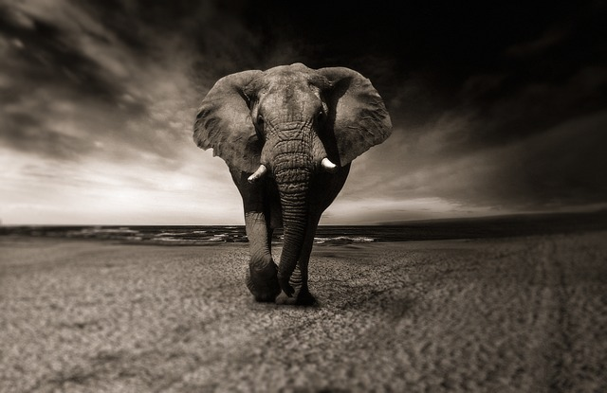


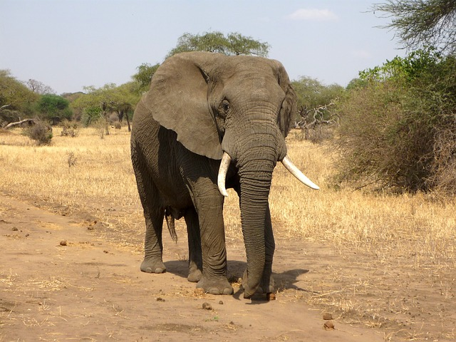
Definition
Grouping of “similar” instances.

Slide 5
Definition
Grouping school students

Slide 6
Earlier examples
Psychology:
The description of personality: basic traits resolved into clusters. Cattell, Raymond B.
Anthropology:
“Quantitative Expression of Cultural Relationships.”

Slide 7
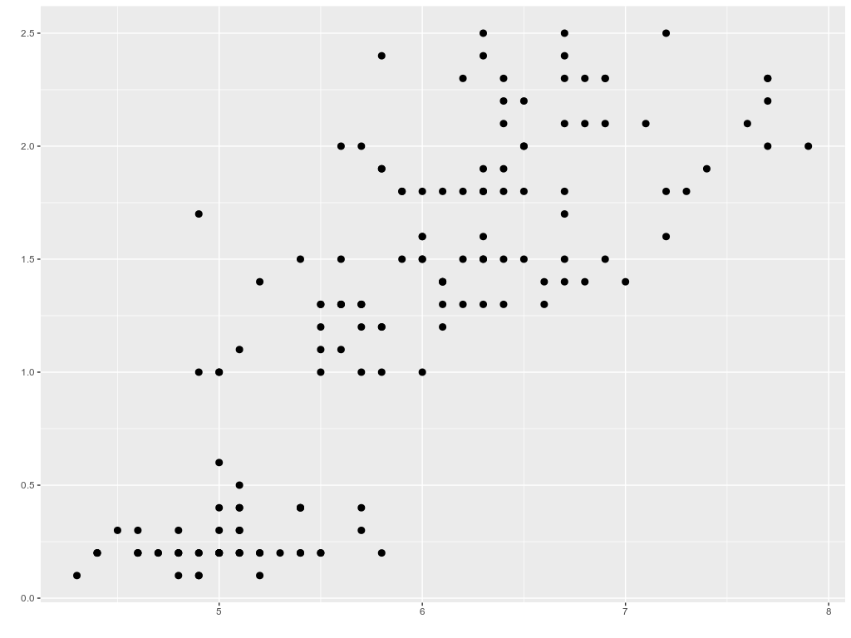
Example – the red indians & the anthropologist

Slide 8
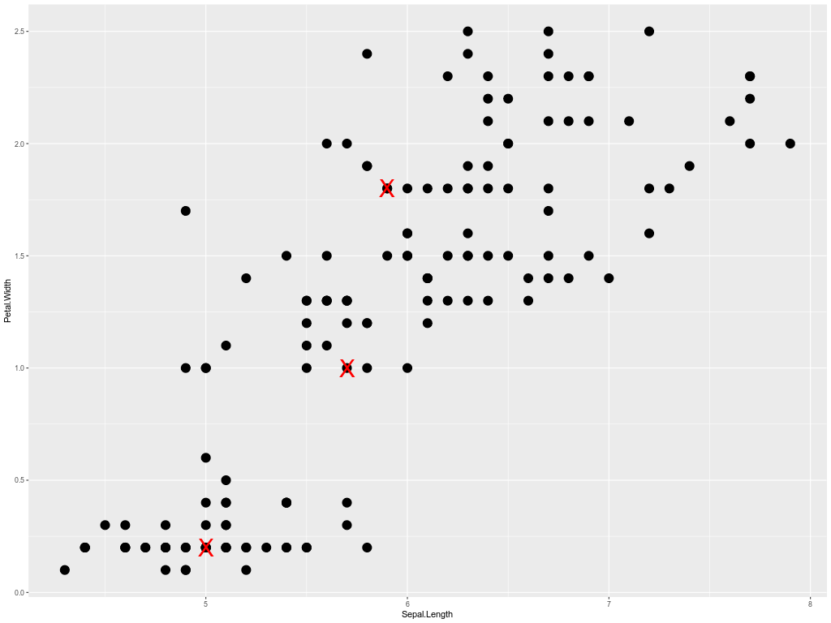
Steps

Slide 9
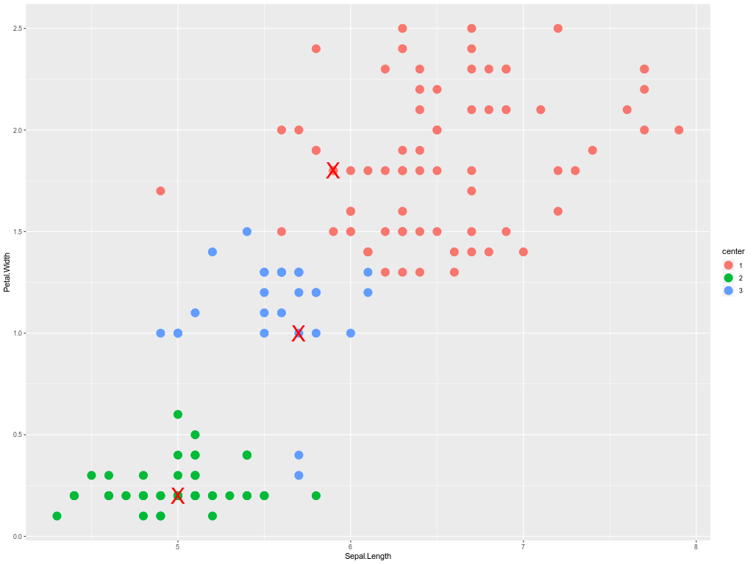
Steps

Slide 10
Steps

Slide 11
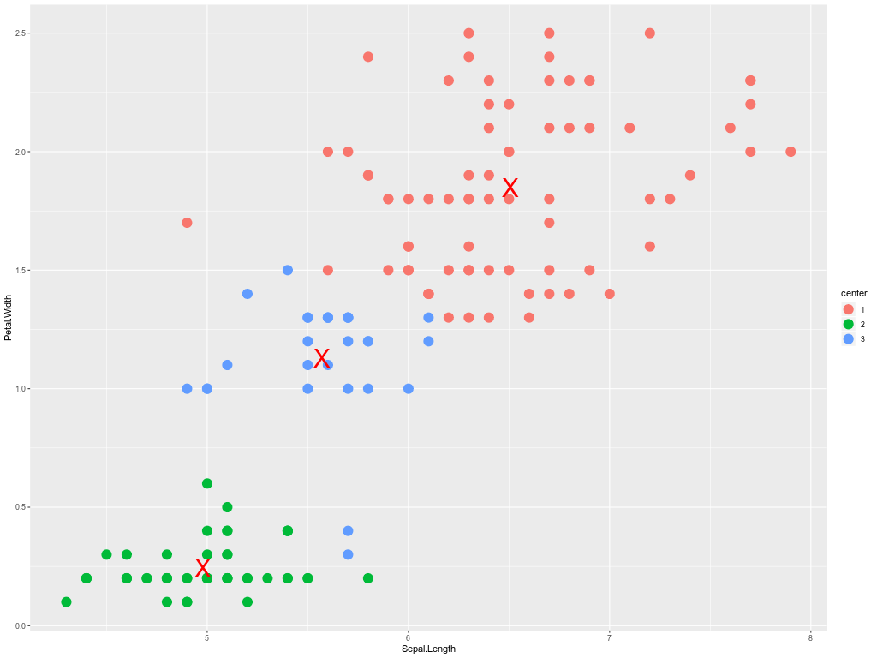
Steps

Slide 12
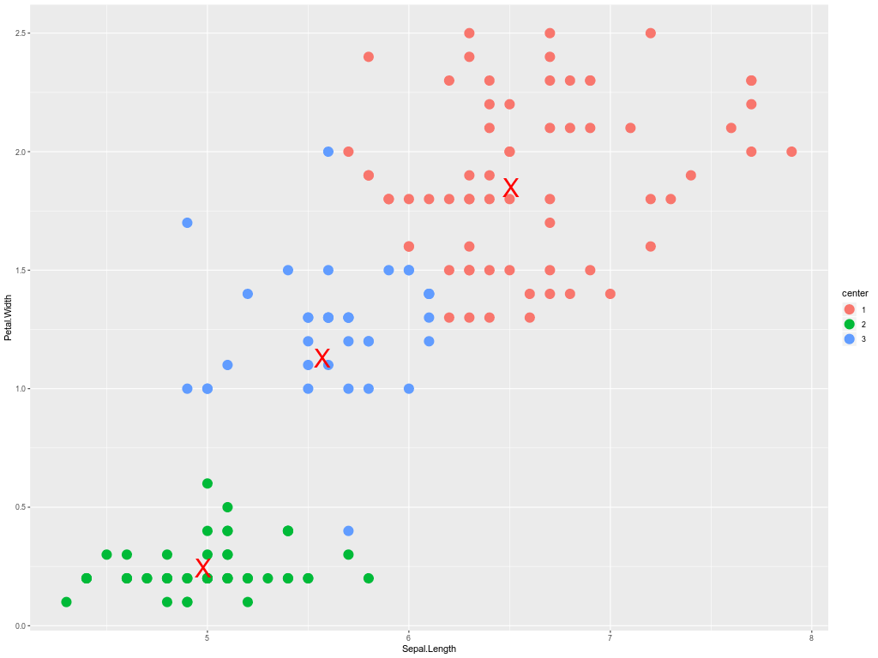
Steps

Slide 13

Steps

Slide 14
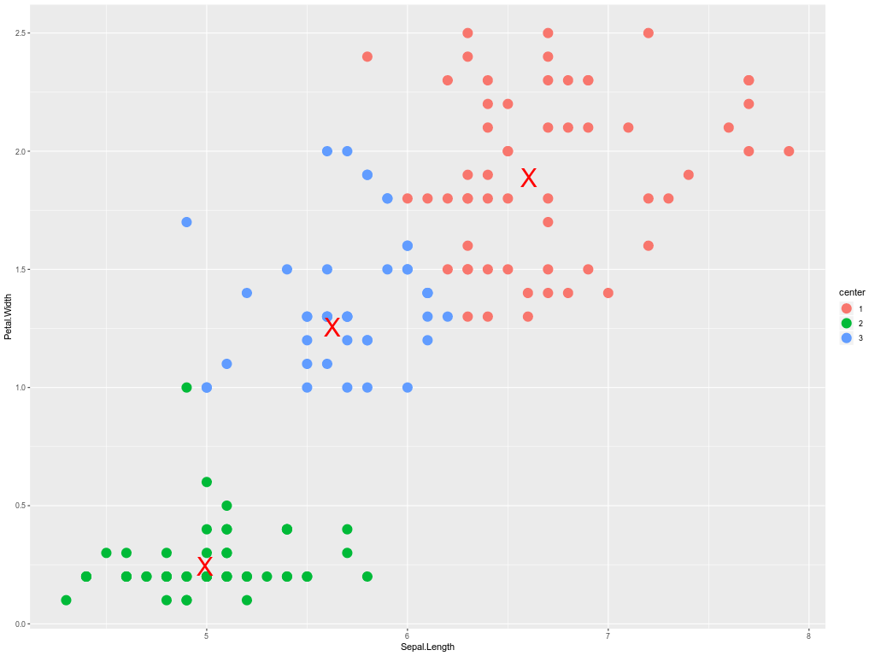
Steps

Slide 15
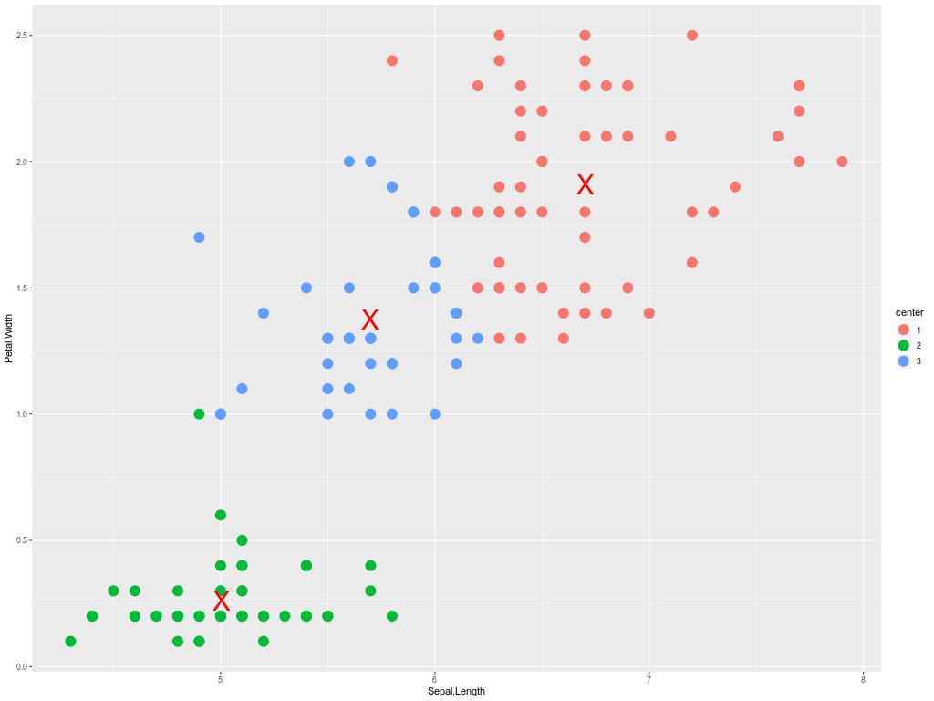
Steps

Slide 16
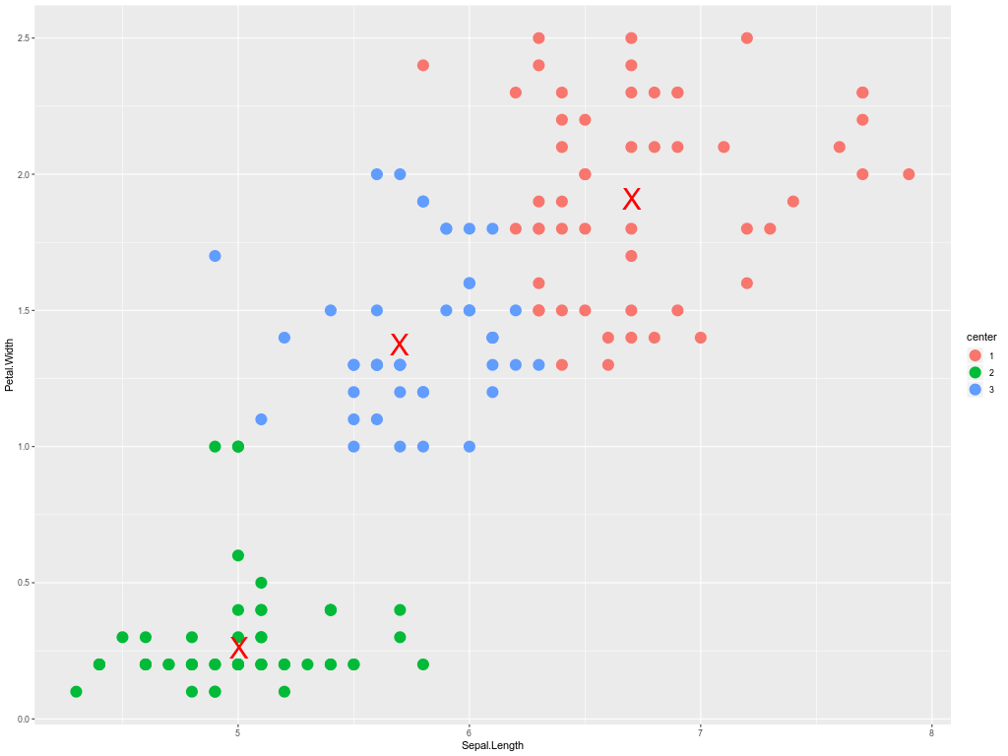
Steps

Slide 17

Steps

Slide 18
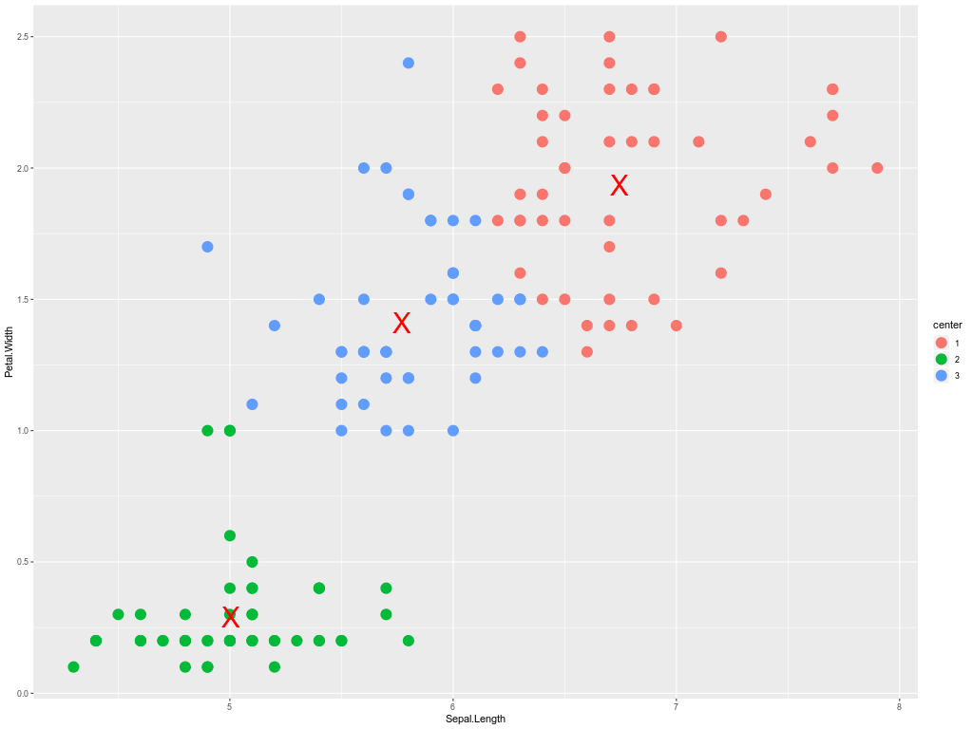
Steps

Slide 19

Steps

Slide 20

Steps

Slide 21

Steps

Slide 22
Steps

Slide 23
Steps

Slide 24
Centroid based: K-means
Insert k points and use them to decide the clusters
1. For each data point, decide which of the k points in the nearest. → assign to a cluster
2. Recalculate the position of the k points
Loop on 1 and 2 until the k points don’t move
Logical?
Initialization matters, must give K, local minimum

Slide 25
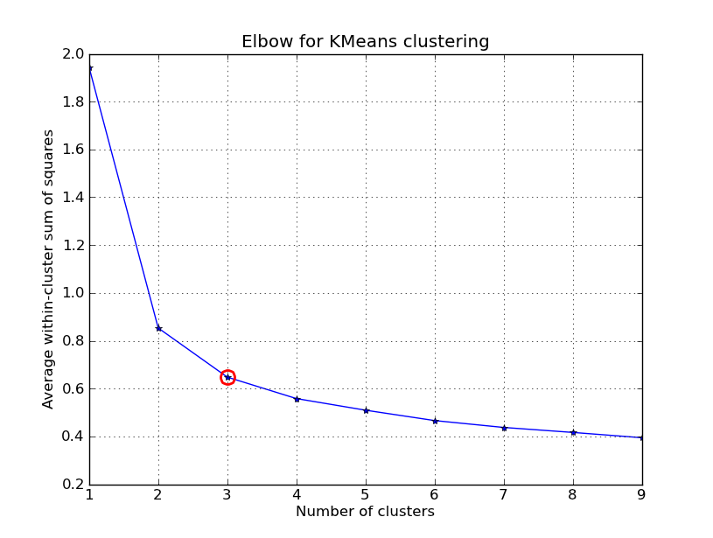
Centroid based: K-means
Assessing different clusters
Sum of squares from the means

Slide 26
Clustering types
Centroid based
Distribution based
Density based
Hierarchal based

Slide 27
Gaussian Mixture Model
Find distributions within the data, Introduce soft margins withing clusters.
Like Kmeans, we must choose K, however data is not assumed to be spherical
Also sensitive to initialization.
Demo:
https://lukapopijac.github.io/gaussian-mixture-model/

Slide 28
Density based: DBSCAN
Don’t insert any external entity, find densities within your data.
Choose a density distance, eps.
Choose minimum points within distance, minPts.
Loop over all the points, and within each point’s density distance check if there are minimum points.
If yes, flag as core point.
Check the points within its density dist, if they have no minPts within eps then it is a boundary point.
Check the other points if they aren’t core or border then outlier.

Slide 29
Density based: DBSCAN
MinPts=3
EPS

Slide 30
Density based: DBSCAN
Note:
1. Unlike kmeans, it possible that some points will have no cluster.
2. You don’t choose K.
3. Sensitive to parameters
Demo
https://www.naftaliharris.com/blog/visualizing-dbscan-clustering/

Slide 31
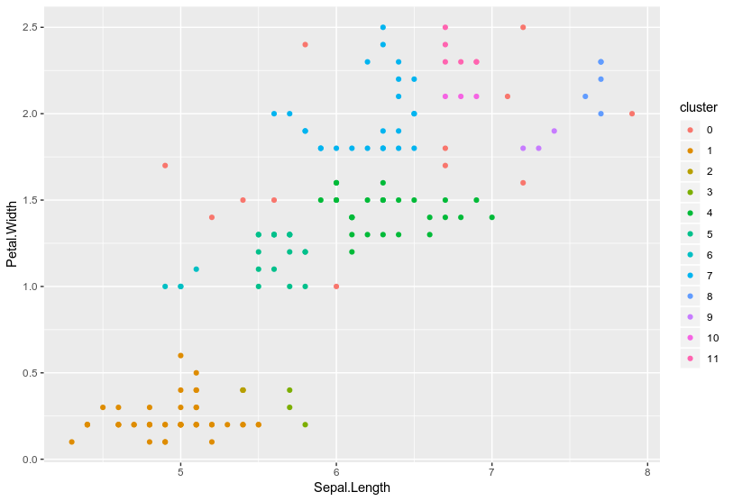
Density based: DBSCAN

Slide 32
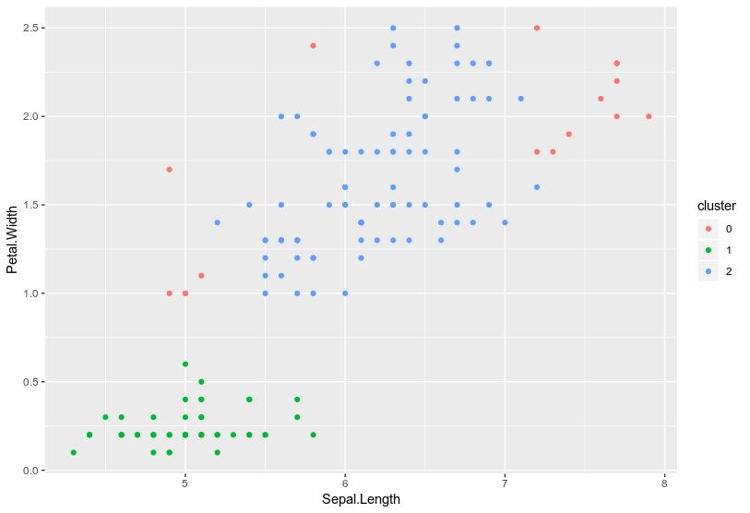
Density based: DBSCAN

Slide 33
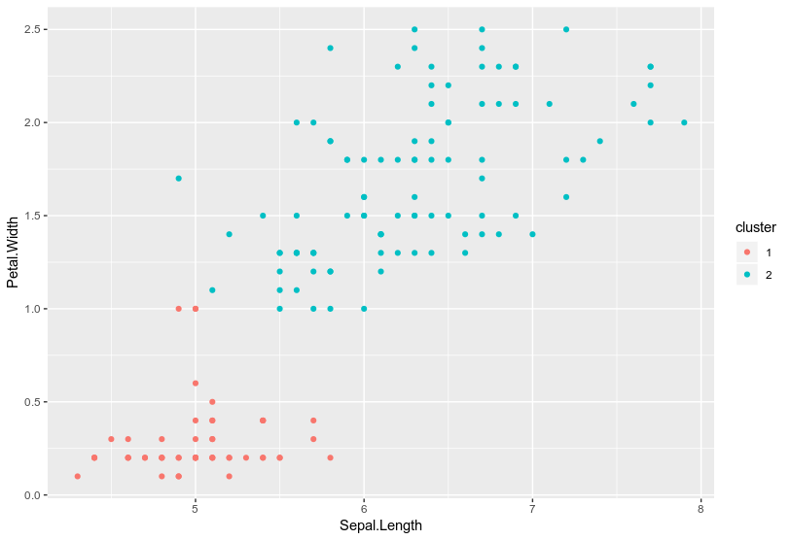
Density based: DBSCAN

Slide 34
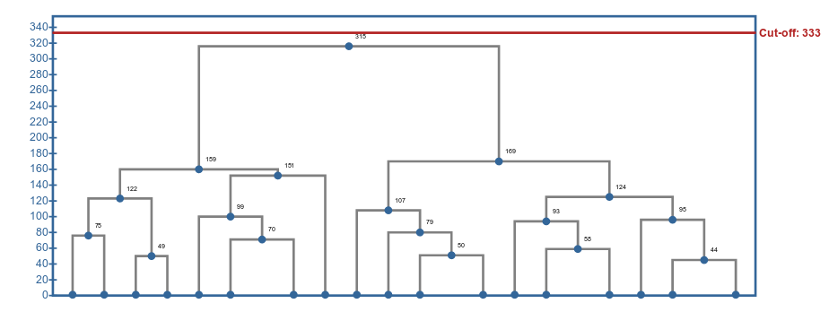
Hierarchal clustering
Agglomerative: Start from the individual points, search the nearest point, form a cluster, search nearest clusters, form a bigger cluster.
K can be dynamically chosen, with cutoff or manual of the dendogram.
Alternative: iterative k-means
Demo:
https://live.yworks.com/demos/analysis/clustering/index.html

Slide 35
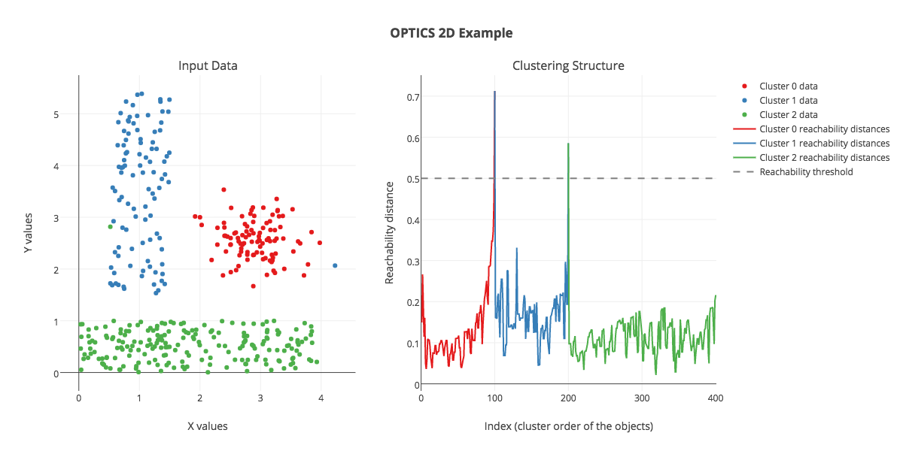
Optics
Density based clustering with varying densities per cluster
Number of clusters can be chosen after the algorithm stops
https://github.com/marionleborgne/optics-demo

