Slide 1

MobiCar

Slide 2
contain
Introduction
Our team
Connect with us
Design
OUR VIEW
components

Slide 3
Introduction
Our presentation today about Mobile Controlled Car which provide easy driving using mobile application , accurate movement, line tracking and we look forward to joining with the competition.

Slide 4
Our team
Our team consists of nine members and they are:
Ahmed_Osama_Mahmoud
Ayman_Badr_Ahmed
Ayman_Mohammed_Saad
Hossam_Wageh_Byomy
Mahmoud_Mohamed_Abdelrazik
Mahmoud_Mohammed_Hafez
Mahmoud_Mohammed_Shaker
Shady_Shebl_Abdelhamid
Mahmoud Mohammed Hesham Mohammed

Slide 5
Connect with us
You can connect with our team by two ways:
1.gethub web site:
https://github.com/aymanprocessor/ASUMobiCarG03
2.Facebook group:
https://www.facebook.com/groups/1562636500452651/
And you can provide us by watching our mobicar video on the YouTube channel
https://www.youtube.com/watch?v=qjFwNkSU6Zk&feature=youtu.be

Slide 6
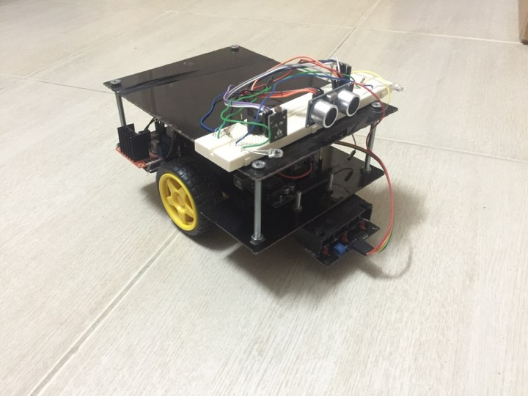
Design

Slide 7
Our view
Design the car which satisfy the main requirements:
easy driving, accurate movement and line tracking.
The cost and efficiency were from our responsibility so we discuss many effective points like that :
We change the arduino kit from MEGA to UNO where we choose MEGA because we want many analogue inputs during using different sensors need that. so we replace it with ONO one and solving the problem of inputs by change the sensors with others which use analogue and digital inputs ,by this solution we can decrease the cost .

Slide 8
we are using used batteries with high quality and high efficiency rather than buy new batteries with high cost and low efficiency so we decide that by thinking about our needs from battery where we interested in the quality of operation to present our project well.
we used good connectors to have nice connections and high
Performance.
Finally; after each edition we are testing the car carefully to decrease the errors to the minimum ration possible.

Slide 9
components
For the car’s circuit
1x Ultrasonic sensor
1x line follower sensor with 3 ir
1x LDR sensor module
1x Temperature sensor
1x Gyroscope and accelerometer sensor mpu5060
2x White led &2x red led
4x 330 Ohm Resistance
1x Buzzer

Slide 10
1x breadboard Some wires & jumpers 1x Arduino uno kit 1x Bluetooth module 1x two 3.7 v battery holder 1x three 3.7 v battery holder 4x 3.7 v battery holder 1x driver module l298n 2x dc geard motors 2x 0.22 uF capacitors 2x wheels 2x caster wheels

Slide 11
for the car’s frame 2x fiber glass sheets 4x 7cm screws 4x 4.5m screws2 4x nuts

