Slide 1

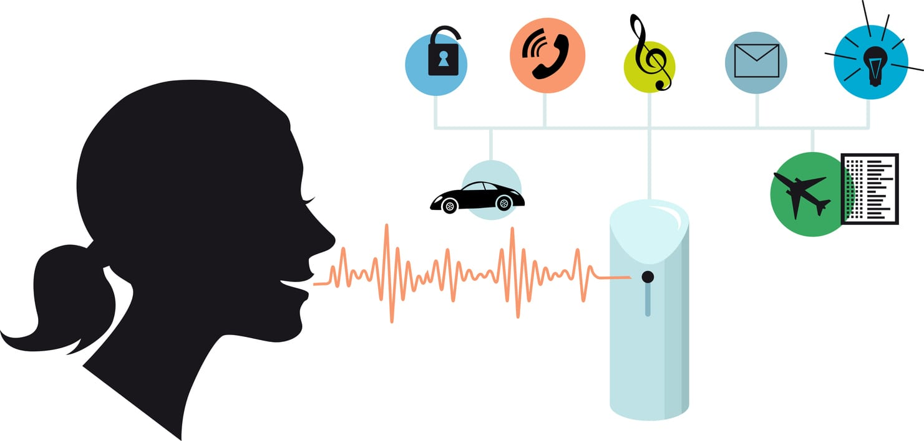
United International University
An Automatic Speaker
Recognition System
Digital Signal Processing laboratory Presentation
Department of Electrical & Electronic Engineering

Slide 2

Faculty & Members
Nafi Ul Kaysar Buruz
ID: 021 221 101
Asikur Rahaman
ID: 021 191 004
Ayman Zafar
ID: 021 191 058
Nafiul Islam
ID: 021 183 004
Sagor Paul
ID: 021 191 070
Dr. Ahmed, Khawza Iftekhar Uddin
Professor,
Department of Electrical and Electronic
Engineering
United International University,
Dhaka, Bangladesh
Department of Electrical & Electronics Engineering

Slide 3
Contents
Introduction
Literature Review
Methodology
Results
Conclusion
Department of Electrical & Electronics Engineering

Slide 4
INTRODUCTION
Department of Electrical & Electronics Engineering

Slide 5
LITERATURE REVIEW
Department of Electrical & Electronics Engineering

Slide 6
Background
Literature Review
[1]L.R. Rabiner and B.H. Juang, Fundamentals of Speech Recognition, Prentice-Hall, Englewood Cliffs, N.J., 1993.
[2]S.B. Davis and P. Mermelstein, “Comparison of parametric representations for monosyllabic word recognition in continuously spoken sentences”, IEEE Transactions on Acoustics, Speech, Signal Processing, Vol. ASSP-28, No. 4, August 1980.
[3] S. Furui, “An overview of speaker recognition technology”, ESCA Workshop on Automatic Speaker Recognition, Identification and Verification, pp. 1-9, 1994.
[4]comp.speech Frequently Asked Questions WWW site,
Http://svr-www.eng.cam.ac.uk/comp.speech/
By reading this paper we got the idea how to implement the
procedure of MFCC in a sequence and correct way.
Department of Electrical & Electronics Engineering

Slide 7
METHODOLOGY
Department of Electrical & Electronics Engineering

Slide 8
Speech Feature Extraction
Speaker recognition can be classified into identification and verification. Speaker identification is the process of determining which registered speaker provides a given utterance. Speaker verification, on the other hand, is the process of accepting or rejecting the identity claim of a speaker.
Principles of Speaker Recognition

Slide 9
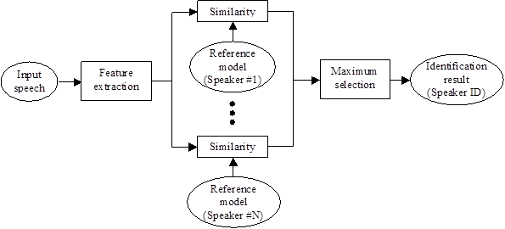
Basic structures of speaker recognition systems
Figure: Speaker identification

Slide 10
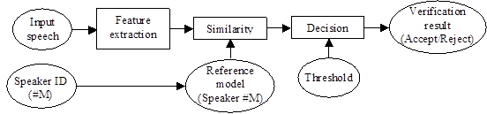
Basic structures of speaker recognition systems
Figure: Speaker verification

Slide 11
Speech Feature Extraction
Speech Feature Extraction
Introduction
Mel-frequency cepstrum coefficients processor
Frame Blocking
Windowing
Fast Fourier Transform (FFT)
Mel-frequency Wrapping
Cepstrum
Summary

Slide 12
Example of speech signal

Slide 13
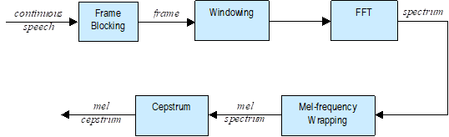
Mel-frequency cepstrum coefficients processor
Figure: Block diagram of the MFCC processor

Slide 14
Windowing
FFT

Slide 15
Multiplying

Slide 16
DCT

Slide 17
Feature Matching
Overview
Clustering the Training Vectors
Feature Matching

Slide 18
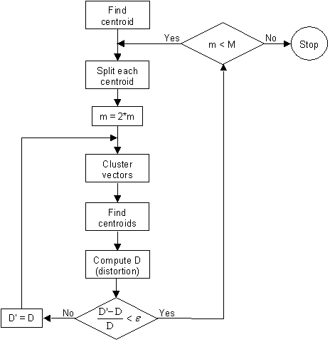
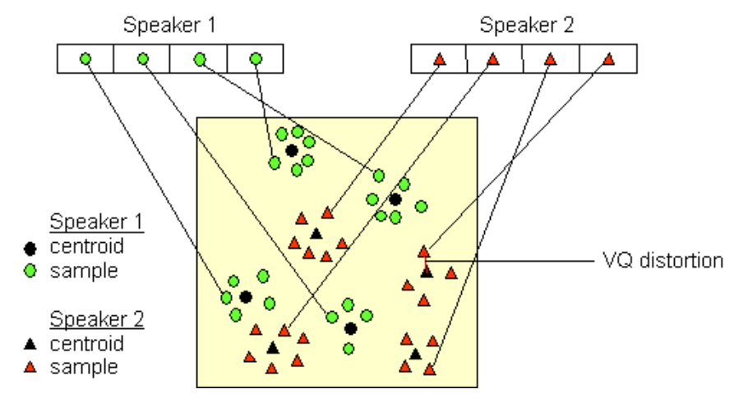
Feature Matching
Clustering the Training Vectors

Slide 20
Feature Matching
Speech Data
Speech Processing
Vector Quantization
Simulation and Evaluation
Project
Department of Electrical & Electronics Engineering

Slide 21
RESULTS
Department of Electrical & Electronics Engineering

Slide 22
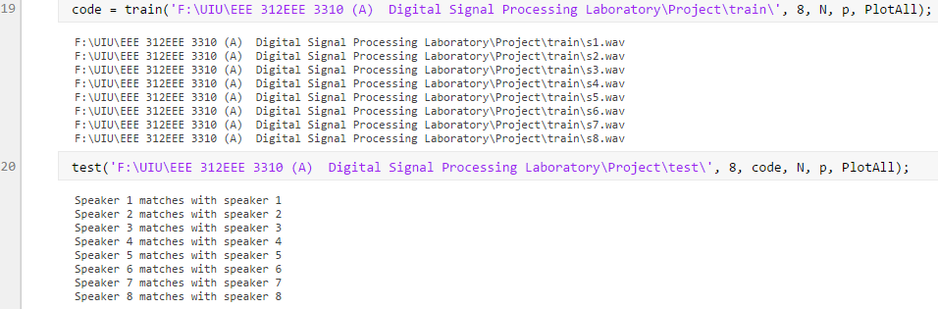
Results
Department of Electrical & Electronics Engineering

Slide 23
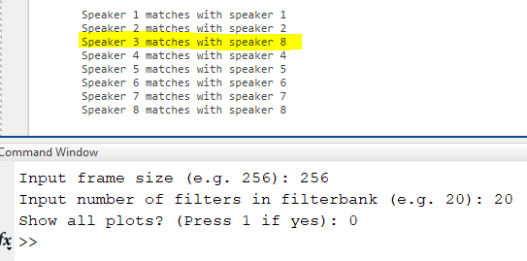
Results
Department of Electrical & Electronics Engineering

Slide 24
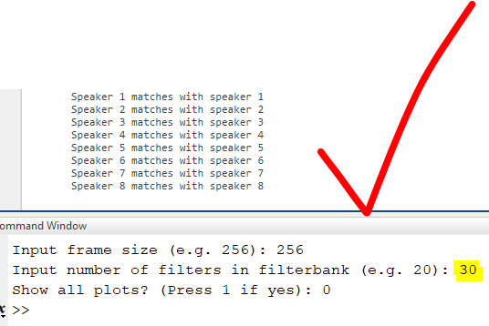
Results
Department of Electrical & Electronics Engineering

Slide 25
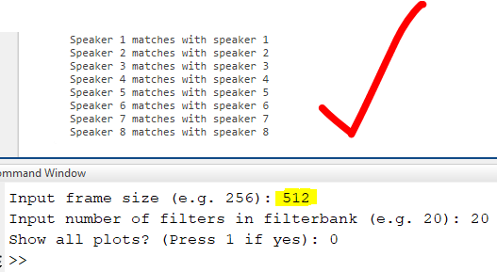
Results
Department of Electrical & Electronics Engineering

Slide 26
APPLICATIONS
Banking by Telephone
Database Access Service
Voice Dialing
Telephone Shopping
Information Services
Voice Mail
Security Control for Secret information Areas
Remote Access to Computer
Department of Electrical & Electronics Engineering

Slide 27
CONCLUSION
Department of Electrical & Electronics Engineering

Slide 28


Question and Discussion

Slide 29

Department of Electrical & Electronics Engineering

