Slide 1
MICROPROCESSOR AND INTERFACING LABORATORY
PROJECT PRESENTATION
Group - 02

Slide 2
SMART HOME MONITORING
SYSTEM

Slide 3
﻿Meet The Group
Ayman Zafar
021 191 058
Md. Rashed
021 192 009
Sayem Hossain Rafi
021 211 020
Emon Mia
021 192 019

Slide 4
OVERVIEW
Introduction
Components
Code
Schematic
Hardware
Advantages
Future Goal
Conclusion

Slide 5
INTRODUCTION
Smart homes allow you to have greater control of your energy use, all while automating things like adjusting Humidity & temperature, fan-lights on&off and adjusting irrigation based on the weather.
In this project we are focusing temperature part how we sense the home temperature

Slide 6

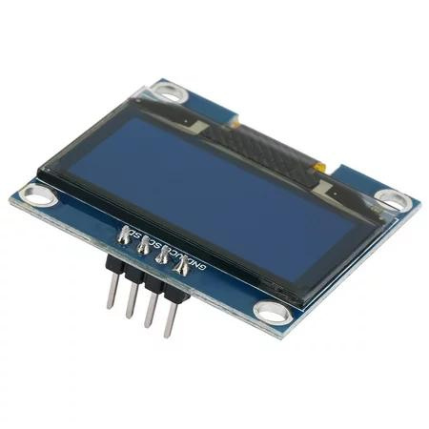
Components
OLED display using I2C communication
01
OLED Display via I2C: Utilizes I2C protocol for seamless communication. OLEDs offer high contrast, low power, and vivid displays. Simplified interfacing, enabling text, graphics, and animation. Ideal for portable devices, wearables, and IoT applications. Streamlined connectivity for versatile, eye-catching visual outputs

Slide 7
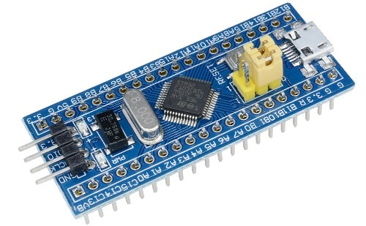
STM32 Microcontroller
02
STM32 Microcontrollers: Versatile 32-bit chips by STMicroelectronics. ARM Cortex-M architecture, diverse peripherals, and memory options. Efficiency in low-power modes, connectivity via various protocols. Ideal for IoT, automotive, and consumer electronics. Power-packed solution for embedded applications.

Slide 8
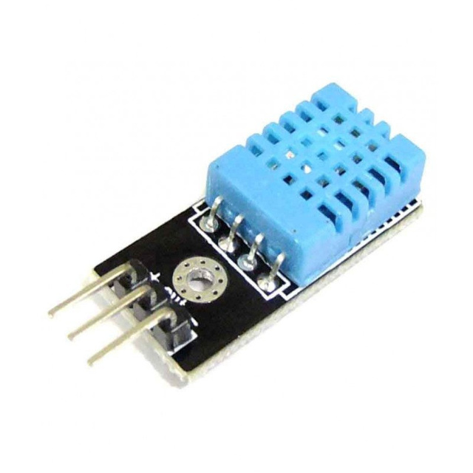
DHT11
Low-cost digital sensor for measuring temperature and humidity.
Features: Accuracy, reliability, and ease of use.
Integration with STM32: Connecting DHT11 to STM32 for data acquisition
03

Slide 9
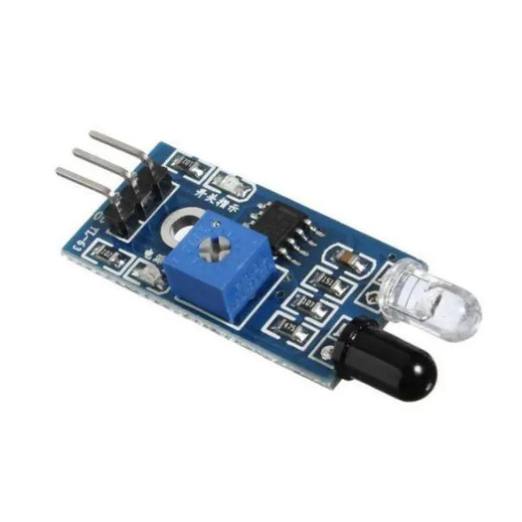
IR sensor
04
An infrared sensor (IR sensor) is a radiation-sensitive optoelectronic component with a spectral sensitivity in the infrared wavelength range 780 nm … 50 µm. IR sensors are now widely used in motion detectors, which are used in building services to switch on lamps or in alarm systems to detect unwelcome guests.

Slide 10
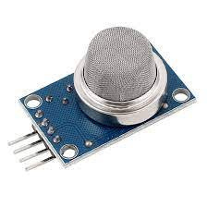
Smoke sensor
05
MQ6 Gas sensor is a Metal Oxide Semiconductor (MOS) type Gas Sensor mainly used to detect the LPG and Butane gas concentration in the air either at home or in industry. This sensor contains a sensing element, mainly aluminum-oxide based ceramic, coated with Tin dioxide, enclosed in a stainless-steel mesh.

Slide 11
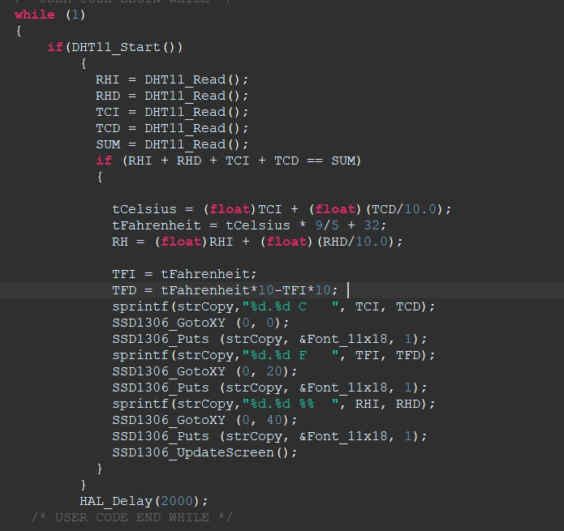
CODE

Slide 12

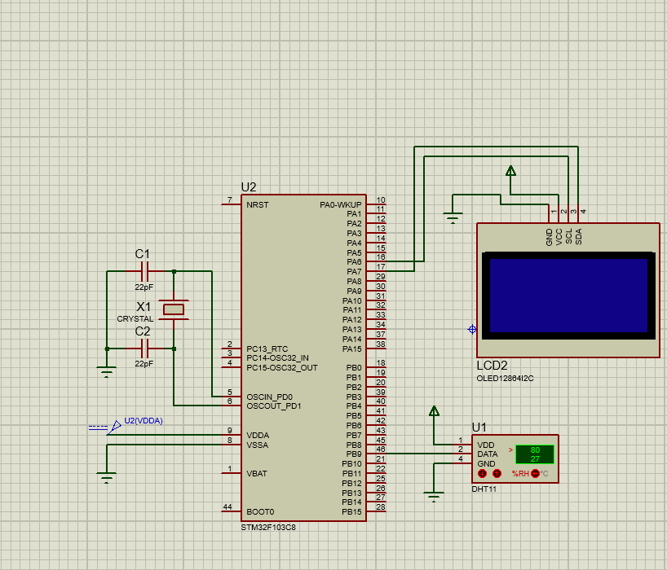
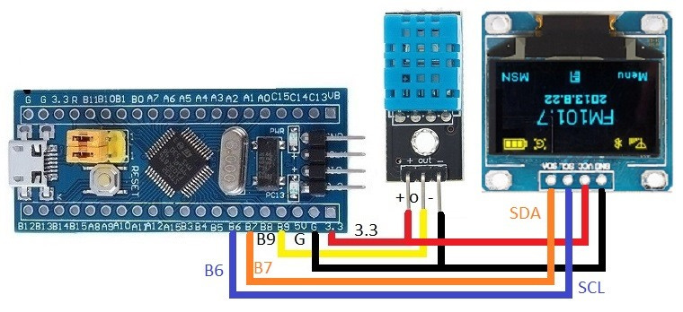

Schematic & Diagram

Slide 13
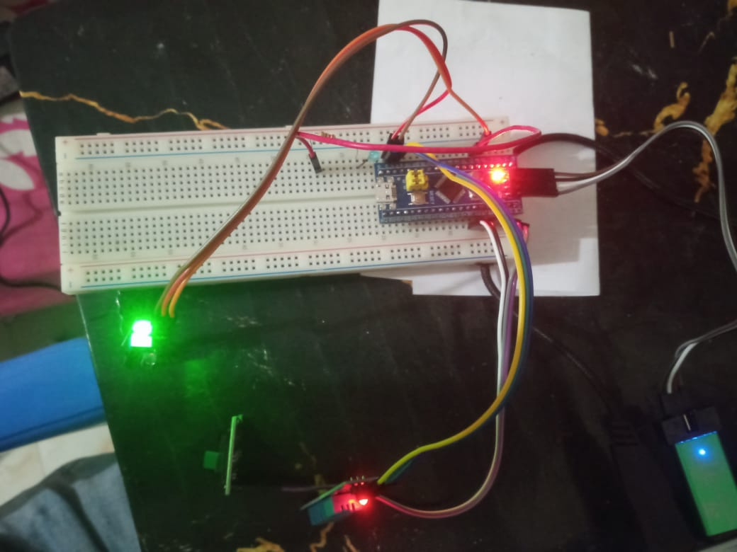
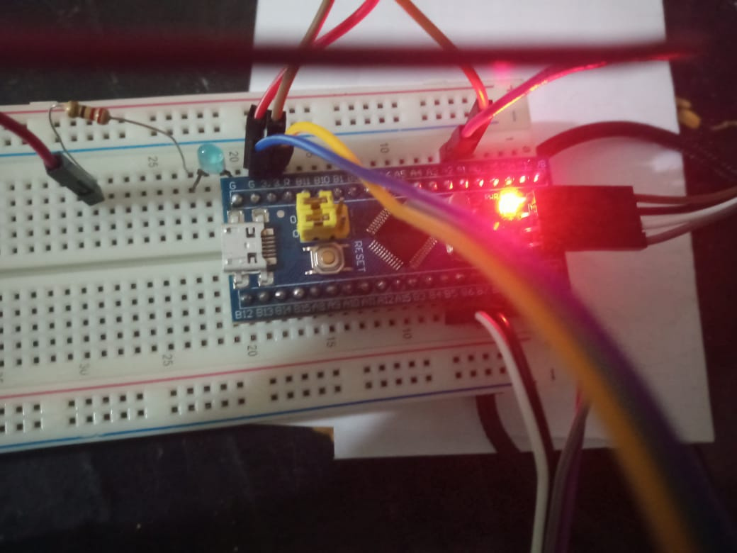
Hardware

Slide 14
Advantages
01
03
User-friendly controls
Energy savings and management
02
04
Convenience of smart home solutions
Remote access
05
06
Enhanced safety and real-time monitoring
Increased productivity

Slide 15


Future Goal
01
02
03
04
Intelligent detection and water management
Security system
Control of all devices using one device, usually a smartphone or tablet
Implement in real life and make it
Convenience and cost savings

Slide 16
Conclusions
smart home environment monitoring projects using STM32 microcontrollers offer a comprehensive and efficient solution for monitoring and managing the home environment, providing users with a more comfortable and secure living experience.

Slide 17




THANK YOU

