Slide 1
Customer Shopping Behavior Analysis
Prepared by: Ayman Mohamed Masoud Soliman

Slide 2
Project Overview
Title: Customer Shopping Behavior Analysis.
Objective: Identifying key drivers of revenue and customer loyalty to optimize marketing spend.
The Data: 5,000+ transactions across 5 categories.

Slide 3
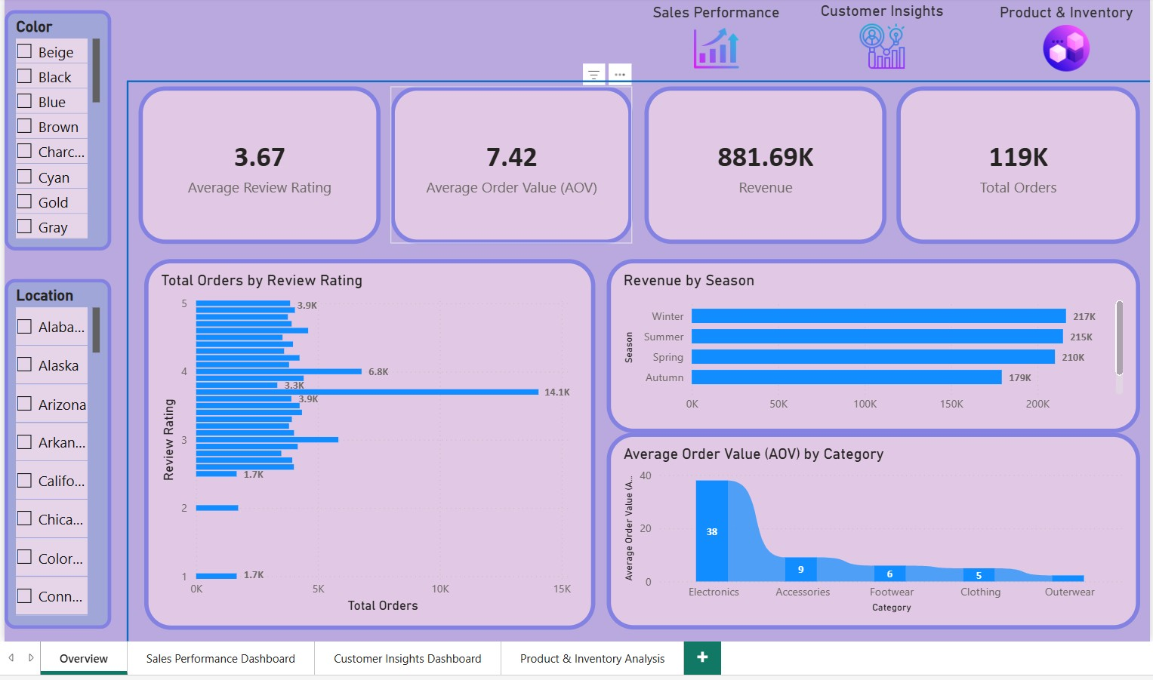
Overview Dashboard
This dashboard provides a high-level overview of the commercial performance, showing a total revenue of 881.69K. The Average Order Value (AOV) stands at 7.42. This low average spend combined with high total revenue indicates a very high volume of orders 119K, reflecting strong and frequent demand for the products.
Additionally, a three charts showing the below:
Total orders by review rating:
This chart illustrates that while the most frequent rating is a 4, the overall average rating is lower at 3.67. This gap suggests a potential risk to customer satisfaction. It highlights the need for a deep-dive investigation to identify the root causes of lower ratings and implement strategies to improve the customer experience.
Revenue by season:
This chart identifies seasonal performance peaks, allowing to determine which periods require a higher marketing investment. By aligning the promotional spend with high-revenue seasons, this can maximize the Return on Investment (ROI).
Total orders by season:
This chart illustrates peak purchasing periods, providing insight into seasonal shopping frequency. Identifying these trends is essential for optimizing marketing expenditure and ensuring operational readiness during high-demand seasons.

Slide 4
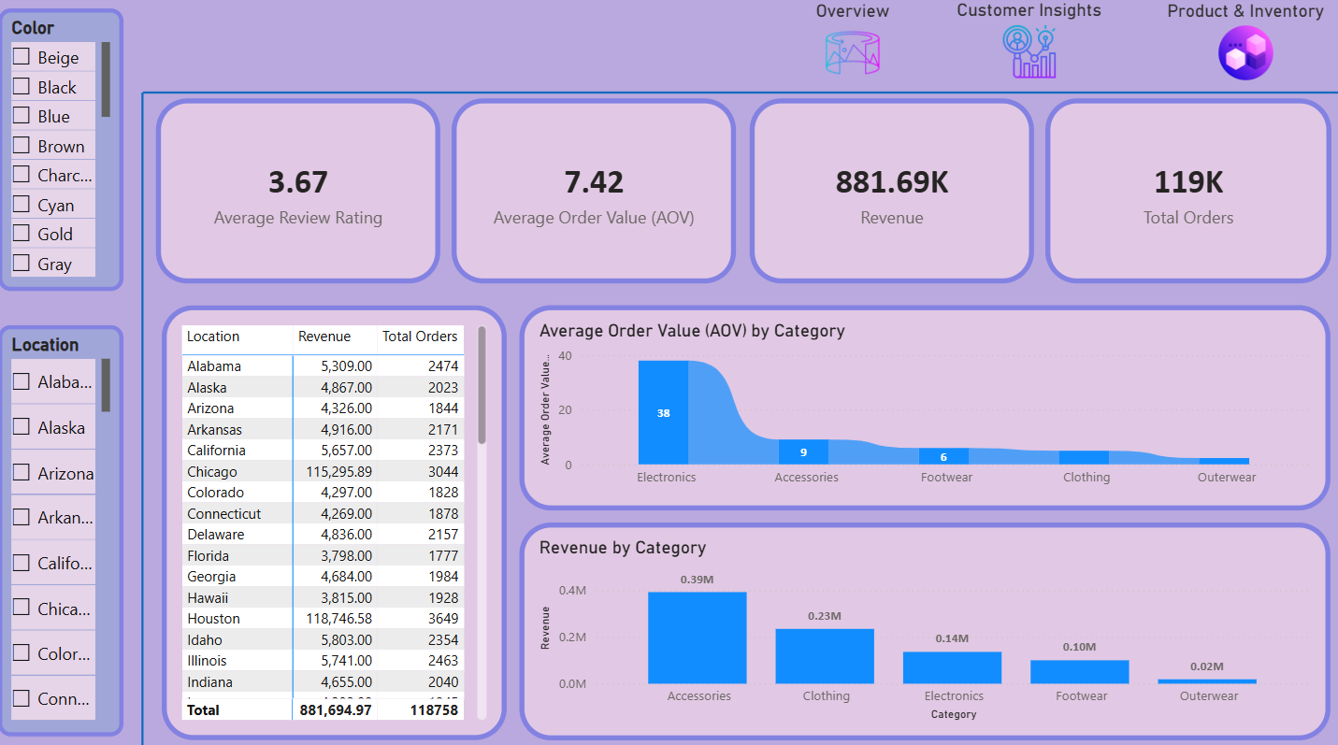
Sales Performance Dashboard
The dashboard focuses on presenting the below:
Revenue and orders per location:
This analysis identifies regional demand by tracking revenue and order volume per state, enabling to allocate resources to high-growth locations.
AOV by category:
This chart displays which categories command the highest average transaction value. This helps identify our premium product lines and understand which categories are the primary drivers of our total revenue.
Revenue by category:
This chart highlights which categories are the primary drivers of the total sales. Identifying the top-performing categories is crucial for informed inventory planning and targeted marketing campaigns.

Slide 5
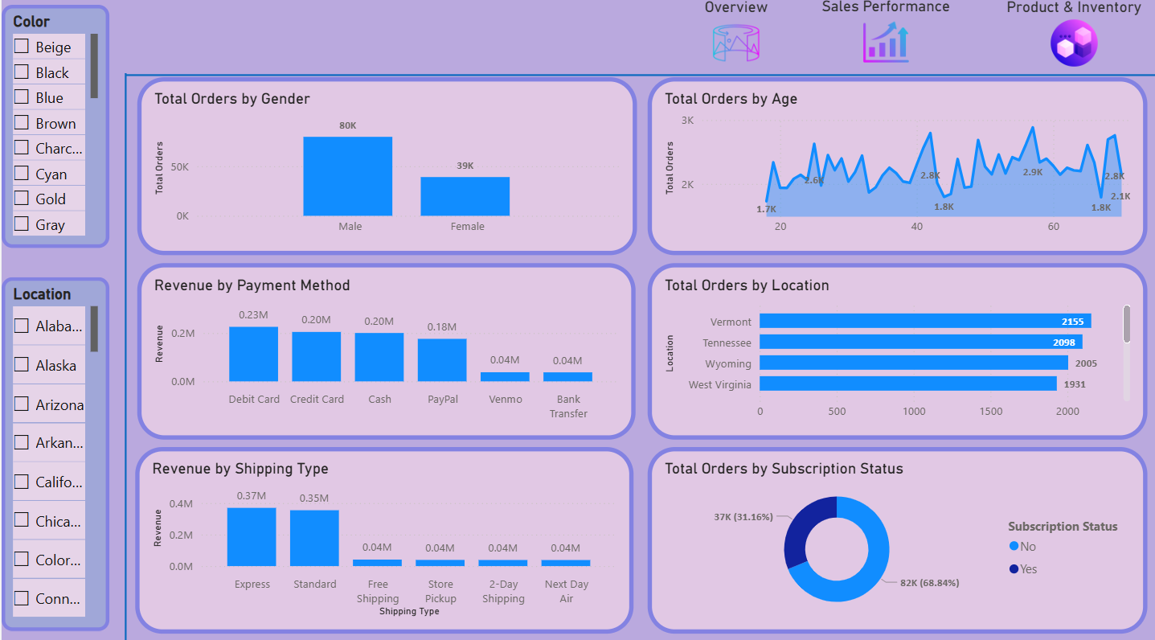
Customer insight dashboard
his dashboard evaluates the customer base by correlating revenue and order volume with key demographics and behavioral traits including age, gender, and location, as well as logistical preferences like shipping and payment methods.
This multidimensional view provides deep insights into customer intimacy and allows to pinpoint the top 10 high-demand regions.

Slide 6
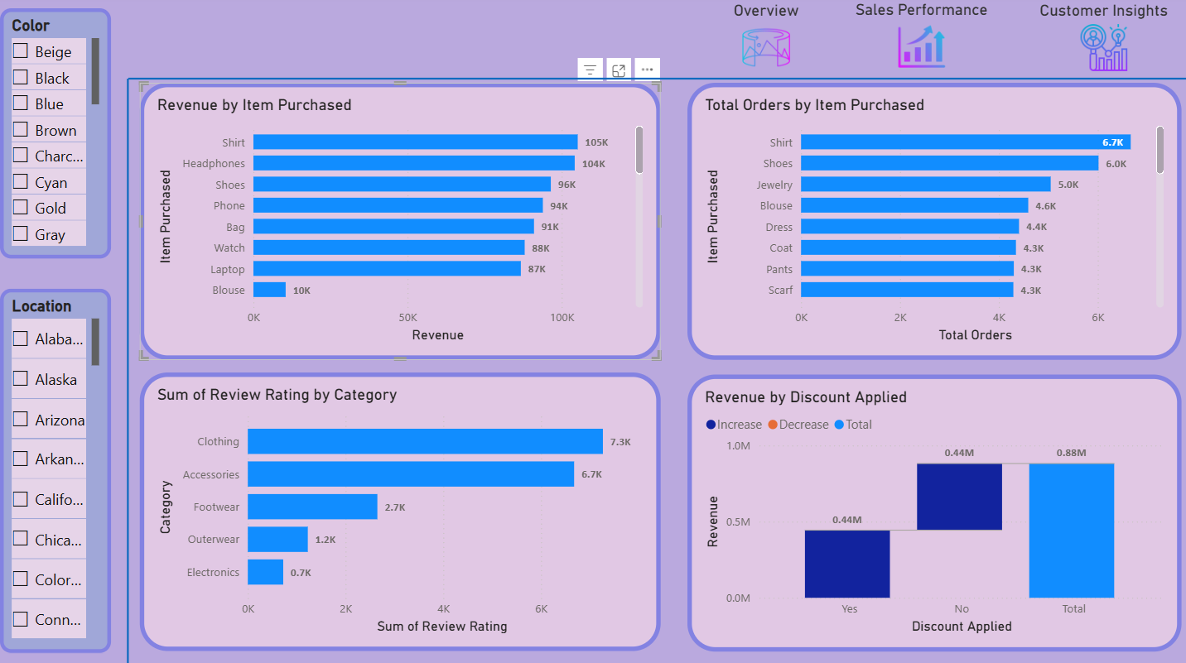
Product and Inventory
Product Performance & Promotion Analysis: This dashboard provides a look at the product catalog by analyzing revenue and order volume per item. It specifically evaluates the impact of discounts on total sales and cross-references review ratings with product categories.
These insights allow to measure product-specific profitability, determine the effectiveness of the promotional strategies, and gauge overall customer satisfaction.

Slide 7


